Slide 1
Writing a review

Slide 2
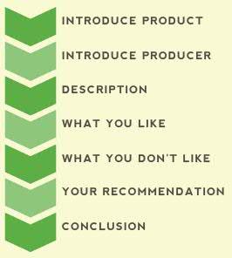
Simple recipe

Slide 3
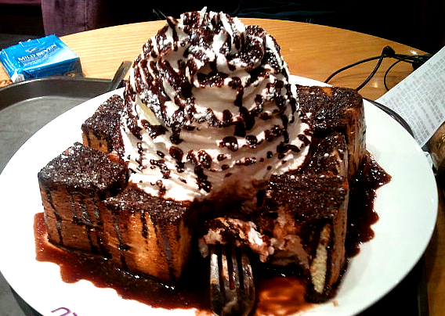
—————————————————————————————–
PRODUCT: Tim & Jim’s Chocolate Whip Bread COST: 9000 won GOOD POINTS: It goes well with coffee, It is good for sharing, the bread is soft
BAD POINTS: It is really dry, it is expensive, the whipping cream is too sweet. RECOMMENDATION: If you are looking for something sweet to share then this bread may be for you, however it is extremely dry and sweet so I would recommend pairing it with bitter coffee or tea e.g. Americano, Chai tea.
RATING: 3.5/5 _____________________________________________________________

Slide 4
Finalizing your review
1
Make your review clear and concise. Get to the point. Don’t be too wordy.
2
Proofread your review. read through your review carefully, checking for proper grammar and spelling.
3
Have someone else read it. Give your review to someone to read before you post it online or publish it.
.
4
Submit your review.

Slide 5
—————————————————————————————–
PRODUCT:
COST:
GOOD POINTS:
BAD POINTS:
RECOMMENDATION:
RATING: _____________________________________________________________

Slide 6
—————————————————————————————–
PRODUCT:
COST:
GOOD POINTS:
BAD POINTS:
RECOMMENDATION:
RATING: _____________________________________________________________

Slide 7
Key
Cost ranges from:
$ = cheap
$$= reasonable
$$$= moderately expensive
$$$$= expensive
$$$$$ = very expensive
—————————————————————————————–
RESTAURANT NAME: Jake’s Chicago Pizza
DESCRIPTION OF RESTAURANT: A place for Chicago pizza and various pasta dishes.
COST: $$
YOUR EXPERIENCE:
GOOD POINTS:
BAD POINTS:
RECOMMENDATION:
RATING: _____________________________________________________________

Slide 8
Key
Cost ranges from:
$ = cheap
$$= reasonable
$$$= moderately expensive
$$$$= expensive
$$$$$ = very expensive
—————————————————————————————–
RESTAURANT NAME: Dos Mas Mexican Grill
DESCRIPTION OF RESTAURANT: Mexican style burritos (eat-in & take-out)
COST: $
YOUR EXPERIENCE: I eat at DOS MAS once a week.
GOOD POINTS:
BAD POINTS:
RECOMMENDATION:
RATING: _____________________________________________________________

Slide 9
Key
Cost ranges from:
$ = cheap
$$= reasonable
$$$= moderately expensive
$$$$= expensive
$$$$$ = very expensive
—————————————————————————————–
RESTAURANT NAME:
DESCRIPTION OF RESTAURANT:
COST:
YOUR EXPERIENCE:
GOOD POINTS:
BAD POINTS:
RECOMMENDATION:
RATING: _____________________________________________________________

Slide 11
—————————————————————————————–
MOVIE TITLE: Mad Max Fury Road
MAIN ACTORS: Charlize Theron, Tom Hardy
DESCRIPTION OF MOVIE: A woman rebels against an evil ruler in post apocalyptic Australia in search for her homeland with the help of a group of female prisoners, a psychotic worshiper, and a drifter named Max.
GOOD POINTS: Full of action, great CGI effects
BAD POINTS: Not much of a storyline, 90% of the movie is just fighting.
RECOMMENDATION: If you are looking for an action film that can kill your time this movie is for you. Plan to be excited from the graphic effects much more than the overall story.
RATING: *** _____________________________________________________________

Slide 12
—————————————————————————————–
MOVIE TITLE:
MAIN ACTORS:
DESCRIPTION OF MOVIE:
GOOD POINTS:
BAD POINTS:
RECOMMENDATION:
RATING: _____________________________________________________________

Slide 13
http://www.eslflow.com/howtowritemoviesongreviews.html
____________________ (movie) is a movie about _______________________________________ (short general description of the movie)
I _______________ (liked / didn't like) _____________________ this movie because ___________________________________________________________________________________________________.
Overall, I feel that _______________________ (movie) is worth / not worth watching because ______________________________________________________.
___________________. The most important event in _______________________ (movie) happens when _______________________________________________ (explain the event).
I found it interesting that ____________________________________________________________________________ (state what you found interesting).
The part of _______________________ (movie) I liked best was ________________________________________________ (write what you liked best about the movie) because _____________________________ (write why).
The part of _______________________ (movie) I liked least was ________________________________________________ (write what you liked best about the movie) because _____________________________ (write why).
I would / would not recommend _______________________ (movie) to my friends because _____________________________ (write why).

