Slide 1
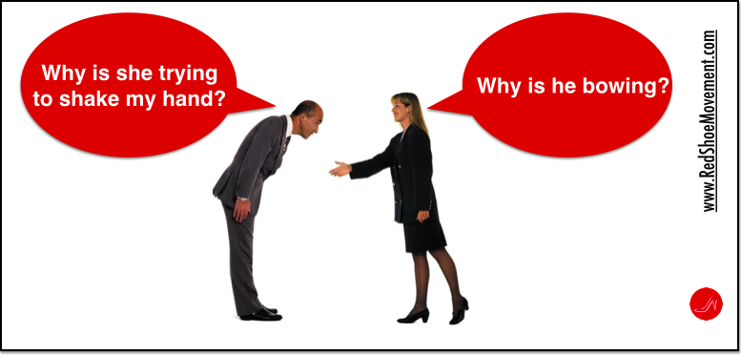
Wow, That’s Different
Cultural Differences to Keep in Mind

Slide 2
Warm-up Discussion
What country would you like to visit?
What country would you like to live in and why?
What country would you like to work in?

Slide 3
Dialogue practice
Page 75

Slide 4
Culture Shock
Have you ever experienced culture shock?
Have you ever experienced reverse culture shock?
Do you think "when in Rome, do as the Romans do" is always good advice? Why or why not? Have you ever been in a situation where you felt you had to "do as the Romans do"?
Have you ever felt confused by the actions of someone from another culture? If so, tell me about it.
How are your language teachers different from your teachers in your culture? How are they the same?

Slide 5
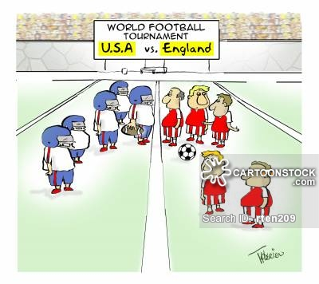
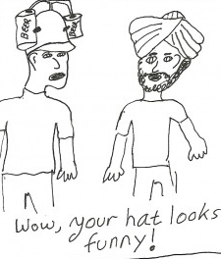
Cultural Differences

Slide 6
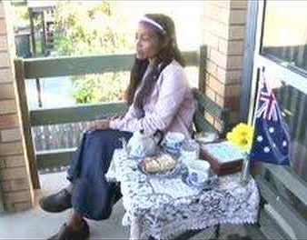
Watch the videos and consider...
What are the cultural differences?
Why did the misunderstandings happen?
How can we avoid misunderstandings like this?

Slide 7
Learning the Culture of your Context
It’s always important to know a little bit about the culture of where you are.

Slide 8
Quiz Time

Slide 9
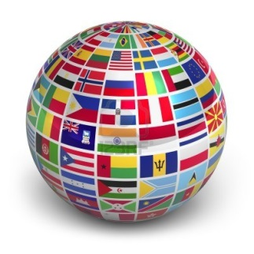
What 3 countries have the most Native speakers of English?
USA, UK, Canada
b. USA, India, UK
c. USA, India, Pakistan
d. USA, Australia, Canada
1. USA 291,524,091 | 6.Phillippines 43,994,000
2.India 125,344,736 | 7.Canada 25,246,220
3.Pakistan 88,690,000 | 8.Australia 18,172,989
4.Nigeria 79,000,000 | 9.South Africa 19,424,417
5.UK 59,600,000 | 10.Ireland 4,450,252

Slide 10
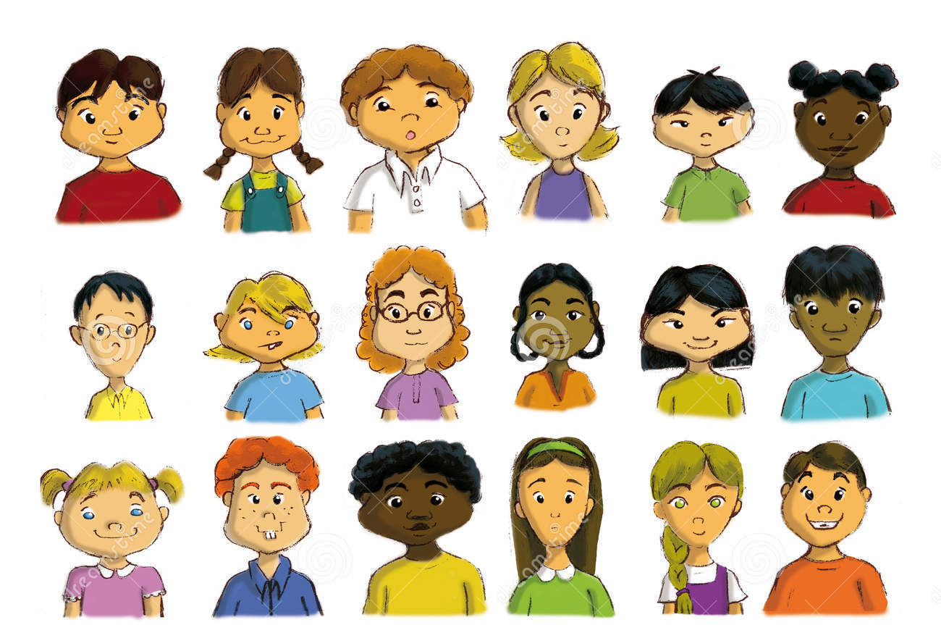
Which of these people are native speakers of English?

Slide 11
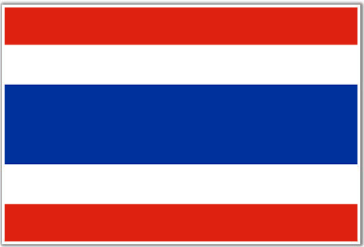
In Thailand…
a. Men holding hands is considered a sign of friendship.
a. it is common to see men walking along holding
hands.
b. it is common to see a man and a woman holding
hands in public.
c. it is rude for men and women to walk together.
d. men and women traditionally kiss each other on meeting in the street.
Public displays of affection between men and women, however, are unacceptable.

Slide 12
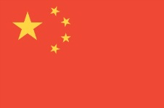
What does the color yellow mean in China? Ex. yellow book
a. Good luck
b. Bad Luck
c. Adult Content (18+)
d. Happiness
C. The word yellow often refers to adult content in China .

Slide 13
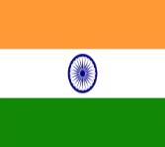
When a taxi driver shakes his head from side to side, it probably means..
c. This is the Indian way of saying “yes.”
a. he thinks your price is too high.
b. he isn’t going in your direction.
c. he will take you where you want to go.
d. he doesn’t understand what you’re asking.
It can also express general agreement with what you’re saying or suggest that an individual is interested in what you have to say.

Slide 14
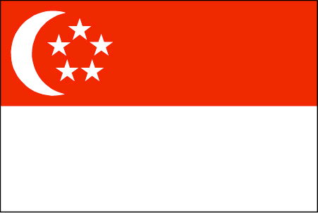
Which is NOT banned in Singapore?
a. Spitting
b. Littering
c. Gum
d. Lighters
D. Lighters are not banned in Singapore unless they look like a weapon.

Slide 15
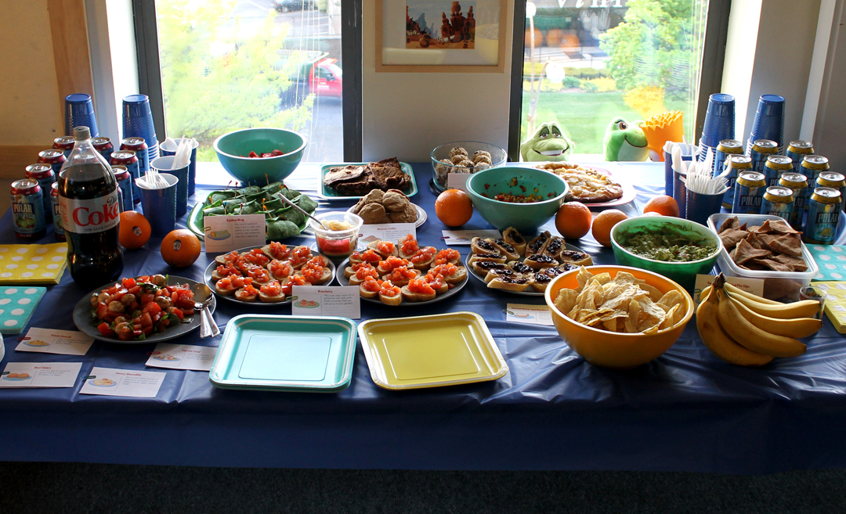
In Canada, a potluck party is..
C.
a . a party where everyone sings.
b. a party where everyone bangs on pots.
c. a party where everyone brings some food to share.

Slide 16
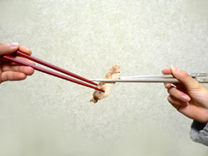
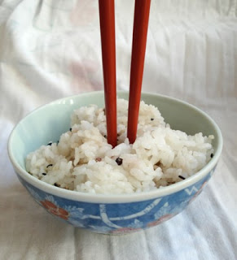
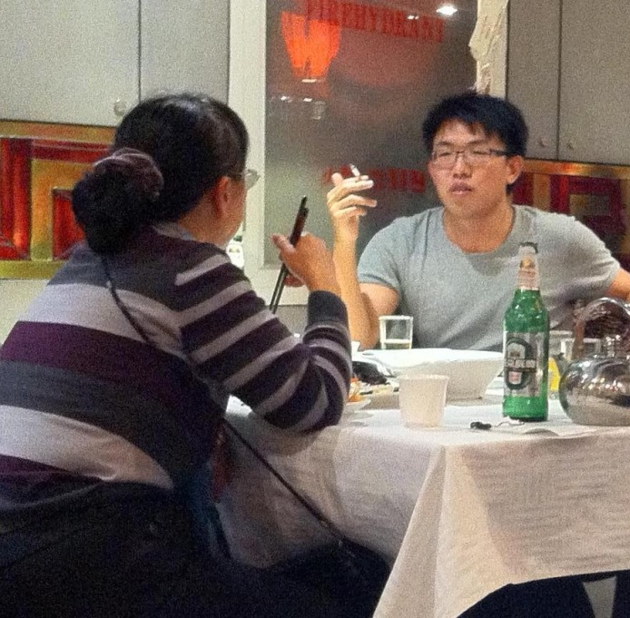
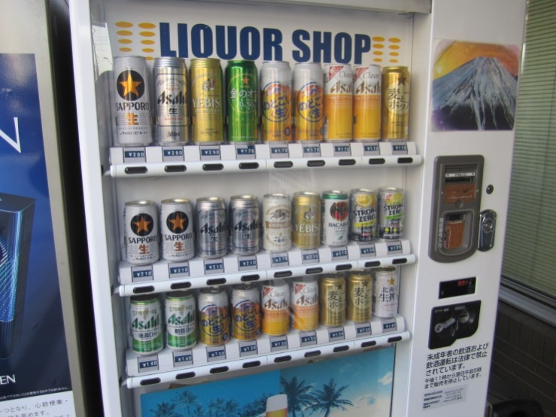
Which is OK in Japan?

Slide 17
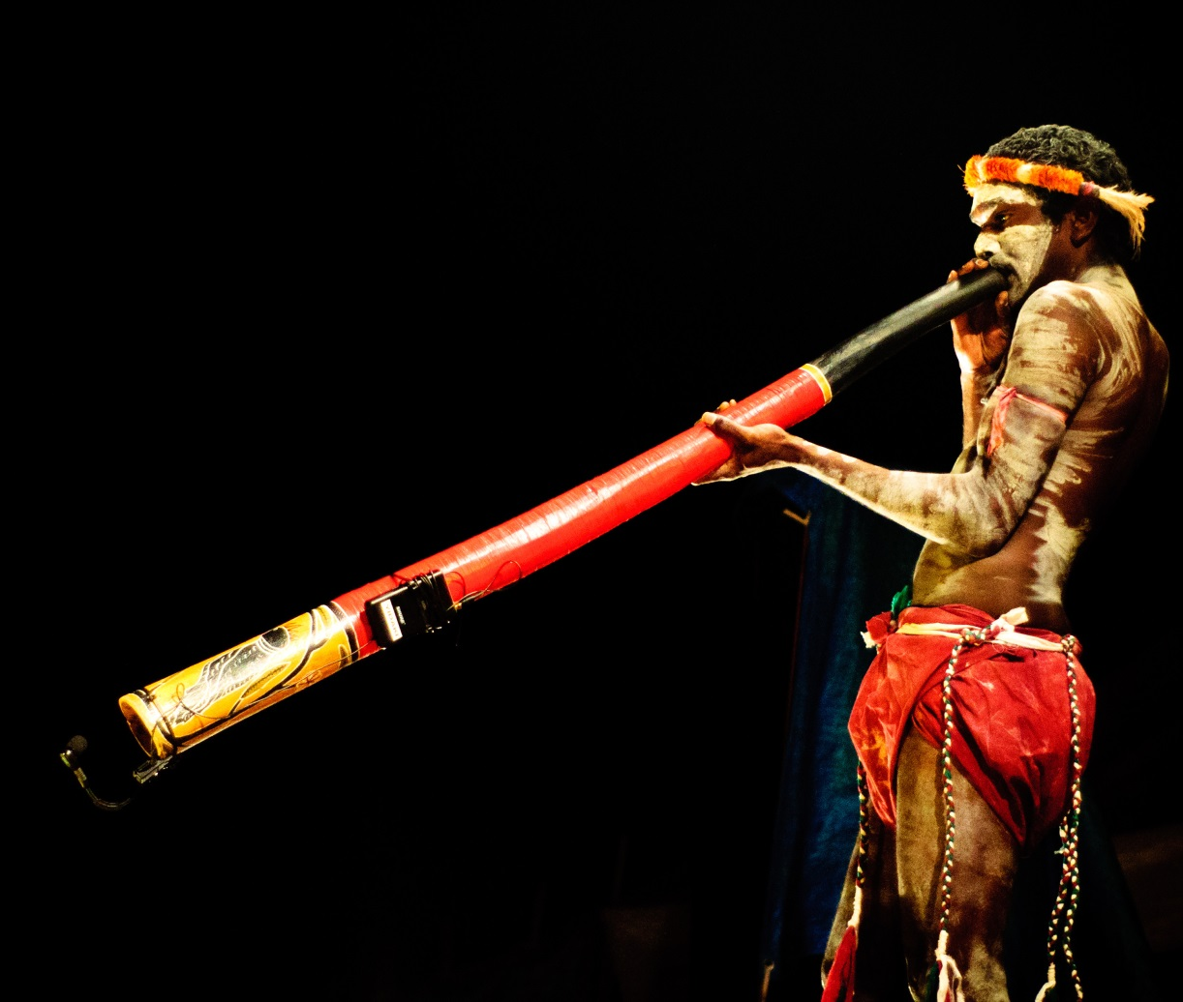
What country does this intrument come from?
a. Kenya
b. New Zealand
c. Nigeria
d. Australia
C. The didgeridoo was developed over 1500 years ago in Australia!

Slide 18
Which country has the most lakes in the world?
a. USA
b. Russia
c. Canada
d. China
C. With over 3 million lakes,60% of all the lakes in the world are found in Canada.

Slide 19
Project
Pick a country
Research some important cultural facts about the country
Taboos
Customs
Other interesting facts
Present your country to the class

Slide 20
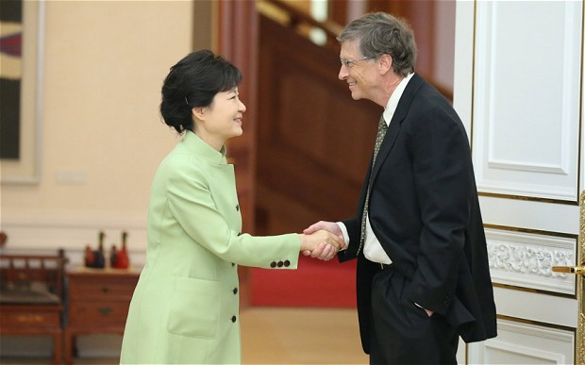
Are you seriously going to do that?
Korean Cultural Awareness

Slide 21
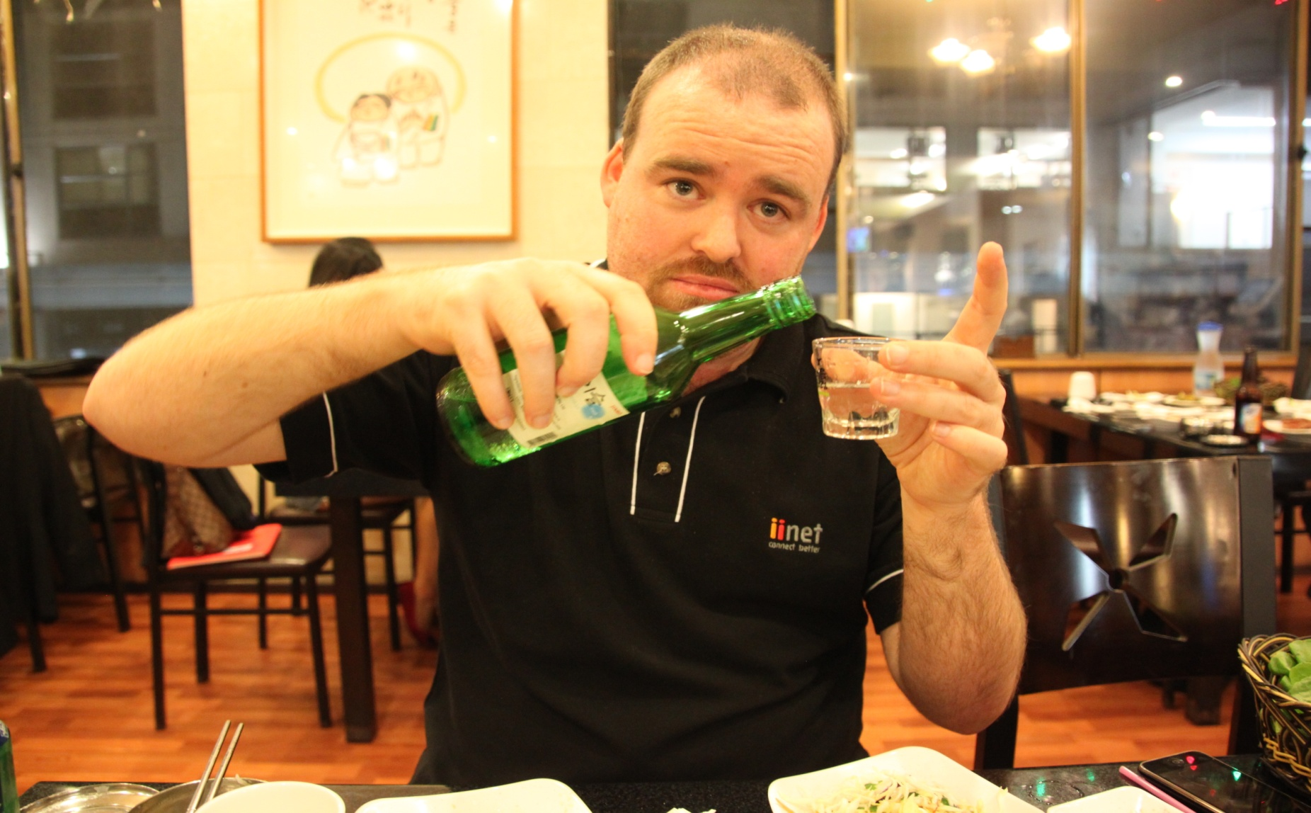
It’s Our Custom

Slide 22
With your team write down…
…some things that foreigners do in Korea that you think may be rude or strange?
…some things that Korean people do that foreigners may think is strange?

Slide 23
Pass it on activity
What do you like most about your own culture?
Is there anything in your culture that you don’t particularly like?
When people outside of Korea as asked about Korea, what do you think they think of?
If you could describe Korean culture in one word what would you say?

Slide 24
Korean Culture Project
You have been assigned to teach a new group of employees from India about Korean culture. They are all in their mid 20s and are single. They may be interested in work culture, social culture, dating culture, and entertainment culture.
What would you tell them?
What does it mean to be polite in your culture?
What is considered rude in your culture?
Think of important things they should know about Korean culture.

