Slide 1
Naomi’s Dilemma

Slide 2
Who do you feel more comfortable with? Why?
Doctor
Teacher
Pilot
Boss

Slide 3
What do you think?
Please survey the people in your group
Is it Ok for Coworkers to date? Explain your opinion.
Is it OK for a doctor to date his patients? Explain your opinion.
Is it OK for a professor to date his students? Explain your opinion.
Is it OK for the boss to date his or her employees? Explain your opinion.

Slide 4
Listen to Naomi’s Situation

Slide 5
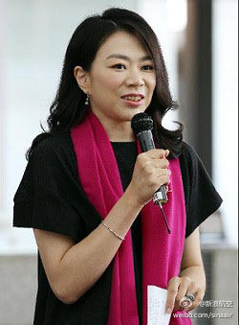
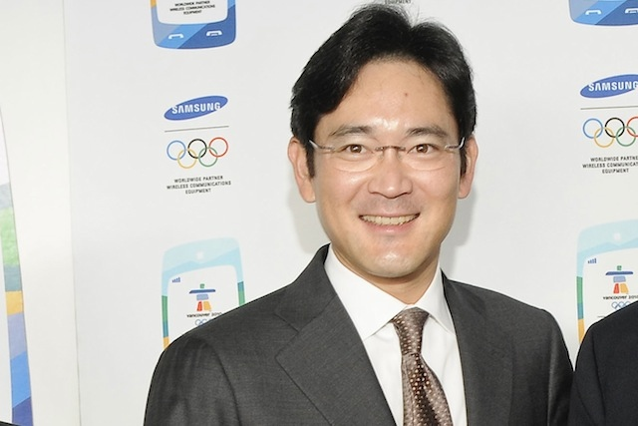
Would you ever date your boss?
What would the benefits of dating your boss be?
What would the drawbacks be?
Would you ever date your boss? Why or why not?
Try to add as much supporting information as possible referring to what we discussed in class (i.e. the benefits and drawbacks).

Slide 6
Sexual Harassment
What is it?
When does harmless flirting become sexual harassment?
Is sexual harassment an issue in Korea?

Slide 7
Wrap-up Reflection
Please write a response to one of the situations on page 53

