Slide 1
Notes:
Sources of images: google images and rrrather.com

Slide 2
Would you rather…
…be able to fly or be invisible?
Notes:
rrrather.com

Slide 4
Would you prefer…
…to be talented at all musical instruments…
…or to be talented at all sports?
Notes:
rrrather.com

Slide 5
Would you rather…
…forget who you are…
…. or forget who everyone else is?
Notes:
rrrather.com

Slide 6
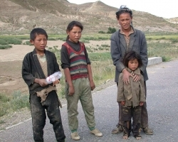
If you won $1 billion, would you prefer…
…to keep it all and share none of it…
…or to give it to people who don’t have much?
Notes:
rrrather.com

Slide 7
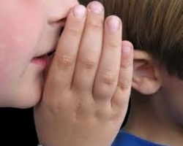
rather
…only be able to whisper…or only be able to shout?
Notes:
rrrather.com

Slide 8
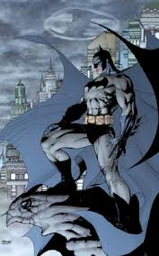
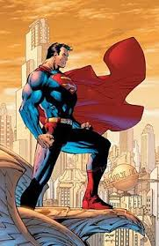
prefer
… be batman… … be superman?
Notes:
rrrather.com

Slide 9
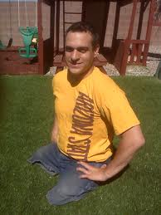
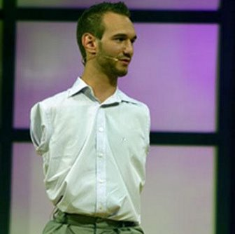
rather
…no arms…. …no legs?
Notes:
rrrather.com

Slide 10
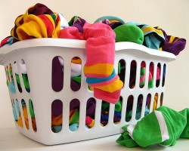
prefer
… the laundry…
…the dishes?
Notes:
rrrather.com

Slide 11
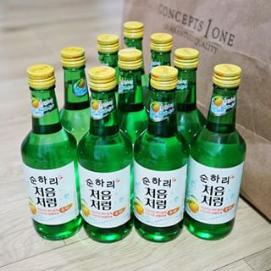
rather
…soju .... juice?
Notes:
rrrather.com

Slide 12
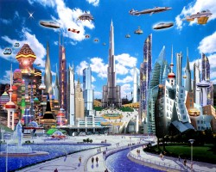
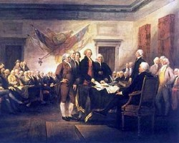
prefer
…meet your great grandchildren…
…or your ancestors?
Notes:
rrrather.com

Slide 13
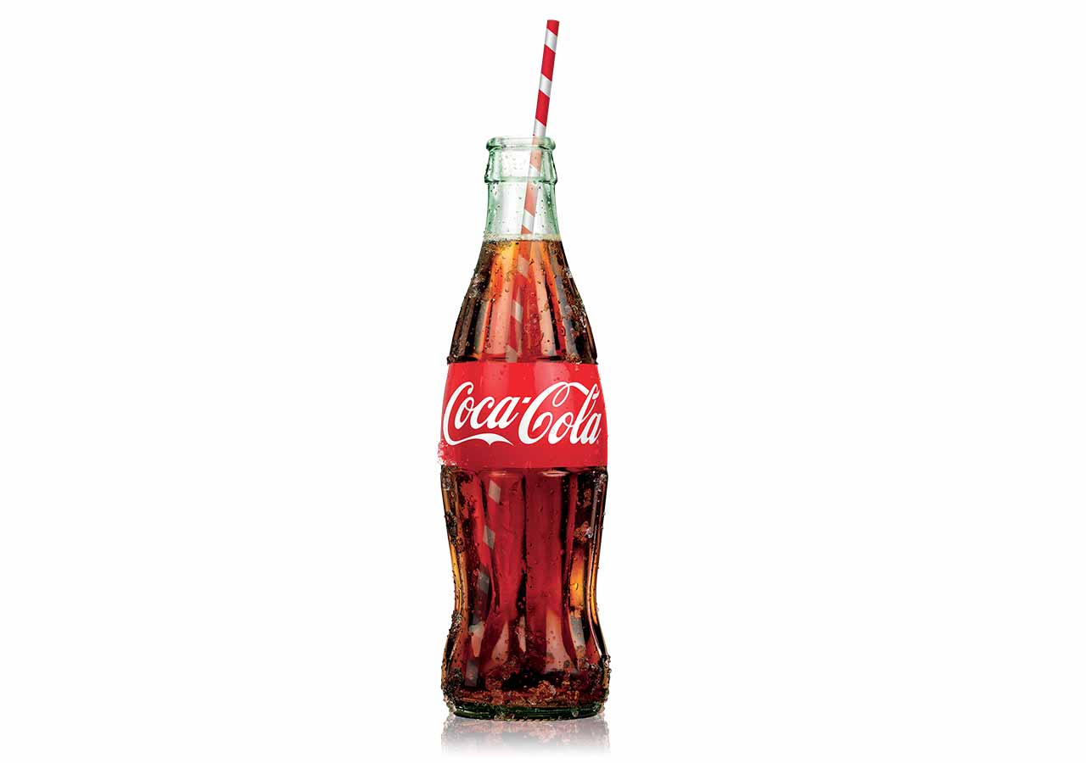
prefer
… drink from a cup
… drink from a bottle
Notes:
rrrather.com

Slide 14
prefer
… be smart
… or good looking
Notes:
rrrather.com

Slide 15
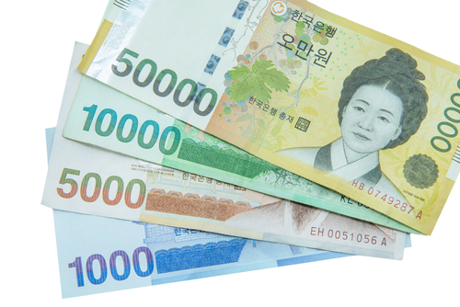
rather…
… health
…or money
Notes:
rrrather.com

Slide 16
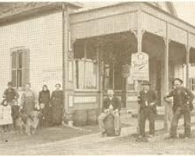
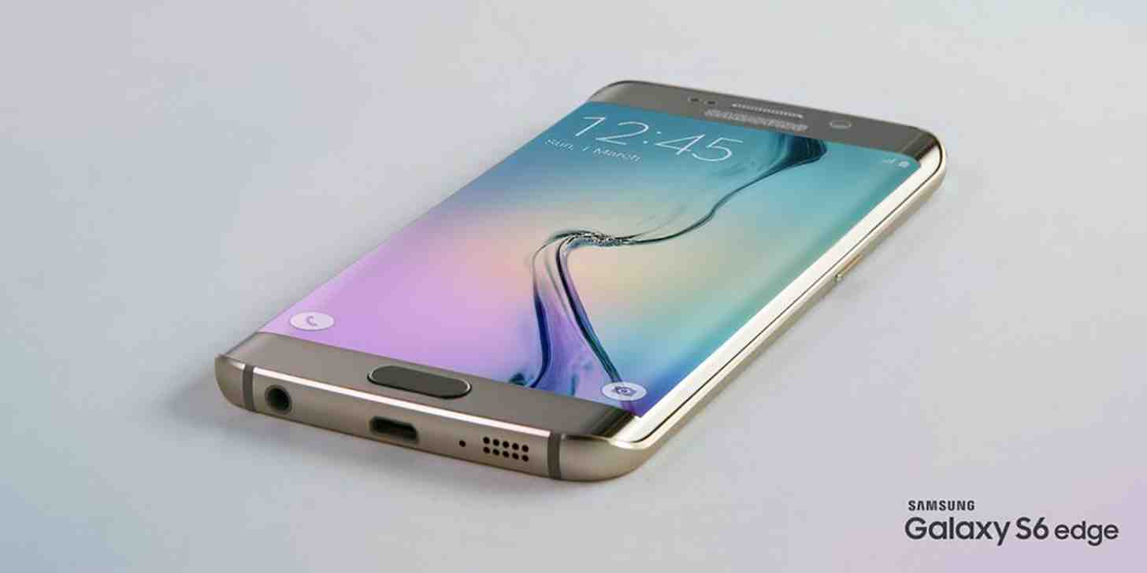
prefer
…live without electricity, plumbing, medicine…
… or live without your smart phone
Notes:
rrrather.com

Slide 17
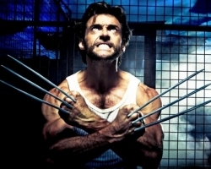
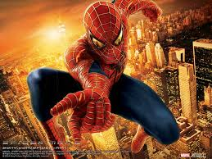
rather
…be wolverine or be spider-man?
Notes:
http://www.rrrather.com/48

