Slide 1
World Travel

Slide 2
World travel discussion

Slide 3
Travel agent project
Work with a partner.
Choose a country that you are interested in.
Search about interesting things to do in that country.
Help your clients make a 3 day schedule for their trip to that country.

Slide 4
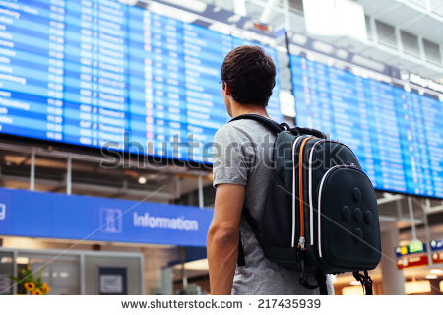
What advice would someone who is travelling for the first time?
This is your clients first time travelling to another country.
What are 5 pieces of advice you would give them to make their trip safer and more enjoyable?

