Slide 1
Working with results

Slide 2
SPSS Survival Manual by Julie Pallant
A paired-samples t-test was conducted to evaluate the impact of the intervention on students’ scores on the Fear of Statistics Test (FOST). There was a statistically significant decrease in FOST scores from Time 1 (M = 40.17, SD = 5.16) to Time 2 (M = 37.5, SD = 5.15), t (29) = 5.39, p < .001 (two-tailed). The mean decrease in FOST scores was 2.67 with a 95% confidence interval ranging from 1.66 to 3.68. The eta squared statistic (.50) indicated a large effect size.
An independent-samples t-test was conducted to compare the self-esteem scores for males and females. There was no significant difference in scores for males (M = 34.02, SD = 4.91) and females (M = 33.17, SD = 5.71; t (434) = 1.62, p = .11, two-tailed). The magnitude of the differences in the means (mean difference = .85, 95% CI: –1.80 to 1.87) was very small (eta squared = .006).

Slide 3
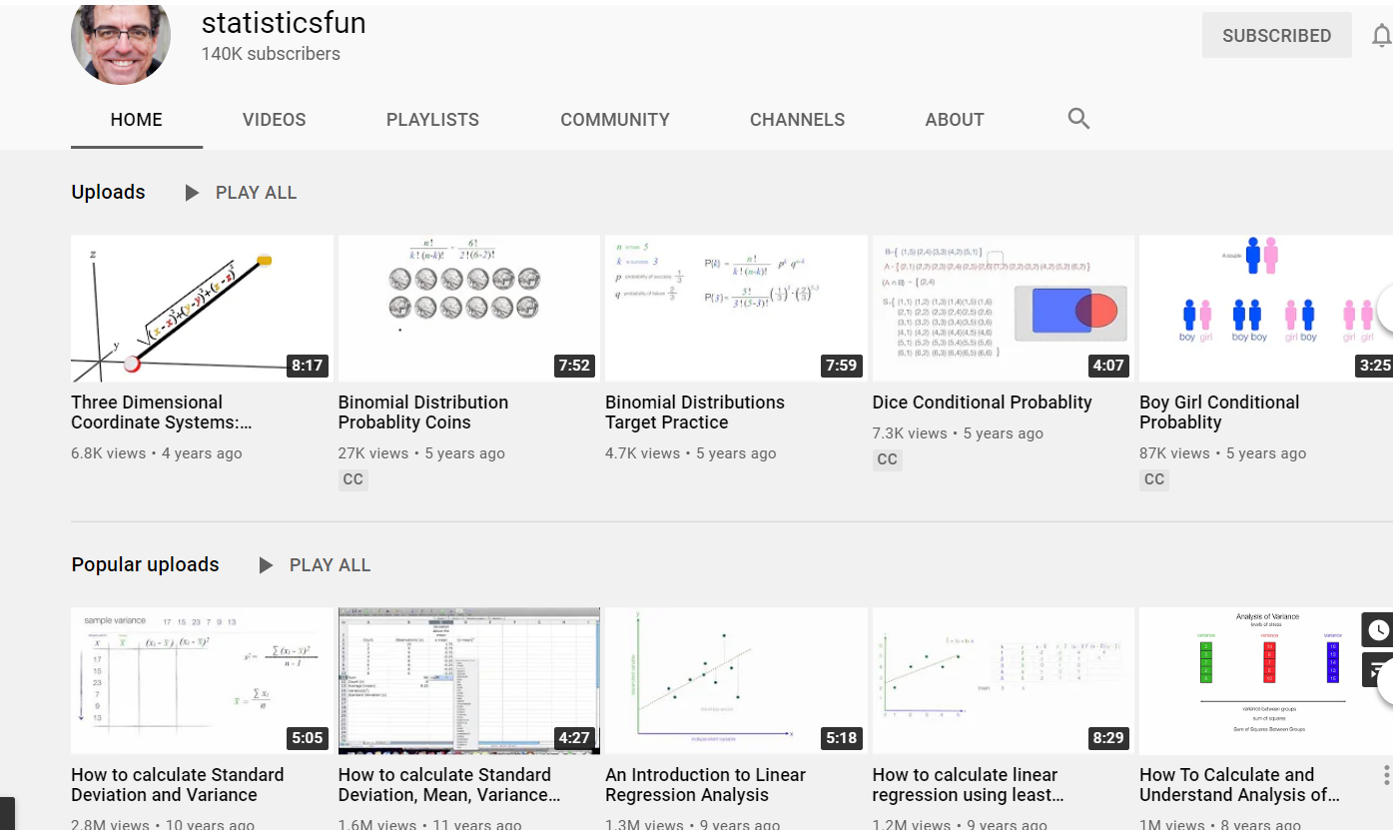
Udemy courses & Youtube

Slide 4
Working with quantitative results
 | Mean | N | Std. Deviation | Std. Error Mean
Pre-test | 39.25 | 20 | 10.76 | 2.40
Post-test | 55.25 | 20 | 10.32 | 2.30
Mean | Std. Deviation | t | df | Sig. (2-tailed)
-16.00 | 14.42 | -4.96 | 19.00 | 0.0001
When it comes to the speaking accuracy, the students scored on the post-test better than the pre-test from 39.25 to 55.25 by 16.00. Also, the mean difference is statistically significant (p<0.05). Therefore, there was a significant improvement in speaking accuracy from the pre-test between the pre-test and post-test. (M=39.25, SD=10.76) to the post-test [M=55.25, SD=10.32, t(19)=-4.96, p<0.05].

Slide 5
 | Mean | N | Std. Deviation | Std. Error Mean
pre-test | 36.51 | 20 | 14.09 | 3.15
post-test | 79.71 | 20 | 16.70 | 3.73
mean | Std. Deviation | t | df | Sig.(2-tailed)
-43.19 | 20.13 | -9.59 | 19 | 0.000
The result show that the mean difference for speaking accuracy significantly improved from 36.51 to 79.71 by 43.20 points (t-value=-9.59, p-value=0.000, p<0.05). Statistically, there was a significant improvement after a month treatment from the pre-test (M=36.51, SD=14.09) to the post-test [M=79.71, SD=16.70, t(19)=-9.59, p<0.05].

Slide 8
Practice with Quantitative results

Slide 9
Paired & independent results (experimental design t-test)

Slide 11
Working with Qualitative results

Slide 12
Sample
X of the teachers that were interviewed expressed that changing to a system that assesses their students’ productive proficiency would be difficult for them since they are not comfortable teaching productive skills. Specifically, Jinyong explained that he felt his own productive skills were not good enough to teach his students.
“It’s a shame but my English ability of speaking and writing is not good enough to teach students”

Slide 13
Try to write a brief discussion of your findings
Find themes to present the findings under.
Use the following to select quotes from

