Slide 1
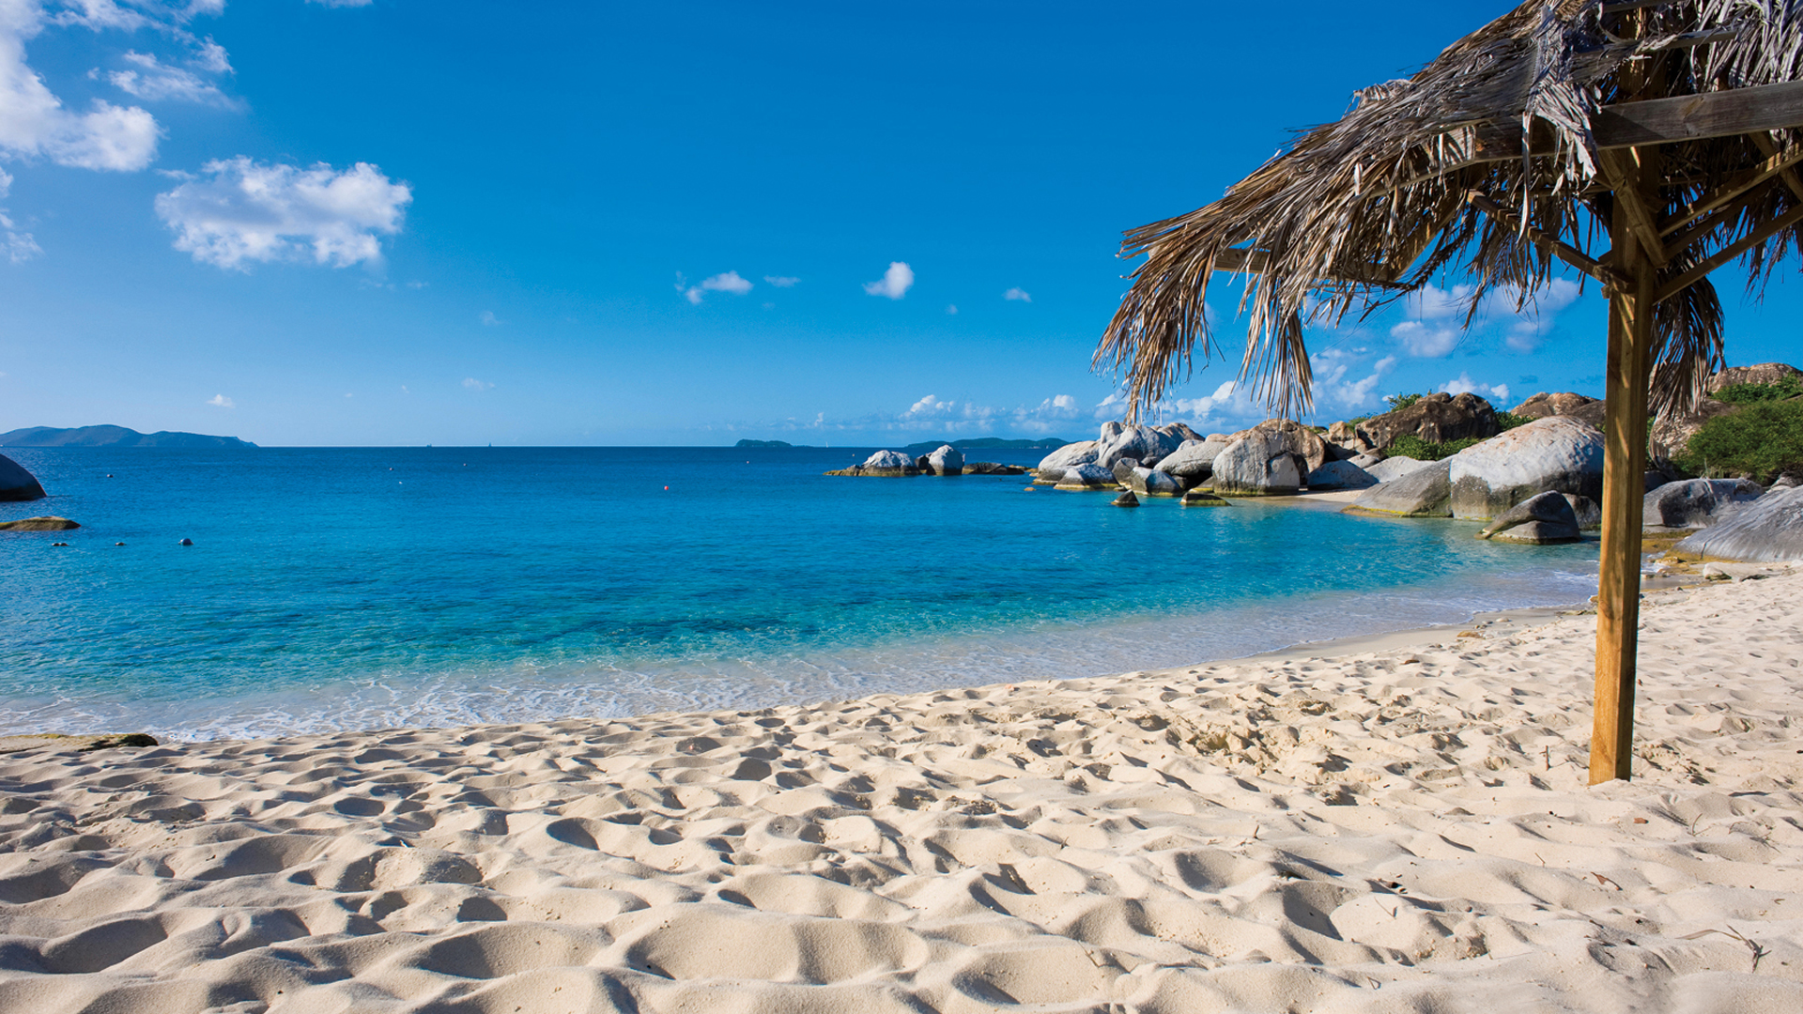
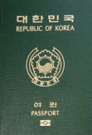
Oh My Gosh, Where’s My Passport?

Slide 2
Do you have a passport?
Do you?

Slide 3
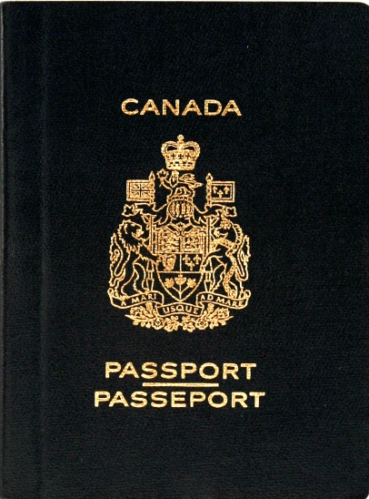
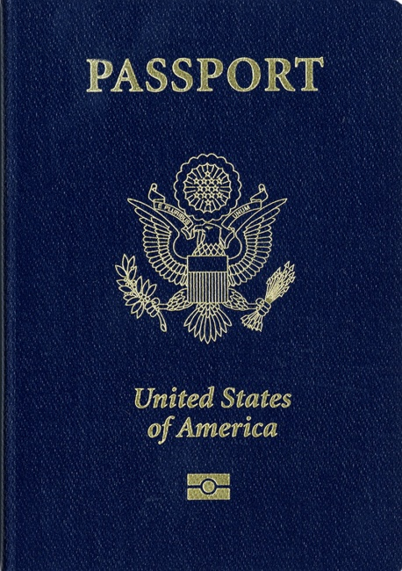
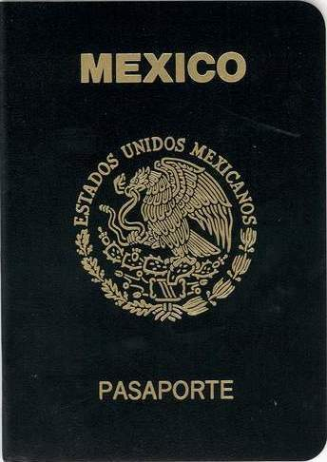
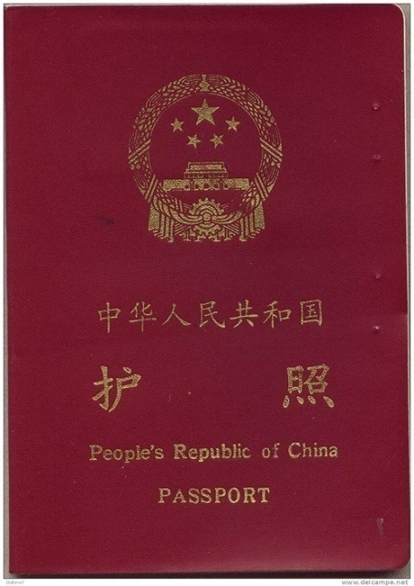
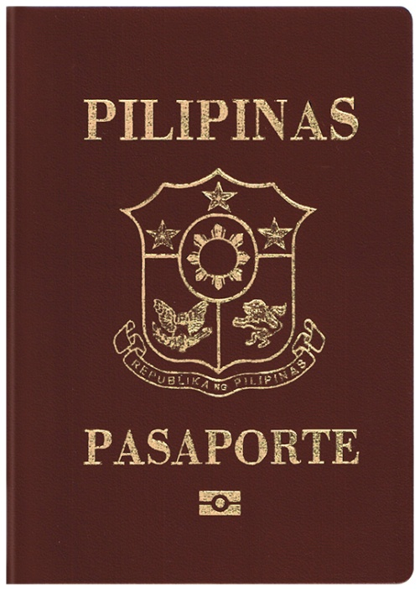
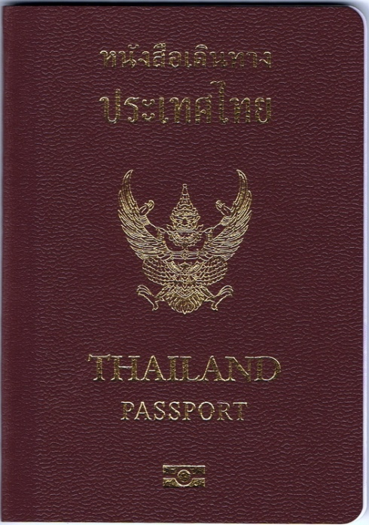
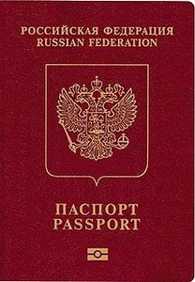
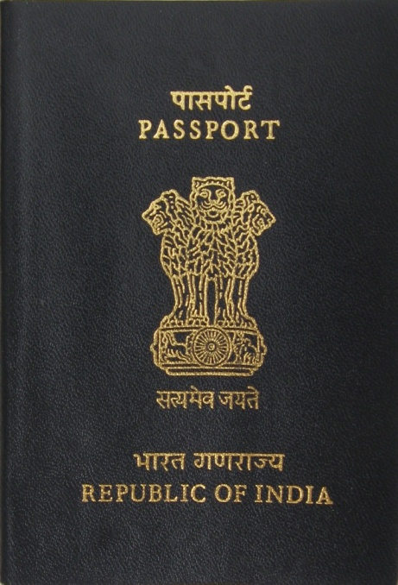
Passport Quiz

Slide 4
Discussion

Slide 5
Travel Experience
What is the best or most interesting thing to happen to you when you were travelling?
What is the worst thing that has happened to you when travelling?

Slide 6
Honeymoon In
Bali, Indonesia

Slide 7
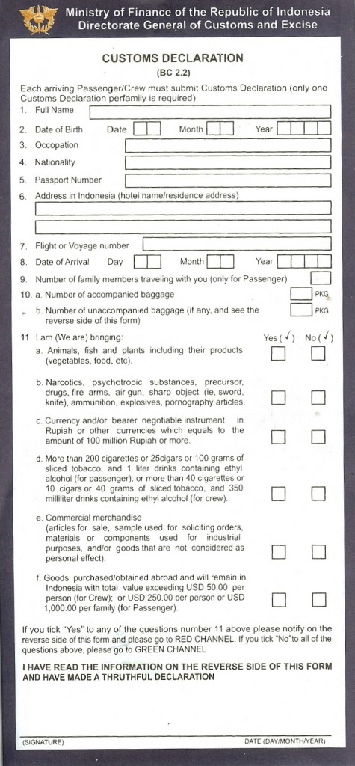
Filling in the customs form

Slide 8
You arrive in Indonesia and are at immigration…
Immigration Officer: Can I see your passport please?
Immigration Officer: What is your purpose of your visit?
Immigration Officer: Is this your first time in _______?
Immigration Officer: What is the duration of your stay?
Immigration Officer: Are you travelling alone?
Immigration Officer: Where are you staying?
Immigration Officer: Do you have anything to declare?

Slide 9
Warm-up
If you were in another country and your passport was lost or stolen what would you do?

Slide 10
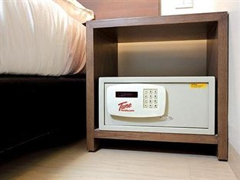
What would you do?
You are at the airport counter to check in and discover that in your last-minute rush to get the airport on time for your flight home from vacation, you forgot to take your passport out of the safety deposit box in your hotel room. You have 90 minute before your flight departs and it is 30 minutes each way to your hotel without any traffic. The next flight is not until tomorrow evening however you really need to get home today because you have an interview tomorrow for your dream job.

Slide 11
Advice
If someone asked you for the following advice what would you suggest to them?
I am really worried about by passport and valuables being stolen when I am in Indonesia. I heard that there is a lot of theft. I am also really worried about losing my passport because last year my friend lost her passport in Kuta and could not go home for 2 weeks.

