Slide 1
What is CLIL?
The Foundations

Slide 2
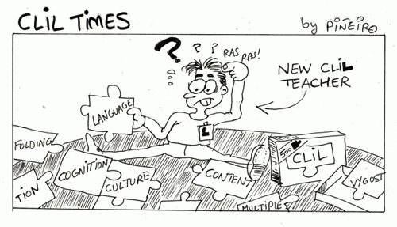
Initial questions
What is CLIL?
What are the origins of CLIL?
What are the core principles of CLIL?
What are the benefits and drawbacks of CLIL lessons?
How can I make a CLIL lesson?
Notes:
CBI often involves a language teacher teaching through English, working with a content teacher to co-teach a course, or a content teacher designing and teaching a course for ESL learners. CLIL often involves a content teacher teaching content through a second or foreign language, as does CBI, but also may involve content from subjects being used in language classes. That is, the CLIL curriculum may originate in the language class, whereas CBI tends to have as its starting point the goals of a content class. CBI emerged somewhat organically, advocated by a number of academics and educators supported by an extensive literature extending over a considerable period of time but without official sanction. CLIL, on the other hand, was officially proposed in a European Commission policy paper in which member states were encouraged to develop “teaching in schools through the medium of more than one language” (EC 1976). The acronym “CLIL” has been widely circulated within member states of the European com-munity since 1994 and has become, by decree “the core instrument for achieving policy aims directed at creating a multilingual population in Europe” (Dalton-Puffer 2007: 1). And unlike CBI, CLIL not only aims at stimulating multilingualism of all citizens in the European community but also strives to “preserve the independence and health of local languages” (EURYDICE 2013).
https://www.google.com/search?q=clil+vs+cbi&oq=clil+vs+cbi&aqs=chrome..69i57j0i10i512l2j0i390l4.3903j0j7&sourceid=chrome&ie=UTF-8#fpstate=ive&vld=cid:9ba14068,vid:8mDG-nN5SLM

Slide 3
What is CLIL?

Slide 4


CLIL: Simple definition
Students learn a subject through the medium of a foreign language (European Commission)
Notes:
https://op.europa.eu/en/publication-detail/-/publication/756ebdaa-f694-44e4-8409-21eef02c9b9b

Slide 5
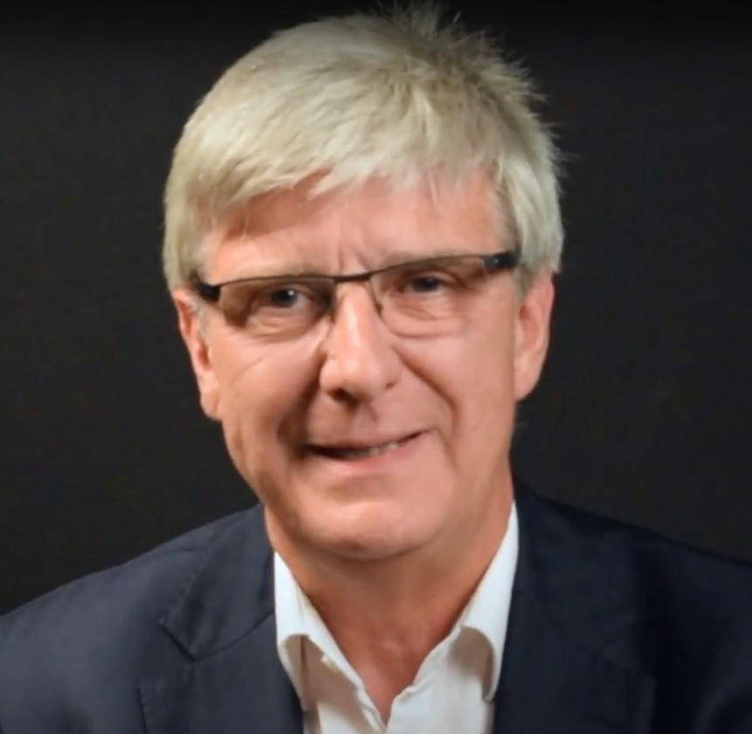
CLIL DefinEd
CLIL refers to situations where subjects, or parts of subjects, are taught through a foreign language with dual-focused aims, namely the learning of content and the simultaneous learning of a foreign language. (Marsh, 1994)
Notes:
David Marsh from the University of Jyvalskyla, Finland coined the term CLIL in 1994

Slide 6
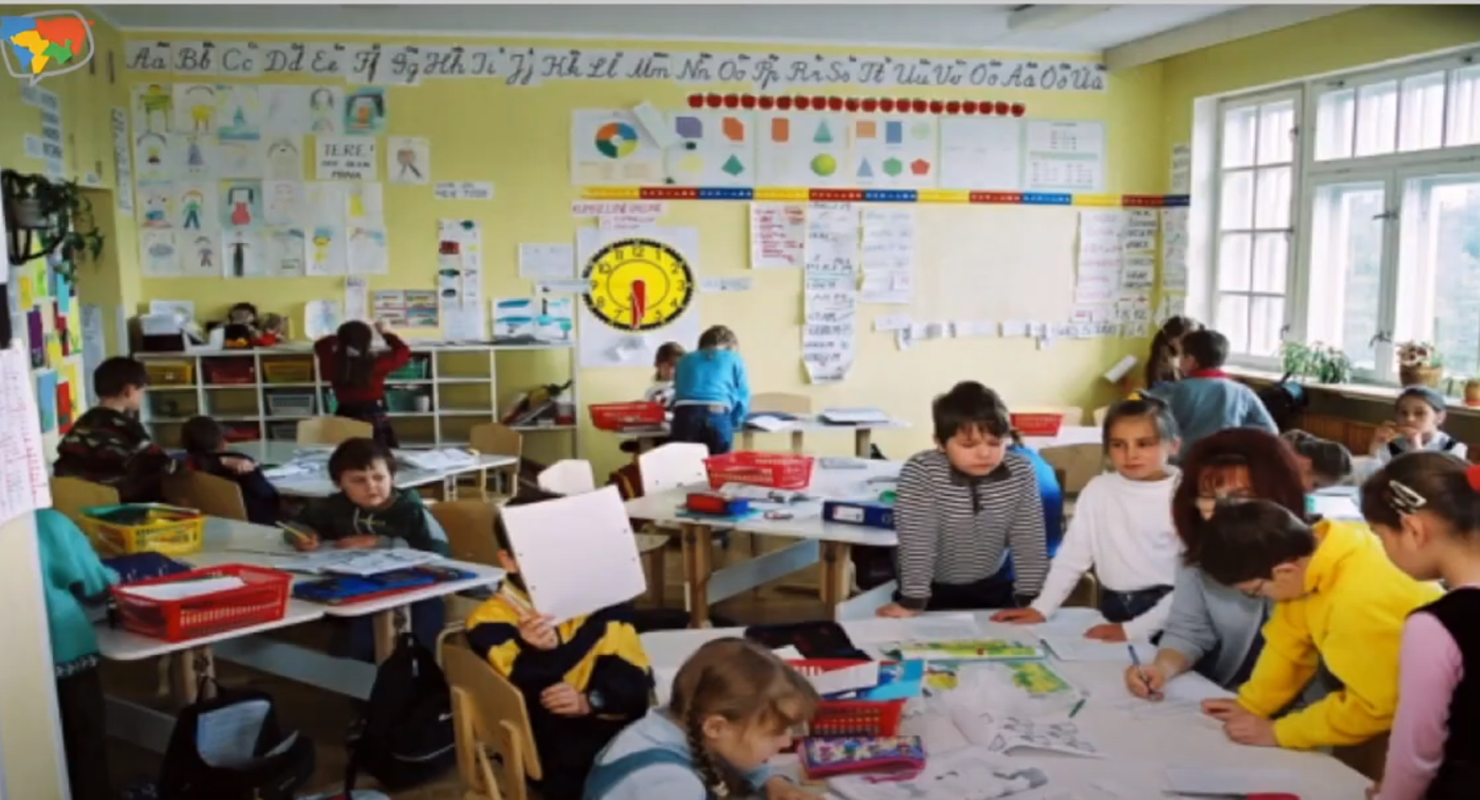

Slide 7
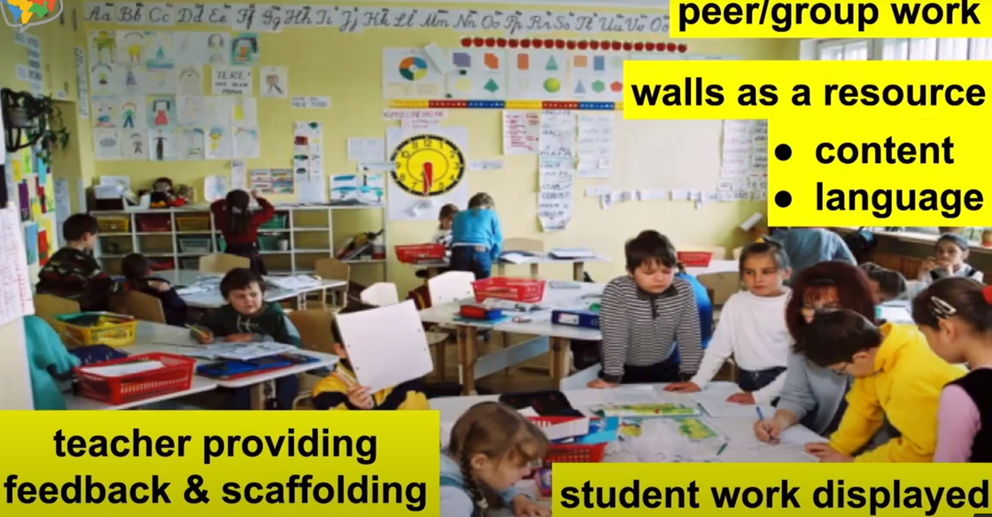

Slide 8
What are the origins of CLIL?

Slide 9
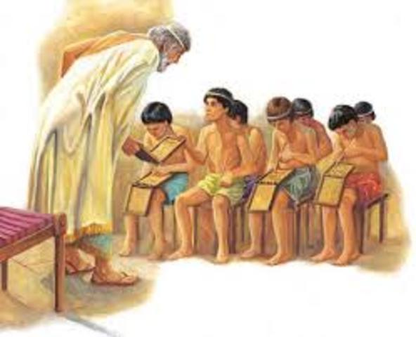

History
The acronym CLIL was first used in 1994 by David Marsh from the University of Jyväskylä in Finland (Coyle et al., 2010)
However, the concept was already being used much before then.
  Using a foreign language for teaching content was popular as early as in Ancient Rome, where children were educated in Greek (Coyle et al., 2010).
  The tradition of bilingual education has a long history in countries with more than one official language, e.g. Canada – English/French; Hong Kong – English/Cantonese
*Note: Bilingual education refers to the teaching of academic content in two languages, in a native and second language
Notes:
In Hong Kong where both English and Cantonese are official, both languages are taught in school and are mandatory subjects. Either English or Cantonese is used as the medium of instruction for other subjects. Increasingly, there are a large number of Mandarin Chinese-speaking schools in operation throughout Hong Kong as well since 1996. Study of Mandarin is mandatory in junior years (from Grade 1 to Grade 9). Hong Kong also has a bilingual education program using both Cantonese a
Coyle, Do, Philip Hood & David Marsh. 2010. CLIL. Cambridge: Cambridge University Press.nd Hong Kong Sign Language.

Slide 10


More History
In the mid-1960s, one of the first usages for L2 instruction in the French language took place in Canada and it was applied for a kindergarten by a group of people living in Quebec.
The programme immersing students in a foreign language was then adopted in other schools. In successive decades, the phrase ‘immersion’ teaching’ was used to refer to bilingual education.
In1978, the European Commission (EC) implemented a language policy which focused on “encouraging teaching in schools through the medium of more than one language” (Marsh, 2002, p. 51).
The more schools started to teach some subjects in foreign languages, the more content was used in the means of foreign language teaching. CLIL suited EU multilingualism in terms of educational and political driver and the term CLIL was coined by David Marsh in 1994.
Notes:
Marsh, D. (ed.): 2002, CLIL/EMILE—The European Dimension: Actions, Trends and Foresight Potential, Public Services Contract DG EAC, European Commission, Strasbourg.

Slide 11
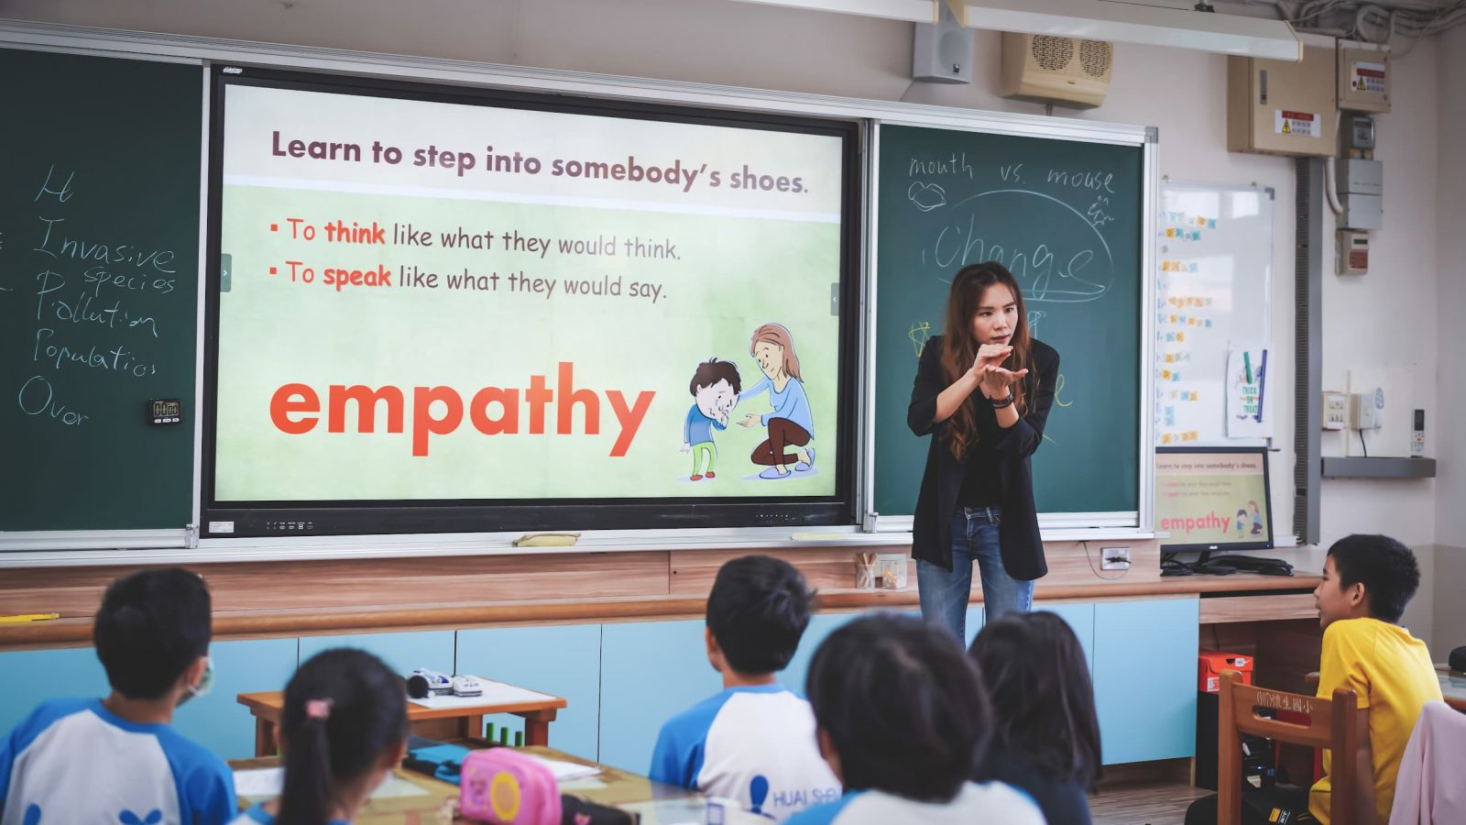
Check-up
Explain how this class would be conducted if it were an immersion class.
What about if it was a bilingual education setting?

Slide 12

CONFUSION Alert!
The multiplicity of terms used to refer to instructional approaches for the integration of content and language learning (immersion, CBI, CBLT, CLIL, EMI) can be a source of confusion.
That’s because they all commonly share the purpose of additive bilingualism via a dual focus on content and language learning.

Slide 13
CONFUSION Alert!
Multiplicity of terms
CLIL
CBI
Immersion
Bilingual Ed.
CBLT
EMI
Debate continues about the extent to which immersion, CBLT, CBI, and CLIL are different, similar, or the same.
Some argue that CLIL represents an appropriate umbrella term that generally refers to various approaches towards content integration (e.g., immersion is a type of CLIL) (Marsh, 2002). In this case you may find terms being used interchangeably (e.g., CLIL and CBI are the same concept with a different name) (Cenoz et al., 2014).
There are others who argue that CLIL and CBI represent very different concepts, where CLIL represents the intersection between content and language from the content perspective (i.e., CLIL happens in content classes), while CBI is an attempt at responding to the content needs of learners in language classes (Dalton-Puffer et al., 2014).
Notes:
Cenoz, Gennessee & Gorter (2014). "Critical analysis of CLIL: Taking stock and looking forward". Applied Linguistics. 35 (3): 243–262.
Dalton-Puffer, Llinares, Lorenzo & Nikula (2014). ""You can stand under my umbrella": Immersion, clil and bilingual education. A response to Cenoz, Genesee & Gorter (2013)". Applied Linguistics. 35 (2): 213–218.
Marsh, D. (ed.): 2002, CLIL/EMILE—The European Dimension: Actions, Trends and Foresight Potential, Public Services Contract DG EAC, European Commission, Strasbourg.

Slide 14
Initial questions
What is CLIL?
What are the origins of CLIL?
Notes:
CBI often involves a language teacher teaching through English, working with a content teacher to co-teach a course, or a content teacher designing and teaching a course for ESL learners. CLIL often involves a content teacher teaching content through a second or foreign language, as does CBI, but also may involve content from subjects being used in language classes. That is, the CLIL curriculum may originate in the language class, whereas CBI tends to have as its starting point the goals of a content class. CBI emerged somewhat organically, advocated by a number of academics and educators supported by an extensive literature extending over a considerable period of time but without official sanction. CLIL, on the other hand, was officially proposed in a European Commission policy paper in which member states were encouraged to develop “teaching in schools through the medium of more than one language” (EC 1976). The acronym “CLIL” has been widely circulated within member states of the European com-munity since 1994 and has become, by decree “the core instrument for achieving policy aims directed at creating a multilingual population in Europe” (Dalton-Puffer 2007: 1). And unlike CBI, CLIL not only aims at stimulating multilingualism of all citizens in the European community but also strives to “preserve the independence and health of local languages” (EURYDICE 2013).
https://www.google.com/search?q=clil+vs+cbi&oq=clil+vs+cbi&aqs=chrome..69i57j0i10i512l2j0i390l4.3903j0j7&sourceid=chrome&ie=UTF-8#fpstate=ive&vld=cid:9ba14068,vid:8mDG-nN5SLM

Slide 15
What are the core principles of CLIL?

Slide 16
CLIL Core Principles
In a CLIL lesson, language is used to learn as well as to communicate.
The subject matter/ lesson content determines the language needed to be learned.
The focus is not only on language, nor only on content, they are interlinked throughout the lessons.
L1 can be used as a supportive tool in the classroom to scaffold students’ learning.
Students should learn the content and be able to talk about it.
Effective CLIL lessons focus on fostering learners’ curiosity and interest while developing their abilities to share, question, and apply the information to their lives.
Notes:
A CLIL lesson addresses the questions, “Why is this information important?” and “How can I talk about it?”
Effective CLIL lesson plans focus on fostering learners’ curiosity and interest while giving them the tools to share, question, and apply information to their lives.

Slide 17
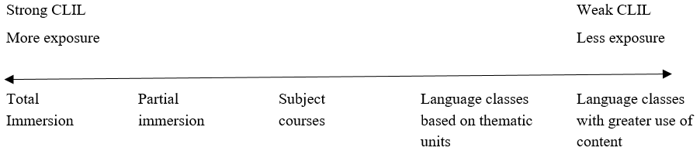
Strong vs Weak forms of CLIL

Slide 18
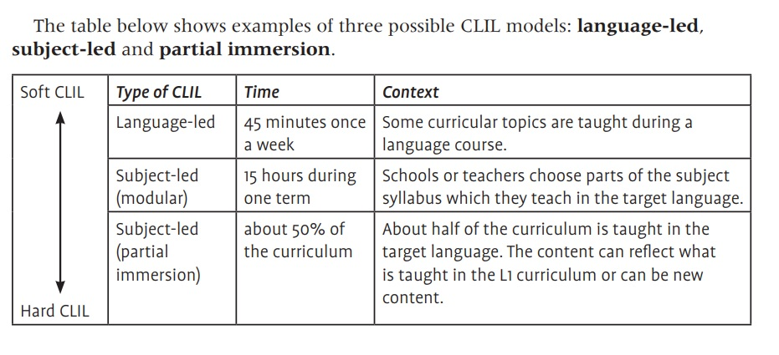
Notes:
https://skyteach.ru/2019/04/01/what-is-clil-and-how-can-we-apply-it-to-english-teaching/

Slide 19
The 4 Cs of CLIL

Slide 20
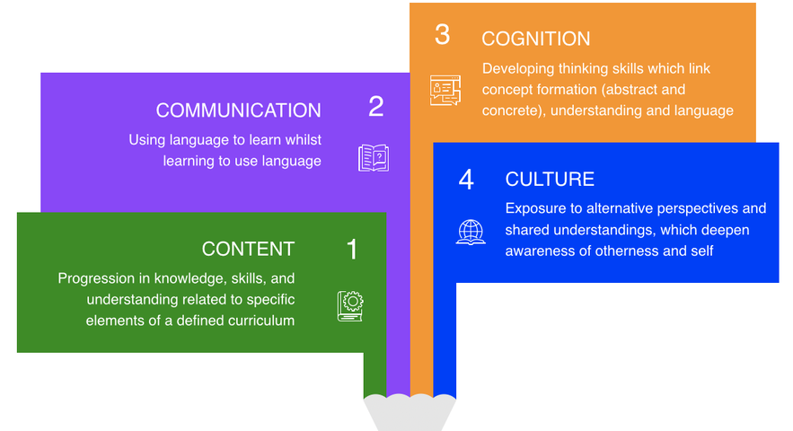
Coyle’s 4Cs curriculum (1999)
Notes:
Coyle, D. 1999. “Theory and Planning for Effective Classrooms: Supporting Students in Content and Language Integrated Learning Contexts.” In Learning Through a Foreign Language, edited by J. Masih, 46–62. London: CILT. [Google Scholar]

Slide 21
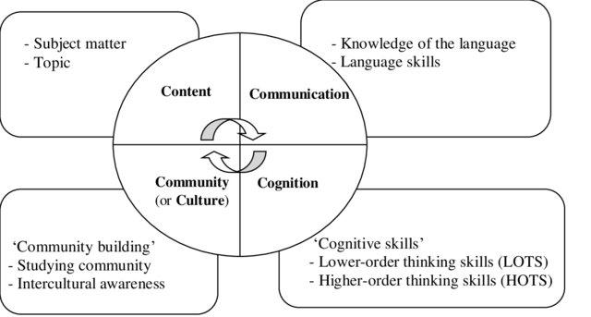
The 4 Cs Defined
Content
  refers to the subject matter. CLIL lessons should foster the progression of knowledge, skills, and understanding of the content.
Communication
  refers to the learning and use of language related to the content. CLIL lessons involve interaction in a communicative context and the development of appropriate language knowledge and skills to do so.
Cognition
  refers to engagement in lower and higher-level cognitive processing. In CLIL lessons learners should be involved in a variety of lower and higher-order thinking activities/tasks.
Culture
  refers to the understanding of oneself and others around the world. It is about understanding how oneself and others may relate to the content being learned in order to deepen feelings of community and global citizenship.
Notes:
Figure adapted from Ikeda, 2011
Ikeda, M. (2011) CLIL no Kihon Genri [the basic principles of CLIL], in Izumi, S., Ikeda, M., Watabe, Y. (eds.), CLIL (Content and Language Integrated Learning): New Challenge in Foreign Language Education at Sophia University, (CLIL, Naiyou Gengo Togogata Gakusyu, Jochi daigaku gaikokugo) Volume 1: Principles and Methodologies, 25 Designing supplementary. Sophia University Press, 1- 14.

Slide 22
content
Some CLIL programs develop cross-curricular links among different subjects (more common in Elementary).
  E.g., if they are learning about the history of a country in another class you may focus on the food and culture of the country in your class.
  Some teachers collaborate with other subject teacher to find such links.
It is NOT about teaching the same content in L2! It is about finding links to expand and deepen their knowledge.
It is important to analyse content for its language demands to ensure it is at the appropriate level for students. It is also important for the teacher to present the content in a way that is easy to understand.
Notes:
Bentley, K. (2010). The TKT course: CLIL module. Cambridge University Press.

Slide 23
communication
This involves students producing language related to the content in both oral and written forms.
It is important for the teacher to encourage students to participate in meaningful interaction in the classroom.
The focus for the teacher should be to increase student talking time and decrease teacher talking time.
The teacher should also promote self-evaluation and peer and group feedback during the lessons.
The key point is that by producing the target language while studying the subject content, students’ knowledge and language skills are integrated.

Slide 24
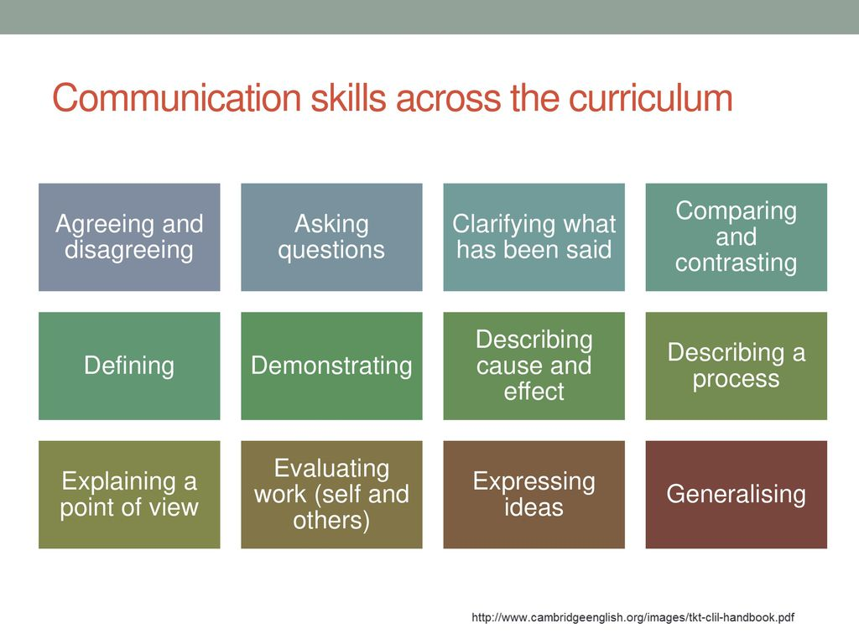

Slide 25
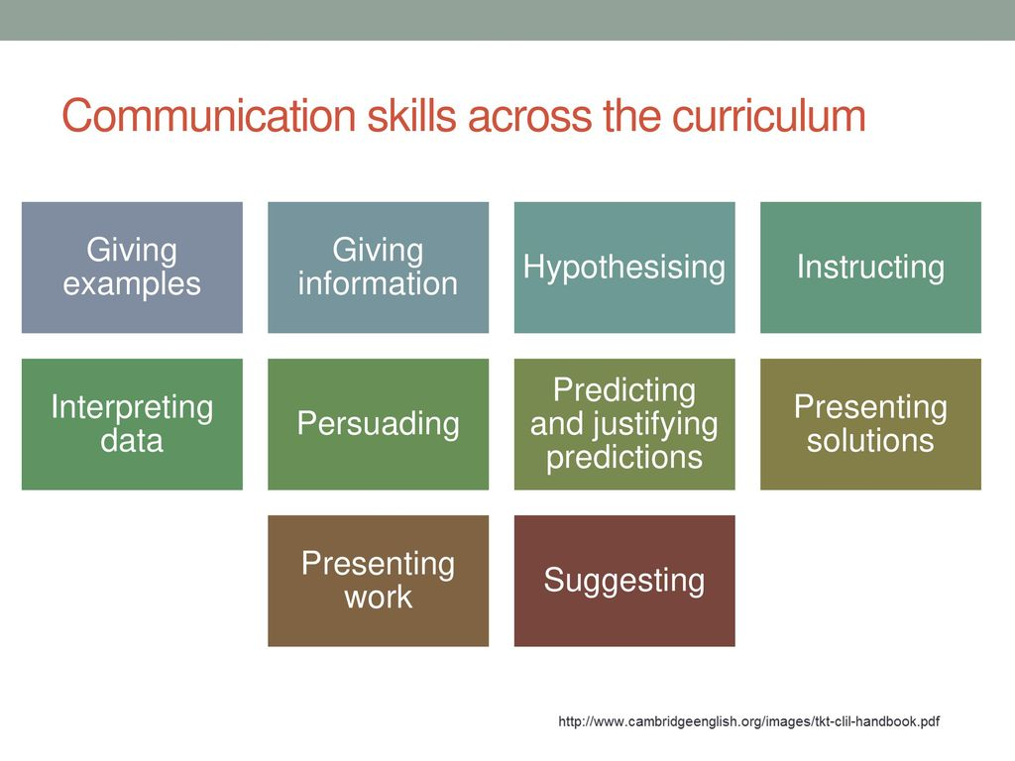

Slide 26
Language in CLIL Lessons

Slide 27
Overview
CLIL is not simply "translating" content learning from the first-language into another language.
“In CLIL settings, it is necessary for learners to progress systematically in both their content learning and their language learning and using, so using language to learn is as important as learning to use language.” (Coyle et al., 2010, p 35)
However, in CLIL settings there is a difference in levels between the cognitive competence and the linguistic competence.
  Many CLIL learners have a cognitive level higher than their linguistic level of the CLIL language.

Slide 28
Teacher’s job
CLIL teachers need to give special support for language, and, therefore, plan language carefully, analyzing what kind of language learners will be using.
Teachers have to make explicit the interrelationship between content objectives and language objectives.

Slide 29
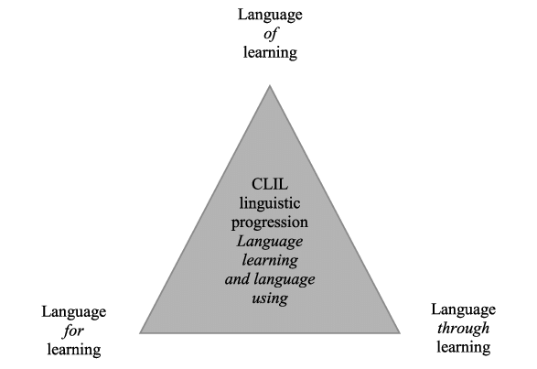
Language Triptych
Notes:
Coyle, Hood, and Marsh, 2010

Slide 30
Language of, for, through learning
Language of learning
  Language specifically related to the content of the lesson. Students need to know this key language to understand the content of the lesson. These are content-specific words e.g., key vocabulary and phrases, key grammar points required to understand the content.
  Example: If the lesson is related to science students need to know science-specific words to follow the lesson as well as keywords related to the content being covered.
Teachers need to consider
  What type of language does this subject or theme use?
  Define the content-obligatory language, such as keywords, phrases and grammatical demands of the unit.

Slide 31
Language For learning
Language for learning
  Language that learners need to operate and participate in the lesson.
  Learners need to be supported in developing skills such as those required for pair work, cooperative group work, asking questions, debating, chatting, enquiring, thinking, memorizing and so on.
  Unless learners are able to understand and use language which enables them to learn, to support each other and to be supported, quality learning will not take place.
Teachers need to consider
  What kind of language do learners need to operate effectively in this CLIL lesson/ unit?
  What are the possible language demands of typical tasks and classroom activities? (e.g., how to work in groups, organize research)

Slide 32
Language through learning
Language through learning
  This is new language that naturally emerges through the lesson. It can not be predicted in advance. It happens naturally.
  New words and phrases may emerge during group work or when students ask the teacher a question.
  While engaging in the lesson and different tasks/ activities students may link to existing knowledge or experiences which pushes them in new linguistic directions. They may require new language in this case. The teacher should encourage and support such emerging language in the classroom.
Teachers should consider
  What strategies can our learners use to access new language for themselves?
  When new language emerges, how shall we capture and select language for further development?

Slide 33
HABITATS
(from Coyle, Hood and Marsh (2010), CLIL, CUP)

Slide 35
Language through learning may emerge if, for example, during the mini-project preparation, students working in groups need language to express a new idea which they have constructed and which is not in their resources - this might involve dictionary work and teacher support.

Slide 36
Task: Categorize the language
Language of learning
river
I agree with you
What does “X” mean?
Teacher, what can I say if I want to provide evidence?
I have a different idea…
X has a higher density than Y
buoyancy
I think we should…
Can you please explain X to me?
Teacher, how can I say X in English? “elevate”
Language for learning
Language through learning

Slide 37
Cognition
CLIL promotes cognitive or thinking skills which challenge learners.
Engaging in a variety of low and high-order thinking skills can lead to deeper learning and retention of the content.
Teachers should consider
  It is up to the teacher to consider the activities and tasks to ensure learners engage in a variety of cognitive skills in their lessons. One may choose to start with low order thinking in their first activity and move toward high-order thinking skills throughout the lesson.

Slide 38
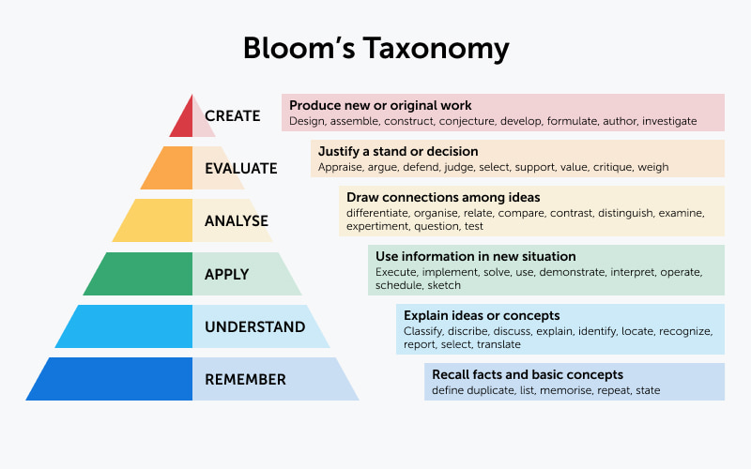
Bloom’s revised taxonomy

Slide 39
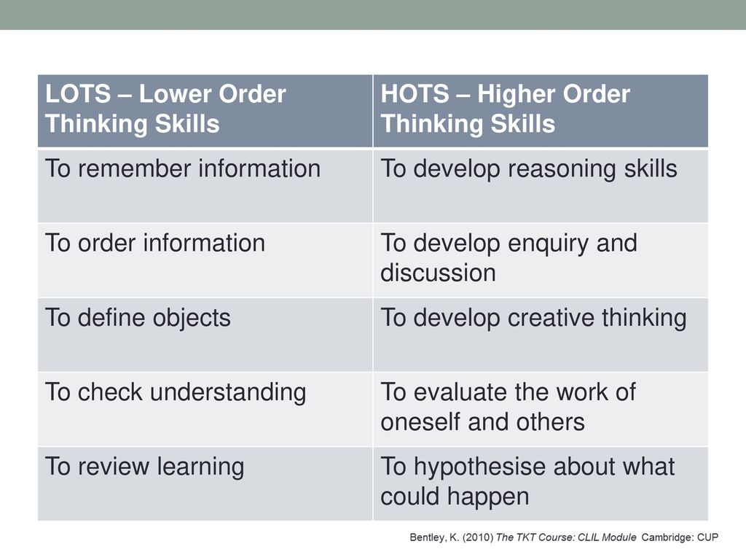

Slide 40
Sorting activity: LOTS/ HOTS
Analyze
Examine, experiment, test,
question, compare, contrast
Creative Thinking
Imagine what would happen if…, Invent, Make a new plan, create a story, build a new design
Defining
What is X? What is the function of X? describe, define, translate
Remembering
List, name, recall, recite, spell
Ordering
What is the sequence? rank, organize
Evaluating
What is your opinion of X? How would you rate it? What is your assessment of X?
Reasoning
Why did X happen? What causes/ caused X? What could logically change the result?
Apply
How would you apply what you learned to X situation? Build, make a video

Slide 41
Sorting activity
Remembering
List, name, recall, recite, spell
Apply
How would you apply what you learned to X situation? build, make a video
Evaluating
What is your opinion of X? How would you rate it? What is your assessment of X?
Defining
What is X? What is the function of X? describe, define, translate
Analyze
Examine, experiment, test,
question, compare, contrast
Creative Thinking
Imagine what would happen if…, invent, make a new plan, create a story, build a new design
Ordering
What is the sequence? rank, organize
Reasoning
Why did X happen? What causes/ caused X? What could logically change the result?

Slide 42

culture
Learners need to think about how the topic relates to and/ or impacts themselves as well as others in different positions around the world.
Learners can be introduced to a wide range of cultural contexts.
Learners need to develop positive attitudes towards people from other countries and cultures.
Learners need to develop their awareness of their responsibilities as a local as well as global citizen.
Notes:
https://slideplayer.com/slide/11845354/

Slide 43
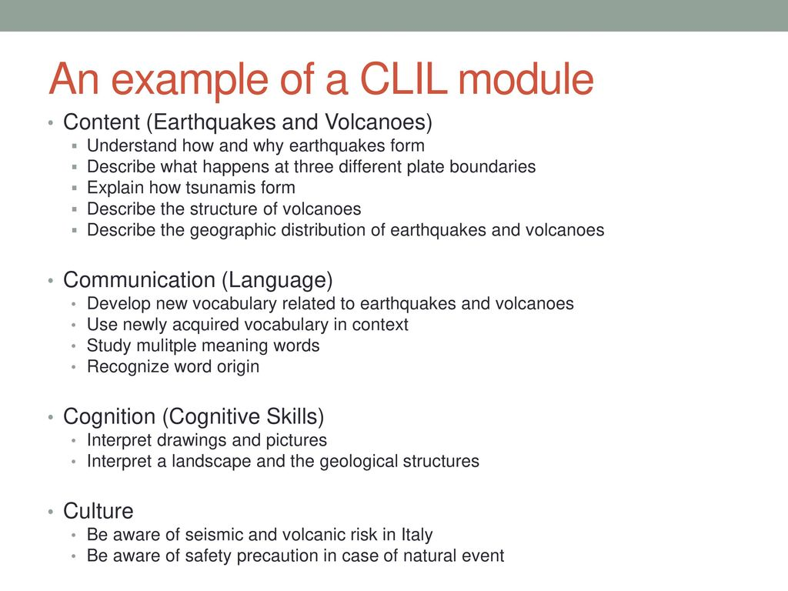
Mapping the 4cs into Lesson aims

Slide 44
Initial questions
3. What are the core principles of CLIL?
Notes:
CBI often involves a language teacher teaching through English, working with a content teacher to co-teach a course, or a content teacher designing and teaching a course for ESL learners. CLIL often involves a content teacher teaching content through a second or foreign language, as does CBI, but also may involve content from subjects being used in language classes. That is, the CLIL curriculum may originate in the language class, whereas CBI tends to have as its starting point the goals of a content class. CBI emerged somewhat organically, advocated by a number of academics and educators supported by an extensive literature extending over a considerable period of time but without official sanction. CLIL, on the other hand, was officially proposed in a European Commission policy paper in which member states were encouraged to develop “teaching in schools through the medium of more than one language” (EC 1976). The acronym “CLIL” has been widely circulated within member states of the European com-munity since 1994 and has become, by decree “the core instrument for achieving policy aims directed at creating a multilingual population in Europe” (Dalton-Puffer 2007: 1). And unlike CBI, CLIL not only aims at stimulating multilingualism of all citizens in the European community but also strives to “preserve the independence and health of local languages” (EURYDICE 2013).
https://www.google.com/search?q=clil+vs+cbi&oq=clil+vs+cbi&aqs=chrome..69i57j0i10i512l2j0i390l4.3903j0j7&sourceid=chrome&ie=UTF-8#fpstate=ive&vld=cid:9ba14068,vid:8mDG-nN5SLM

Slide 45
What are the benefits and drawbacks of CLIL lessons?

Slide 46

Group Discussion
Based on what you have learned so far discuss and make notes on the possible benefits and drawbacks CLIL lessons.
  Think about possible benefits/ challenges related to your learners.
  Also, consider what possible benefits/challenges you may have as a teacher.

Slide 47
Benefits of CLIL
Authentic and meaningful lessons (real-life connection and purpose)
The language that students learn in a CLIL lesson is not the typical language learned in a traditional language lesson, but language relevant to their future.
Learners can develop both content knowledge and language (L2) skills (as well as various other areas e.g., social, cognitive, emotional, and physical).
Can help prepare learners for tertiary-level education/ workplace/internationlization.
Promotes supportive collaboration between teachers of different subjects.
  Complements other subjects which can lead to deeper learning.
Learners can be more motivated to learn both the content and the language.
  Develop multilingual interests and attitudes

Slide 48
CLIL challenges
Learners’ L2 proficiency may not be high enough to understand the content.
Learners may have insufficient understanding of the content through the medium of a foreign language.
There is not a single model/ recipe for CLIL – lessons are created around the content.
Teachers can have a burden creating CLIL lessons (requires some critical thinking and creativity).
It can be challenging for language teachers to teach unfamiliar subject content or content beyond their linguistic levels.
Assessment may be confusing/ challenging for teachers.
Students and parents may reject the approach in learning contexts which are exam focused.
Other contextual challenges. (students, parents, other teachers, admin, etc.)

Slide 49

KWL reflection
Go back to your KWL sheet that did in week 1.
What questions have been answered thus far?
Which questions do you still have.
Write down any further questions based on what you have learned up to this point.

Slide 50
review

Slide 51
Take a minute to think and discuss the answers to these questions
What is CLIL?
What are the origins of CLIL?
What are the core principles of CLIL?
What are the benefits and drawbacks of CLIL lessons?
How can I make a CLIL lesson?
Notes:
CBI often involves a language teacher teaching through English, working with a content teacher to co-teach a course, or a content teacher designing and teaching a course for ESL learners. CLIL often involves a content teacher teaching content through a second or foreign language, as does CBI, but also may involve content from subjects being used in language classes. That is, the CLIL curriculum may originate in the language class, whereas CBI tends to have as its starting point the goals of a content class. CBI emerged somewhat organically, advocated by a number of academics and educators supported by an extensive literature extending over a considerable period of time but without official sanction. CLIL, on the other hand, was officially proposed in a European Commission policy paper in which member states were encouraged to develop “teaching in schools through the medium of more than one language” (EC 1976). The acronym “CLIL” has been widely circulated within member states of the European com-munity since 1994 and has become, by decree “the core instrument for achieving policy aims directed at creating a multilingual population in Europe” (Dalton-Puffer 2007: 1). And unlike CBI, CLIL not only aims at stimulating multilingualism of all citizens in the European community but also strives to “preserve the independence and health of local languages” (EURYDICE 2013).
https://www.google.com/search?q=clil+vs+cbi&oq=clil+vs+cbi&aqs=chrome..69i57j0i10i512l2j0i390l4.3903j0j7&sourceid=chrome&ie=UTF-8#fpstate=ive&vld=cid:9ba14068,vid:8mDG-nN5SLM

Slide 52

Critically thinking about CLIL lesson plan
How do you keep healthy? (Food and Health)
Life cycles in changing habitats (Biology/ Life cycles)
Think about the 4 Cs. Are they reflected well?
How about language of, for, through learning?
What about the order of activities in relation to lower and higher order thinking skills?

Slide 53
Appendices

Slide 54
