Slide 1
Vocabulary Learning and retention Strategies
Learning and remembering words

Slide 2
Defining vocabulary learning strategies
Techniques which students use to comprehend, store, and remember information and skills” (Chamot and Kupper,1989, p.9)
The process by which information is obtained, stored, retrieved and used... therefore vocabulary learning strategies could be any which affect this broadly defined process (Schmitt,1997, p.203).

Slide 3
Strategies to…
Encounter new words
Understand the meaning
Remember the words (FUMP)

Slide 4
Important
Different strategies work for different people

Slide 5
Learners’ strategies
Anja: I read a text and write definitions of new words (from a dictionary) but I do not write the new word down. I try to remember the word that goes with the definition the next day. If I can’t, I reread the text and try the exercise again. If I do remember the word I write it down, although I sometimes wait to see if I can remember it after two or three days.

Slide 6
Learners’ strategies
David: I copy out the sentences from the text that have a new word in but in place of the new word I leave a gap. At university you have to read ______ journals (academic). Later I go back and try to fill in the gaps.
Learners’ strategies

Slide 7
Learners’ strategies
Aasmah: Whenever my teacher teaches me new grammar or vocabulary, I always try to use it over the next few days. I try to use it in lessons and outside if I can. That way I think I remember it better and I get feedback on if I’m using it properly.

Slide 8
Learners’ strategies
Gaston: When I find a new word I ask myself as many questions as I can about it. What does it rhyme with? Where’s the stress? How many syllables does it have? What word class is it? What words are derived from it? What words combine with it? What does it make me think of?

Slide 9
Thinking time
Think about the strategies you use to encounter , understand, and remember new words.
Where do you encounter new words?
When you encounter a new word, how do you find its meaning?
What works or has worked best for you to remember the Spelling, How to use it, Meaning, and Pronunciation?

Slide 10
Strategy sorting activity
reading, listening, interacting
rote repetition
In ones head
Look at the words again after 24 hours, after one week and after one month.
Making flashcards
ask someone (classmate, teacher, friend, parent etc.)
word association
with visuals
with other words (English, Korean)
highlighting
using the word actively
Speaking
Writing
using websites or apps
guessing the meaning from the context OR prefix, root, suffix
vocabulary learning workbooks
looking words up in the dictionary or online
writing down new words as one hears or sees them
Encounter new words
Understand the meaning
Remember the words (FUMP)

Slide 11
Strategies to encounter new words
Interacting
Online
Websites/ Apps
Chats
Groups
Messengers
Texting
Offline
Friends
Family
others
Reading
Books
Comics
News
Magazines
Textbooks
Menus
Dictionary
Websites/ Apps
Listening
T.V.
Movies
Songs
Podcasts
Audiobooks (audible.com)
Eavesdropping
Websites/ Apps

Slide 12
Strategies to understand meaning
Looking it up in a dictionary or online
Guessing the meaning from the context OR prefix, root, suffix
Asking someone (classmate, teacher, friend, parent etc.)
Websites/ Apps

Slide 13
Remember the words (FUMP)
rote repetition
In ones head
Look at the words again after 24 hours, after one week and after one month.
Making flashcards
word association
with visuals
with other words (English, Korean)
using the word actively
Speaking
Writing
using websites or apps

Slide 14
What about highlighting?
Not purposeful unless additional steps are taken to understand the meaning and remember it.

Slide 15
Useful apps and websites
Word associations
Lexipedia
Word it out
Memrise
Anki
Word to Word
Magoosh
Vocabulary.com
Freerice.com

Slide 16
Concordances

Slide 17
Why are concordances useful
Good for checking word usage and contexts of word usage.
Good to check what words often surround the word.
Good reference to check if students answers on a test are acceptable or not.

Slide 18
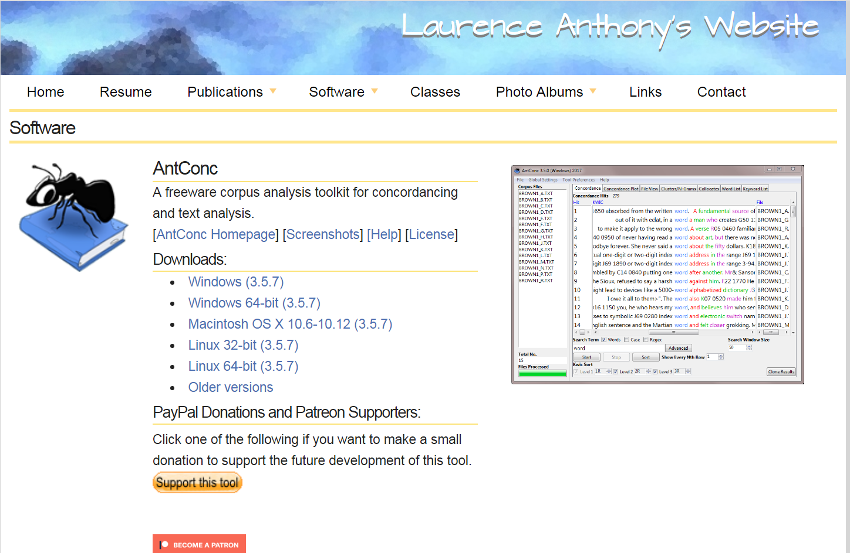
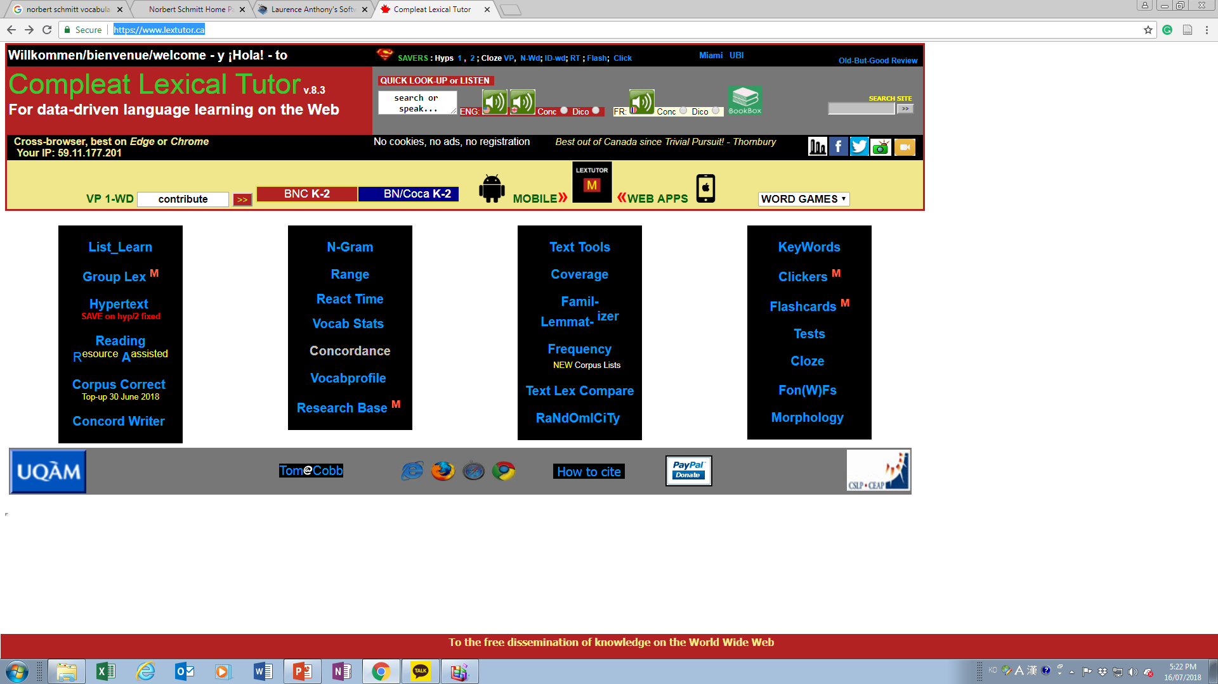
Useful sites

Slide 19
Teaching vocabulary learning strategies

Slide 20
Remember
Different strategies work for different people.
Help learners develop what works best for them by introducing them to different strategies (directly or indirectly).
Give them a lot of exposure and practice with different strategies through different classroom activities and tasks.
Many of the strategies for finding meaning and remembering can be turned into learner centered classroom activities, or given as out of class tasks or assignments.

Slide 21
Teaching VLS
According to Mike Graves (2006), for younger learners, strategies can be taught casually and informally in the context of reading.
In middle school it is possible to introduce strategies through more formal instruction.
In an ideal world, initial instruction would be largely concluded by high-school.
However, if older students have not had quality instruction in word-learning strategies, they are likely to profit from instruction in at least some elements.

Slide 22
Teaching VLS Guidelines
Do not teach too many strategies at once. Give them enough time to practice with one or two before introducing another.
Key point: teach one or two strategies well rather than more strategies less well.
Explain but also demonstrate/ show students how to use the strategy you are presenting

Slide 23
references
Chamot, A.U., & Kupper. L. (1989): Learning strategies in foreign language instruction. Foreign Language Annals, 22, 13-24.
Oxford, R. (1990). Language Learning Strategies. Boston: Heinle & Heinle Publishers
Schmitt, N. (1997). Vocabulary Learning Strategies. In Schmitt, N., and McCarthy, M. Vocabulary: Description, Acquisition and Pedagogy. Cambridge: Cambridge University Press.
Watkins, P. (2014). Learning to Teach English (2nd ed.). Peaslake: Delta Publishing.

