Slide 1
VOCABULARY ASSESSMENT

Slide 2
Thinking
What are some of the purposes for assessing students vocabulary other than to check the progress of the words they learned in class?
Tip: Think of usage before a course, during a course, and after a course.

Slide 3
Uses of vocabulary assessment results
Before a course:
  To identify students level for level placement purposes
  To help plan a courses vocabulary teaching (needs analysis)
During a course
  To assess students progress in vocabulary learnt
  To evaluate if the learners have met the learning goals expected by the teacher for the words taught (receptive vs. productive, can they actually use the word in writing or speaking etc.)
After a course
  Measuring end of course achievement
    Measuring progress (pre-post levels, comparing different tests at different times during the course to the final comprehensive test)
    Assessing knowledge level of taught words
    Identify outstanding problems that still may exist

Slide 4
An important link to reading comprehension
Tests of vocabulary are highly predictive of performance on tests of reading comprehension.
A lot of researches show that depth of vocabulary knowledge, breadth of vocabulary knowledge and reading comprehension are highly, and positively, correlated.
Depth of vocabulary knowledge made a significant, and unique, contribution to the prediction of scores on reading comprehension beyond the prediction provided by the breadth of vocabulary knowledge.
(See Shen, 2008)

Slide 5
Sources of vocabulary to assess
Items in the course book
Items specified in the syllabus or curriculum
Words from a frequency list

Slide 6
In-class testing of vocabulary
As teachers we need to test vocabulary to know how effective our teaching has been
Testing provides a forms of feedback for both the teacher, learners, parents, and other stakeholders.
If learners know they are being tested on the vocabulary they often pay more attention and are pushed to review outside of class.
Testing reinforces and recycles words they learn and also motivates learners to study the words they get wrong.

Slide 7
Vocabulary Assessment Tools
In your experience how has your vocabulary been assessed as a learner?
How have you assessed your learners’ vocabulary as a teacher?
What was being tested in each of the tests? (FUMP, Depth of knowledge, etc.)
Do you see any problems with some of the tests?

Slide 8
Types of tests
Vocabulary size tests
Depth of knowledge

Slide 9
Various vocabulary assessment tools
(available at http://www.lextutor.ca/tests/)
Vocabulary Levels Tests (VLTs)
  To check vocabulary size at different word frequency levels – both receptive and productive
    2000, 3000, 5000, 10000-word levels; AWL
    Aim at score of at least 80%
Word Association Test
  Meaning (different senses of a word), collocations
Vocabulary Knowledge Scale (VKS)
  To check “quality” or “depth” of vocab knowledge
Vocab Profiler
  Lexical richness (type/token ratio) – more different words
  More frequent words or more low-frequency words being used

Slide 10
Size or Depth?
(available at http://www.lextutor.ca/tests/)
Vocabulary Levels Tests (VLTs)
  To check vocabulary size at different word frequency levels – both receptive and productive
    2000, 3000, 5000, 10000-word levels; AWL
    Aim at score of at least 80%
Word Association Test
  Meaning (different senses of a word), collocations
Vocabulary Knowledge Scale (VKS)
  To check “quality” or “depth” of vocab knowledge
Vocab Profiler
  Lexical richness (type/token ratio) – more different words
  More frequent words or more low-frequency words being used

Slide 11
Vocabulary Size

Slide 12
Well-known size tests
Vocabulary Levels Test (Nation)
Vocabulary Size Tests (Nation)
X_Lex and Y_ Lex tests (Meara)
www.lextutor.ca/tests

Slide 13
Depth of Knowledge

Slide 14
Depth of knowledge tests
How well does one know a word or phrase and what are they able to do with the word?
  Spelling
  Pronunciation
  Part of speech
  Meaning
  Collocations
  Inflected forms
  Related words/ synonyms/ antonyms
  How and when to use it in writing
  How and when to use it in speaking

Slide 15
Depth of Knowledge
  How accurate are students in their ability to recall the form, use and pronunciation of a lexical item ?
  To what level of detail and accuracy do students understand the meaning?
  To what extent are they able to accurately use the lexical item?
(See Read, 2004; Nation, 2013)

Slide 16
Checking Meaning, Usage, Spelling
How well to learners know the specific meaning of a lexical item

Slide 17
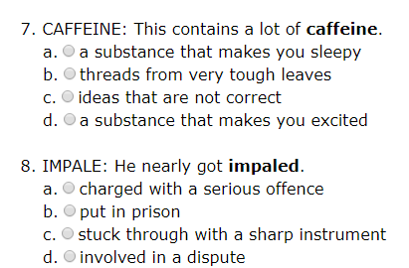
Multiple choice

Slide 18
Multiple choice
Which of the following is incorrect?
  Caffeine. can be found in coffee.
  Consuming caffeine generally makes people sleepy.
  Consuming caffeine generally makes people feel less sleepy.
Which usage is correct?
  He likes to caffeine his cereal in the morning.
  The dark chocolate I ate contained a lot of caffeine.
  I went to the caffeine and bought a coffee.

Slide 19
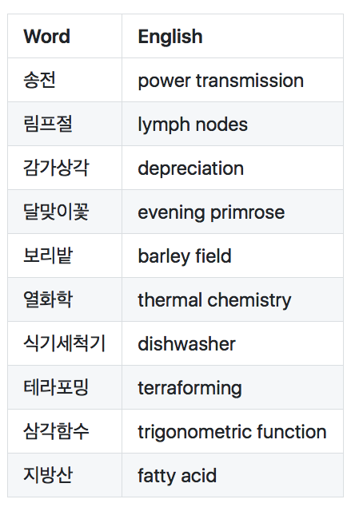
Definitions
L1-L2

Slide 20
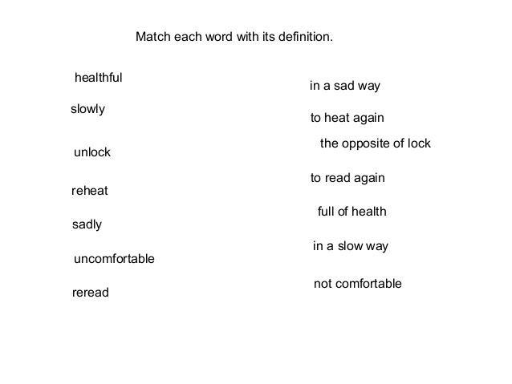
Definition matching

Slide 21
Graphic organizers
Word | Part of Speech | Definition | Sentence
infiltrate
 |  | to throw someone out of a window
clandestine |  |  | Their clandestine meetings went undiscovered for two years

Slide 22
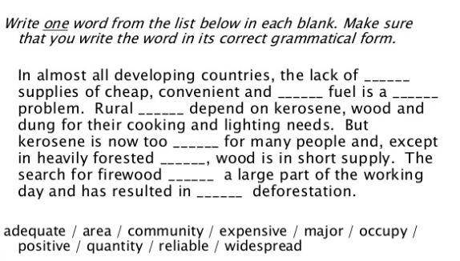
Fill-in the blank

Slide 23
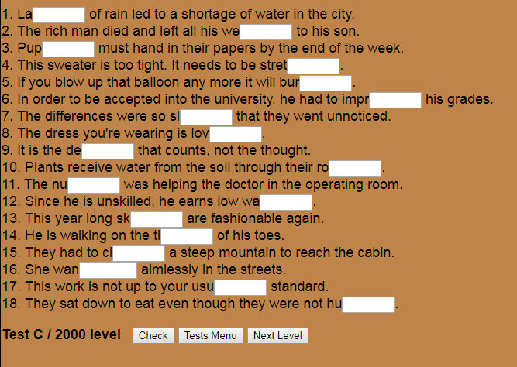
Fill-in-the-blank

Slide 24
Fill-in-the blank
A nuclear family consists of only a (1) ……….., (2) ……………… and children. In my country, an extended (3) ………… is more common. It consists not only of (4) ……… and children but also of (5) ………., aunts, uncles and cousins. My (6) ………….. lives with us and loves looking after her grandchildren. My mum’s brother, my (7) ……… George, is a widower and has lived with us since (8) ……… Helen died. He is also my godfather.

Slide 25
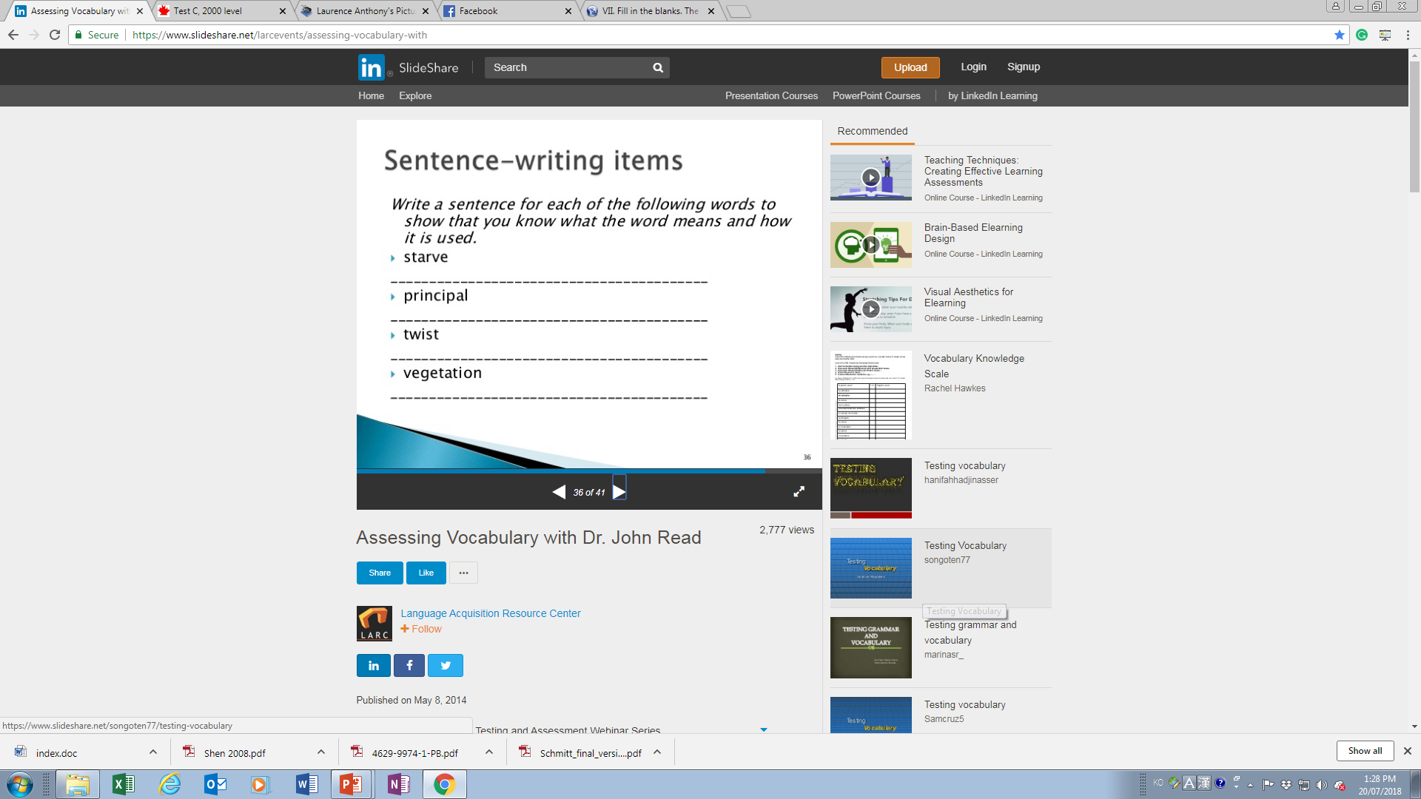
Usage in writing

Slide 26
Usage in speaking
Get students to record using the word in 3 sentences using the voice recorder on their phones.

Slide 27
Usage in speaking
Interview with students
Have them use the specific words they learned in context.
You may want to give them a situation to set the scene.

Slide 28
Usage in speaking
Describe a situation you would use word X and create a short dialogue where one of the participants uses the word accurately and appropriately.

Slide 29
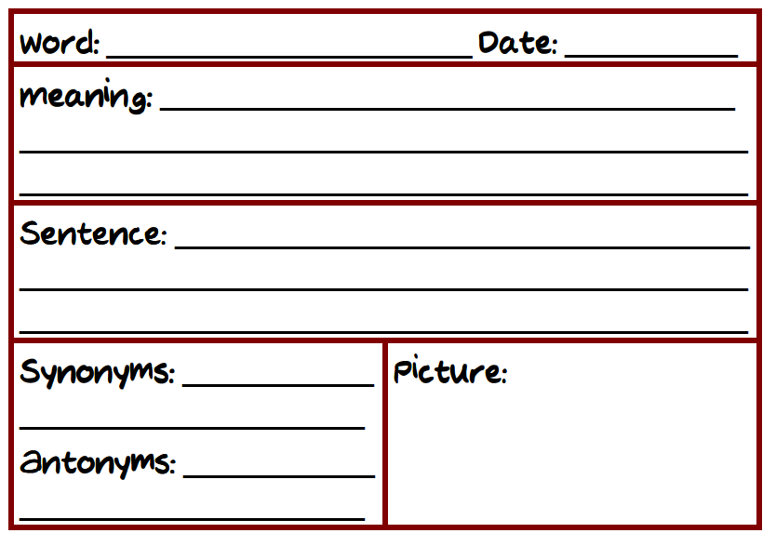
Test card

Slide 30
Vocabulary Knowledge Scale
VKS

Slide 31
Vocabulary Knowledge Scale (VKS)
This is an excellent way to measure ongoing progress learning individual words.
A vocabulary knowledge scale measures how well you know and can use words on a rating scale.

Slide 32
Task: refectory, rotate, defenestrate

Slide 33
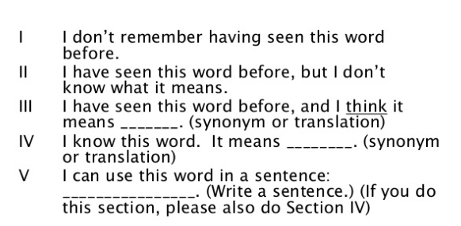
Developed by Mari Wesche & Sima Paribakht (1996)

Slide 34
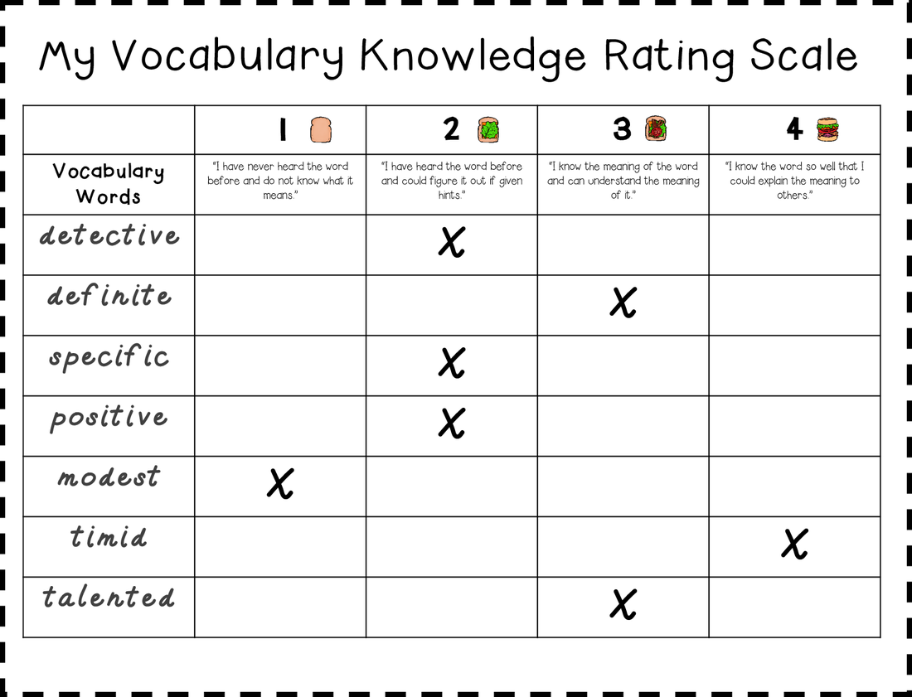
Vocabulary Knowledge Scale (VKS)

Slide 35
Problems with VKS
Do you notice any problems with the VKS?

Slide 36
Problems with VKS
Self-reported in nature
ability to produce a sentence with target vocab = ability to use the word appropriately (i.e. social and contextual factors)

Slide 37
Creative Application Task
Use your knowledge of what we have covered in this lesson to construct a test that measures your students depth of knowledge of 3 words of your choice.
Hint: they can’t just say they can do something, they need to prove it to you…

Slide 38
References
Nation, I.S.P.(2103). Learning vocabulary in another language (2nd ed.). Cambridge: Cambridge University Press.
Read, J. (2004). Plumbing the depths: How should the construct of vocabulary knowledge be defined? In P. Bogaards & B. Laufer (Eds.), Vocabulary in a second language: Selection, acquisition and testing (pp. 209-227). Amsterdam: John Benjamins
Schmitt, N. (2014). Size and depth of vocabulary knowledge: What the research shows. Language Learning, vol. 64 (4), p. 913–951.
Shen, Z. (2008) The roles of depth and breadth of vocabulary knowledge in EFL reading performance. Asian Social Science, 4(12), 135-137.

