Slide 1
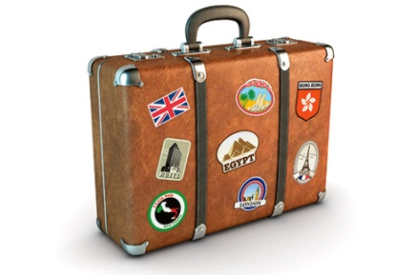
Travel and Tourism

Slide 2
Getting Started
With your groupmates discuss places you have visited for vacation (in China or other Countries)
What were your favourite experiences when traveling?
Have you ever been on a package tour?
What do you feel are the good and bad points about the package tour?

Slide 3
Congratulations!
You got a new job as a tour operator!
You will now start working with your new team.

Slide 4
New Words

Slide 5
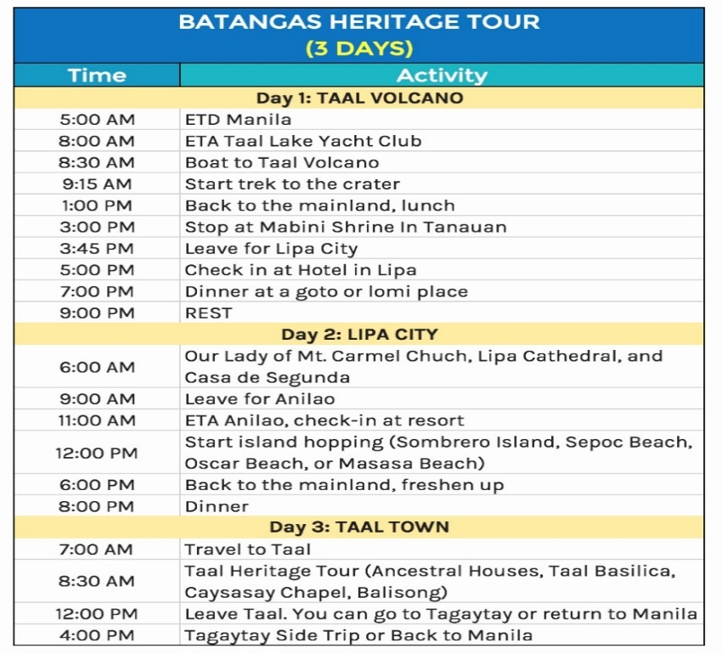
itinerary (n)
Schedule for travel
I just received the itinerary for my package tour to Bantagas.

Slide 6
target demographic (n)
a specific group of people that you want to include.
The company’s new product is aimed at their target demographic of young adults.

Slide 7
Helpful Phrases

Slide 8
How about going to (location)?
How about (your suggestion)?
What do you think about going to (location)?
When do you think we should (do something)?
What time do you think we should (do something?)
That’s a great idea but… how about/ what about..?

Slide 9
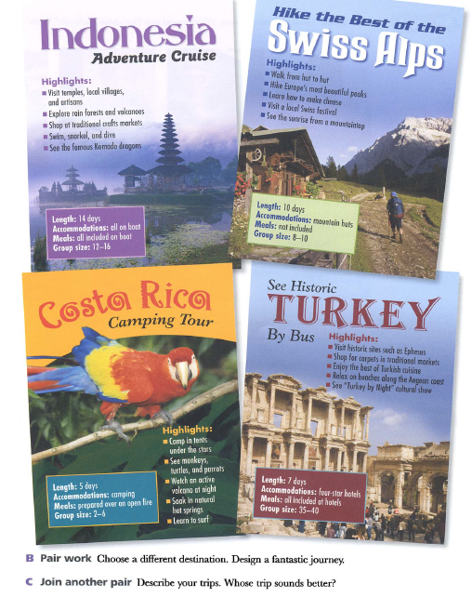
Design a tour
Your first job is to design a travel itinerary for a 3-day 2-night package tour for a country of your choice.

Slide 10
Your job
Design a plan for a country of your choice that none of your group members have visited.
Think about a daily plan
Where you will go
What you will do
Time for each activity
Transportation
Food
Hotel
Cost of your package (must be realistic)
Consider the traveller demographic you are targeting.
You want as many people to choose your trip as possible!

Slide 11
Example
Time | Day 1 | Day 2 | Day 3
8-9 am | Breakfast | Breakfast | Breakfast
10 pm | Arrive back at hotel

