Slide 1
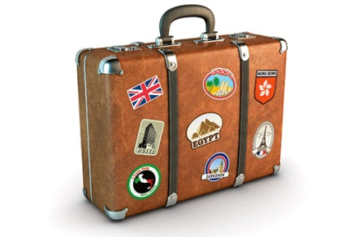
Travel and Tourism

Slide 2
What kind of traveler are you?

Slide 3
What do you like to do on vacation?
Page 66

Slide 4
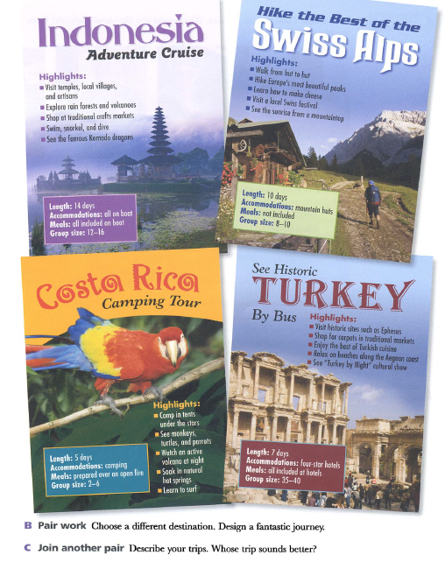
Design a tour
Page 67

