Slide 1
Translating Words and Lexemes
Examining the benefits and drawbacks

Slide 2
Benefits and Drawbacks
What are some of the benefits and drawbacks of translation when teaching the meaning of vocabulary items or lexis?

Slide 3
Key Points when translating
If used judiciously, it can aid language acquisition.
If used haphazardly, it can inhibit language acquisition.

Slide 4
When translating…
Use translation as a tool not as a habit.
Literal translation can be dangerous!

Slide 5
Some Rationale for Using L1
Korean English teachers are obligated to teach lesson content that is far above the students’ level of English comprehension.
Teachers have difficulty managing classes in English only.
Teachers are under time constraints to cover test content material.

Slide 6
Examining Common Classroom L1 Use

Slide 7
Common Ways Korean is Currently Used
Teacher translating text for students line by line as they read.
Directly translating words/ phrases.
Matching English words with Korean words.

Slide 8
Using L1 Effectively
Student Centered Rationale
Teacher Centered Rationale

Slide 9
Student Centered Rationale
Facilitating and aiding the comprehension of L2 that is extremely difficult or abstract.
Increasing deeper understanding through L1 explanation.
BE CAREFUL OF LITERAL TRANSLATION!!

Slide 10
Teacher Centered Rationale
Checking students understanding of difficult or abstract concepts (Atkinson, 1987)
Drawing attention to/emphasizing key points

Slide 11
The Dangers of Translation

Slide 12
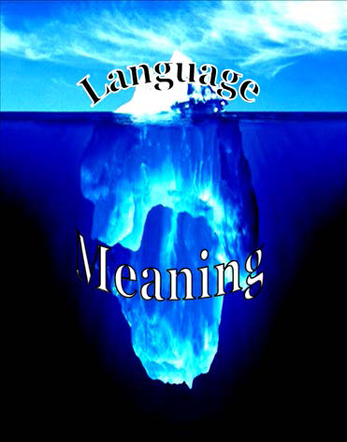
The Double Iceberg Model (Whitehead & Hwang, 2012)
English
Korean

Slide 13
Common Translation Process…
English
Korean
[1]
Language
Meaning in context

Slide 14
Thinking Process for Translation
English
Korean
Language
[2]
[3]
[3a]
Meaning in context
[1]
[2a]
[4. Same or Different?]

Slide 15
Word Meaning Relationships
Relationship | Definition
1:1 | The word or phrase meaning being translated from English has a perfect word or phrase match in Korean. English word + Meaning = Korean word + Meaning
Fake 1:1 | Type A Words appear to have 1:1 relationship; however, in context the meaning of the English word is not what it first appears. Therefore, the Korean translation/explanation must also reflect the meaning in context.
 | Type B On the surface, the words appear to have a perfect 1:1 relationship; however, slight differences exist in meaning. (Word meaning differs in different language and cultures.)
1:0 | English word and meaning has no direct match in Korean, and therefore, requires an explanation of meaning.

Slide 16
Steps to Effective L1
DO NOT translate word to word simply from memory or from an English to Korean dictionary! (GTM style) this can lead to inaccurate translation!
Find the English meaning of the word or phrase in the context you are teaching.
DO NOT teach multiple definitions. The context will give you the correct meaning to teach.
This is your starting point to effective translation.

Slide 17
Let’s Try
I ate a big apple.

Slide 18
1:1 Relationship English can be directly translated into Korean with no loss in meaning
big apple
큰사과

Slide 19
1:1 Translation
English
Korean
big apple
큰사과
Language
Meaning

Slide 20
Let’s Try
I went to the Big Apple.

Slide 21
Fake 1:1 Relationship 1.English can be directly translated but the meaning is inaccurate 2.It is possible to match the word indirectly to a word with the same meaning in Korean
big apple
뉴욕
큰사과
New York
New York

Slide 22
Fake 1:1 Translation
English
Korean
Fake 1:1 (Type A) Translation
There is a representative in the Korean language, but meaning is different. The translation/explanation must reflect the meaning in the context.
Big Apple
큰사과
Language
Meaning

Slide 23
Let’s Try
The boy ate some shepherd’s pie.

Slide 24
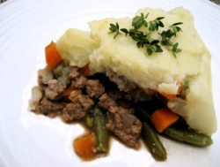
Fake 1:1 Relationship (Type A) 1.English can be directly translated but the meaning is inaccurate 2. Contextual meaning has no direct translation therefore explanation required
Shepherd’s Pie
양치기의 파이
???
고기에 그래비 소스를 섞고 매시트 감자를 위에 얹어 먹는 영국음식.

Slide 25
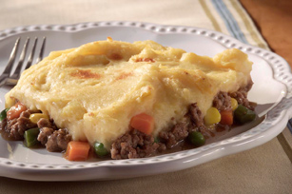
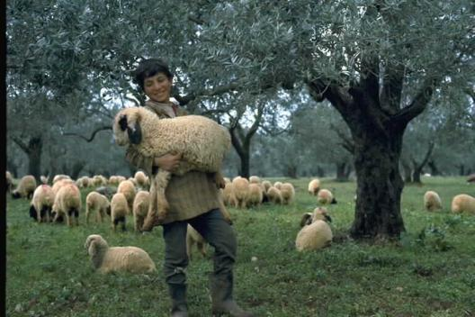
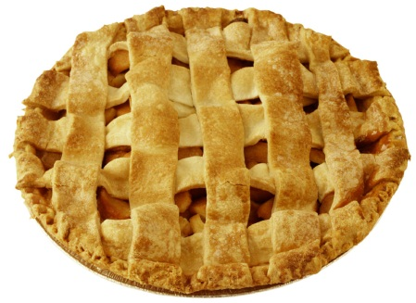
Fake 1:1 Translation
English
Korean
Fake 1:1 (Type A) Translation
There is a representative in the Korean language, but meaning is different. The translation/explanation must reflect the meaning in the context.
shepherd’s pie
양치기의 파이
Language
Meaning

Slide 26
Let’s Try
I love you~

Slide 27
Fake 1:1 Relationship (Type A) English word has a very close direct translation however slight meaning difference may exist.
사랑해
사랑해
I love you
사랑해
가족이나 친구들 사이에서 ‘I love you’를 습관적으로 쓰인다. 한국어로 무겁고 깊이가 있는 ‘사랑해’란 표현 비해 영어는 더 쉽게 자주 사용된다.

Slide 28
Fake 1:1 Translation
English
Korean
Fake 1:1 (Type B) Translation
On a language level, it seems to be a perfect match, however, languages hold different usage and meaning. In such cases, you have to give explanation to provide a full picture of the word/expression used.
I love you
난 너를 사랑해
Language
Meaning

Slide 29
Let’s Try
Xiaoming ate a poutine for lunch.

Slide 30
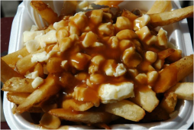
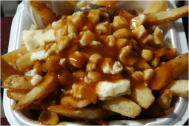
1:0 direct translation is not possible (no word or phrase match)
사랑해
사랑해
감자튀김에 그레이비 소스랑 치즈를 버무린 음식.
poutine
???

Slide 31
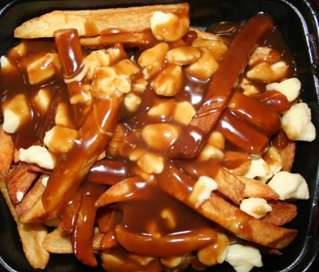
Fake 1:1 Translation
English
Korean
Fake 1:0 Translation
There is no direct match in Korean for the English word/phrase. In such case, you have to provide explanation to understand what it means and how it is used.
poutine
Language
Meaning

Slide 32
Thinking Time
The test was a piece of cake!
Shut Up! I can’t believe you won!!
The bag is heavy.
I saw a snail on the road. The car was driving so slow!
An old man sees a young boy (they have never met).. He says, “Come here son!”.
Hi pumpkin! How was your day?
I bought a kilt when I went to Scotland

Slide 33
Extra Practice
The coffee shop was crowded.
My friend launched his new clothing line last week.
She was paranoid about her parents finding out.
He injured his leg in the game.
She got cold feet before the wedding.
He was very masculine.

Slide 34
Steps to Effective L1
DO NOT translate word to word simply from memory or from an English to Korean dictionary! (GTM style) this can lead to inaccurate translation!
Find the English meaning of the word or phrase in the context you are teaching.
DO NOT teach multiple definitions. The context will give you the correct meaning to teach.
This is your starting point to effective translation.

Slide 35
Implications of the Model

Slide 36
Practice

Slide 37
Practice

Slide 38
Practice

Slide 39
Practice
Flies are very sensitive to the smell of meat. Many female flies like to lay their eggs on meat to provide food for their babies. During past wars when many people were wounded, it could take several days for all the injured soldiers to be found and taken to a doctor. Since the soldiers were lying outside, sometimes the doctors found maggots inside the wounds. After some time, the doctors noticed that the soldiers who had maggots in their wounds recovered faster than the soldiers who did not. They studied what was happening and discovered that the maggots only ate the dead flesh. Not only that, but the maggots produced a chemical called allantoin, which helped the wounds heal faster. Look at the ingredient lists of hand lotions and deodorants, toothpastes, and soaps. Do you have any allantoin in your house?

Slide 40
Practice

