Slide 1
transcribing

Slide 3
About transcribing
Is more detailed transcription always better? No. Qualitative research demands flexibility, and transcribers use what works for them and their audiences. (Tracy, 2012)
How they are constructed depends on the goals of the larger research project.

Slide 4
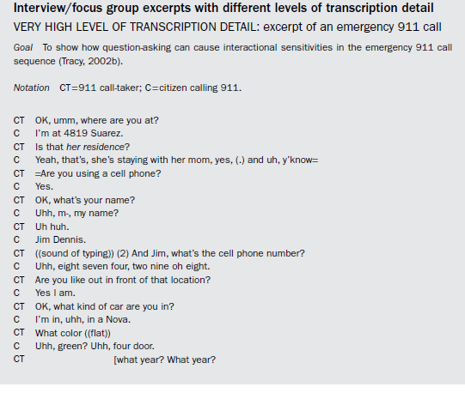

Slide 5
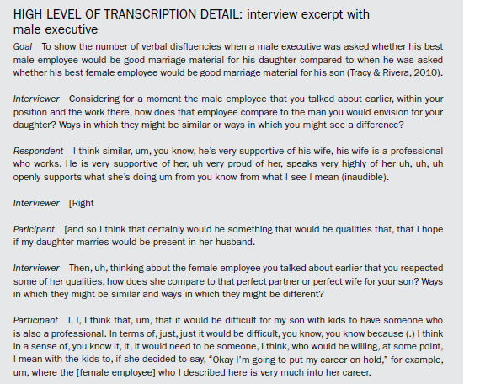

Slide 6
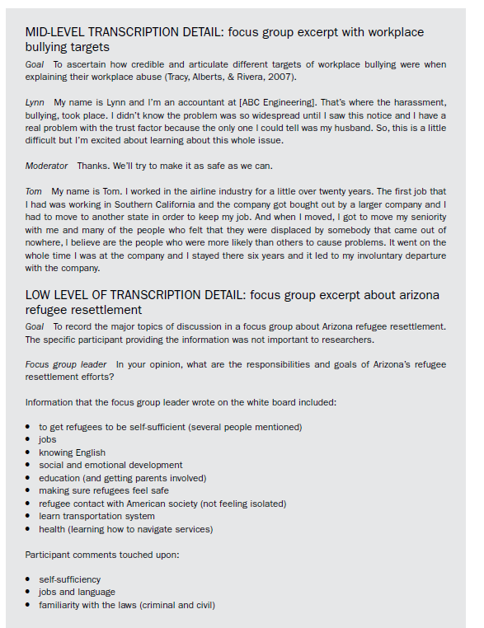
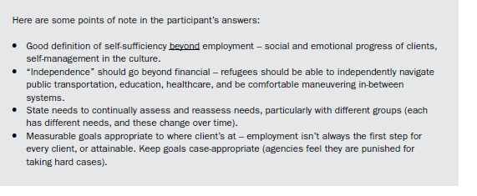

Slide 7
Let’s try transcribing one of our interviews
What level of detail is appropriate?
What details should we leave in and which are ok to leave out?
How can we ensure that our transcriptions are accurate?
Should we be objective or subjective?
Should we interpret what they are saying as we transcribe?

Slide 8
Tracy, S. J. (2012). Qualitative research methods: Collecting evidence, crafting analysis, communicating impact. John Wiley & Sons.

