Slide 1
transcribing

Slide 2
What do you know?

Slide 3
What is the purpose of transcribing?
Familiarize yourself with the data
Show rigor
Provides a written file to work from when coding

Slide 5
About transcribing
Is more detailed transcription always better? No. Qualitative research demands flexibility, and transcribers use what works for them and their audiences. (Tracy, 2012)
How they are constructed depends on the goals of the larger research project.

Slide 6
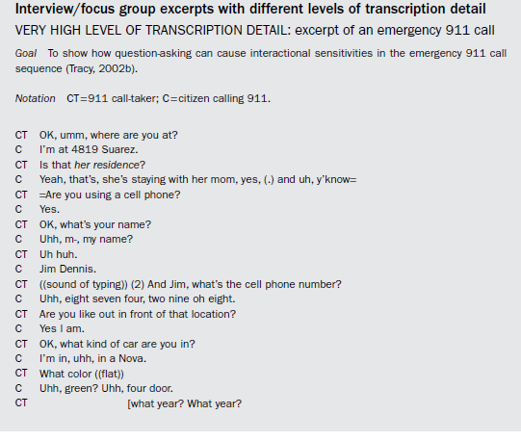
Focus on the language

Slide 7
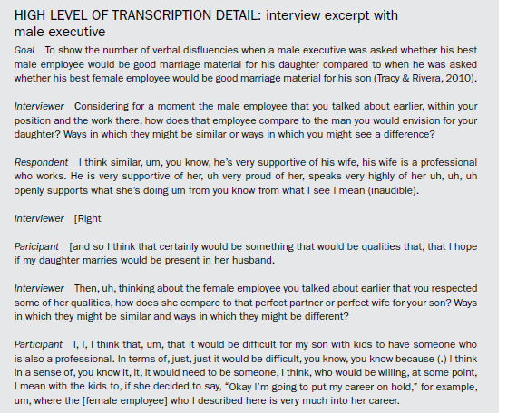
Focus on the content

Slide 8
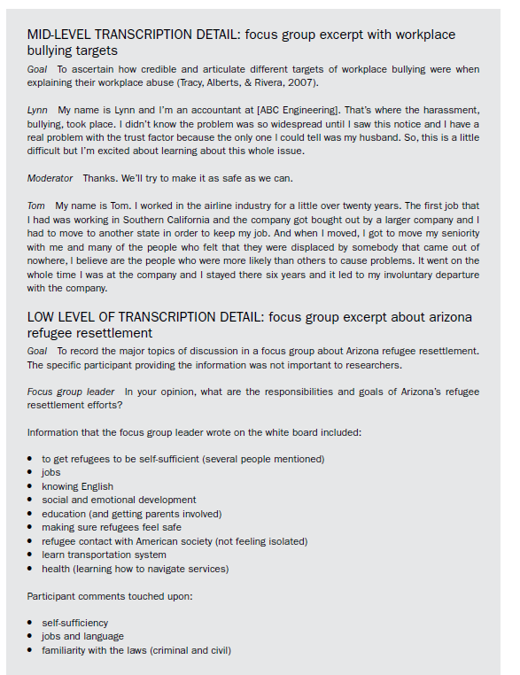
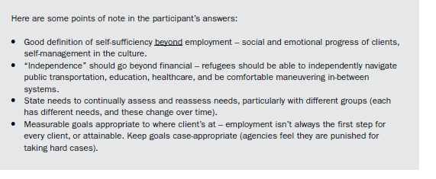
Focus on the Key points/ themes

Slide 9
Let’s try transcribing our interviews
What level of detail is appropriate?

Slide 10
Helpful Tool
OneDrive word
Otter.ai
Voice recorder apps
Google docs -> tools

Slide 11
Tracy, S. J. (2012). Qualitative research methods: Collecting evidence, crafting analysis, communicating impact. John Wiley & Sons.

