Slide 1
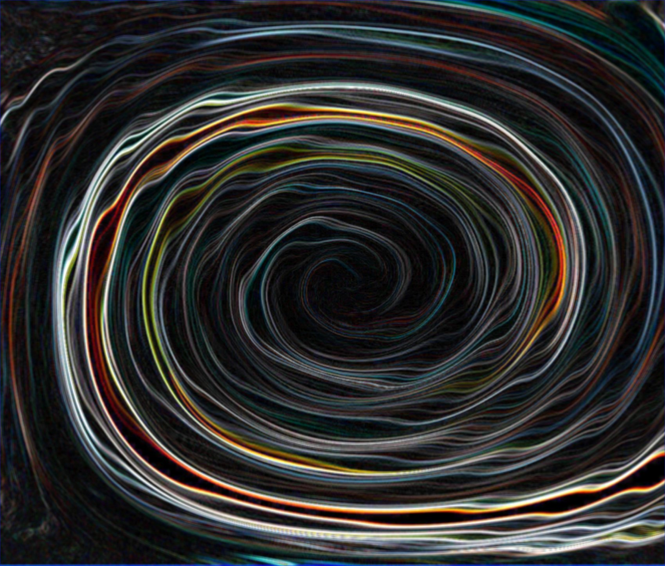
TIME
What is it?

Slide 2
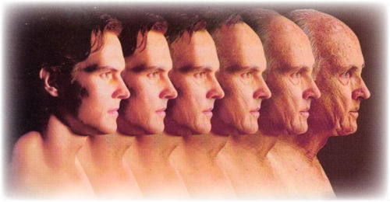
What is time?

Slide 3
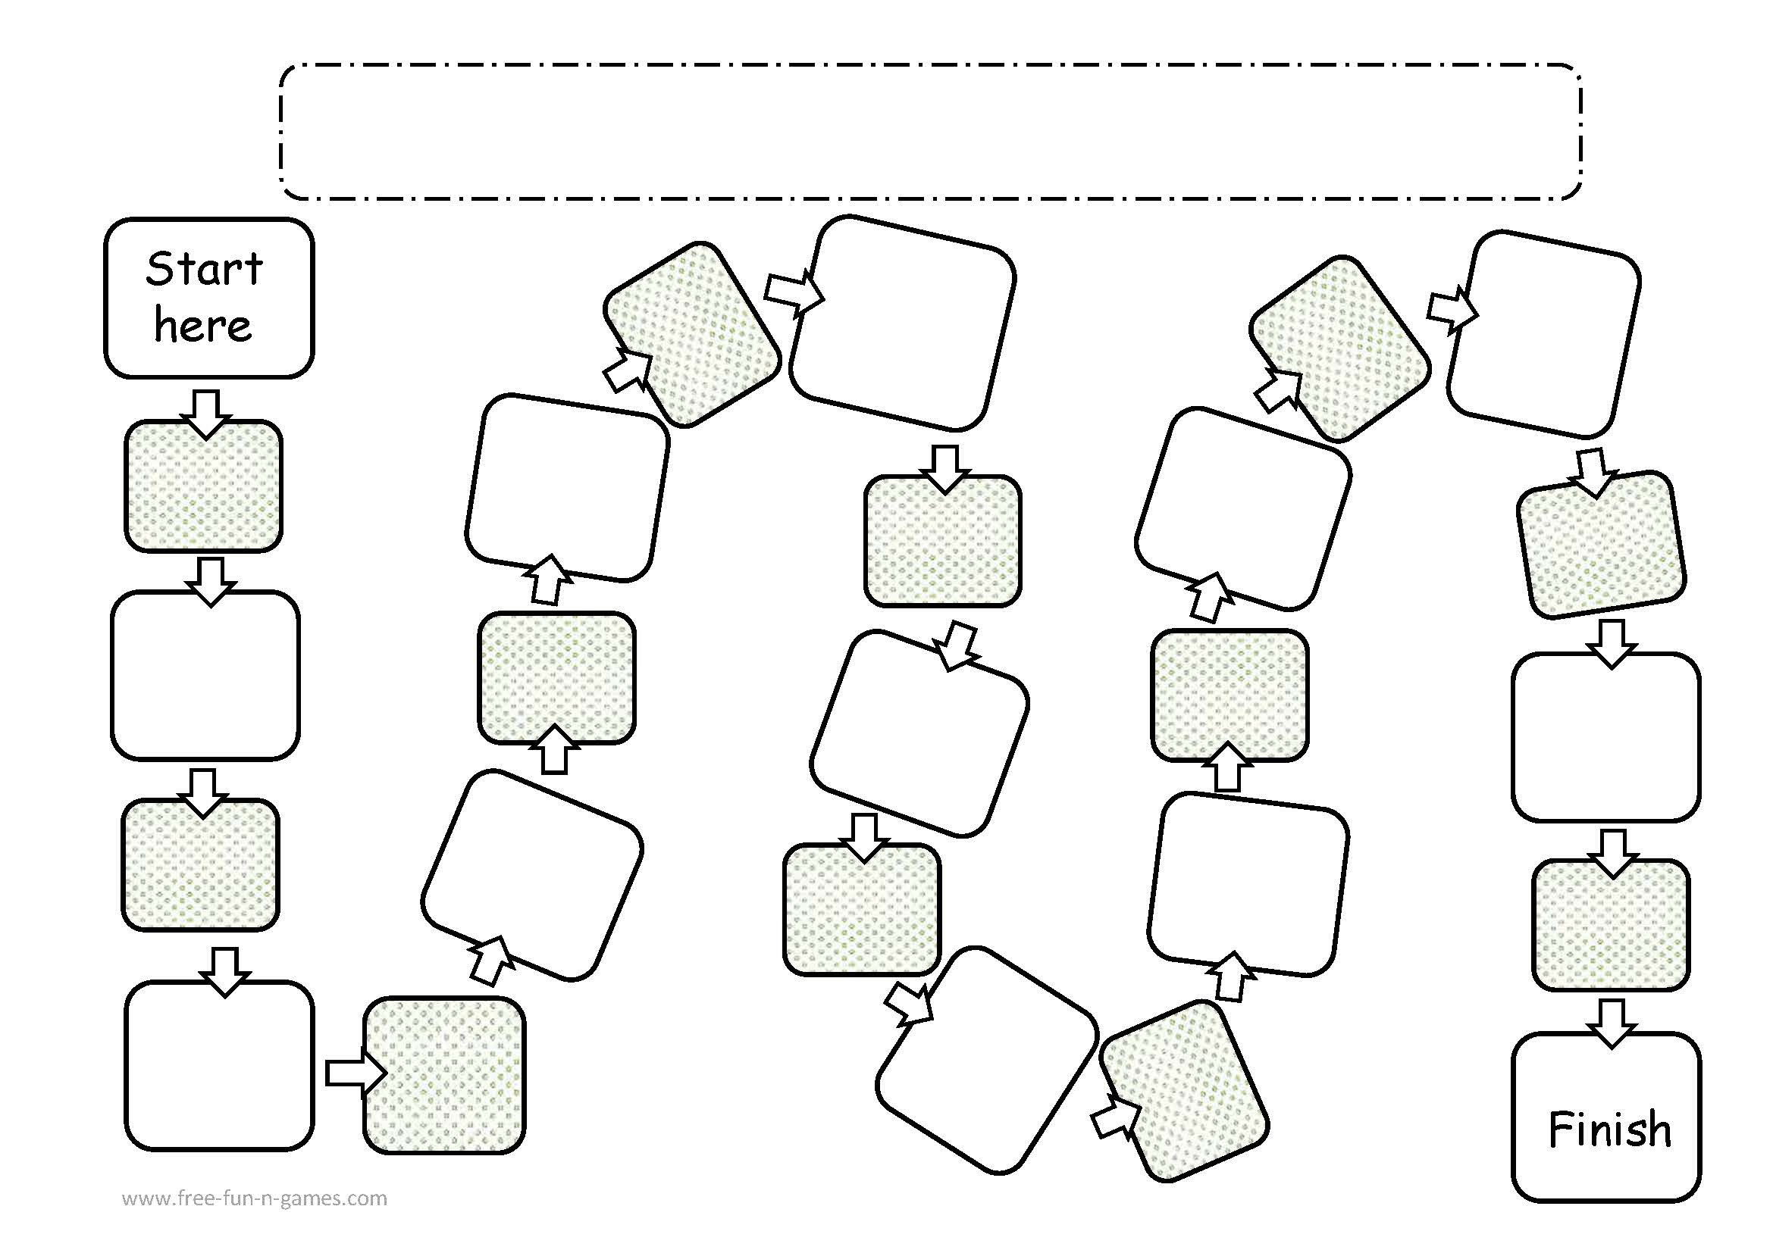
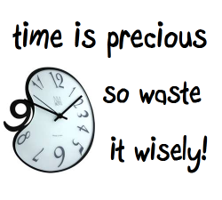
About Time
Fill in the blank
Time is _____!
If you could pause a time in your life, when would you do so? Why?
How would you define time?
If you had the power to control time, what would you do? Why?
I think most about the past/present/
future because…
What would you do if you have lots of free time and no responsibilities?
If you could travel in time when would you travel to ? Why?
When you have free time what do you usually do? Why?
FINISH
What is your favorite time of the day? Why?
Do you think it is important to be on time? Why or why not?
One good thing about time is… One bad thing about time is..
How much time do you spend doing things you don’t like? Why?
When do you feel time is going fast and when time goes slow? Why?
If you had more time in a day what would you do?

Slide 4
Discussion Board
If you had the power to stop time or pause it, would you? Why or why not?
At what point in your life would you have like time to have stopped, or sped up? Why?

Slide 5
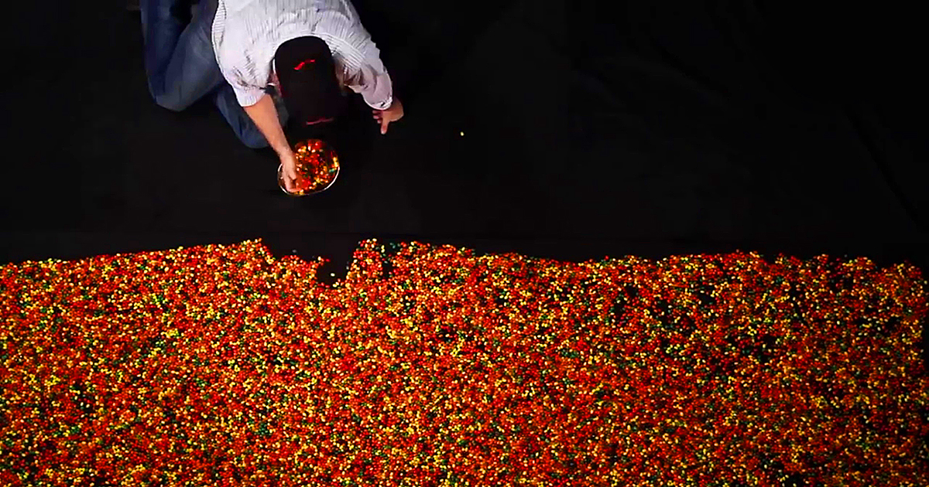
A Lifetime of Jelly Beans
28,835 jelly beans!

Slide 6
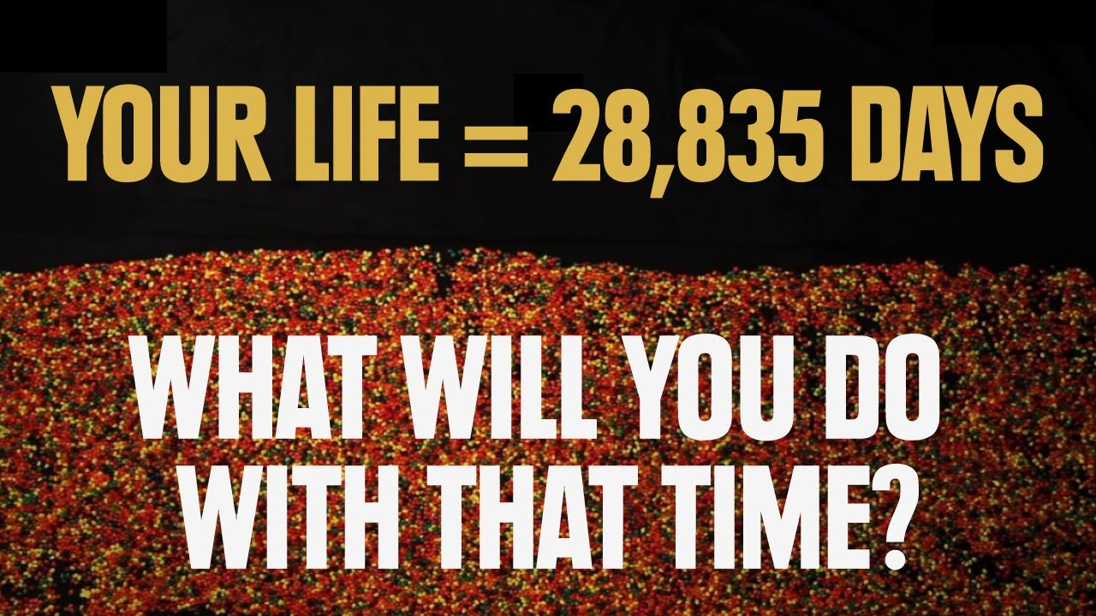
How did the video make you feel?

Slide 7
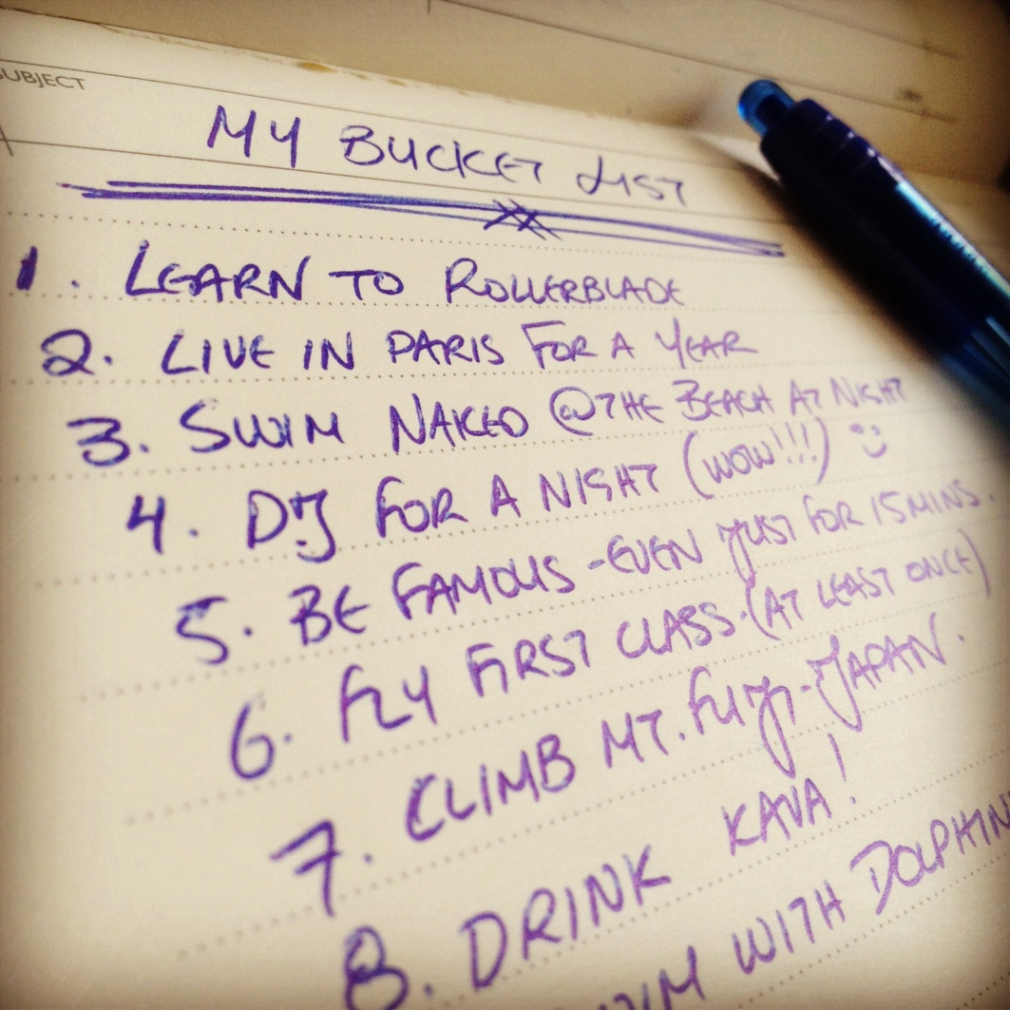
Bucket List
In your life, what are 10 things that you want to do.

Slide 8
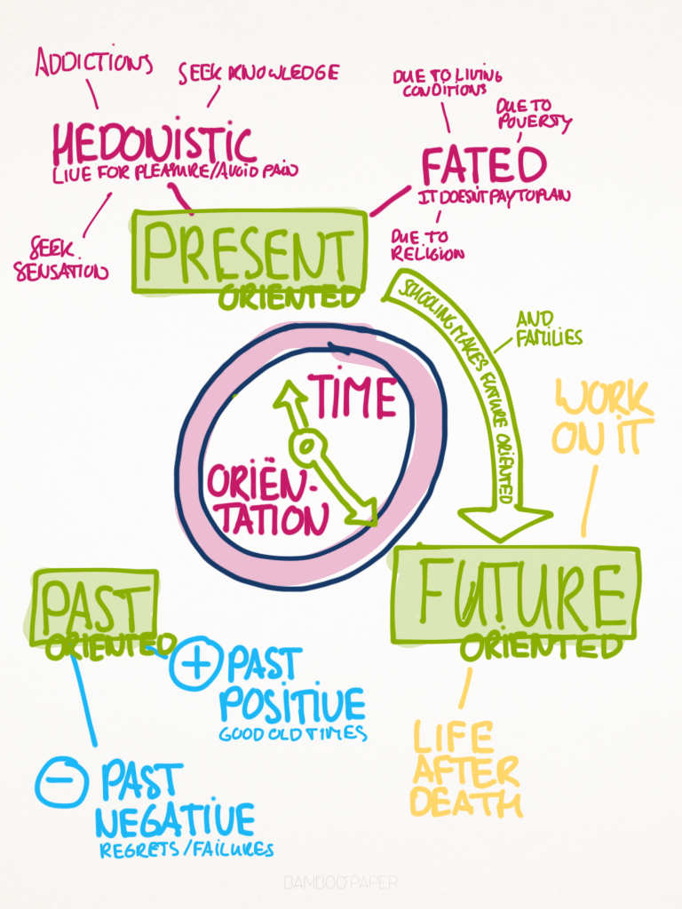
Time Perspectives

Slide 9
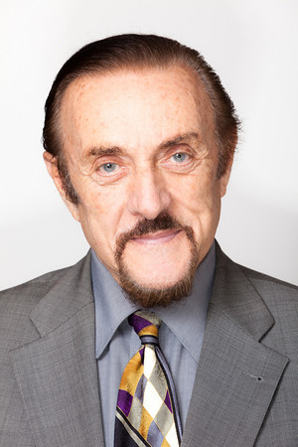
Philip Zimbardo
psychologist and a professor emeritus at Stanford University

Slide 10
What's Your Type?
The ‘past-negative’ type. You focus on negative personal experiences that still have the power to upset you. This can lead to feelings of bitterness and regret.
The ‘past-positive’ type. You take a nostalgic view of the past, and stay in very close contact with your family. You tend to have happy relationships, but the downside is a cautious, “better safe than sorry” approach which may hold you back.
The ‘present-hedonistic’ type. You are dominated by pleasure-seeking impulses, and are reluctant to postpone feeling good for the sake of greater gain later. You are popular but tend to have a less healthy lifestyle and take more risks.
The ‘present-fatalistic’ type. You aren’t enjoying the present but feel trapped in it, unable to change the inevitability of the future. This sense of powerlessness can lead to anxiety, depression and risk-taking.
The ‘future-focused’ type. You are highly ambitious, focused on goals, and big on making ‘to do’ lists. You tend to feel a nagging sense of urgency that can create stress for yourself and those around you. Your investment in the future can come at the cost of close relationships and recreation time.

Slide 11
The Marshmallow Test

Slide 12
Time Orientation
Studies have shown that Now/Future orientated individuals are more successful. (Zimbardo and Boyd, 2008; de Posada, 2009)

Slide 13
Planning for the Future
Think about the year 2025….
What do you hope your life will be like?
Where will you be living?
What will you be doing?
Who will you be with?

Slide 14
How can you achieve your future life?
What do you have to do to get there?
What’s your plan?

Slide 15
Writing a letter to your past and future
Write a letter to yourself when you were 12 years old. What would you tell yourself? What do you know now that would have helped you when you were younger?
Write a letter to your future self 10 years from now. What would you say to your future self? What do you want to know ?

Slide 16
SAMPLE
Dear George,
You have some very important but difficult years coming up. The next ten years will have some of the best times and worst times. The best piece of advice I can give you is to open your mind to the world. Understand differences, accept differences within others as well as within yourself. Work hard now because hard work pays off in the future. Know that no matter how difficult times may be, time heals everything. Give things time. Life is beautiful once you find the beauty in imperfection as much as in perfection. Find your passion and follow it with all your heart. Don’t let anyone beat you because they have worked harder than you. They should only be able to beat you if they are better than you not because they worked harder.

