Slide 1
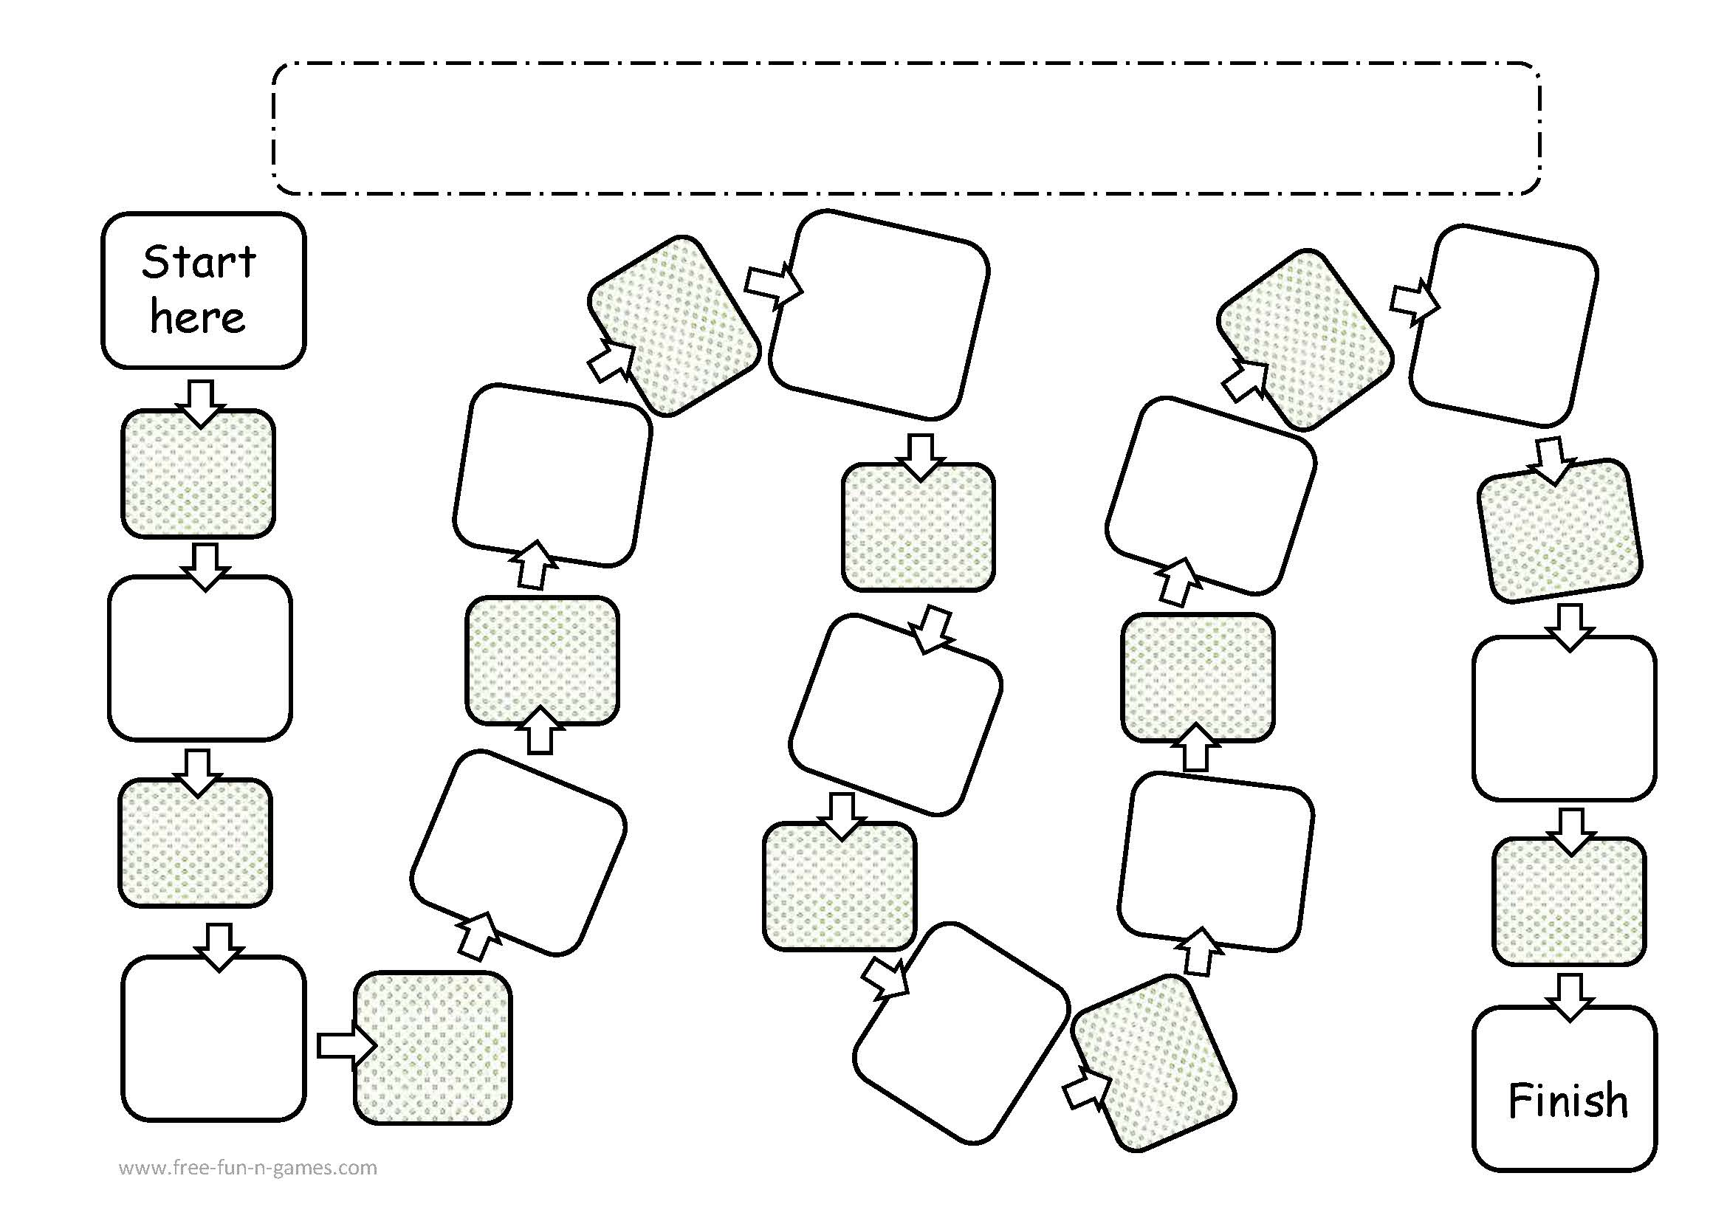
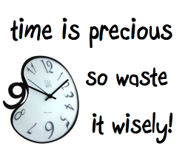
About Time
Fill in the blank
Time is _____!
If you could pause a time in your life, when would you do so? Why?
How would you define time?
If you had the power to control time, what would you do? Why?
I think most about the past/present/
future because…
What would you do if you have lots of free time and no responsibilities?
If you could travel in time when would you travel to ? Why?
When you have free time what do you usually do? Why?
FINISH
What is your favorite time of the day? Why?
Do you think it is important to be on time? Why or why not?
One good thing about time is… One bad thing about time is..
How much time do you spend doing things you don’t like? Why?
When do you feel time is going fast and when time goes slow? Why?
If you had more time in a day what would you do?

