Slide 1
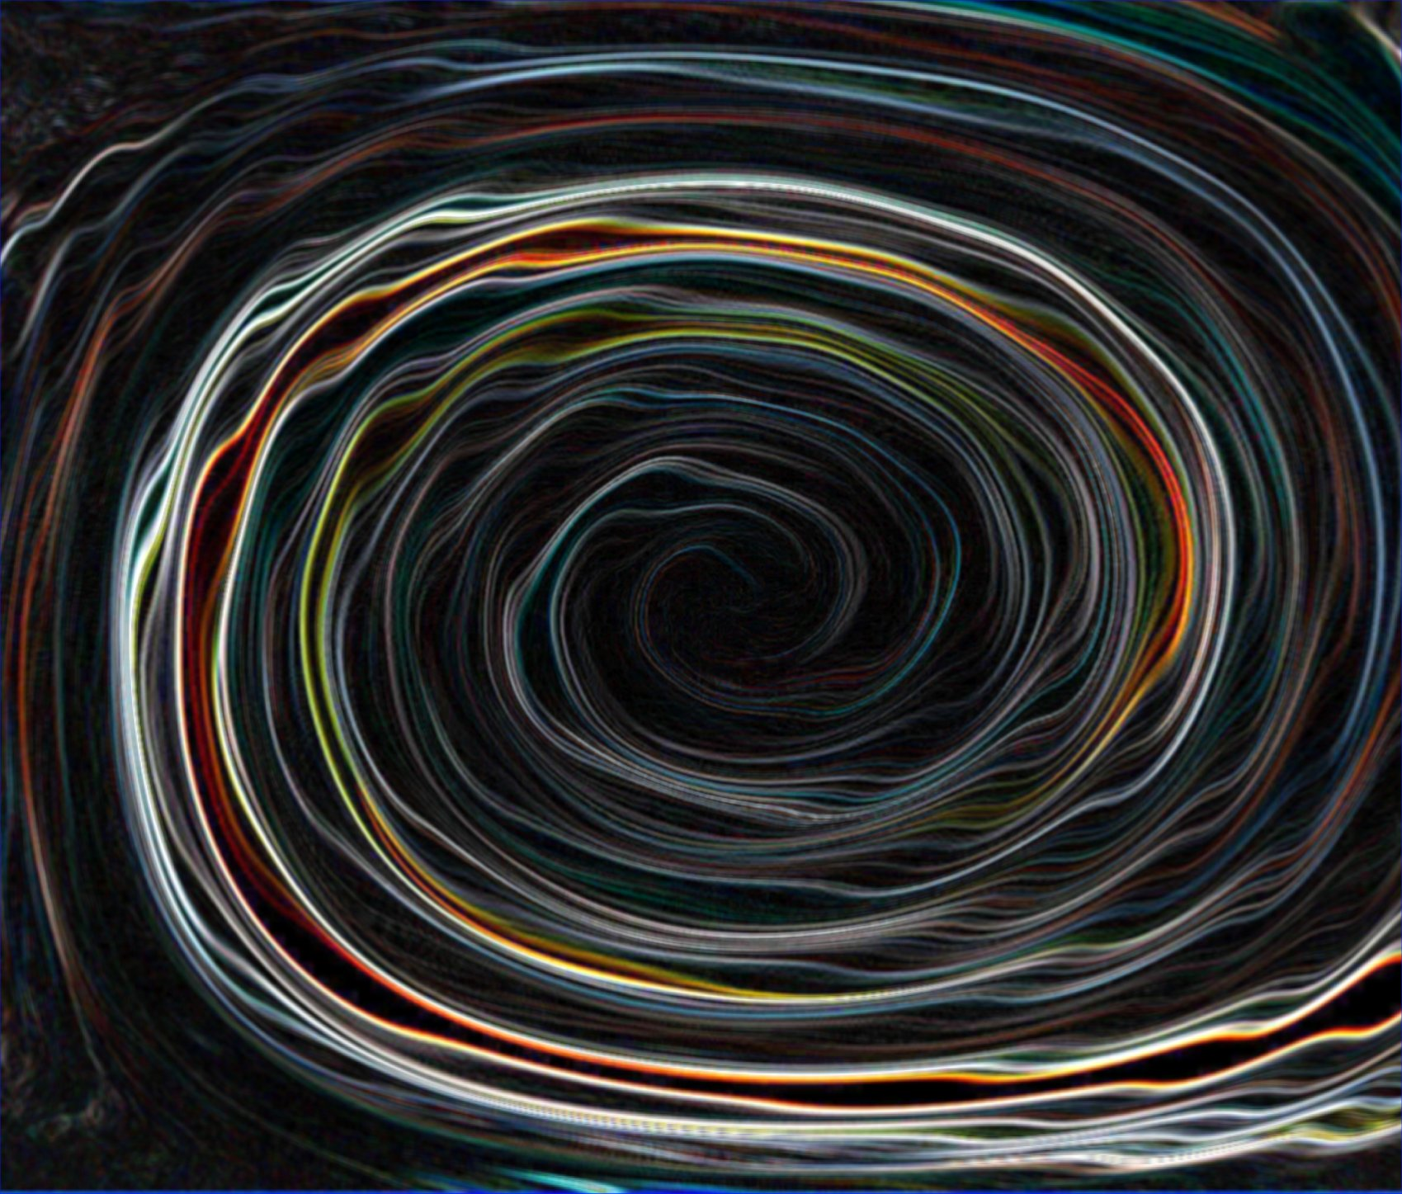
TIME
What is it?

Slide 2
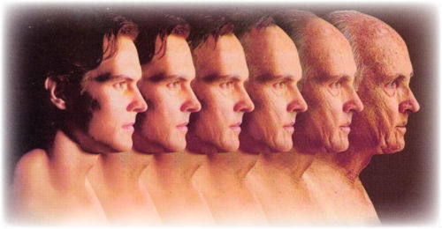
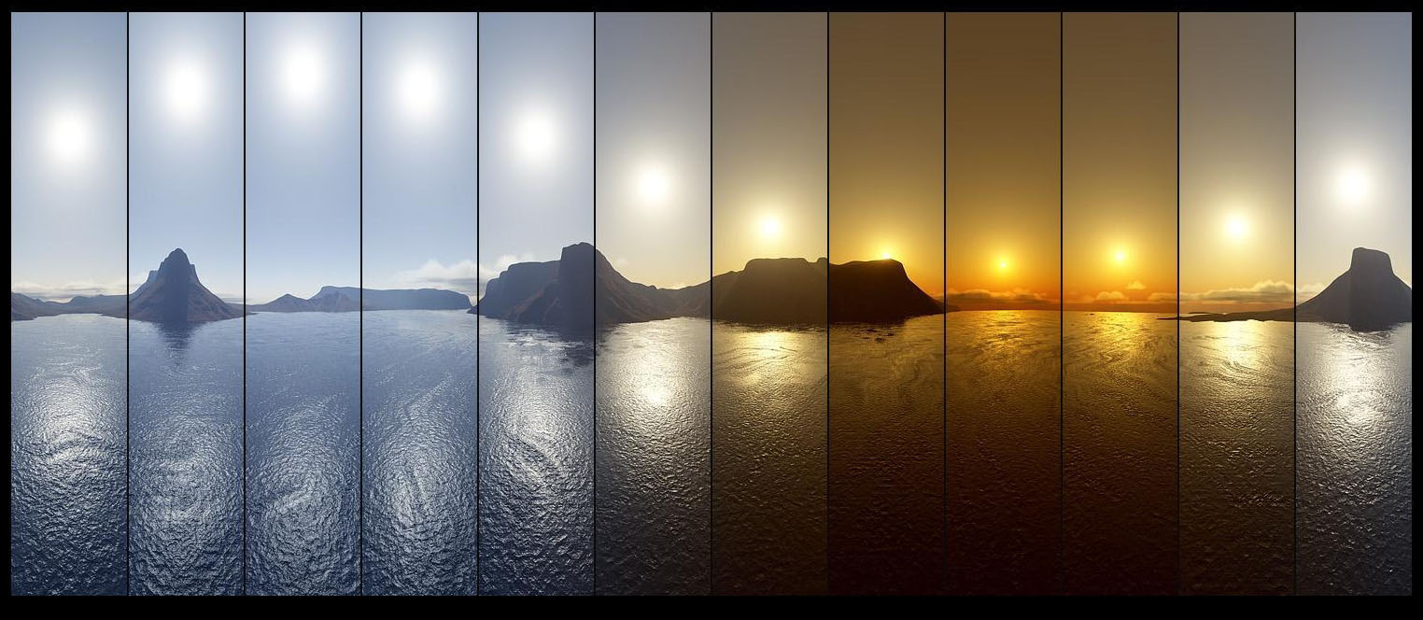
What is time?

Slide 3
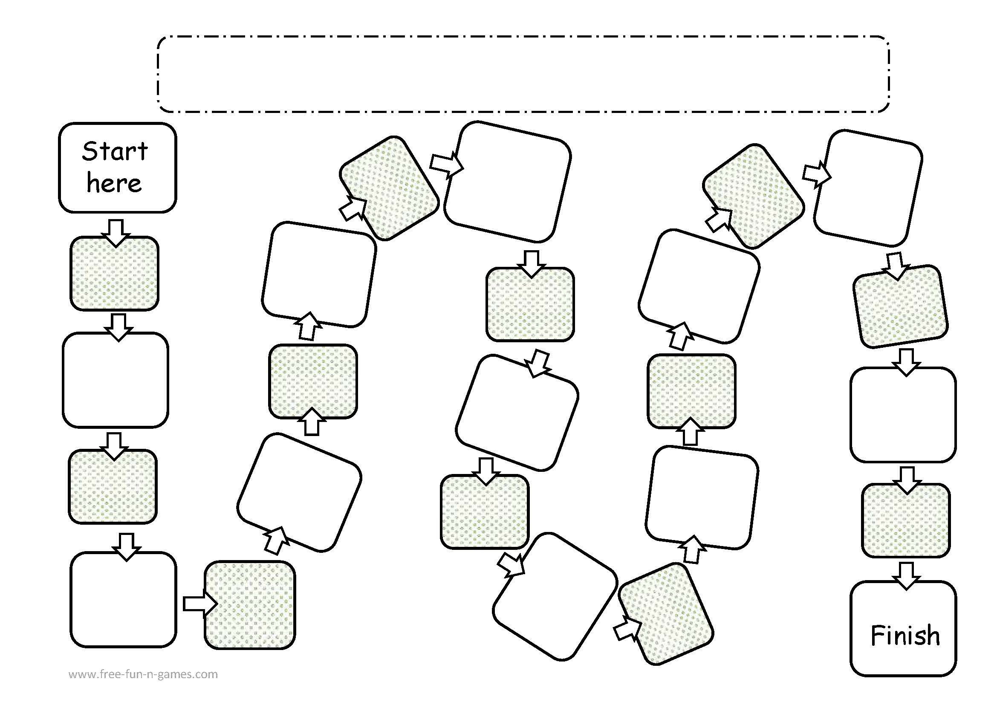
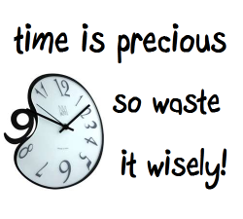
About Time
Fill in the blank
Time is _____!
If you could pause a time in your life, when would you do so? Why?
How would you define time?
If you had the power to control time, what would you do? Why?
I think most about the past/present/
future because…
What would you do if you have lots of free time and no responsibilities?
If you could travel in time when would you travel to ? Why?
When you have free time what do you usually do? Why?
FINISH
What is your favorite time of the day? Why?
Do you think it is important to be on time? Why or why not?
One good thing about time is… One bad thing about time is..
How much time do you spend doing things you don’t like? Why?
When do you feel time is going fast and when time goes slow? Why?
If you had more time in a day what would you do?

Slide 4
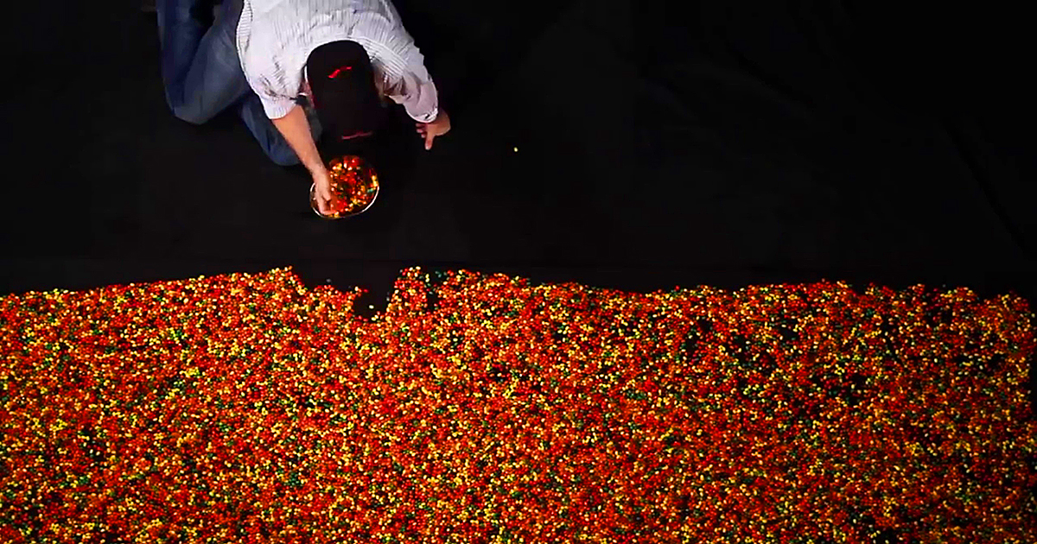
A Lifetime of Jelly Beans
28,835 jelly beans!

Slide 5
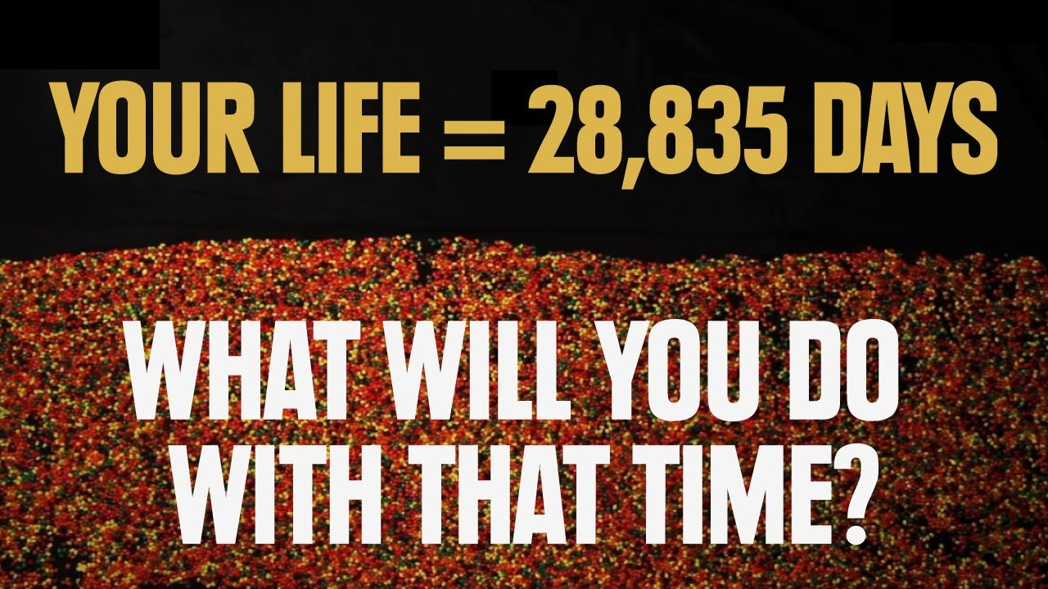
How did the video make you feel?

Slide 6
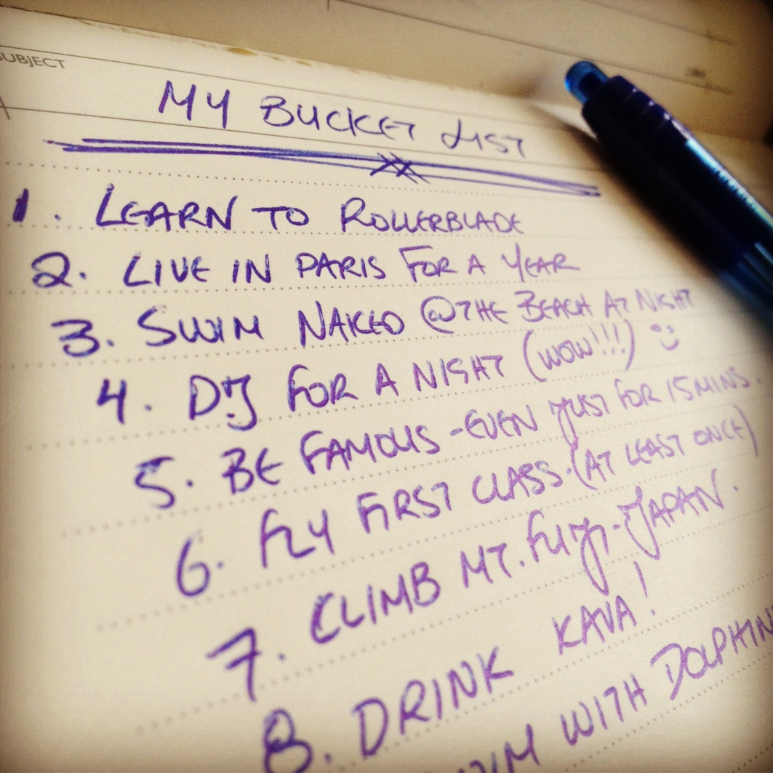
Bucket List
In your life, what are 10 things that you want to do.

Slide 7
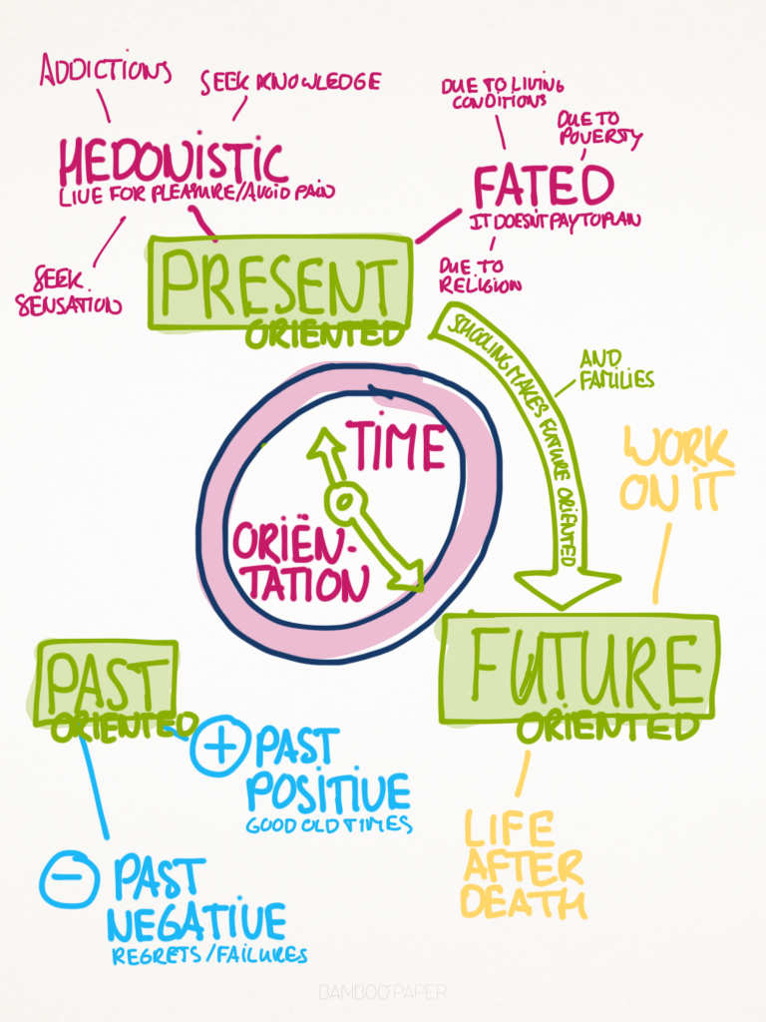
Time Perspectives

Slide 8
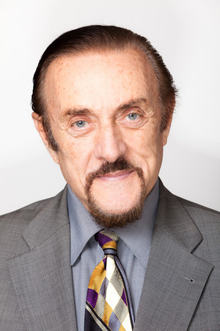
Philip Zimbardo
psychologist and a professor emeritus at Stanford University

Slide 9
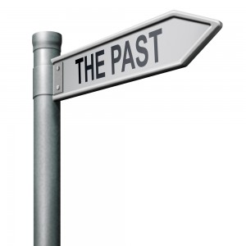
What's Your Type?
The ‘past-negative’ type. You focus on negative personal experiences that still have the power to upset you. This can lead to feelings of bitterness and regret.
The ‘past-positive’ type. You take a nostalgic view of the past, and stay in very close contact with your family. You tend to have happy relationships, but the downside is a cautious, “better safe than sorry” approach which may hold you back.

Slide 10
The ‘present-hedonistic’ type. You are dominated by pleasure-seeking impulses, and are reluctant to postpone feeling good for the sake of greater gain later. You are popular but tend to have a less healthy lifestyle and take more risks.
The ‘present-fatalistic’ type. You aren’t enjoying the present but feel trapped in it, unable to change the inevitability of the future. This sense of powerlessness can lead to anxiety, depression and risk-taking.

Slide 11
The ‘future-focused’ type. You are highly ambitious, focused on goals, and big on making ‘to do’ lists. You tend to feel a nagging sense of urgency that can create stress for yourself and those around you. Your investment in the future can come at the cost of close relationships and recreation time.

Slide 12
The Marshmallow Test

Slide 13
Time Orientation
Studies have shown that Now/Future orientated individuals are more successful. (Zimbardo and Boyd, 2008; de Posada, 2009)

Slide 14
If time travel were possible, which period of world history would you like to return to? Why?
How far into the future would you like to travel? What do you hope to see?
On your time travels, you can take five objects to show people what life is like towards the end of the 20th century. What five objects would you take? Why?
Which famous person from the past would you most like to meet? Why?
What would you ask this person?
How would you spend the time with this person?

