Slide 1
The World of Social Media

Slide 2
Common Social Media Platforms

Slide 3
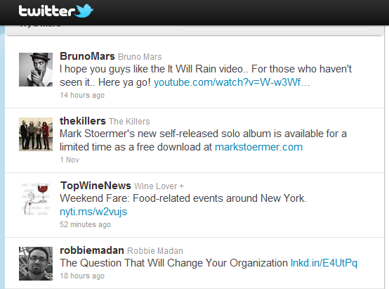
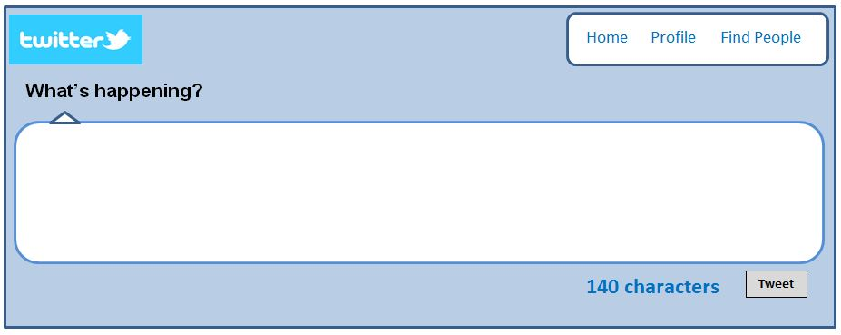
What is twitter?

Slide 4
Twitter
Twitter is microblogging. Twitter, and 'tweeting', is about broadcasting daily short burst messages to the world, with the hope that your messages are useful and interesting to someone.
Twitter is also about discovering interesting people online, and following their burst messages for as long as they are interesting.

Slide 5
Hashtags #howtousehashtags
Definition: The # symbol, called a hashtag, is used to mark keywords or topics in a Tweet.
It was created organically by Twitter users as a way to categorize messages.
Clicking on a hashtagged word in any message shows you all other Tweets marked with that keyword.
Example: I just watched the movie #Fastastic 4!
Using hashtags correctly:
If you Tweet with a hashtag on a public account, anyone who does a search for that hashtag may find your Tweet

Slide 6
Using @name
What is a reply?
A reply is a response to another user's Tweet that begins with the @username of the person you're replying to. You can reply by clicking the Reply button on a Tweet.
Any Tweet that is a reply to you begins with your @username and will show up in your Notifications tab.
When a Tweet starts with a @username, the only users who will see it in their timeline (other than the sender and the recipient) are those who follow both the sender and the recipient.
What is a mention?
A mention is a Tweet that contains another user’s @username anywhere in the body of the Tweet.
If you include multiple @usernames in your Tweet, all of those people will see your Tweet in their Notifications tab.

Slide 7
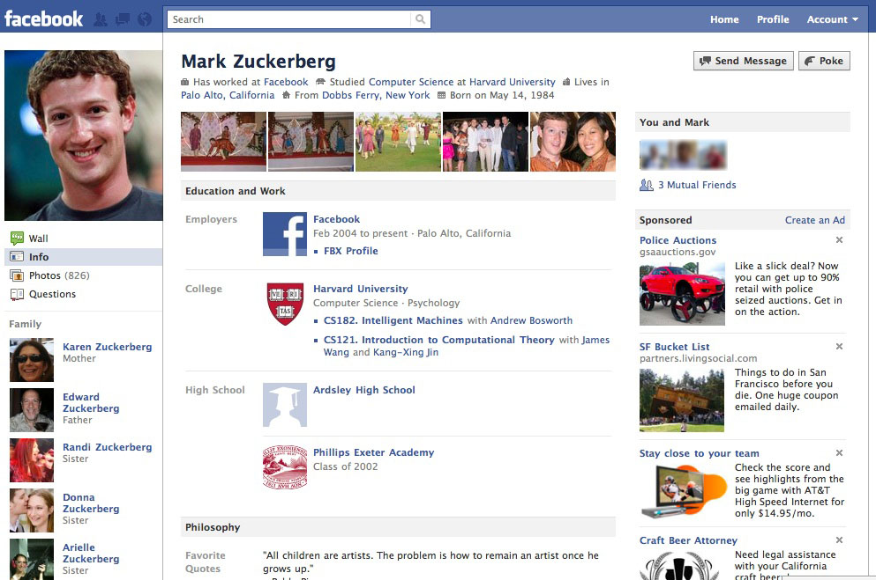
Facebook

Slide 8
Today’s Task
Sign up
See how to make a group
Join the class group

