Slide 1
THE UNBORN CHILD
The choices of childbirth

Slide 2
Responsibilities
What is the proper age to have children?
How would you feel if you found out you were going to have a child?

Slide 3
When should people have children?
People should have children when….
People should not have children when….

Slide 4
Mali’s Dilemma

Slide 5
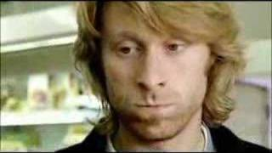
The Options
What options does she have?
What is the best way to avoid Mali’s situation?

Slide 6
Scenarios

Slide 7
Caring for a baby
A baby should sleep on its
Back
Side
Stomach
At what temperature is a baby’s fever extremely dangerous?
35 degrees celsius
45 degrees celsius
40 degrees celsius
Before picking up a newborn baby you should always do what?
When wiping a baby’s bottom you should wipe
Back to front
Front to back
Both are fine
Which sound is the best to soothe a crying baby?
A mother’s singing
A soft lullaby
White noise
When do babies start to walk?
6 months
10 months
1 year
2 years
When a newborn baby cries it could mean which of the following things?
Hungry, diaper, sick, tired
Grumpy, tired, bored, attention
Angry, sick, hungry, tired
A newborn baby needs to be fed
5 times a day
7 times a day
8 times a day
10 times a day
What should be in a babies crib?
Lots of toys
Stuffed animals and a blanket
Just a sheet and a baby blanket
After your baby eats you should
Put them to sleep
Change their diaper
Burp them
Play with them
What is one of the most important developmental activities for babies?
Reading to them
Letting them play with your phone
Listening to music
When In a car a baby should be
Held by the mother or father
Sitting with a seatbelt on
In a baby car seat belted in

Slide 8
Question 1
A baby should sleep on its
Back
Side
Stomach

Slide 9
Question 2
At what temperature is a baby’s fever extremely dangerous?
35 degrees celsius
45 degrees celsius
40 degrees celsius

Slide 10
Question 3
Before picking up a newborn baby you should always do what?

Slide 11
Question 4
When wiping a baby’s bottom you should wipe
Back to front
Front to back
Both are fine

Slide 12
Question 5
Which sound is the best to soothe a crying baby?
A mother’s singing
A soft lullaby
White noise

Slide 13
Question 6
When do babies start to walk?
6 months
10 months
1 year
2 years

Slide 14
Question 7
When a newborn baby cries it could mean which of the following things?
Hungry, diaper, sick, tired
Grumpy, tired, bored, attention
Angry, sick, hungry, tired

Slide 15
Question 8
A newborn baby needs to be fed
5 times a day
7 times a day
8 times a day
10 times a day

Slide 16
Question 9
What should be in a babies crib?
Lots of toys
Stuffed animals and a blanket
Just a sheet and a baby blanket

Slide 17
Question 10
After your baby eats you should
Put them to sleep
Change their diaper
Burp them
Play with them

Slide 18
Question 11
What is one of the most important developmental activities for babies?
Reading to them
Letting them play with your phone
Listening to music

Slide 19
Question 12
When In a car a baby should be
Held by the mother or father
Sitting with a seatbelt on
In a baby car seat belted in

Slide 20
Bonus Question
A baby should be put to bed before?
10 pm
7 pm
9 pm
8 pm

Slide 21
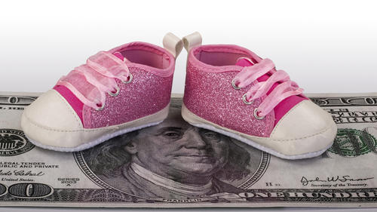
Childcare Reality

