Slide 1
The Road to Success

Slide 2
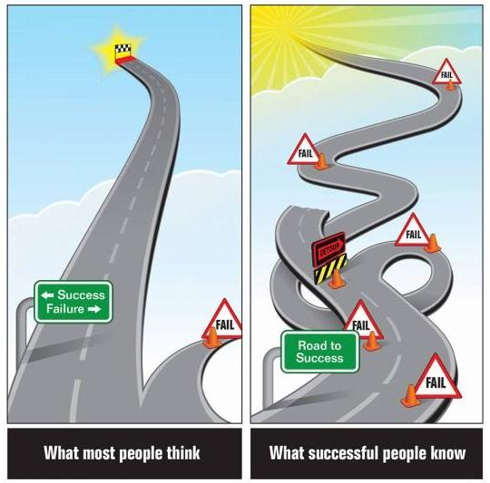
The Road to Success

Slide 3
Success
What is success?
What makes someone successful?
Write down as many characteristics of success as possible.

Slide 4
Who is the most successful?
Beethoven
Michael Jordan
Bill Gates
Steve Jobs
Picasso
Einstein
Mother Teresa
Walt Disney

Slide 5
What do they have in common?
Beethoven
Michael Jordan
Bill Gates
Steve Jobs
Picasso
Einstein
Mother Teresa
Walt Disney

Slide 6
The 8 Traits Successful People Have in Common…

Slide 7
Successful Habits

Slide 8
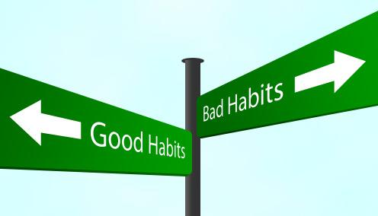
Future Changes
What are 5 things that you can work on or change in order to develop better habits for success?

Slide 10
Likeonomics
The most likeable people, ideas and organizations are the ones we believe in and buy from.

Slide 11
Likability Factors Tim Sanders- The Likeability Factor
Honesty
Being humble
Empathy
Sense of humor
Positivity
Politeness
Control of hostility
?
https://www.hrtoolbox.nl/xquestion/pid/14329

Slide 13
