Slide 1
The poster

Slide 2
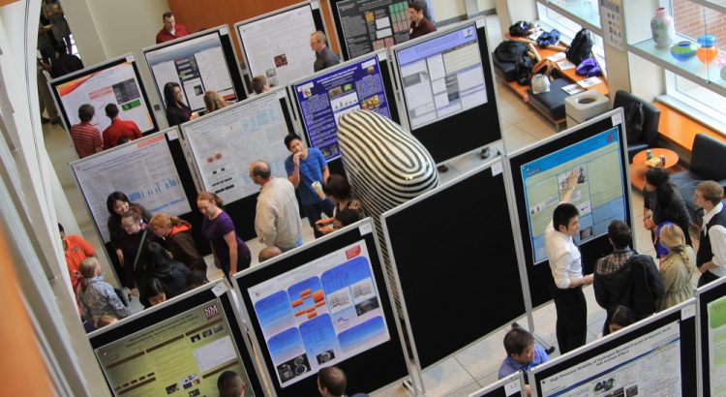
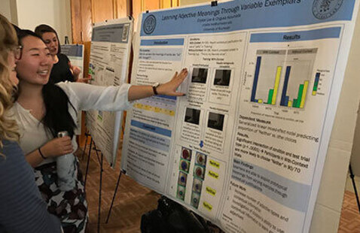
Poster Presentation Setting

Slide 3
Why a poster presentation?
Good place to start if you are nervous about public speaking
Low-stakes
Allows you to personally interact with people who are interested in your topic
Can be viewed any time at a conference

Slide 4
What do you do?
Set-up your poster
Stand by the poster
Discuss your poster and work with people who visit
Answer questions and get feedback from the visitors

Slide 5
Getting started
What are some things you need to consider when planning a poster?
Audience – who is your intended/ expected audience
Style – create on the computer, create by cut-outs, create by drawing
Materials – what materials do you need to complete it?
Content – what content do you want to include?

Slide 6
What are some things you need to consider when making the poster?
Appeal – Organization, Clarity, Color
Text – appropriate for the situation (I suggest Times Roman), large enough to read
Graphics – attractive, large enough, clear

Slide 7
Assessing your poster
Can you find relevant information easily?
Is the text legible (font, size, colour and spacing)?
Is there too much/little data?
Are the key graphics large enough to be seen from 3 meters away?
Are the graphics attractive, relevant and appropriate?
Would you stop to look at this poster at a poster session?
Is the title short and attention grabbing?
Is the subject matter clear?
Is the layout visually appealing and does it guide the audience?
Is the poster well organised?
Is the poster easy to scan-read?

Slide 8
Assessing posters

Slide 9
Assessing sample posters

Slide 11
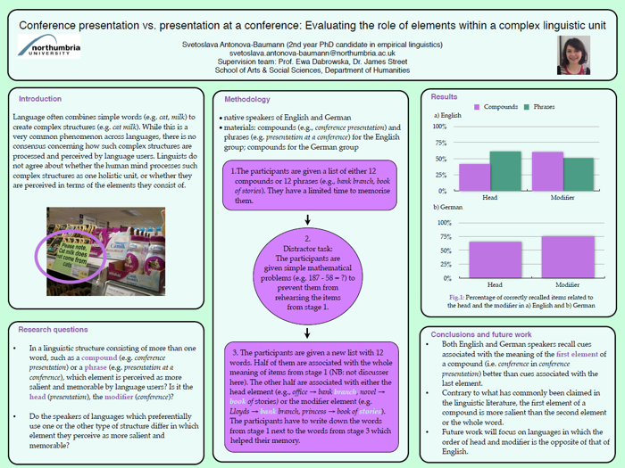

Slide 13
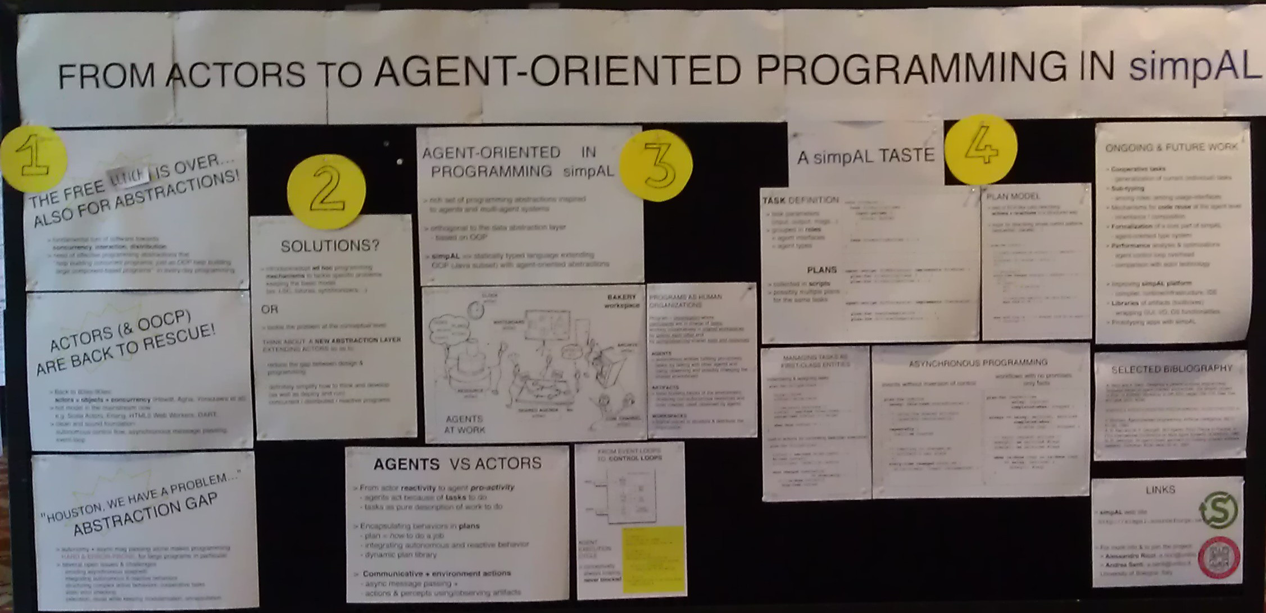

Slide 15
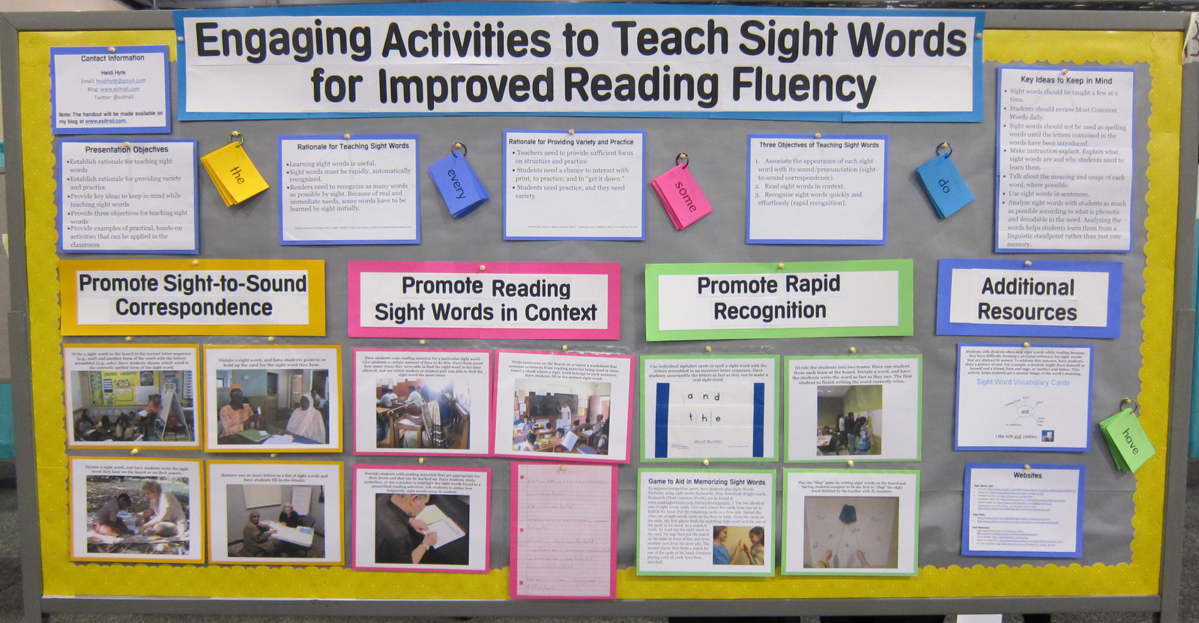

Slide 17
Your Task
Take an article of your choice
Pretend that you were the one who did the study (just for practice)
Create a poster for it based on the relevant information
Use can use a template of your choice

Slide 18
Poster presentation templates
https://www.posterpresentations.com/html/free_poster_templates.html
https://www.genigraphics.com/templates
https://templates.office.com/en-us/Posters

Slide 19
What are some things you have to consider when presenting the poster?
Dressing for the occasion
Not shying away from visitors
Clearly presenting what is there
Monitoring the participants to make sure they understand
Allowing participants to ask questions
Giving visitors your contact information (business cards, handout etc.)

