Slide 1
The Nature of Research
Epistemological and ontological views

Slide 2

Scientific Research

Slide 3
Scientific Research
Consists of an investigation that:
seeks answers to a question
systematically uses a predefined set of procedures to answer the question
collects evidence
produces findings that were not determined in advance
produces findings that may be applicable beyond the immediate boundaries of the study

Slide 4
What do you think?
Not everything that counts can be counted, and not everything that can be counted counts.
~William Bruce Cameron

Slide 5
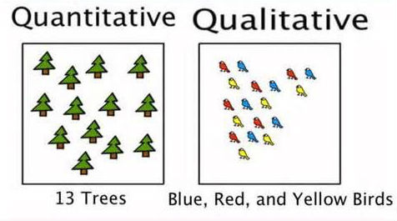


Slide 6
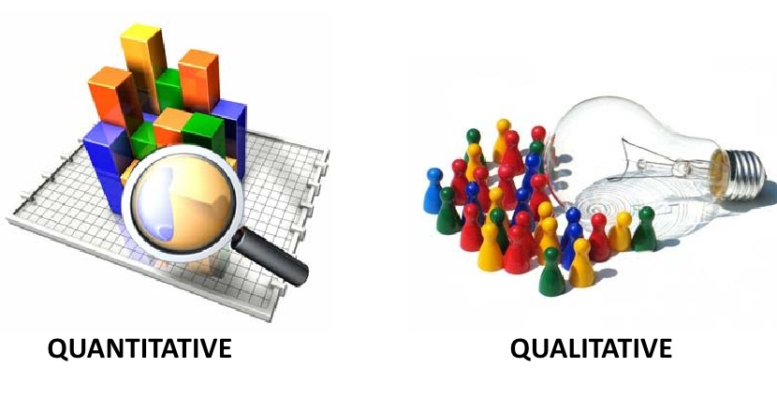
Quantitative vs Qualitative Similarities
Research questions are addressed through some form of inquiry.
Seek to build knowledge about the objects under investigation.
Follow field accepted methods and processes.
Collect and analyze data.
Present outcomes/ implications.

Slide 7
What are some of the differences between quantitative and qualitative research?
With your group write down as many things as you can think of.
Quantitative | Qualitative

Slide 8
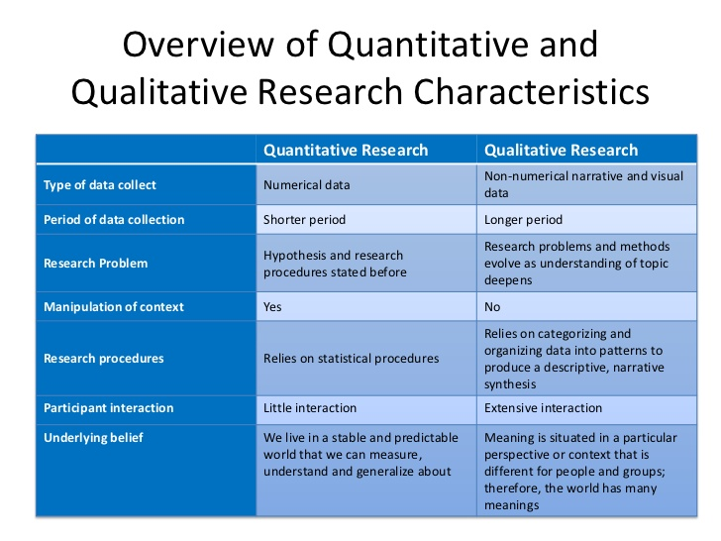
Quantitative vs Qualitative Differences

Slide 9
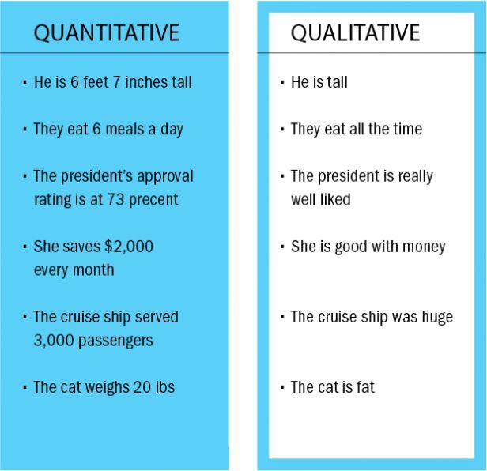

Slide 10
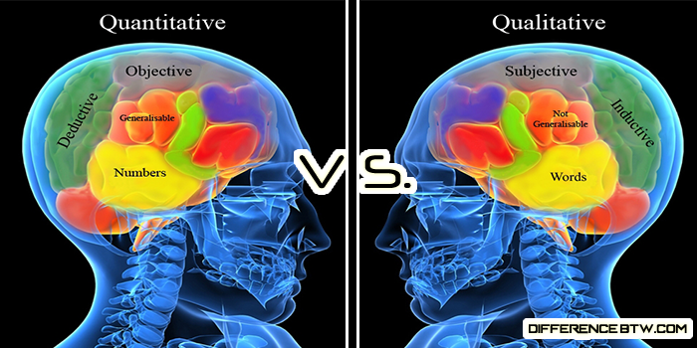

Slide 11
Characteristics of Qualitative Research
Open inquiry
Inductive
Descriptive
Interpretive
Multiple perspectives
Cyclic
Context specific

Slide 12
When not to use Qualitative
When numbers are needed to make a decision (what proportion of people )
Results are to be projected to the total population
When to use Qualitative
To identify the important problem to be solved at community/ local/ policy levels
To inform what people are doing, thinking, and saying about a problem
Generate a list of options for interventions
To investigate how best to implement promising interventions

Slide 13
Mixed Methods
Quantitative & Qualitative

Slide 14
Combining qualitative & quantitative methods
Advantages of each complement the other, resulting in a stronger research design, and more valid and reliable findings.
Inadequacies of individual methods are minimized
The what can also be supported with the why
Offers a balance between logic and stories
What are the qualities of a good teacher?
Place a check by all the qualities you agree with.
Humor
Teaching style
Passion
Knowledgeable
Good looking
Other________

Slide 15
?Qualitative before quantitative#
Qualitative techniques can be used to provide much needed information when exploring new areas
Can give you a general idea of the topic you are exploring and the issues that exist
Can be used to gather information that can be used to create a survey or other follow up data collection procedures.
Use of qualitative method to check assumptions & refine research questions is valuable across & within culture

Slide 16
# quantitative before Qualitative ?
Quantitative studies can result in numerical data that lacks explanation
Qualitative studies help to provide clarity to such data
By doing quantitative first you can collect the what, then go back and get the why.
What are the qualities of a good teacher?
Place a check by all the qualities you agree with.
Humor
Teaching style
Passion
Knowledgeable
Good looking
Other________

Slide 17
Research Paradigms
“the set of common beliefs and agreements shared between scientists about how problems should be understood and addressed” (Kuhn, 1962)

Slide 18
Research Paradigms
According to Guba (1990), research paradigms can be characterized through their:
ontology – What is reality?
epistemology – How do you know something?
methodology – How do you go about finding it out?

Slide 19
Part 1
How the world works

Slide 20


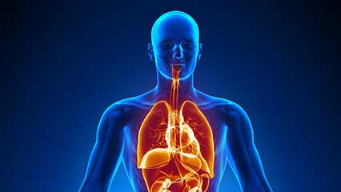


How does the world work?
  weather, cars, cell phones, the human body, teachers, students
Do all of these work in the same way?

Slide 21
Science & Social Science
Science studies the natural world, looking for patterns and connections to make useful predictions.
  Seeking truths and universal laws
  Seeking definitive answers to how things work
Social science studies society and the manner in which people behave and influence the world around us.
  Seeking understanding
  Seeking explanation

Slide 22
Thinking time
Does A lead to B in human action? If you do A then B? (i.e. If you study hard you will get a good grade on the exam)
Can we predict human behavior with 100% accuracy (in this situation people do this, or this works best in this situation)? Why or why not?
What are some things that influence human behavior? (internal, external)

Slide 23

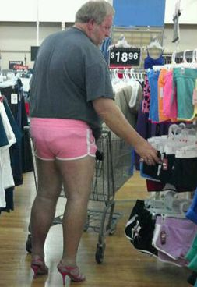
Discussion
Humans are influenced by various internal and external factors and are capable of choosing how they act from moment to moment and situation to situation.
We can say what is probable but not make any generalized claims or truth statements about human actions

Slide 24
Ontology
What is the nature of the object under investigation?
How you view the way things really are and how things really work (Denzin & Lincoln,1998, p. 201)
The object under investigation is objective and governed by universal laws
The object under investigation is subjective and may change

Slide 25
Ontological views
  Things are controlled by universal laws outside of human control.
  If you think that things act in accordance with universally constant rules i.e physics (gravity), chemistry (if you mix A with B you get C).
  If you think A + B = C (objectivism) = more quantitative
  Things are controlled by both external and internal factors and can change
  If you think abklifjnclkieuygkasbliupo may lead to C but can change
  If you think C is the result of multiple, changeable internal and external factors. (constructivism or complexivism)
VS

Slide 26
Part 2
The nature of knowledge

Slide 27
What kind of knowledge can we have and how is knowledge created?
What kind of knowledge can we have about things?
  Facts
  Probabilities
  Subjective knowledge
How can we create knowledge?
  Measuring
  Observing
  Testing
  Asking
  Reasoning

Slide 28
Thinking time
What kind of knowledge can we have about things?
  Facts
  Probabilities
  Subjective knowledge
How can we create knowledge?
  Measuring
  Observing
  Testing
  Asking
  Reasoning
What kind of knowledge can we have about the things below?
How can we create knowledge about them?

Slide 29
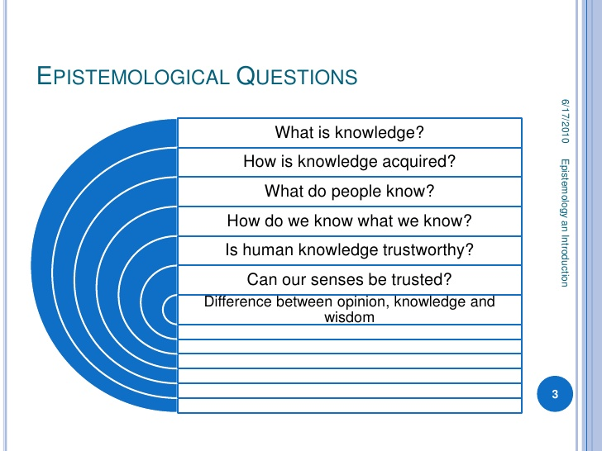
Epistemology
What can I know about it?
How can I know about it?

Slide 30
Epistemological views
If I think abklifjnclkieuygkasbliupo may lead to C but can change based on internal and external factors
Learning is a combination of internal and external variables i.e. the learning environment, the teacher, the student’s motivation, the student’s personality, study habits, parental support etc. Different combinations work for different people.
interpretivism = things can change. we can know probabilities but not facts, things differ for different people so we can have only subjective knowledge
If I think A + B = C
paying attention in class + studying hard = learning
If we think specific universal components result in learning then we can figure out the exact recipe for learning!
positivism = there is truth/ laws to find

Slide 31
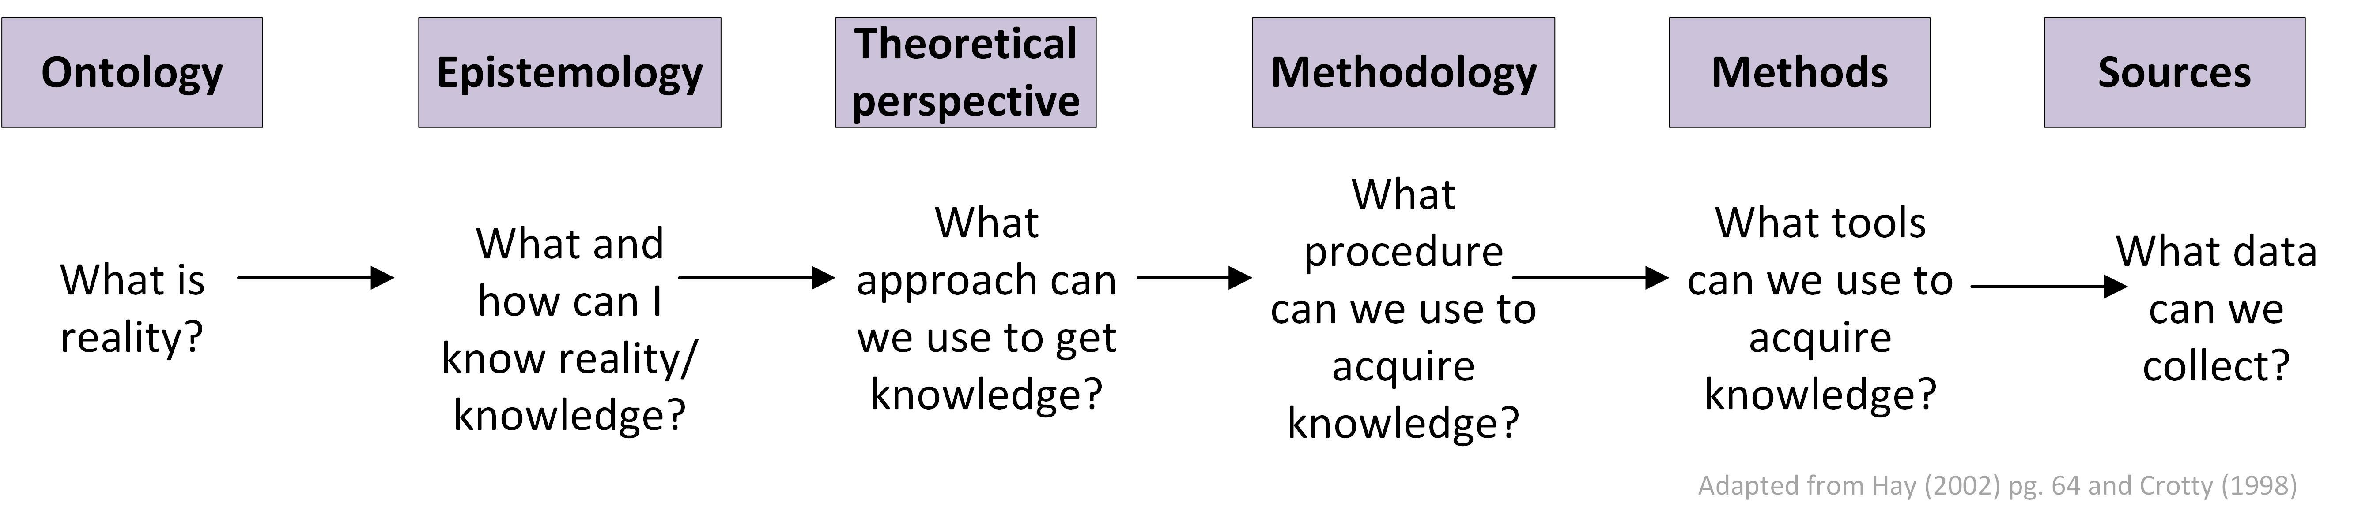
Thinking flow

Slide 32
Two traditional research paradigms
Positivists believe that there is a single reality, which can be measured and known, and therefore they are more likely to use quantitative methods to measure and this reality.
Constructivists believe that there is no single reality or truth, and therefore reality needs to be interpreted, and therefore they are more likely to use qualitative methods to get those multiple realities.

Slide 33
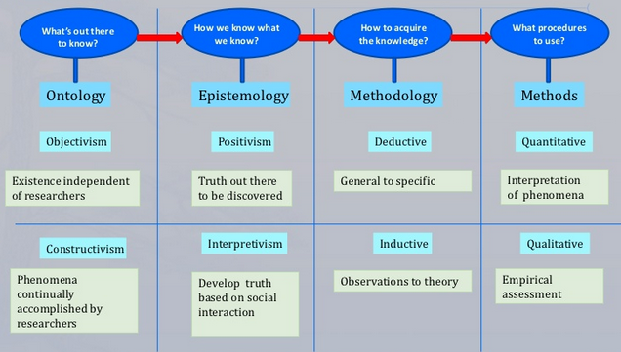

Slide 34
Key points
Your ontological views
  How you believe things work
  Your thoughts on the internal and external forces that affect the outcome
  Ontological views of different things can be different
Your epistemological views
  Are based on your ontological views
  How you believe things work will determine what you think we can know about it.
  It will also determine how you think we can gain more knowledge about something.
  Epistemological views of different things can be different
Ontological Views
inform
Epistemological Views

Slide 35
You have both
You have both ontological and epistemological views. They are different!
Ontological views
  What influences the way things behave? (Universal laws external to human influence)
  What influences the result? ( A combination of variable internal and external factors)
Epistemological view
  Based on what influences their behavior what can we know about them? (facts, probabilities, subjective knowledge)
  How can we study them ( test, observe, measure, ask, reason)

Slide 36
How does a person learn language?
Is there a recipe for learning language? Do you think that A+B+C+D+E with 100% result in a person learning a language?
Does it depend on many factors internal and external to the person learning? Does it differ from person to person? Does each person require their own individual recipe?

Slide 37
What makes a good teacher?
If a teacher follows a certain recipe does that mean they will be a good teacher? Does it mean that their students will learn?
Does it depend on many factors? Does each teacher differ?

Slide 38
Important to consider
What is taught in a classroom is not always learned.
What is learned in classroom is not always taught.
People work in different ways and have different things that work for them.

Slide 39
Check up
What are your ontological views of human behavior?
What are your ontological views of how the sun behaves?

Slide 40
Check up
What can we know about human behavior based on your ontological views?
  Facts
  Probabilities
  Subjective knowledge
How can we know about human behavior better?
  Observing
  Testing
  Asking
  Rationalizing
  Measuring

Slide 41

Reflection
When it comes to researching teaching and learning what are your ontological and epistemological views?
Which research approach most fits your views? Explain why?
Are there anything that is unclear or questions that you have about the lesson content?

