Slide 1
The Nature of Research
Epistemological and ontological views

Slide 2
Scientific Research

Slide 3
Quantitative vs Qualitative Similarities
Research questions are addressed through some form of inquiry.
Seek to build knowledge about the objects under investigation.
Follow field accepted methods and processes.
Collect and analyze data.
Present outcomes/ implications.

Slide 4
What are some of the differences between quantitative and qualitative research?
With your group write down as many things as you can think of.
Quantitative | Qualitative

Slide 5
Quantitative vs Qualitative Differences

Slide 7
What does it look like?

Slide 10
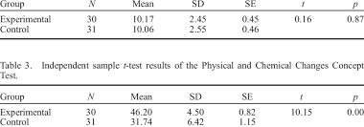

Slide 13
What do you think?
Not everything that counts can be counted, and not everything that can be counted counts.
~William Bruce Cameron

Slide 14
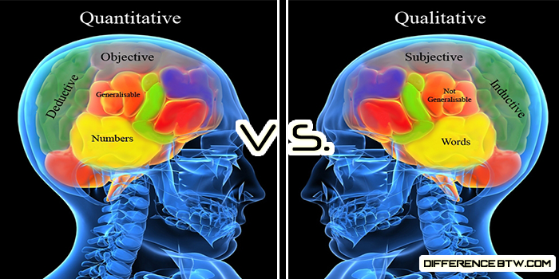

Slide 15
Characteristics of Qualitative Research
Open inquiry
Inductive
Descriptive
Interpretive
Multiple perspectives
Cyclic
Context specific

Slide 16
A rule of thumb for deciding whether to use qualitative or quantitative data is:
Use quantitative research if you want to confirm or test something (a theory or hypothesis)
Use qualitative research if you want to understand something (concepts, thoughts, experiences)

Slide 17
Quantitative or Qualitative?
You want to test the effects of a certain treatment on a group.
I want to know more about students’ difficulties with something.
You want to see if teaching grammar way A is more effective than teaching grammar in way B.
I want to know what successful language learners’ have done to develop their language.
You want to know what challenges teachers face in the classroom.
You want to know if there is a relationship between 2 things (e.g., L1 reading ability and L2 reading ability)

Slide 18
Mixed Methods
Quantitative & Qualitative

Slide 19
Mixed Methods Overview
Combines both quantitative and quantitative data collection and analysis to answer a study’s research questions.
Numbers and detailed description.
Why?

Slide 20
Combining qualitative & quantitative methods
Advantages of each complement the other, resulting in a stronger research design, and more valid and reliable findings.
Inadequacies of individual methods are minimized
The what can also be supported with the why
Offers a balance between logic and stories
What are the qualities of a good teacher?
Place a check by all the qualities you agree with.
Humor
Teaching style
Passion
Knowledgeable
Good looking
Other________

Slide 21
Qualitative before quantitative
Qualitative techniques can be used to provide much needed information when exploring new areas
Can give you a general idea of the topic you are exploring and the issues that exist
Can be used to gather information that can be used to create a survey or other follow up data collection procedures.
Use of qualitative method to check assumptions & refine research questions is valuable across & within culture

Slide 22
Quantitative before Qualitative
Quantitative studies can result in numerical data that lacks explanation
Qualitative studies help to provide clarity to such data
By doing quantitative first you can collect the what, then go back and get the why.
What are the qualities of a good teacher?
Place a check by all the qualities you agree with.
Humor
Teaching style
Passion
Knowledgeable
Good looking
Other________

Slide 23
More practice
You want to investigate if there is a relationship between annual household income and student’s motivation to learn English.
You want to know teacher learners’ views of the characteristics of a good teacher educator.
You want to investigate what workplace factors create the largest stress for in-service teachers and what could help them cope with such stresses.
You want to know if the temperature of a room (hot, average, cold) effects the number of taught words students can remember.

