Slide 1
The Metaverse & Personal website
Creating & Managing Online spaces for teaching and learning

Slide 2
The metaverse
The classroom of the future?

Slide 3
The future of education
As technology has advanced new environments have arisen for teaching and learning
When Covid hit the world, education was required to turn to online platforms
Many people used video conferencing tools such as Zoom, Webex, and MS Teams
However, the future of educational environments may be the metaverse and even more so a 4d metaverse

Slide 4
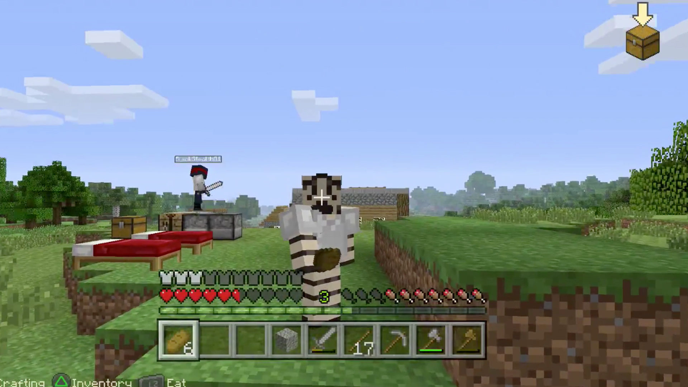
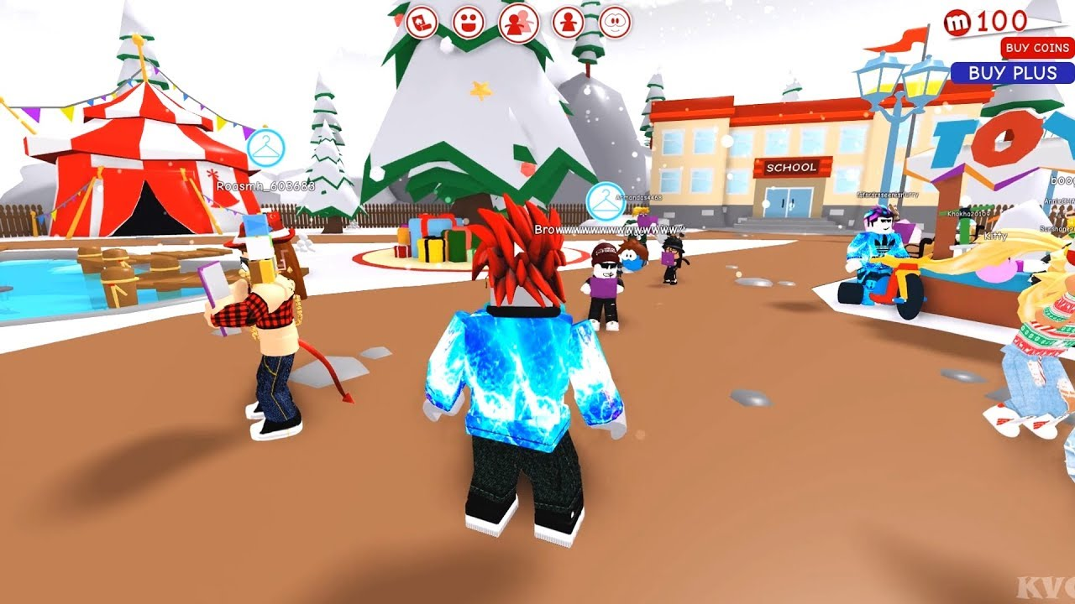
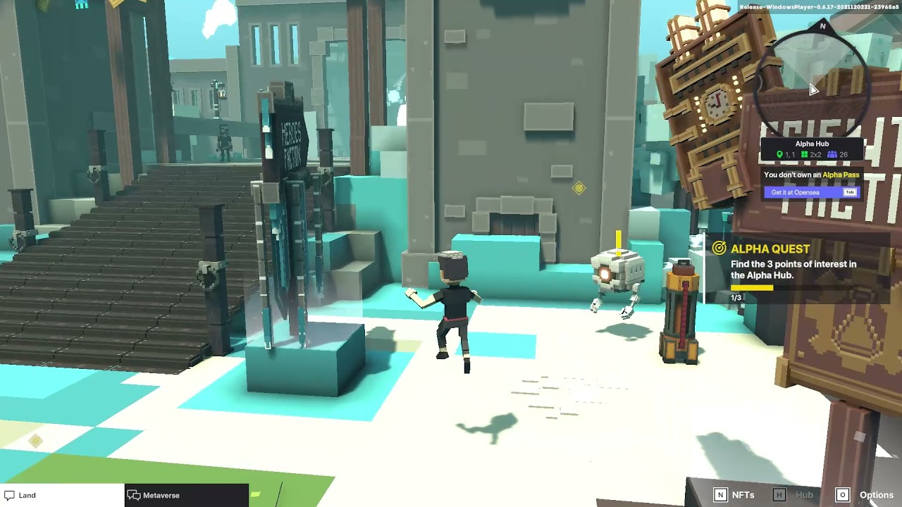
People these days are immersed in the metaverse

Slide 5
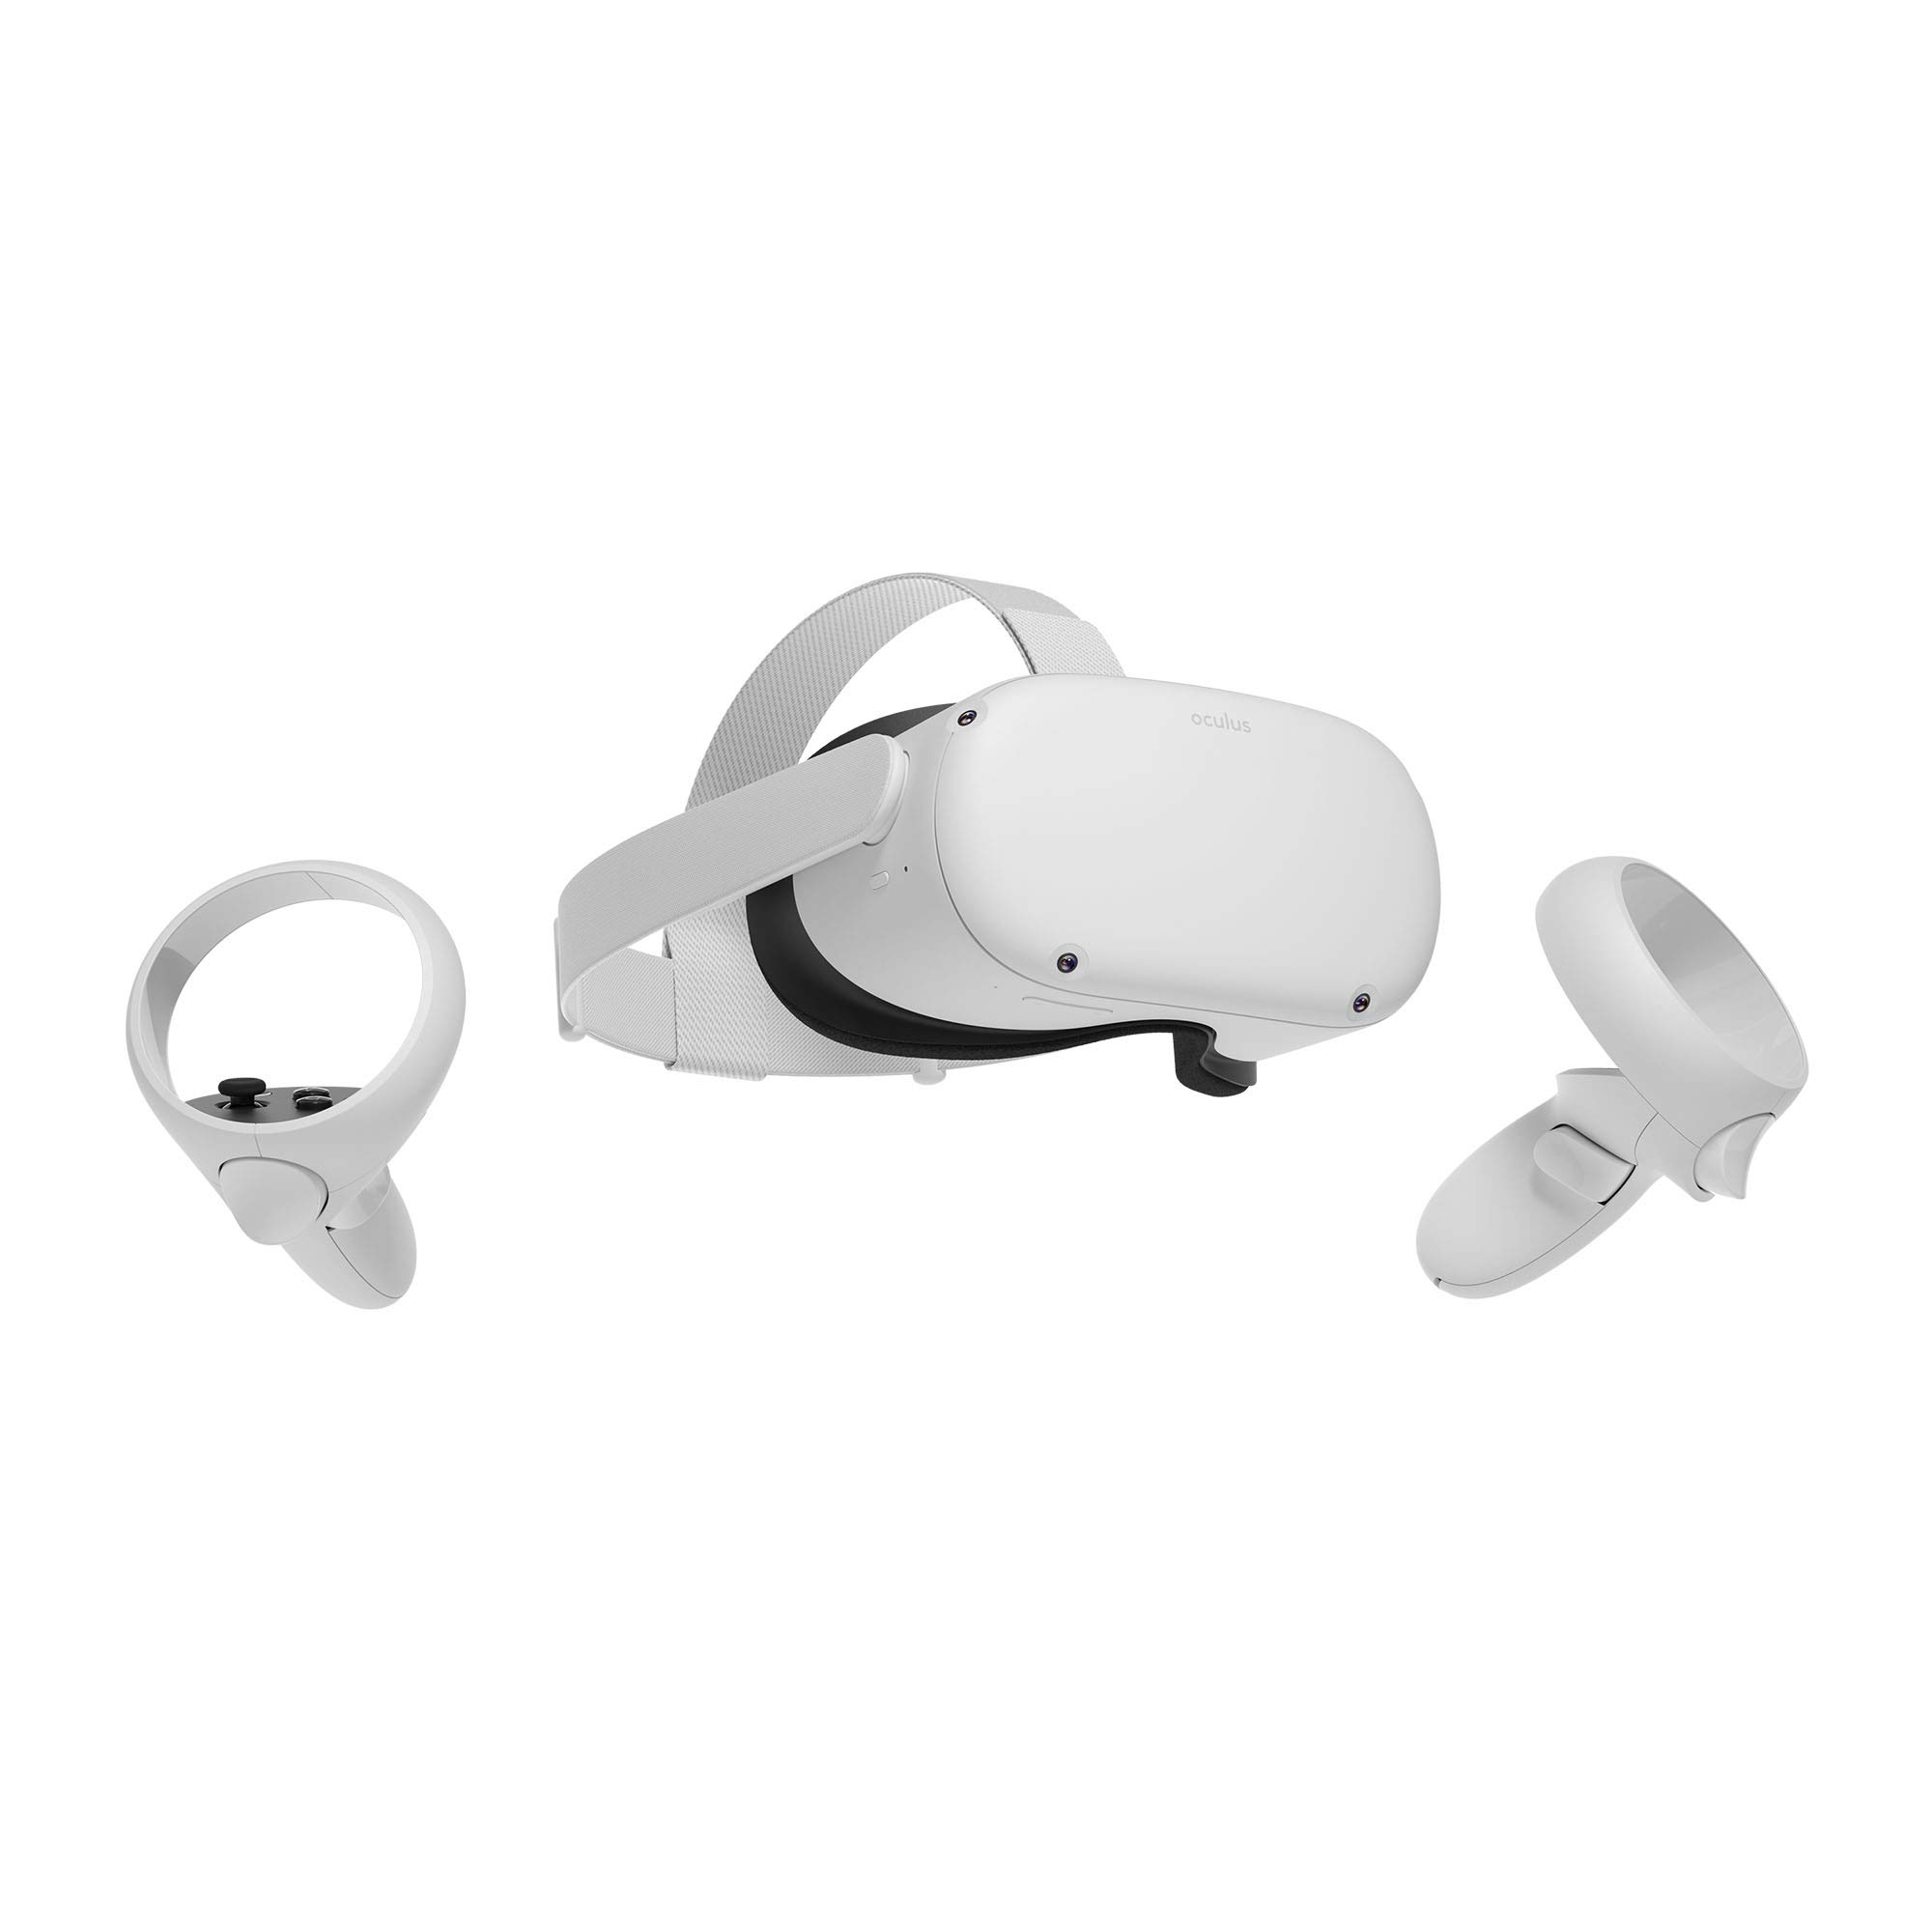
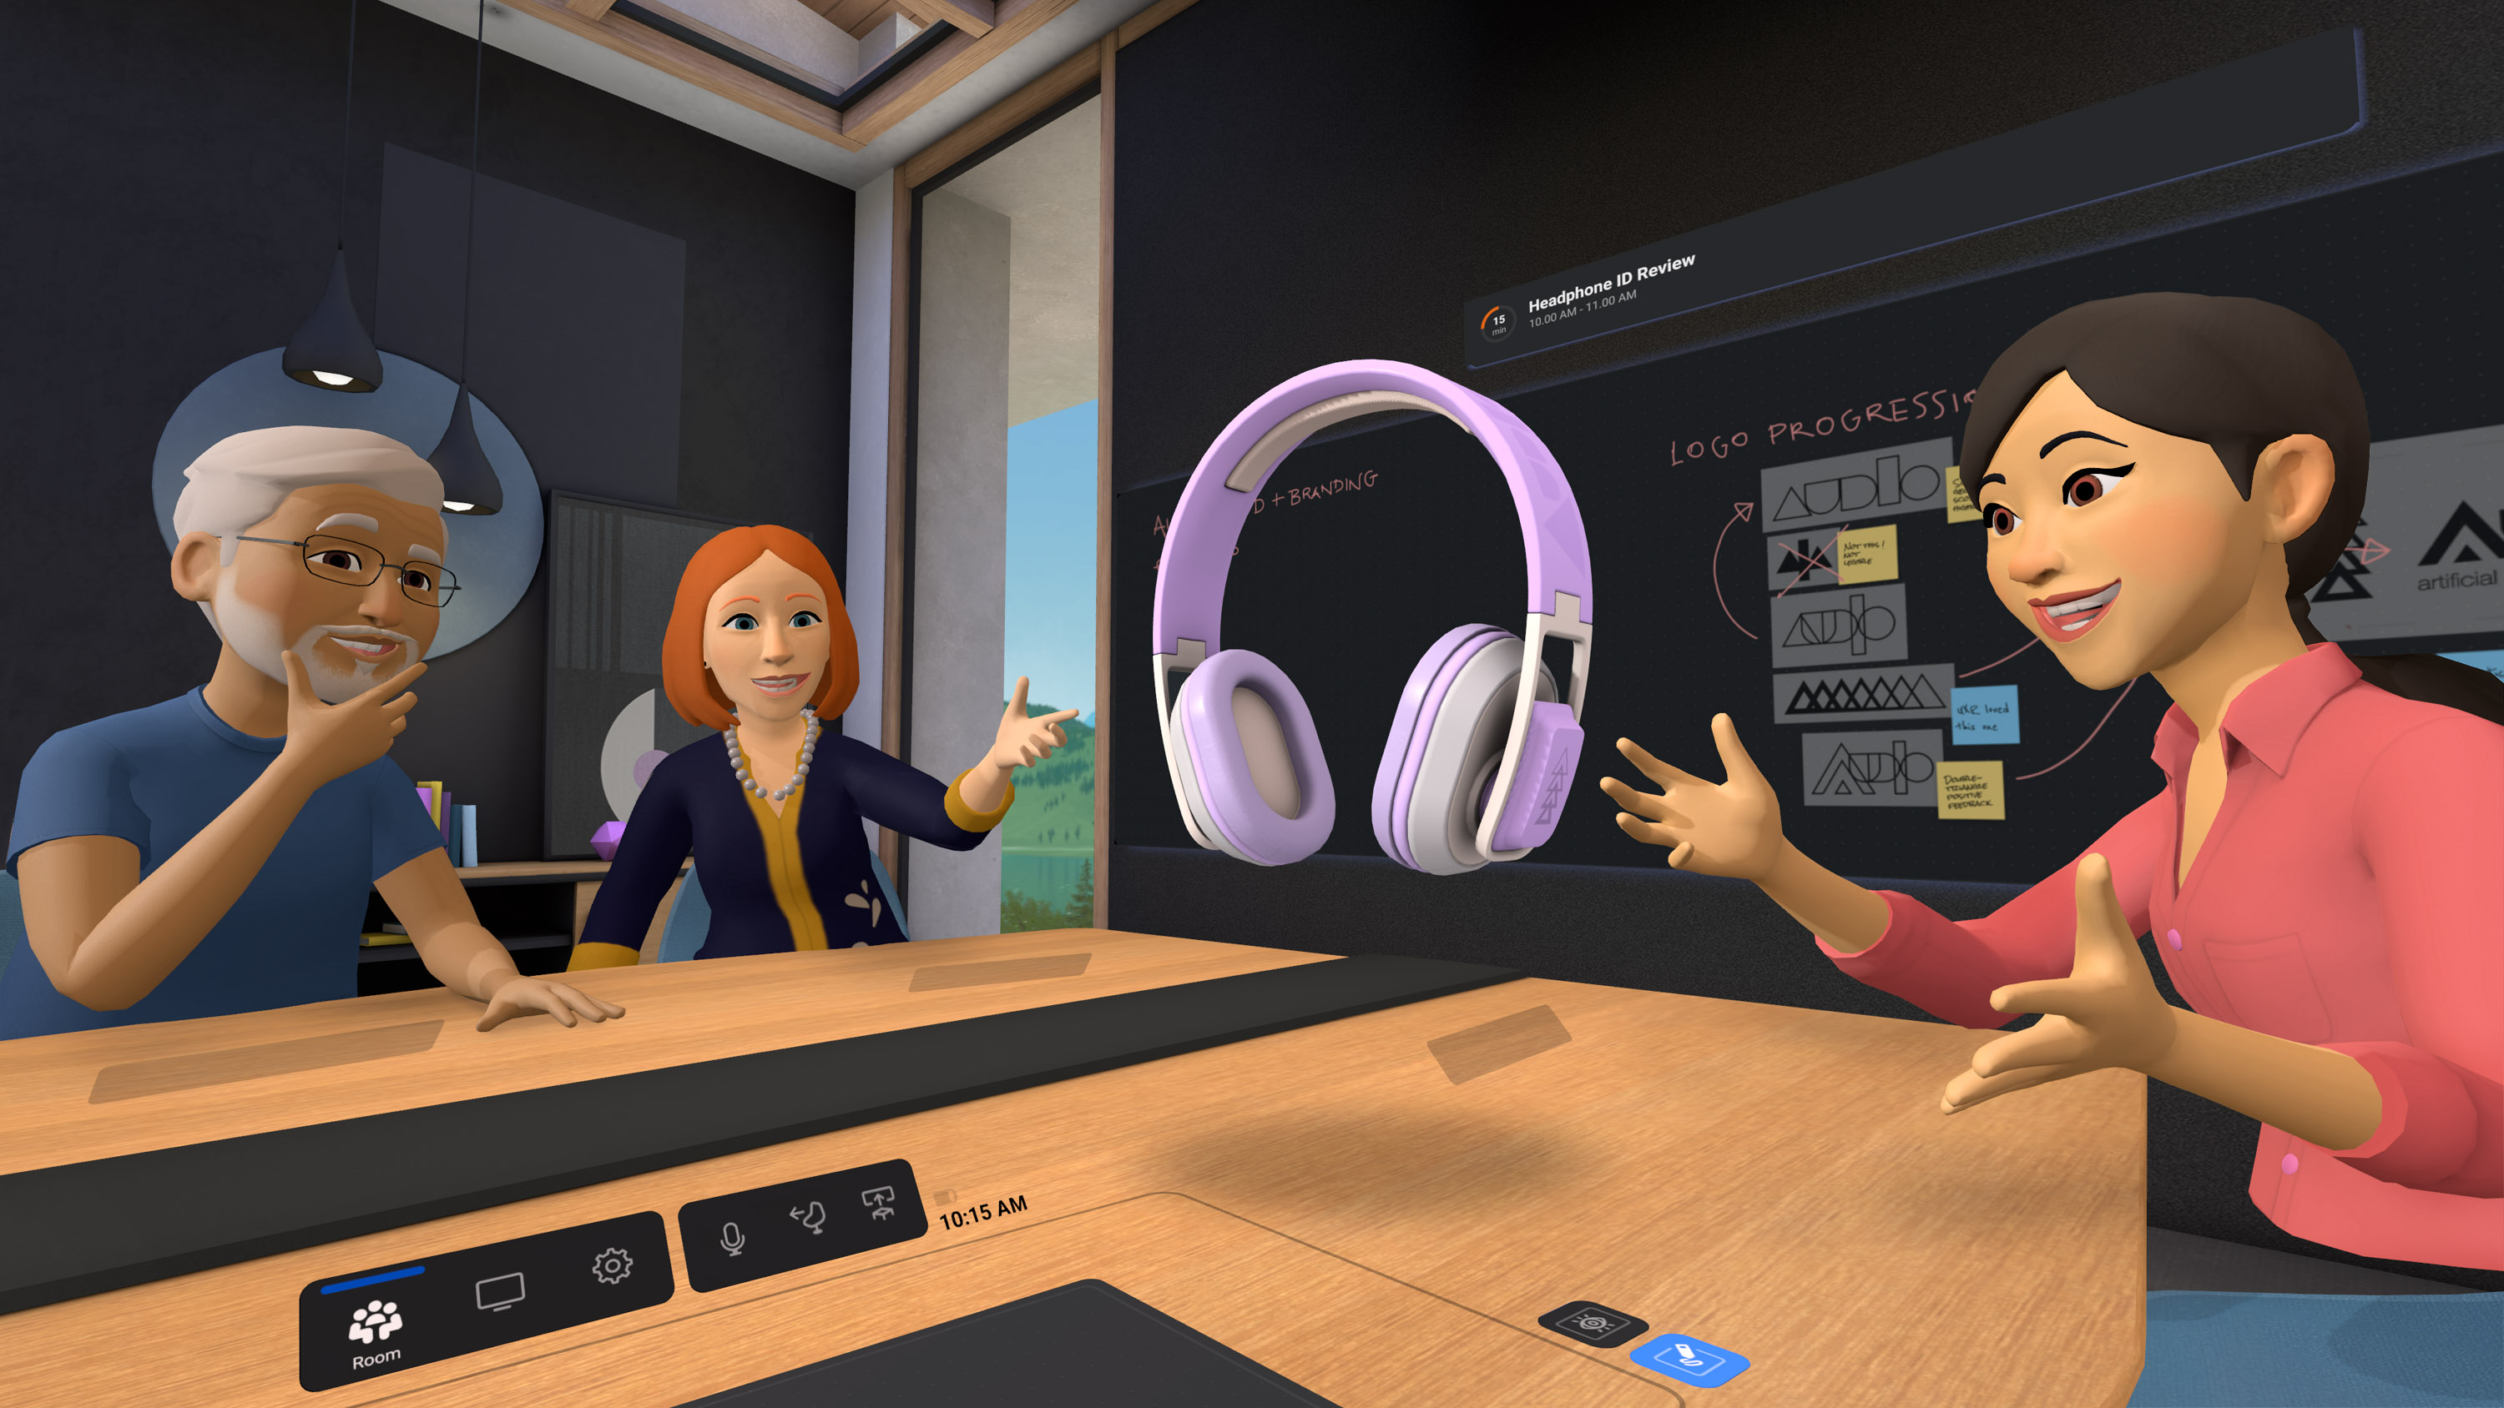
Meta is desperately trying to make the metaverse happen

Slide 6
Playing around with the metaverse for classroom purposes
Framevr.io

Slide 7
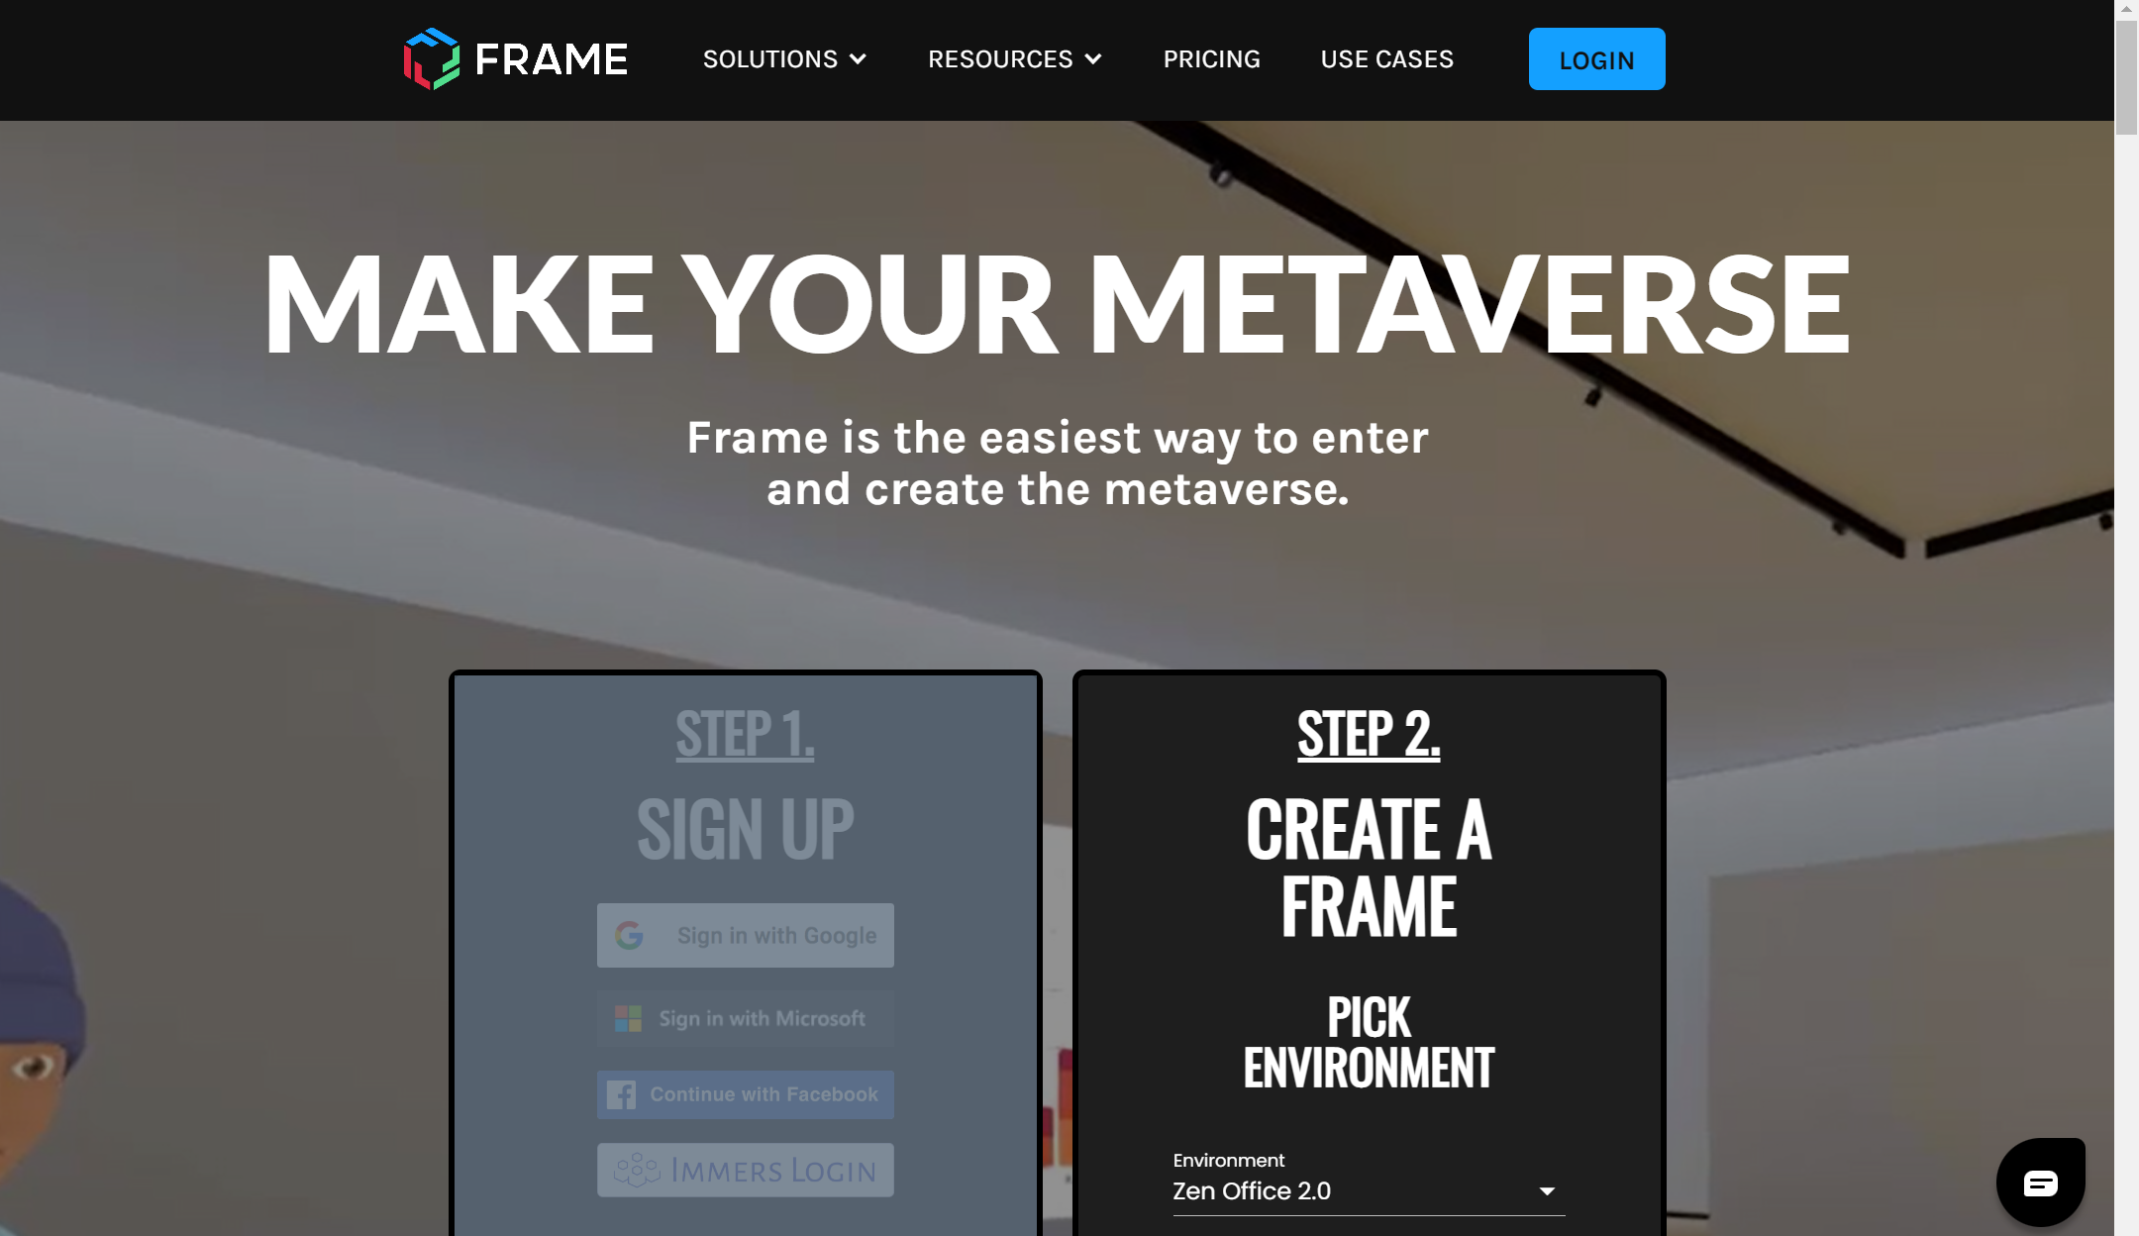
Framevr.io

Slide 8
Personal Websites
www.sdkrashen.com/
www.finchpark.com/
http://www.scottthornbury.com/

Slide 9
Thinking…
What are the benefits of having a professional website?

Slide 10
What we are going to do today
Visit some sample sites
Sign-up and sign-in
Select a theme and layout that suits your tastes and needs
Learn how to create and maintain pages
Learn how to add and delete files, videos, pictures etc.
Learn how to add and use a blog page

Slide 11
Sample sites
http://suwonunivenglishian.weebly.com/
http://profgwhitehead.weebly.com

Slide 12
Key points to a good website
Make sure it attractive to visitors
Make it look clean & Keep it that way
Keep a consistent layout
Use pictures to make it visually appealing
Choose a nice, easy to read font
Use color (but not too much)
Interesting/ useful content
Make sure it is user friendly
Easy for visitors to navigate and find what they are looking for
Make sure the content you are presenting is accurate
Spelling and grammar
Lesson content
Additional content

Slide 13
Important!
Also consider your own privacy
Do not post things that you do not wish to be shared
There are a lot of people out there who may steal things from your site if you let them
Be very careful of personal information

Slide 14
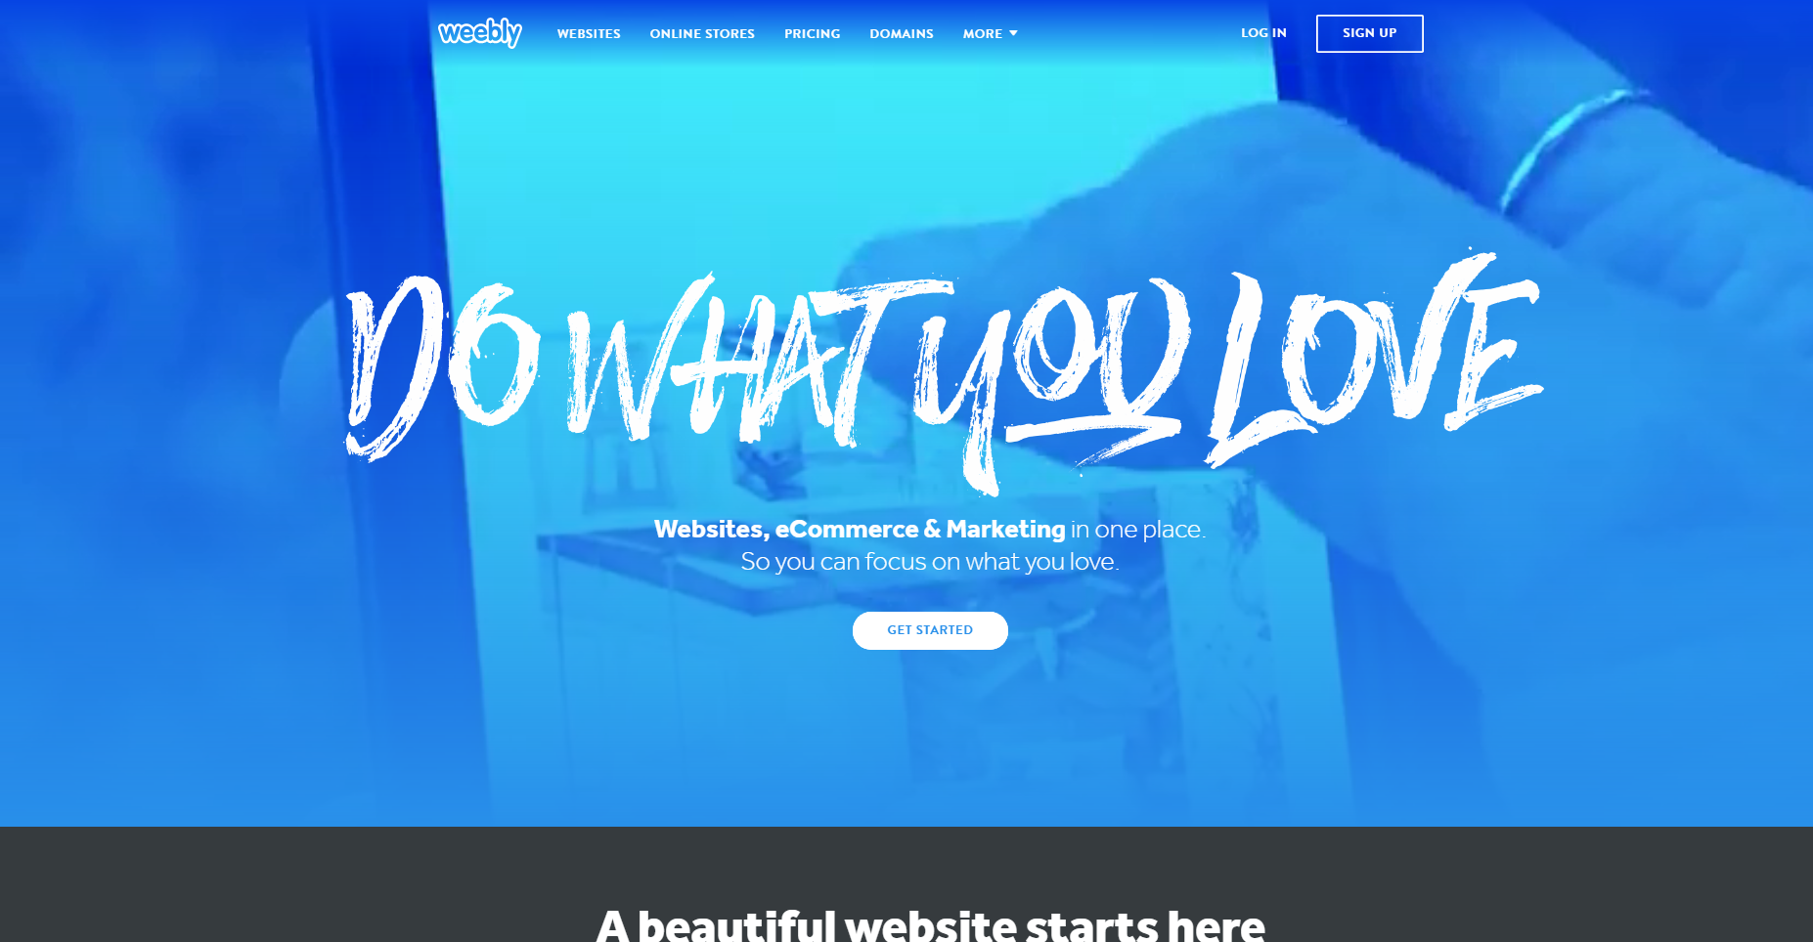
www.weebly.com

Slide 15
Today’s Task
Create a new page
Call it practice
Add a youtube video of your choice
Add a file of your choice
Add an image
Add a title and text box with content of your choice
Add a button that links to hufs.ac.kr
Create a Blog page
Enter 1 blog post
Add an image
Add some text
Share your site
Browse others sites

