Slide 1
The Keys to Online Communication

Slide 2
Discuss
What language do you read most on the internet?
Korean
English
Other
What are some of your favorite apps or websites?

Slide 3
Discuss
What language do you use to write the most on the internet?
Korean
English
Other

Slide 4
Think…
When reading English on the internet, what makes it difficult?
When writing on the internet, what makes it difficult?

Slide 5
Why write in English on the internet?
What are some of the reasons that people write in English instead of their mother tongue?

Slide 6
Percentage of Internet Content by Language

Slide 7
Internet Users by Language

Slide 8
Why English
It reaches the widest audience!
Since English is the current global language, there are more people in the world who can read English than any other language.

Slide 9
Things to consider when writing on the internet…
Your audience (Who?)
Who are you writing to
English speaker/ Non-English speaker
Teacher/ Professor/ Boss/ Friend
Who will read it
Your purpose (Why?)
To complain
To inform
To apply
Etc.
The type of writing (What?)
Casual/ formal register
Genre

Slide 10
Key Points in Internet Writing
Remember: What you write on the internet can affect the way people perceive you.
Clear writing reaches the widest possible audience by being simple and easy to understand.
Focus on the message and emotion in your writing.
Example:
hand in your assignment before class on Friday
HAND IN YOUR ASSIGNMENT BEFORE CLASS ON FRIDAY
Please, hand in your assignment before class on Friday ☺
TIP: Please and I’m sorry but…. Are ways to make messages much softer

Slide 11
Examples of softening
I’m sorry but you handed in your assignment late so I have to deduct one point ☹
YOUR ASSIGNMENT IS LATE. ONE POINT DEDUCTION!

Slide 12
Using “Please”
It’s always a good habit to use please and thank you ☺
Can you please…. ?
Please, …. ?
Very nice: Can you please change the date of the exam?
Soso: Please, change the date of the exam.
Rude: Change the date of the exam.
Very Rude: CHANGE THE DATE OF THE EXAM!!

Slide 13
Emoticons
:D __________
:) __________
:P __________
:( __________
;) __________
=,( __________
:@ __________
:| __________
:o __________

Slide 14
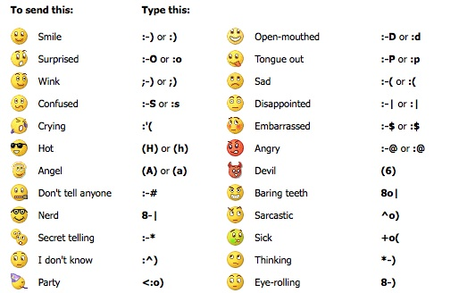

Slide 15
Clarity and Emotion practice
I can’t come to work because I am sick. (to your boss)
I want to change my exam time (to your professor)
I DON’T WANT TO SEE THAT MOVIE!!! :@ ( to your new friend)
Your assignment was TERRIBLE! DO IT AGAIN! ( a teacher to a student)

Slide 16
TIPS
Can’t change will not be able to/ won’t be able to
Is it ok if… change Would you mind if…?
Can you please change Would it be possible to…?
Could I please
Would you mind (gerund)….?
TIP: Ask about possibility before do you mind questions ☺

Slide 17
Final Task
Yo Prof.G,
My bus is LATE! I AM GOING TO BE LATE FOR CLASS!!! Don’t mark me as late because I don’t want to lose points!
JiSu
Send an email to Prof. G at prof.gwhitehead@gmail.com

Slide 18
www.chatstep.com

Slide 19
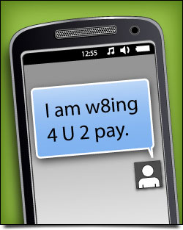
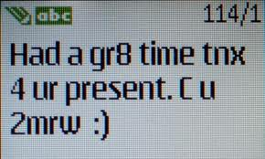
Text Messaging

Slide 21
Can you decode these texts?
4got to tell u that u looked gr8t last nite.
@ work sry ill call u l8r
R we gng 2 go Evlnd tmrow?
Pls let me kno b/c I have 2 make resv ty.

