Slide 1
The basics
Key Points & Useful Tools

Slide 2
Characteristics of academic writing
It is written in formal language (no slang, idioms, contractions)
Content is based on facts and supported by references (rather than feelings of biases)
*present and argue the facts and leave your emotion out.
Facts are accurate and backed by quality resources
Referencing formatting follows specific guidelines (APA 7th edition)

Slide 3
Myths about academic writing
Myth #1: I need to use big words.
Have the courage to write an article you would want to read. Don’t use words you wouldn’t normally use when talking about your research. If you read a sentence and can’t understand it yourself, then no one else can either. Publishers and journals want you to write clearly, concisely and actively.
Myth #2: Writers only start writing when they have everything figured out
Writers figure out much of what they want to write as they write it. Rather than waiting, get some writing on the page—even with gaps or problems. You can come back to patch up rough spots.
Myth #3: Perfect first drafts
Nobody writes perfect first drafts; polished writing takes lots of revision.

Slide 4
Myths about academic writing
Myth #4: Some got it; I don’t—the genius fallacy
When you see your writing ability as something fixed or out of your control, then you won’t believe you can improve as a writer and are likely not to make any efforts in that direction. With effort and study, though, you can improve as a writer. I promise.
Myth #5: Good grammar is good writing
When people say “I can’t write,” what they often mean is they have problems with grammatical correctness. Writing, however, is about more than just grammatical correctness. Good writing is a matter of achieving your desired effect upon an intended audience. Plus, as we saw in myth #3, no one writes perfect first drafts. Clarity, organization, flow, cohesiveness are key to good academic writing.

Slide 5
Samples
A lot of researchers don’t agree with it, but new research says…
I interviewed some of my friends and asked them questions about their opinions.
In conclusion, I think it’s kinda important for other people to listen to what I am saying cuz the findings of this study can’t be denied.

Slide 6
Sample comparisons
A lot of researchers don’t agree with it, but new research says…
Many researchers disagree with this (see for example Choi, 2010, Kim, 2006; Whitehead, 2020); however, the most current research suggests…
I interviewed some of my friends and asked them questions about their opinions.
Interviews were conducted with a purposive sample of 8 university MA learners in South Korea, to investigate their opinions on the issue.
In conclusion, I think it’s kinda important for other people to listen to what I am saying cuz the findings of this study can’t be denied.
To conclude, this study has many important implications and it is therefore recommended for stakeholders to carefully consider these findings.

Slide 7
Presentation

Slide 8
presentation
The appearance of your written work is extremely important.
Font
Organization
Accuracy
Errors that could have been caught with a careful proofreading are a sign of laziness and are less easily forgiven.

Slide 9
examples
In response to the ongoing and growing concerns, in 2006, the Ministry of Education, Science and Technology announced plans to design a new high-stakes English ability test, known as the National English Ability Test (NEAT). This costly multi-year initiative has aimed at addressing and resolving criticisms of previous testing systems and initiating new proficiency-based directions in English education in South Korea.
In response to the ongoing and growing concerns, in 2006, the Ministry of Education, Science and Technology announced plans to design a new high-stakes English ability test, known as the National English Ability Test (NEAT). This costly multi-year initiative has aimed at addressing and resolving criticisms of previous testing systems and initiating new proficiency-based directions in English education in South Korea.

Slide 10
Do this
Times New Roman
12 point
Double-spaced (2.0)

Slide 12
Typical structure of an academic article
Literature review
Conclusion
Discussion
Findings
Methods
Introduction

Slide 13
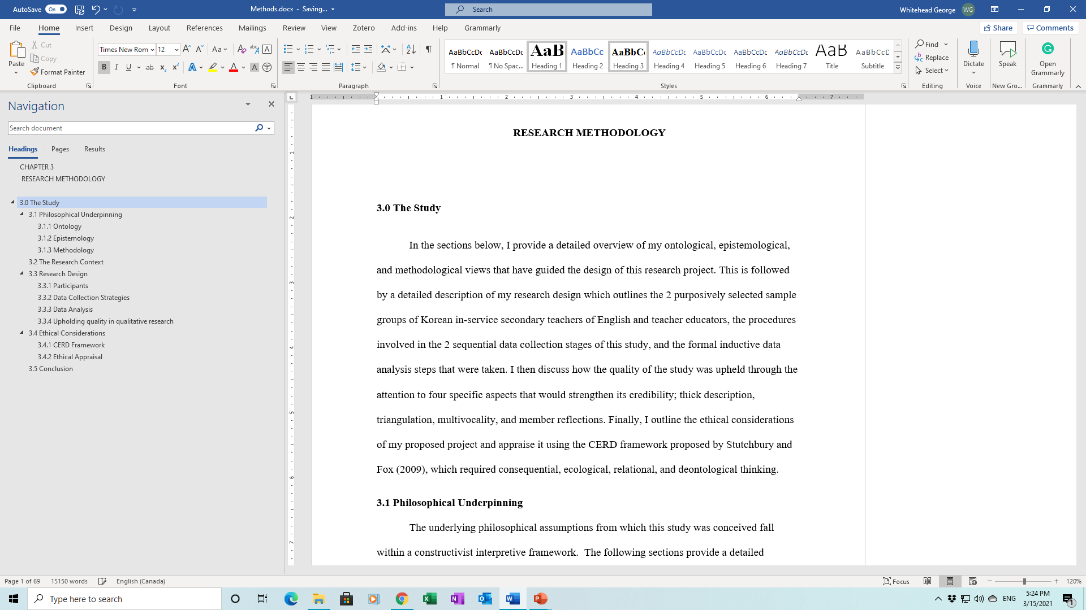
Tips: presentation
MS Word Headings

Slide 14
Tips: presentation
MS Word
Using headings to organize your paper
Introduction
Literature review
Methods
Findings
Discussion
Conclusion
References
Creating a Table of Contents

Slide 15
Proofreading support

Slide 16
examples
English eduactation in south korea has change a lot over the last 50 year. The methods used two teach the language have started to focus on learners ability to communicate in the langageage rather than memorizing rulez and translating texts.
English education in South Korea has change a lot over the last 50 year. The methods used to teach the language have started to focus on learners’ ability to communicate in the language rather than memorizing rules and translating texts.

Slide 17
Tips: proofreading
Grammarly - www.grammarly.com/‎
1checker - www.1checker.com/
MS Word Editor

Slide 18
Help with academic wording

Slide 19
Style: Wording
Phrasebank
http://www.phrasebank.manchester.ac.uk
Academic Word List
https://tefltastic.wordpress.com/2013/02/28/teaching-the-awl/

Slide 20
Transition words
https://allesl.com/transition-words/

Slide 21
Other useful tools
Translators (google translate, Papago etc.)
Speech to text apps (google docs, Microsoft word etc.)

Slide 22
Help from AI

Slide 23
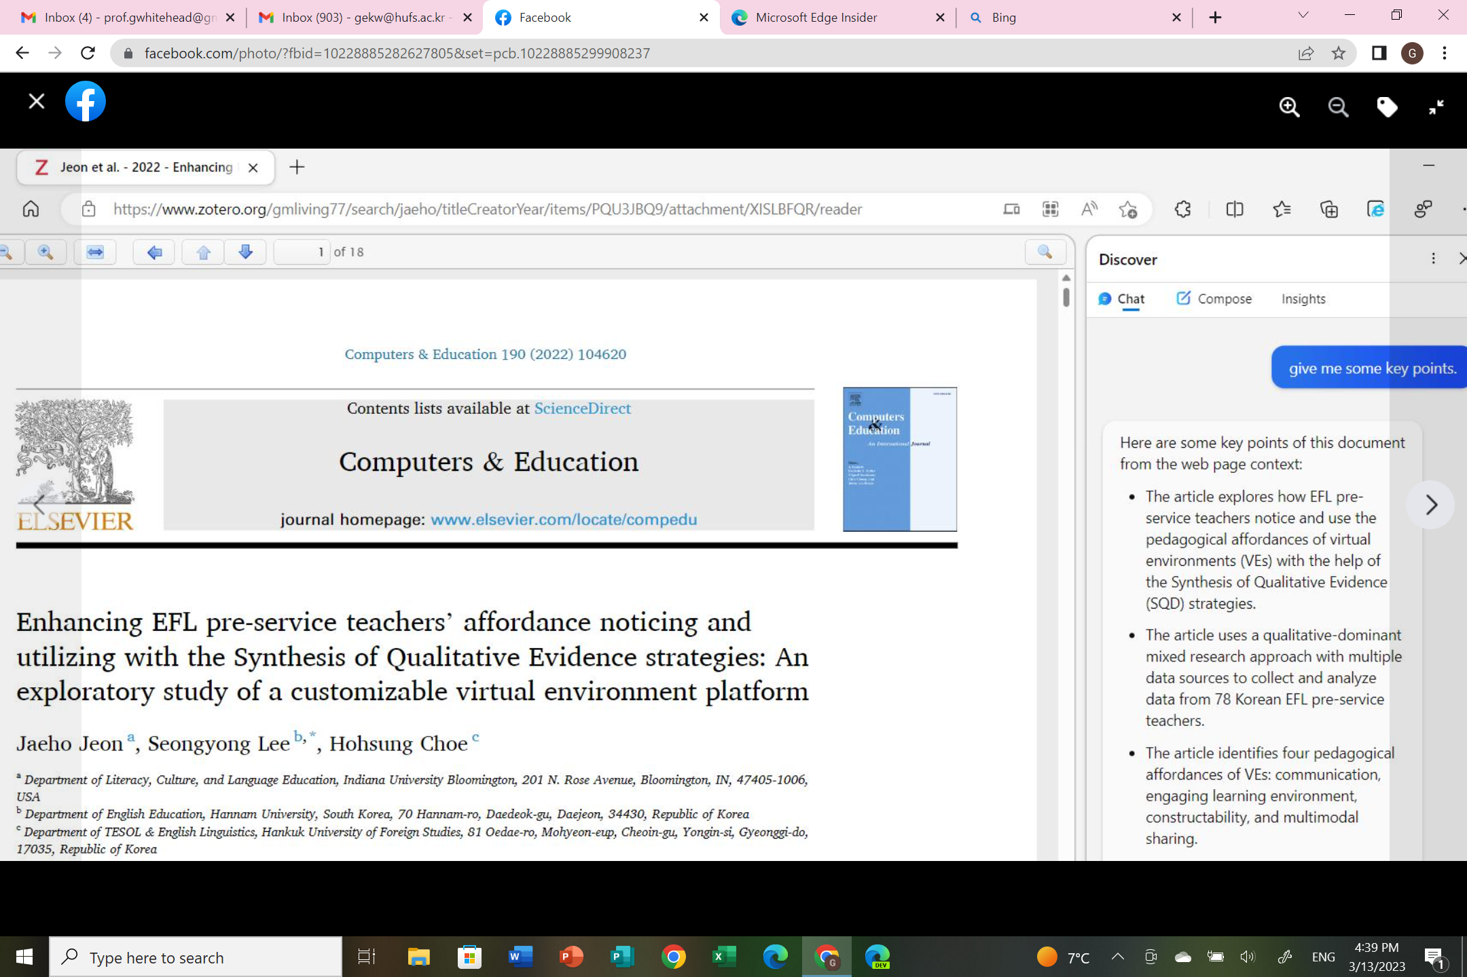
The new Bing + Microsoft Edge Dev.

Slide 24
1. Join the waitlist of New Bing and get it! (currently taking 2-3 days). 우선 New Bing 을 신청해서 받는다. (3월 둘째주 기준 2-3일 걸림)
2. Install Edge Dev (this guy integrates a chrome account...): Edge Dev 브라우저 설치한다 (크롬 계정까지 통합하는 무서운 놈) https://www.microsoftedgeinsider.com/en-us/download/dev
3. In Edge Dev 설정: Settings - sidebar - Apps and notification settings - Discover - (activate) Page context
PDF: You can open your local pdf file in a blank webpage of Edge Dev. (Ctrl + O) Then, chat with Bing AI (ChatGPT) for further work.

Slide 25
Finding quality resources
To write academically you need to read academically!

Slide 26
Key Points
It is impossible to write about something academically if you do not know well about what you are writing about.
What exactly does the topic entail?
How is it defined?
What are they key points/ concepts?
What is the current situation regarding the topic?
What do we need to know more about?
Why do we need to know more about it?
What academic studies have been done recently (past 5 years)?
What have they found in their studies?
Are the findings similar or different?
What have other scholars said about the topic?
What are their views on the topic at present?
Why is the topic important right now?
What further work do they suggest regarding the topic?

Slide 27
Language teacher burnout
What exactly does the topic entail?
How is it defined?
What are they key points/ concepts?
What is the current situation regarding the topic?
What do we need to know more about?
Why do we need to know more about it?
What academic studies have been done recently (past 5 years)?
What have they found in their studies?
Are the findings similar or different?
What have other scholars said about the topic?
What are their views on the topic at present?
Why is the topic important right now?
What further work do they suggest regarding the topic?

Slide 28
Tips: finding resources
HUFS library
Google scholar
RISS
DBPIA
Naver academic
OASIS
Microsoft academic
ResearchGate, Academia
Start with a search for recent articles (within the last 10 years max)
Look at relevant articles’ references to lead you to other good resources
Make sure your resources are reliable (https://www.scimagojr.com/)
Not acceptable: news articles, blogs, Wikipedia, MA theses
Acceptable: peer-reviewed journal articles, academic books, PhD theses, conference papers

Slide 29
Quality sources
Peer-reviewed articles, books, or book chapters
Be careful of predatory publishers (Beall’s list - https://beallslist.net/)
You can check if the journal is of quality here: https://www.scimagojr.com/

Slide 30
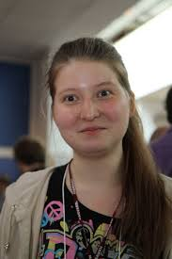
Additional Information
Alexandra Asanovna Elbakyan
Notes:
B-ok.org
Sci-hub.tw
Libgen.io
https://smallpdf.com/unlock-pdf

Slide 31
Task
What academic area or topic are you interested in?
Pick the topic that you are most passionate about, something that you really want to know more about.

Slide 32
Task 1
Tips
Try to find sources that are recent.
Start with most recent and work backwards.
Use one paper to lead you to other relevant papers. ( Reference section)
Find and download 3 recent articles or books that are closely related to a topic you are interested in.

Slide 33
Task 2
Go to the phrasebank Introduction section
Look at phrases from Establishing the importance of the topic for the discipline
Look at Identifying a knowledge gap in the field of study
Copy and paste 2 – 3 phrases that you like/ find useful into a .doc file
For practice: Try to create a sentence of two for each phrase you copy.
Tips
Choose ones that fit your personal style.
Choose the ones that are clearest to you.
There is no need to choose the most difficult or fancy ones, focus on clarity.

