Slide 1
That Commercial is Classic
Media and Marketing

Slide 2
Ask your classmates

Slide 3
What kind of strategies are used to get your attention?
Humour
Celebrities
Emotional appeal
Simple solutions
Sex appeal
Catch phrases
Jingles
What types of companies choose each type?

Slide 4
Jingles and Catchphrases

Slide 5
What famous slogans or catchphrases are there in Korea?

Slide 6
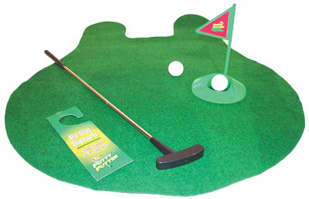
Infomercials

Slide 7
Find an advertisement

Slide 8
Discussion
With your group discuss what are some of the positive and negative points about advertisements.
Think of at least 3 positives and 3 negatives

Slide 9
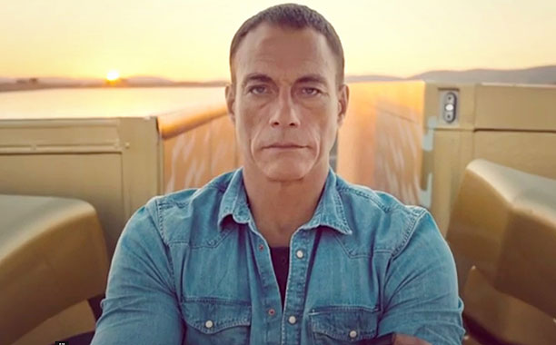
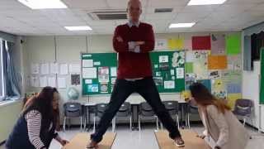
Advertisement Project
You got a new job on the marketing at Coca-cola
They want you to design a new health drink and make a commercial for it.
Select your target audience
Use one of the strategies we have talked about or copy a Korean commercial to advertise your product in English
Write a script
Make a catch phrase and/or a jingle

