Slide 1
Team Building
Conflict and Resolution

Slide 2
Today we are going to work on teambuilding

Slide 3
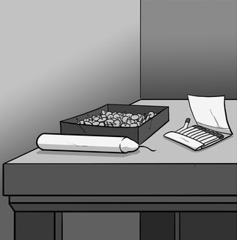
Your first task
You have a candle, matches, and thumbtacks.
Attach the candle to the wall so that it does not drip on the table below.

Slide 4
Your second task
You have 7 pieces of paper and 7 paper clips
Your goal is to make the tallest free-standing tower.
You have 5 minutes.

Slide 5
Team survival

Slide 6
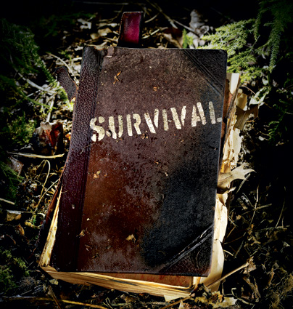
Survival Activity

Slide 7
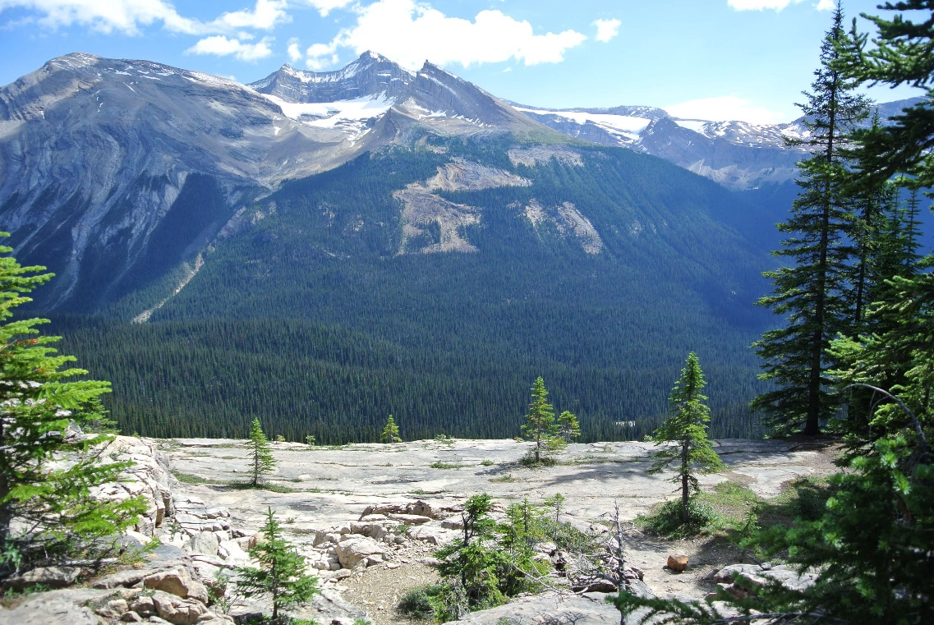
The Situation
It is the middle of January and you and your friends hiking the Canadian Rocky Mountains.

Slide 8
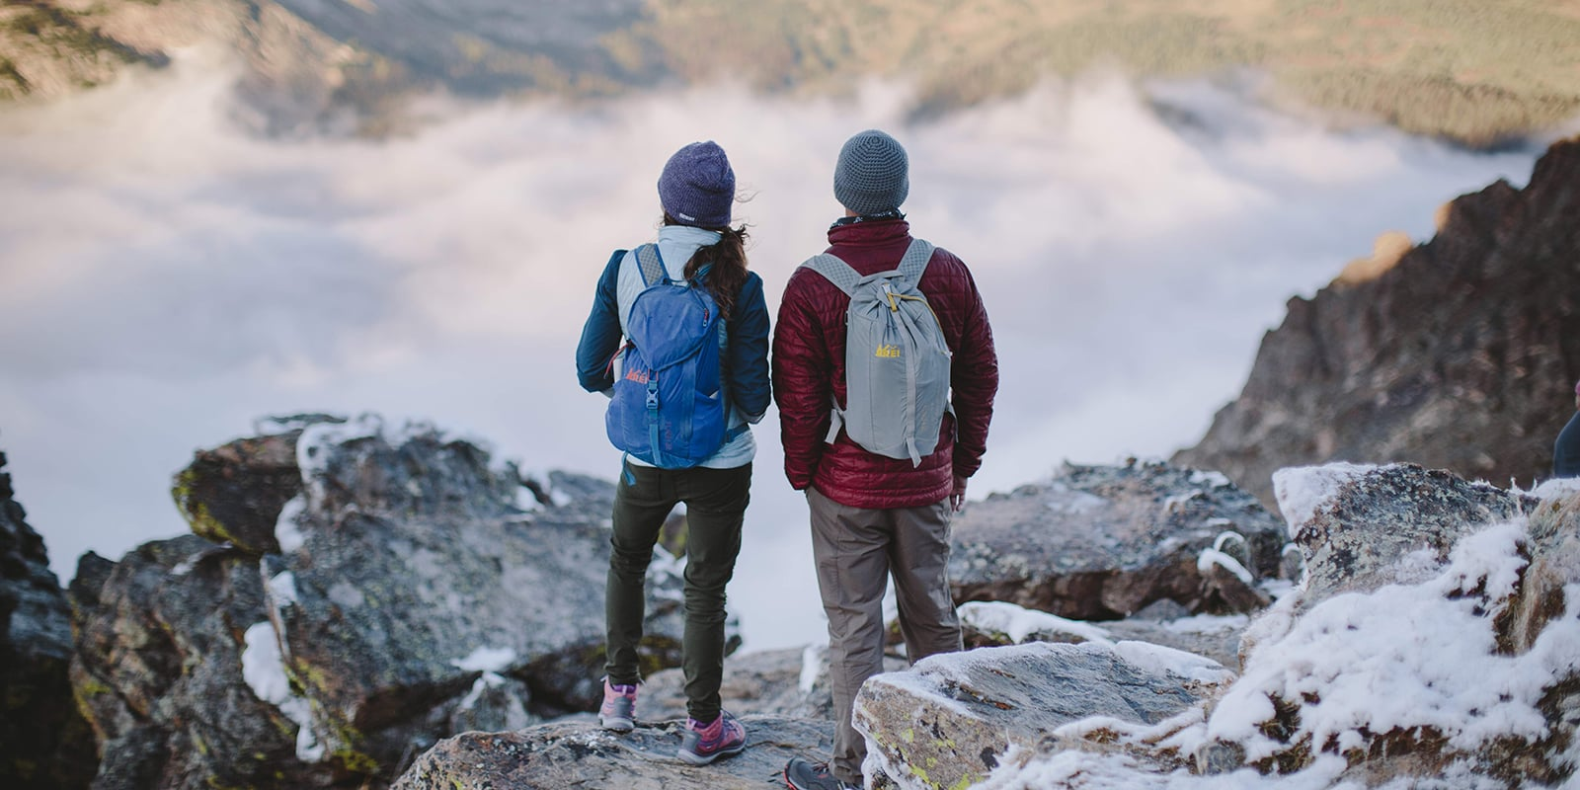
The situation
Unfortunately, during your hike you got lost.
You are now stuck in the mountain.
Your cell phone batteries are dead and you do not have an extra battery pack.

Slide 9
The situation
You look around.
you are in the middle of the mountains
there is about 5 cm of snow around you
the temperature is -25 C at night
the nearest town is 40 Km away.

Slide 10
You have the following items
A ball of steel wool
A small ax
A metal can filled with butter
Newspapers (one per person)
A compass
1.5 litres of whiskey
Your dead phones
Cigarette lighter (without fluid)
Extra shirt and pants for each survivor
20 x 20 ft. piece of heavy-duty canvas
A sectional air map made of plastic
Snickers chocolate bars (one per person)

Slide 11
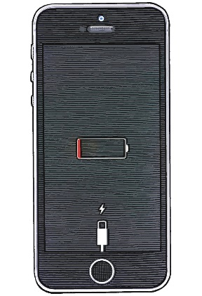
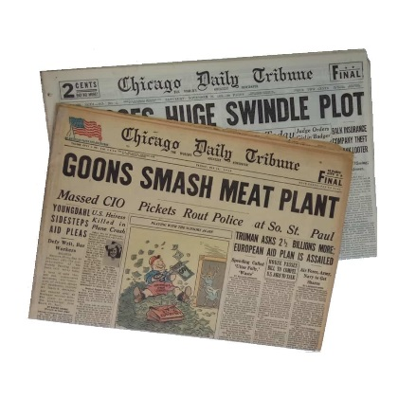
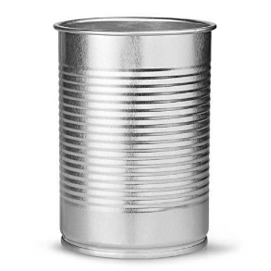
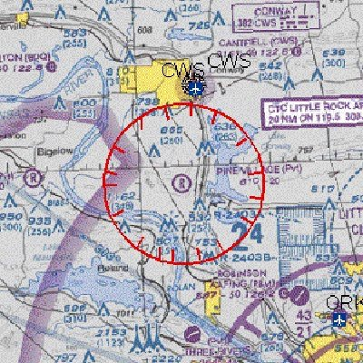
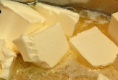
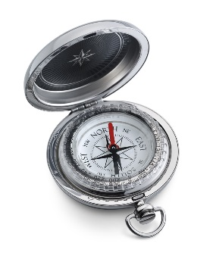
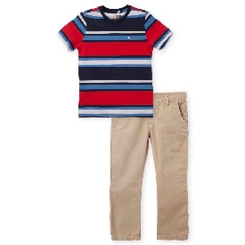
Your task as a group is to list the above 12 items in order of importance for your survival. List the uses for each. You MUST come to agreement as a group.

Slide 12
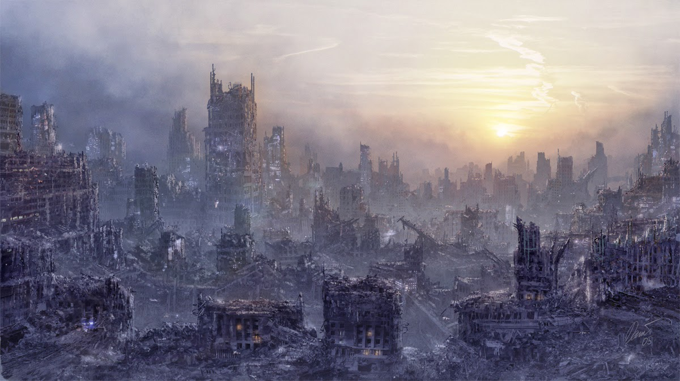
Post Nuclear War

Slide 13
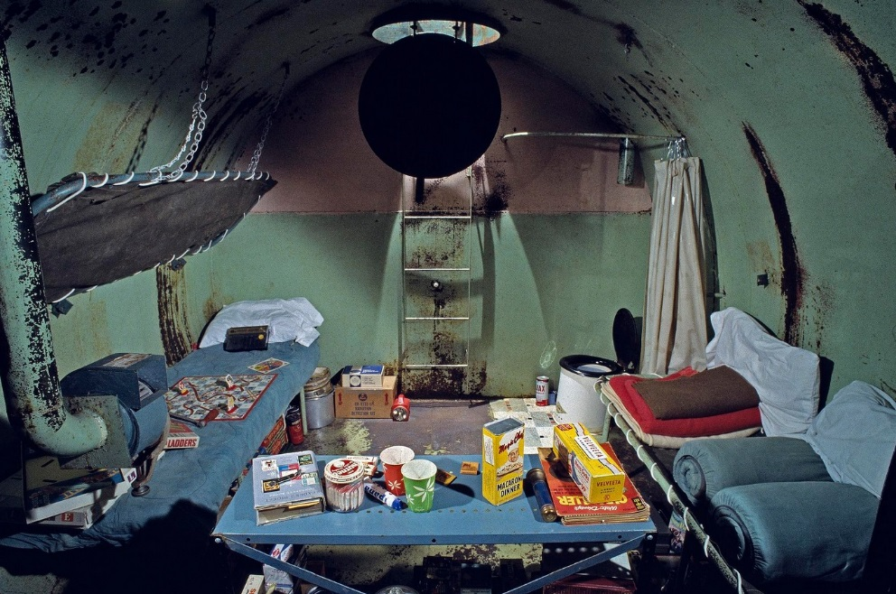
The Situation
Three days ago, nuclear war broke out around the world.
Most of the population has been killed.
You are one of the few survivors.
You are in a shelter with 12 others who have survived.

Slide 14
The dilemma
There are twelve people in the shelter but there is not enough food, water, and other supplies to keep them all alive until the atmosphere is safe.
To survive, the people must stay inside the shelter for at least three months.
There are supplies enough to allow 7 of the 12 people to survive.

Slide 15
Your task
Your task is to decide, based on the information given, which people will be allowed to remain, and which people will be required to leave the shelter.
The survival of the human race depends on your decisions.
Carefully evaluate all information about each of the twelve persons.
Consider their health, experiences, age, sex, and intelligence.
Then decide which 7 people have the best chances of repopulating the earth and will be allowed to stay in the shelter and which 5 must leave.

