Slide 1
Teaching Vocabulary
Inductive Approach

Slide 2
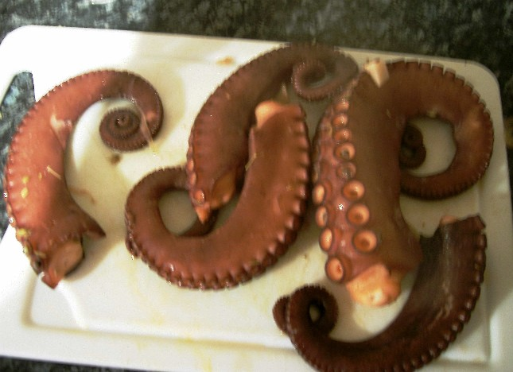
tentacles

Slide 3
suction cups

Slide 4
scuba diver

Slide 5
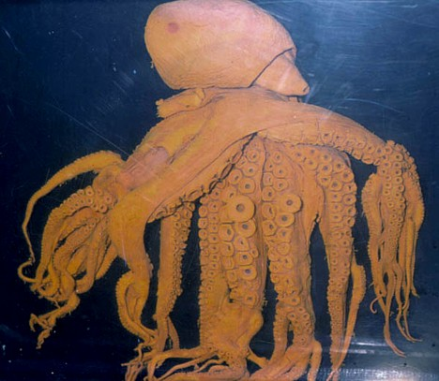
super massive octopus

Slide 6
Eliciting
What is eliciting?

Slide 7
Eliciting
a technique used by the teacher during the lesson that involves the language learner in the process of discovering and understanding language.
The teacher skillfully draws out information from students rather than giving it to them directly.

Slide 8
Why is eliciting important?
The objective of eliciting is to allow the learners the chance to participate in the learning process by letting them express their acquired or intuitive knowledge, and through critical thinking which will enhance their language abilities by adding to what they already know.

Slide 9
Eliciting Vocabulary
Eliciting is often used to pre-teach key vocabulary (words that will appear in the study and activate stages of the lesson).
By involving the students in the process, the learners will more likely hold onto the meaning of these words not only in the lesson, but beyond it.

Slide 10
Ways to elicit
What is another way to say__________? (very, very hungry)
How do you say __________ in English? (insert Korean word)
Provide an example and ask students for the word.
It is something that we drink hot coffee and tea out of.
Draw/ show a picture, ask students for the word.
Act it out and ask students for the word.

Slide 11
Tip
Eliciting works if the vocabulary is within their zone of proximal development or (I + 1) and they know the word.
However, if you can’t elicit the English word from them or they don’t know it, you could always elicit the Korean word first and then introduce the English word.
This still involves them in the process of discovery. ☺

Slide 12
Problems with Eliciting
In cultures where the group is more important than the individual it is unacceptable to stand out either as a success or as a failure. Even with constant encouragement, it is difficult to break down entrenched attitudes and beliefs, and certain strategies may be required.
Eliciting only works if they know the word… so, if they don’t know the word and you try to elicit you are not going to get the word you are trying to pull from them. (deductive to teach, inductive to review?)

Slide 13
Strategies to Overcome Difficulties
Nominate students rather than waiting for volunteers. The student is then not responsible for being made to stand out from the group.
Give learners time to prepare an answer. Spontaneity may be ideal, but students will be more confident if they are given a moment to think about or even to write down an answer.
Ensure that there is no right or wrong answer involved. General questions are more likely to produce answers than those requiring specific knowledge.
Encourage rather than correct. When eliciting language, comments such as ‘nearly right' and ‘try again' are more constructive than ‘no, does anyone else know the right answer

Slide 14
Eliciting
Practice

Slide 15
Task
Practice eliciting the words from your group members.
Practice using each of the 5 techniques
After you are done practicing, each of you may be asked to elicit one word in front of the class using a technique at random ☺
What is another way to say__________?
How do you say __________ in English?
Provide an example and ask students for the word.
Draw/ show a picture, ask students for the word.
Act it out and ask students for the word.

Slide 16
Try to elicit the following words
nervous (adj.)
nap (n)
pencil case (n)
confused (adj.)
dizzy (adj.)
cough (v)
pilot(n)
shoelaces (n)
freckles (n)
heartbroken (adj.)
sticky (adj.)
vomit (v)

Slide 17
Picture Word Inductive Model (PWIM)

Slide 18
The Picture Word Inductive Model uses pictures containing familiar objects, actions and scenes to draw out words from children’s listening and speaking vocabularies and also add to them.

Slide 19
Steps in PWIM
Select a picture
Ask students to identify what they see in the picture. ( objects, actions, location, etc.)
Label the picture parts identified
Draw a line from the identified object or area.
say the word, write the word; ask students to spell the word aloud and then to pronounce it
Add additional words, if you need to
Read and review the picture word chart aloud
Ask students to read the words and classify the words into a variety of groups
(e.g.,  beginning consonants, rhyming words)
Ask students to generate a sentence, sentences, or a paragraph about the picture word chart

Slide 20
PWIM – At the airport
What questions would you ask students to elicit words from the following picture?

Slide 21
Try PWIM with your groupmates

Slide 23
Task
Practice eliciting the words from your group members.
Practice using each of the 5 techniques
After you are done practicing, each of you may be asked to elicit one word in front of the class using a technique at random ☺
What is another way to say__________?
How do you say __________ in English?
Provide an example and ask students for the word.
Draw/ show a picture, ask students for the word.
Act it out and ask students for the word.

Slide 24
Eliciting Practice
scandal (n)
foolish (adj.)
vein (n)
controversial (adj.)
ashamed (adj.)
freezing (adj.)
regularly (adv.)
situation (n)
evidence(n)
pillar (n)
common (adj.)
seek (v)
billboard (n)
cautiously (adv.)
near (adj.)
serious(adj.)
candle (n)
adore (v)
rotate (v)
fundamental (adj.)
acceptable (adj.)
suspect (n)
accomplish (v)
imagination (n)

Slide 25
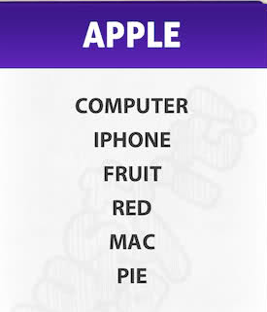
Taboo Activity
Objective: Get your groupmates to say the word without using the other words on the card.

