Slide 1
Teaching Vocabulary & Grammar
Approaches & Techniques

Slide 2
Things to ask yourself
What am I going to teach ( words, phrases, grammar patterns)
How many?
When am I going to teach it? ( before, during, after)
How am I going to teach it ( deductively, inductively)
What do I want my students to be able to do with what they learn? ( understand (receptive) , understand and use (productive))

Slide 3
How many new words in a day?
This question does not have a straightforward answer as it depends on the difficulty and abstractness of the words.
If they are simple verbs or nouns 5-7 would seem appropriate.
For more difficult words 3-5 may be more than enough.
Miller (1956) found that adults, when given a list of items to attempt to memorize, have the ability to recall seven of the items—plus or minus two—without any special training. (but these were just words in a list that these people already knew)

Slide 4
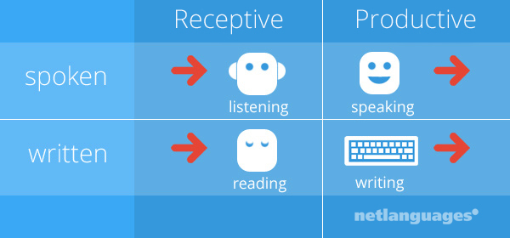
Receptive vs. Productive
You are in receptive control of the language that you understand when you hear it.
You are in productive control of language that you use to express yourself, in speech or in writing.

Slide 5
Words & Phrases

Slide 6
What is it to ‘know’ a word/phrase/ grammatical construction?
To understand receptive input, what do students need to know?
To be able to use it in productive output, what do students need to know?

Slide 7
Depth of knowledge
Knowing a word, phrase, or grammar construction is a matter of degrees of depth: knowing the gist of the meaning is often all you need when you hear or read language.
As you become better acquainted with a word, phrase, or grammar construction, you begin to know its nuances, connotations, etc.
In other words, you must be in control of a lot of information before you are able to use what you learn properly

Slide 8
Depth of knowledge for words & phrases
Spelling
Pronunciation
Part of speech
Meaning
Collocations
Inflected forms
Related words/ synonyms/ antonyms
How and when to use it in writing
How and when to use it in speaking

Slide 9
Depth of knowledge for grammar
Rules (prescriptive vs descriptive)
Patterns ( inflections, collocations, etc.)
Meaning/ difference in meaning from similar grammar points
How and when to use it in writing
How and when to use it in speaking

Slide 10
Example
bald (V)
yind (V)

Slide 11
Can you get a general understanding ?
a. Jima Dima climbed slowly and carefully. He didn’t want to bald while climbing Mount Everest.
b. . Jima Dima climbed slowly and carefully. Jima Dima didn’t want to yind while climbing Mount Everest.

Slide 12
Now try to use the words in a past tense sentence
bald (v)
yind (v)
die
hurt oneself badly (especially in the legs)

Slide 13
Now try to use the words
bald (v)
bold (past simple)
bold (past perfect)
yind (v)
yaund ( past simple)
yaund (past perfect)
die
hurt oneself badly (especially in the legs)

Slide 14
Receptive vs. Productive

Slide 15
Form Use Meaning Pronunciation
Receptive
What does it look like (spelling, grammar construction)?
What does it mean in the context I will see it?
Connotative/Denotative meaning
If it has multiple meanings, how can I know which is correct?
(How is it pronounced?)

Slide 16
Form Use Meaning Pronunciation
Productive
How is it pronounced?
Part of speech ( vocab.)
How is it spelled/ constructed?
What does it mean?
Connotative/Denotative meaning
Is it formal/informal/ common/ uncommon in speaking/writing?
How can I use use it in speaking/ in writing?

Slide 17
Traditional Approach: Presenting Meaning
Deductive presentation – direct/ teacher-centered
Inductive presentation – eliciting/ student centered/ Teacher provides a ‘pregnant context’ , e.g. a situation or story from which the meaning of the word can be easily guessed

Slide 18
What Words/ Grammar Do I Teach?

Slide 19
Do students need to know all of the words and grammatical patterns to get the general meaning?

Slide 20
Personally…
I use my best judgement based on what I feel students will benefit most from.
I think about words they don’t know, but should know (if they are basic)
I also think about which words and grammatical constructions that are crucial for students to understand the input (Key words).
I then have students tell me additional words, phrases, grammar points they would like me to explain (but this may be better to have them do by themselves).

Slide 21
Should you teach all of the words and grammar patterns?
I wouldn’t recommend it.
Definitely teach the words and grammar constructs that are necessary to comprehend the text.
You can skip the ones that you think most of the students already know.

Slide 22
Application Task
Look at the following excerpts.
List all the words or grammar patterns that are likely to be unfamiliar to students.
On the basis of your analysis, what will you teach? Why?
Which will need only brief attention? Why?
Which will you give more elaborate attention to? Why?

Slide 23
Practice

Slide 24
Practice

Slide 25
Practice
Many years ago, psychologists performed an experiment in which they put a number of people in a room, alone except for a ring toss set. It was one of those children’s toys with a short wooden post held upright on the floor and a bunch of round rings. The subjects were left alone to amuse themselves as best they could. As expected, with time to kill, they began trying to toss the rings around the post. What the psychologists discovered was that most of the people moved far enough away from the post so that tossing the rings around it was challenging but not so difficult as to be totally frustrating. In other words, they deliberately positioned themselves between frustration on the one hand and boredom on the other. The process of alternately producing and relieving tension was what made the activity stimulating.

Slide 26
Practice
Many years ago, psychologists performed an experiment in which they put a number of people in a room, alone except for a ring toss set. It was one of those children’s toys with a short wooden post held upright on the floor and a bunch of round rings. The subjects were left alone to amuse themselves as best they could. As expected, with time to kill, they began trying to toss the rings around the post. What the psychologists discovered was that most of the people moved far enough away from the post so that tossing the rings around it was challenging but not so difficult as to be totally frustrating. In other words, they deliberately positioned themselves between frustration on the one hand and boredom on the other. The process of alternately producing and relieving tension was what made the activity stimulating.

Slide 27
Traditional Deductive Teaching Approaches

Slide 28
Deductive teaching
Receptive
Show the word/ phrase/ grammar pattern/ rule
Present the meaning in the context students will see it. ( example sentence)
Do not present multiple meanings
If they know another meaning of the word you can help them to examine the different contexts and how the meaning changes.
Introduce them to how the word is pronounced. (Technology is your friend!)

Slide 29
Deductive teaching
Productive
Show the word/phrase/ grammar pattern/ rule
Present the meaning in the context students will use it. (example sentence)
Give them lots of examples (speaking or writing).
Focus on accurate usage (grammar, meaning in context, appropriate situations etc.).
If they know another meaning of the word you can help them to examine the different contexts and how the meaning changes.
Introduce them to how the word/ phrase is pronounced.

Slide 30
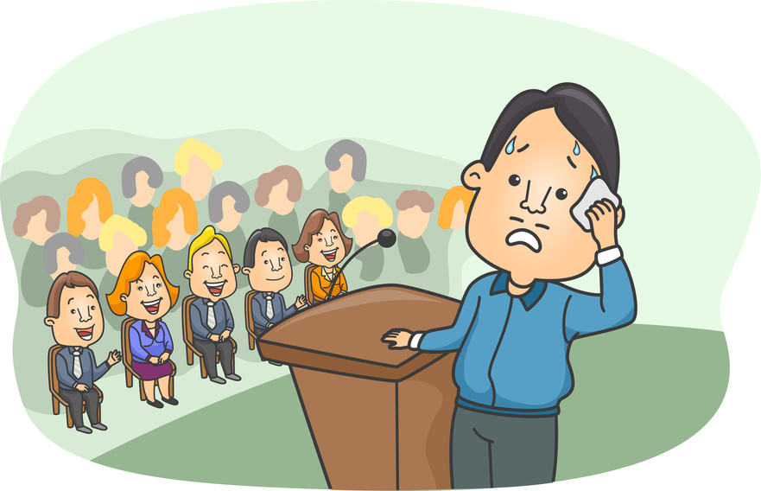
He gets nervous when he speaks in front of people.
nervous (adj.)

Slide 31
nervous (adj.)
– feeling anxious, scared, uneasy
She feels nervous in an airplane.
She is nervous because she has a final exam tomorrow.
He always gets nervous before interviews.

Slide 32
He gets nervous when he speaks in front of people.
Subject + get (s) + adj.+ when + subject + verb
To become (adj) in a specific situation.

Slide 33
1. He gets nervous when he speaks in English. 2. She gets nervous when she has an exam. 3. They get nervous when they have a presentation. 4. I get nervous when I fly.
Subject + get (s) + adj.+ when + subject + verb
To become (adj) in a specific situation.

Slide 34
Present Practice Produce
Present: Teacher presents the new terms to the learners.
Practice: Students then engage in controlled or semi-controlled activities or worksheets that help them learn, personalize, and use the words in the appropriate context. (more than one activity can and probably should go here)
Production: Students use the words in a productive activity (speaking or writing).

Slide 35
Sample vocabulary procedures
Present: Teacher presents the Form, Use, Meaning, and Pronunciation or words that students will see in their textbook story today.
Practice: Teacher has students do a worksheet which has them write down their own definitions of the words and then do a fill-in-the-blank worksheet.
Produce: The teacher then has them do a writing activity which they have to make 3 of their own sentences for each word they learned.

Slide 36
Sample grammar procedures
Present: Teacher presents the grammar point and covers rules, patterns, meaning, examples etc. .
Practice: Teacher has students do a worksheet or activity which has them use the grammar.
Produce: The teacher then has them do a writing activity which they have to make 3 of their own sentences using the grammar point they learned.

Slide 37
Teaching Meaning

Slide 38
What are different ways to teach the meaning of words?
With your group think of as many ways as possible to teach the meaning of words?
Consider the following words:
cake (n.)
scream (v.)
paranoid ( adj.)

Slide 39
What are different ways to teach the meaning of grammar?
With your group think of as many ways as possible to teach the meaning of words?
Consider the following grammar points
Always, often, sometimes, rarely, never
I have been to Europe 3 times.
He can juggle.

Slide 40
Teaching Meaning of Words & Phrases
1:1 translation
dictionary definition
oral/written description
pictures (make sure meaning is clear/ accurate)
body language (gestures, facial expressions)
realia
synonyms/antonyms
examples (lots of them)
media (video, clips, internet)
drawing
eliciting from students
cline
chart

Slide 41
Teaching Meaning of Grammar
L1/ L2 explanation
graphs
charts
clines
examples (lots of them)
stories
media (video, clips, internet)
drawing
eliciting from students

Slide 42
He gets nervous when he speaks in front of people.

Slide 43
He gets nervous when he speaks in front of people.
nervous (adj.)

Slide 44
Facial Expressions & Gestures
exciting enormous terrible painful
strange exhausting tiny itchy
relax smelly funny confused
boring long tired hungry

Slide 45
Drawing
between
ukulele
angry
scorpion
bucket
raccoon

Slide 46
How would you teach the meaning ?
candle (n)
adore (v)
rotate (v)
fundamental (adj.)
acceptable (adj.)
suspect (n)
accomplish (v)
imagination (n)

Slide 47
Task
Practice directly teaching the meaning of 3 words on the following list.

Slide 48
Translating Words and Lexemes
Examining the benefits and drawbacks

Slide 49
Benefits and Drawbacks
What are some of the benefits and drawbacks of translation when teaching the meaning of vocabulary items or lexis?

Slide 50
L1 use is extremely helpful…
To teach students difficult, detailed concepts.
To explain things to students that are too difficult for them to comprehend in L2.
To clarify things.
To check students understanding.

Slide 51
The Dangers of Translation

Slide 52
Classroom Translation Practices

Slide 53
The Double Iceberg Model (Whitehead & Hwang, 2012)
English
Korean

Slide 54
Common Translation Process…
English
Korean
[1]
Language
Meaning in context

Slide 55
Thinking Process for Translation
English
Korean
Language
[2]
[3]
[3a]
Meaning in context
[1]
[2a]
[4. Same or Different?]

Slide 56
Word Meaning Relationships
Relationship | Definition
1:1 | The word or phrase meaning being translated from English has a perfect word or phrase match in Korean. English word + Meaning = Korean word + Meaning
Fake 1:1 | Type A Words appear to have 1:1 relationship; however, in context the meaning of the English word is not what it first appears. Therefore, the Korean translation/explanation must also reflect the meaning in context.
 | Type B On the surface, the words appear to have a perfect 1:1 relationship; however, slight differences exist in meaning. (Word meaning differs in different language and cultures.)
1:0 | English word and meaning has no direct match in Korean, and therefore, requires an explanation of meaning.

Slide 57
Steps to Effective L1
DO NOT translate word to word simply from memory or from an English to Korean dictionary! (GTM style) this can lead to inaccurate translation!
Find the English meaning of the word or phrase in the context you are teaching.
DO NOT teach multiple definitions. The context will give you the correct meaning to teach.
This is your starting point to effective translation.

Slide 58
Let’s Try
I ate a big apple.

Slide 59
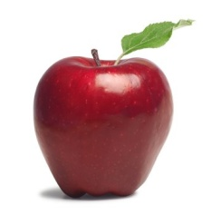
1:1 Translation
English
Korean
big apple
큰사과
Language
Meaning

Slide 60
Let’s Try
I went to the Big Apple.

Slide 61
Fake 1:1 (Type A)Translation
English
Korean
Fake 1:1 (Type A) Translation
There is a representative in the Korean language, but meaning is different. The translation/explanation must reflect the meaning in the context.
Big Apple
큰사과
Language
Meaning

Slide 62
Let’s Try
The boy ate some shepherd’s pie.

Slide 63
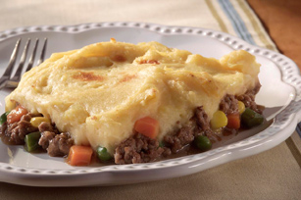
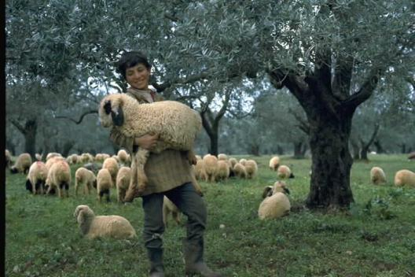
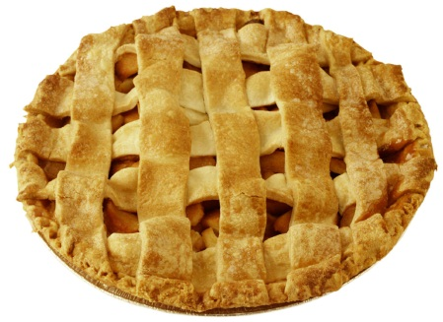
Fake 1:1 (Type A) Translation
English
Korean
Fake 1:1 (Type A) Translation
There is a representative in the Korean language, but meaning is different. The translation/explanation must reflect the meaning in the context.
shepherd’s pie
양치기의 파이
고기에 그래비 소스를 섞고 매시트 감자를 위에 얹어 먹는 영국음식.
Language
Meaning

Slide 64
Let’s Try
I love you~

Slide 65
Fake 1:1 (Type B)Translation
English
Korean
Fake 1:1 (Type B) Translation
On a language level, it seems to be a perfect match, however, languages hold different usage and meaning. In such cases, you have to give explanation to provide a full picture of the word/expression used.
I love you
난 너를 사랑해
가족이나 친구들 사이에서 ‘I love you’를 습관적으로 쓰인다. 한국어로 무겁고 깊이가 있는 ‘사랑해’란 표현 비해 영어는 더 쉽게 자주 사용된다.
Language
Meaning

Slide 66
Let’s Try
Xiaoming ate a poutine for lunch.

Slide 67
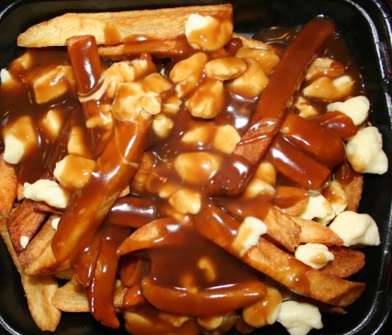
1:0 Translation
English
Korean
1:0 Translation
There is no direct match in Korean for the English word/phrase. In such case, you have to provide explanation to understand what it means and how it is used.
감자튀김에 그레이비 소스랑 치즈를 버무린 음식.
poutine
Language
Meaning

Slide 68
Practice
Application time

Slide 69
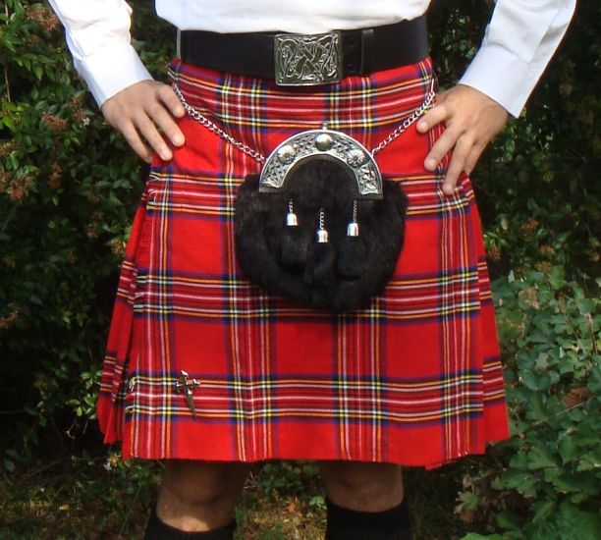
Thinking Time
The test was a piece of cake!
Shut Up! I can’t believe you won!!
The bag is heavy.
I saw a snail on the road. The car was driving so slow!
An old man sees a young boy (they have never met).. He says, “Come here son!”.
Hi pumpkin! How was your day?
I bought a kilt when I went to Scotland

Slide 70
Extra Practice
The coffee shop was crowded.
My friend launched his new clothing line last week.
She was paranoid about her parents finding out.
He injured his leg in the game.
She got cold feet before the wedding.
He was very masculine.

Slide 71
Steps to Effective L1
DO NOT translate word to word simply from memory or from an English to Korean dictionary! (GTM style) this can lead to inaccurate translation!
Find the English meaning of the word or phrase in the context you are teaching.
DO NOT teach multiple definitions. The context will give you the correct meaning to teach.
This is your starting point to effective translation.

Slide 72
Implications of the Model

Slide 73
Checking Understanding of Meaning
Concept Checking Questions

Slide 74
Concept Checking Questions
Purpose: to check if students have understood key concepts in vocabulary/ grammar .

Slide 75
CCQs
Questions
Concept checking questions are specialized questions that elicit responses related to the meaning of the words they were taught.
Eliciting
CCQs

Slide 76
Which of these questions are good to check students understanding?
Do you understand?
Got it?
OK?
알았어?
이해했지?

Slide 77
CCQs and ICQs
The checking of concepts usually occurs in vocabulary and grammar teaching. ( iceberg below the surface)

Slide 78
Concept Checking
www.dictionary.com
Identify the key concept/ meaning of the word, phrase, or grammar point in context (only teach the meaning that they will encounter in the lesson).
Create questions that focus on the key concept/meaning.
REMEMBER: You can use gestures and visual aids to support your concept checking!
Make sure the questions are NOT more difficult than the point you are trying to check.

Slide 79
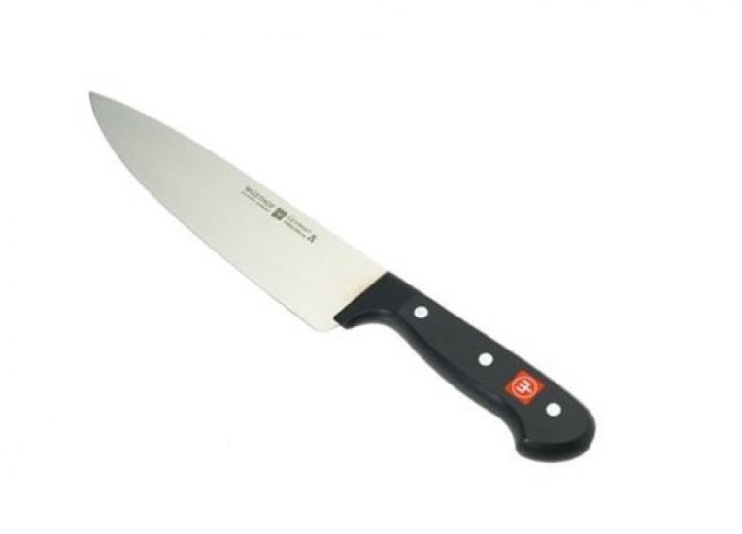
Example CCQs for Vocabulary
sharp (adj.)
The knife is sharp!
Is a spoon sharp?
Is a pen sharp?
Is a knife sharp?
Tell me some things that are sharp.
BEGINNER RECIPE:
1. NO
2. NO
3.YES
4. WHAT?

Slide 80
Example CCQs for Grammar
Will + be + Ving
I will be eating dinner at 6pm.
Does this action start before 6pm?
Am I finished dinner at 6pm?
Is the action in progress at 6pm?
Have + P.P.
I have been to Spuzzum.
Does have + P.P talk about the past, present, or future?
Did she ever go to Spuzzum?
Do we know exactly when she went?

Slide 81
Time to practice
Look at the following examples.
Put a circle next to good CCQs and an X next to bad CCQs.
Bakery (N)
Is Baskin Robbins a bakery?
What can you buy in a bakery?
Does a baker work at a bakery?
Tell me some bakeries in Korea!
Do you like bakeries?
2.
Heavy (Adj)
Is an elephant heavy?
Are you heavy?
What is heavier… a chicken or a horse?
How do you say “heavy” in Korean?
What else is heavy?

Slide 82
MORE CCQ RECIPES
Is a noun + adjective? Ex. Is a knife sharp?
Can a noun + verb? Ex. Can a penguin fly?
Tell me things that are/can_______?
Give me an example!
How do you say ___ in Korean?
No, No, Yes, What?

Slide 83
More Practice
float (v)
rotate (v)
antique (adj.)
octagon (n)
outgoing (adj.)
relative (n)
simmer (v)
fun (adj.)
funny (adj.)
poke (v.)
slippery (adj.)
dangerous (adj.)
sneak (v)

Slide 84
TIP
Don’t answer your own CCQs/ICQs
Break up your instructions with ICQs (do not give long instructions one shot and then try to ICQ all of them!)

Slide 85
Word Frequency
Wordcount.org

Slide 86
Appendices

