Slide 1
Teaching Vocabulary
Deductive Approaches & Techniques

Slide 2
When do we teach vocabulary?
When does vocabulary teaching happen?
What kind of lessons include vocabulary teaching?
Should vocabulary be presented in the same way in all of those types of lesson?

Slide 3
When do we teach vocabulary?
A language (vocabulary) lesson: The teacher identifies a set of lexical items (thematically related) which she wants the learners to use productively.
A skills lesson: This may be either before the lesson (by pre-teaching essential vocabulary prior to a listening or reading text), during a lesson (while monitoring) or after the lesson (taking up words that students had difficulty with).
As it comes up: Learners might ask how to express something in English. The teacher will often provide the learner with a word or phrase, or the teacher will respond to a student’s error.

Slide 4
As a learner
Is this a word that I simply need to recognize when I read or listen?
Is this a word that I want/need to use when I am speaking or writing?

Slide 5
As a teacher
Is this a word that I want my students to simply recognize when listening or reading?
Is this a word that I want my students to use either in speaking or writing?

Slide 6
Knowing vs Using
Children understand words and phrases way before they can say them:
A 2 year old can understand things like "Let's put on our shoes. It's time to go now" well before he/she is able to produce these phrases.
Adults receptive vocabulary remains considerably larger than their productive vocabulary.
This is also the same of learners of English as a second or additional language.

Slide 7
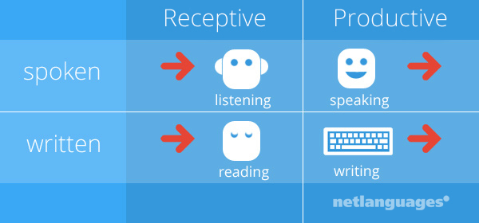
Receptive vs. Productive
You are in receptive control of the words that you understand when you hear them or read them.
You are in productive control of the words that you use to express yourself, in speech or in writing.

Slide 8
What is it to ‘know’ a word?
Receptive vocabulary
What do students need to know?
Productive vocabulary
What do students need to know?

Slide 9
Depth of knowledge
Knowing a word is a matter of degrees of depth: knowing the gist of a word is, quite often, all you need when you hear or read a word.
As you become better acquainted with a word, you begin to know its nuances, connotations, etc.
In other words, you must be in control of a lot of information about a word before you are able to use it properly

Slide 10
Depth of knowledge
How well does one know a word or phrase and what are they able to do with the word?
Spelling
Pronunciation
Part of speech
Meaning
Collocations
Inflected forms
Related words/ synonyms/ antonyms
How and when to use it in writing
How and when to use it in speaking

Slide 11
Example
bald (V)
yind (V)

Slide 12
Can you get a general understanding ?
a. Jima Dima climbed slowly and carefully. He didn’t want to bald while climbing Mount Everest.
b. . Jima Dima climbed slowly and carefully. Jima Dima didn’t want to yind while climbing Mount Everest.

Slide 13
Now try to use the words in a past tense sentence
bald (v)
yind (v)
die
hurt oneself badly (especially in the legs)

Slide 14
Now try to use the words
bald (v)
bold (past simple)
bold (past perfect)
yind (v)
yaund ( past simple)
yaund (past perfect)
die
hurt oneself badly (especially in the legs)

Slide 15
Receptive vs. Productive

Slide 16
Form Use Meaning Pronunciation
Receptive vocabulary
What does it look like (spelling)?
What does it mean in the context I will see it?
Connotative/Denotative meaning
If the word has multiple meanings, how can I know which is correct?
(How is the word pronounced?)

Slide 17
Form Use Meaning Pronunciation
Productive vocabulary
How is it pronounced?
How is it spelled?
What does the word mean?
Connotative/Denotative meaning
Is the word formal/informal/ common/ uncommon in speaking/writing?
How can I use the word in context?
What part of speech is it?

Slide 18
How to approach the teaching of words
Traditional direct approach: Teach vocabulary items
Learner training approach: Teach conscious vocabulary-related strategies
give a man a fish and you feed him for a day; teach a man to fish and you feed him for a lifetime
Natural approach: Create opportunities for spontaneous acquisition via communicative tasks .

Slide 19
Traditional Approach: Presenting Meaning
Deductive presentation – direct/ teacher-centered
Inductive presentation – eliciting/ student centered/ Teacher provides a ‘pregnant context’ , e.g. a situation or story from which the meaning of the word can be easily guessed

Slide 20
Important Definitions

Slide 21
Task:
a word/ lemma -
collocations -
lexical chunks-
lexis-
word family -
With your groupmates find the definition of each of these.
Also provide an example (except for lexis)
You can use the internet!!

Slide 22
Some Important Definitions
a word/ lemma - the word you see in the dictionary or base form of a word.
collocations – words that often go together (make a mess vs. do a mess)
lexical chunks – longer strings of words, phrases, fixed expressions ( up to now, if I were you, How’s it going?)
lexis – all of the words in a language.
word family – a group which of words that have a common feature, pattern or meaning. They usually share a common base or root word, to which different prefixes and suffixes are added. (happy, unhappy, happiness; real, unreal, reality)

Slide 23
What Words Do I Teach?

Slide 24
Do students need to know all of the words to get the general meaning?

Slide 25
What words to teach
The one’s that the book or curriculum tells you to.
The one’s that you think your students will have difficulty with.
The one’s that make the input (reading/listening) difficult to understand.
Depends if you are focusing on general or specific understanding as well as level or comprehension.

Slide 26
[Answers: road, can, stock, sum, luxurious, shake, shook, can, road]

Slide 27
Isabel L. Beck, PhD
Professor Emerita of Education in the School of Education at the University of Pittsburgh. She has conducted research and published widely in the areas of decoding, vocabulary, and comprehension. Her contributions have been acknowledged by awards from the International Literacy Association, the Literacy Research Association, and the American Federation of Teachers.

Slide 28
Choosing Words
Isabel Beck’s (University of Pittsburg)--- vocabulary words into three tiers:
Beck--- students will benefit the most academically by focusing instruction on the tier two words
But if student don’t know Tier 1 words, they need to be taught them.
It all depends on the level of your students.
Using your sense of judgement about which words to teach (I+1)

Slide 29
You can also choose inductively…
Get students to read or listen to a text
Write down or highlight the words that they do not know.
Get students to tell you words they wrote down or highlighted.
Teach them those words.
TIP: You still need to prepare beforehand so you are ready to teach the words. You should be able to guess which words they will have difficulty with.

Slide 30
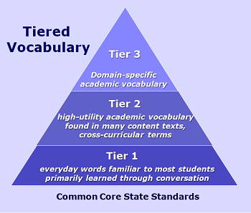
Tier Words
Tier 3---highly specialized, subject specific; frequency of these words is quite low and often limited to specific fields of study
(Aorta, Neurology, Legislature, Circumference, Mozart, Physiology, Feudalism)
Tier 2---abstract, general academic language across content areas; crucial when using mature academic language
(analyze, synthesize, justify, repetition, endurance, coincidence, reluctant, analysis, empire)
Tier 1---Basic words that rarely require instructional focus and are encountered in conversation/oral vocabulary
(Door, house, book,)

Slide 31
Is it tier 2?
Word | Is this a generally useful word? | Does the word relate to other words and ideas that students know or have been learning? | Is the word useful in helping students understand text? | If you answer “yes” to all three questions, it is a Tier 2 word. If not, it is probably a Tier 1 or 3 word.
Notes:
This slide provides educators with a possible strategy that teachers can use to determine Tier 2 words.

Slide 32
Try it out!
The servants would never comment on this strange occurrence [finding the kitchen clean even though none of them were seen doing the cleaning], each servant hoping the other had tended to the chores. Never would they mention the loud noises they'd hear emerging from the kitchen in the in middle of the night. Nor would they admit to pulling the covers under their chins as they listened to the sound of haunting laughter that drifted down the halls to their bedrooms each night. In reality, they knew there was a more sinister reason behind their good fortune.

Slide 33
Critical Thinking:
How helpful is the tier analysis for L2 teachers?
…

Slide 34
Personally…
I use my best judgement based on what I feel students will benefit most from.
I think about words they don’t know, but should know (if they are basic)
I also think about which words are crucial for students to understand the input (Key words).
I then have students tell me additional words they would like me to explain (but this may be better to have them do by themselves).

Slide 35
Should you teach all of the words?
It is kind of up to you.
Definitely teach the words that are necessary to comprehend the text.
You can skip the ones that you think most of the students already know.

Slide 36
Try it out!
The servants would never comment on this strange occurrence [finding the kitchen clean even though none of them were seen doing the cleaning], each servant hoping the other had tended to the chores. Never would they mention the loud noises they'd hear emerging from the kitchen in the in middle of the night. Nor would they admit to pulling the covers under their chins as they listened to the sound of haunting laughter that drifted down the halls to their bedrooms each night. In reality, they knew there was a more sinister reason behind their good fortune.

Slide 37
Comment
Occurrence
Tended
Mention
Emerging
Admit
Haunting
Reality
Sinister
Fortune

Slide 38
Personally…
I use my best judgement based on what I feel students will benefit most from.
I think about words they don’t know, but should know (if they are basic)
I also think about which words are crucial for students to understand the input (Key words).
I then have students tell me additional words they would like me to explain (but this may be better to have them do by themselves).

Slide 39
Application Task
Look at the following excerpts.
List all the words that are likely to be unfamiliar to students.
On the basis of your analysis, which words will you teach? Why?
Which will need only brief attention? Why?
Which will you give more elaborate attention to? Why?

Slide 40
Practice

Slide 41
Practice

Slide 42
Practice
Many years ago, psychologists performed an experiment in which they put a number of people in a room, alone except for a ring toss set. It was one of those children’s toys with a short wooden post held upright on the floor and a bunch of round rings. The subjects were left alone to amuse themselves as best they could. As expected, with time to kill, they began trying to toss the rings around the post. What the psychologists discovered was that most of the people moved far enough away from the post so that tossing the rings around it was challenging but not so difficult as to be totally frustrating. In other words, they deliberately positioned themselves between frustration on the one hand and boredom on the other. The process of alternately producing and relieving tension was what made the activity stimulating.

Slide 43
Traditional Deductive Teaching Approaches

Slide 44
Deductively Presenting a New Word or Phrase
Receptive words:
Show the word
Present the meaning in the context students will see it.
Do not present multiple meanings of the word.
If they know another meaning of the word you can help them to examine the different contexts and how the meaning changes.
Introduce them to how the word is pronounced. (Technology is your friend!)
Productive Words:
Show the word
Present the meaning in the context students use it.
Give them lots of examples (speaking or writing).
Focus on accurate usage (grammar, meaning in context, appropriate situations etc.).
If they know another meaning of the word you can help them to examine the different contexts and how the meaning changes.
Introduce them to how the word is pronounced.

Slide 45
Present Practice Produce
Present: Teacher presents the new terms to the learners.
Practice: Students then engage in controlled or semi-controlled activities or worksheets that help them learn, personalize, and use the words in the appropriate context. (more than one activity can and probably should go here)
Production: Students use the words in a productive activity (speaking or writing).

Slide 46
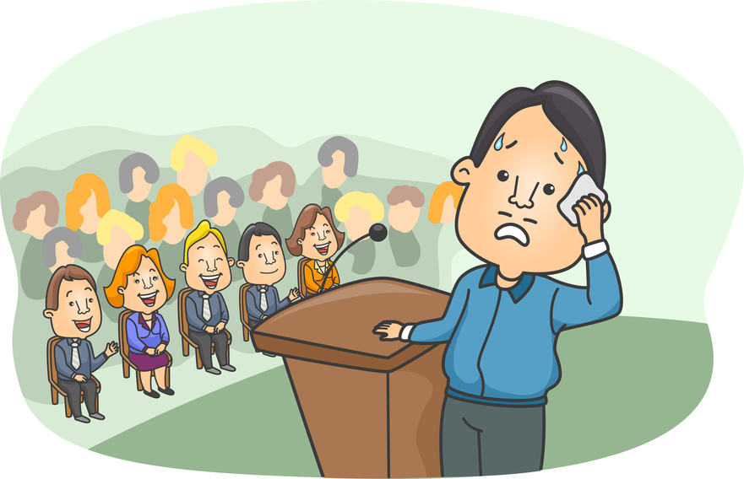
He gets nervous when he speaks in front of people.
nervous (adj.)

Slide 47
Present Practice Produce
Present: Teacher presents the new terms to the learners.
Practice: Students then engage in controlled or semi-controlled activities or worksheets that help them learn, personalize, and use the words in the appropriate context. (more than one activity can and probably should go here)
Production: Students use the words in a productive activity (speaking or writing).

Slide 48
Sample
Present: Teacher presents the Form, Use, Meaning, and Pronunciation or words that students will see in their textbook story today.
Practice: Teacher has students do a worksheet which has them write down their own definitions of the words and then do a fill-in-the-blank worksheet.
Produce: The teacher then has them do a writing activity which they have to make 3 of their own sentences for each word they learned.

Slide 49
Test- Teach-Test
Test 1 – Give students a task to check what they already know. (matching, categorising, ordering, gap-fill, define, translate, etc.)
Teach – Check what students get right. Teach or clarify what they didn’t understand
Test 2 – Give students another (different) task to have them use what they learned in a controlled way. (matching, categorising, ordering, gap-fill, define, translate, etc.)
(*Teach – Check what students get right. Teach or clarify what they didn’t understand.)
Produce – Students use the words in a productive activity (speaking or writing).

Slide 50
Sample
Test: Teacher gives learners a matching task to check what they already know.
Teach: Teacher checks what students get right, then corrects their mistakes and teaches them what they didn’t understand.
Test: Teacher gives learners a gap-fill worksheet to put what they learn into practice.
Teach: Teacher checks what students get right, then corrects their mistakes and teaches them what they didn’t understand.
Test: Teacher has students write their own sentences to put what they learn into practice.

Slide 51
Thinking time…
In what situations is a Test – Teach – Test approach appropriate?
Why is it useful?

Slide 52
Test-Teach-Test
Useful when you are unsure what language the students know.
Provides a simple needs analysis in which teachers can target the specific language needs of their learners.

Slide 53
A Test-Teach-Test approach…
… enables teachers to identify the specific needs of learners concerning a language area and address this need suitably.
It can be particularly useful at intermediate levels and above, where learners may have seen language before, but have specific problems with it.
It can also be useful in mixed level classes to help identify objectives for each individual.

Slide 54
Teaching Meaning

Slide 55
What are different ways to teach the meaning of words?
With your group think of as many ways as possible to teach the meaning of words?
Consider the following words:
cake (n.)
scream (v.)
paranoid ( adj.)

Slide 56
Teaching Meaning
1:1 translation
dictionary definition
oral/written description
pictures (make sure meaning is clear/ accurate)
body language (gestures, facial expressions)
realia
synonyms/antonyms
examples (lots of them)
media (video, clips, internet)
drawing
eliciting from students
cline
chart

Slide 57
He gets nervous when he speaks in front of people.

Slide 58
He gets nervous when he speaks in front of people.
nervous (adj.)

Slide 59
Facial Expressions & Gestures
exciting enormous terrible painful
strange exhausting tiny itchy
relax smelly funny confused
boring long tired hungry

Slide 60
Drawing
between
ukulele
angry
scorpion
bucket
raccoon

Slide 61
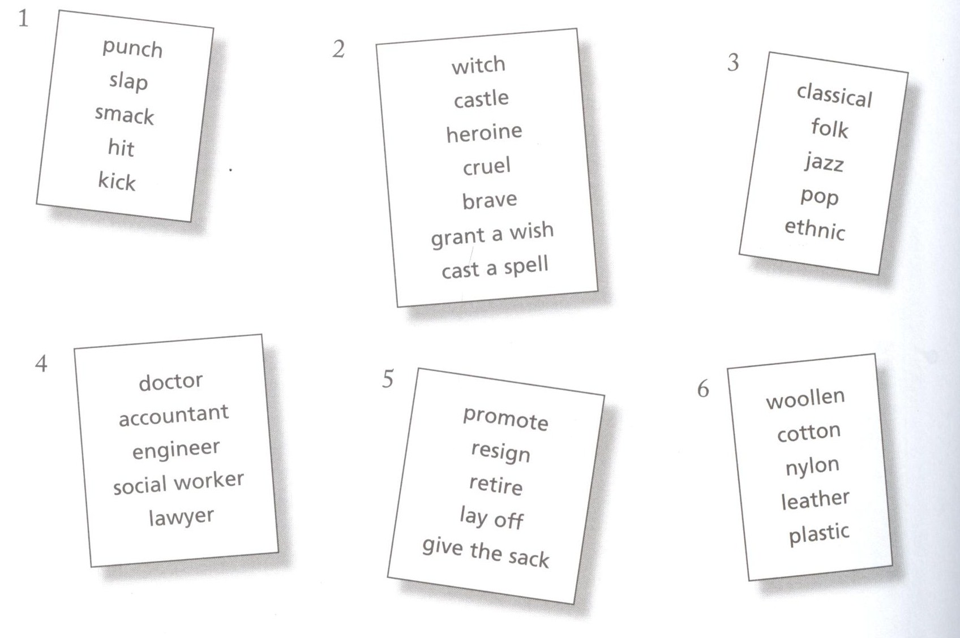

Slide 62
How would you teach the meaning ?
candle (n)
adore (v)
rotate (v)
fundamental (adj.)
acceptable (adj.)
suspect (n)
accomplish (v)
imagination (n)
scandal (n)
foolish (adj.)
vein (n)
controversial (adj.)
ashamed (adj.)
freezing (adj.)
regularly (adv.)
situation (n)
evidence(n)
pillar (n)
common (adj.)
seek (v)
billboard (n)
cautiously (adv.)
near (adj.)
serious(adj.)

Slide 63
Task
Practice directly teaching the meaning of 3 words on the following list.

Slide 64
How would you teach the meaning ?
rotate (v)
fundamental (adj.)
acceptable (adj.)
accomplish (v)
imagination (n)
scandal (n)
foolish (adj.)
controversial (adj.)
ashamed (adj.)
common (adj.)
cautiously (adv.)
serious(adj.)
regularly (adv.)
situation (n)

Slide 65
Translating Words and Lexemes
Examining the benefits and drawbacks

Slide 66
Benefits and Drawbacks
What are some of the benefits and drawbacks of translation when teaching the meaning of vocabulary items or lexis?

Slide 67
Key Points when translating
If used judiciously, it can aid language acquisition.
If used haphazardly, it can inhibit language acquisition.

Slide 68
When translating…
Use translation as a tool not as a habit.
Literal translation can be dangerous!

Slide 69
Classroom Translation Practices

Slide 70
Common Classroom Practices
Teacher translating text for students line by line as they read.
Directly translating words/ phrases.
Matching English words with Korean words.

Slide 71
Supported L1 Practices
Student Centered Support
Teacher Centered Support

Slide 72
Student Centered Support
Facilitating and aiding the comprehension of L2 that is extremely difficult or abstract through translation or explanation in L1.

Slide 73
Teacher Centered Support
Checking students understanding of difficult or abstract concepts
Time efficiency
Drawing attention to/emphasizing key points

Slide 74
The Dangers of Translation

Slide 75
The Double Iceberg Model (Whitehead & Hwang, 2012)
English
Korean

Slide 76
Common Translation Process…
English
Korean
[1]
Language
Meaning in context

Slide 77
Thinking Process for Translation
English
Korean
Language
[2]
[3]
[3a]
Meaning in context
[1]
[2a]
[4. Same or Different?]

Slide 78
Word Meaning Relationships
Relationship | Definition
1:1 | The word or phrase meaning being translated from English has a perfect word or phrase match in Korean. English word + Meaning = Korean word + Meaning
Fake 1:1 | Type A Words appear to have 1:1 relationship; however, in context the meaning of the English word is not what it first appears. Therefore, the Korean translation/explanation must also reflect the meaning in context.
 | Type B On the surface, the words appear to have a perfect 1:1 relationship; however, slight differences exist in meaning. (Word meaning differs in different language and cultures.)
1:0 | English word and meaning has no direct match in Korean, and therefore, requires an explanation of meaning.

Slide 79
Steps to Effective L1
DO NOT translate word to word simply from memory or from an English to Korean dictionary! (GTM style) this can lead to inaccurate translation!
Find the English meaning of the word or phrase in the context you are teaching.
DO NOT teach multiple definitions. The context will give you the correct meaning to teach.
This is your starting point to effective translation.

Slide 80
Let’s Try
I ate a big apple.

Slide 81
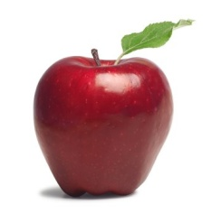
1:1 Relationship English can be directly translated into Korean with no loss in meaning
big apple
큰사과

Slide 82
1:1 Translation
English
Korean
big apple
큰사과
Language
Meaning

Slide 83
Let’s Try
I went to the Big Apple.

Slide 84
Fake 1:1 (Type A) Relationship 1.English can be directly translated but the meaning is inaccurate 2.It is possible to match the word indirectly to a word with the same meaning in Korean
big apple
뉴욕
큰사과
New York
New York

Slide 85
Fake 1:1 (Type A)Translation
English
Korean
Fake 1:1 (Type A) Translation
There is a representative in the Korean language, but meaning is different. The translation/explanation must reflect the meaning in the context.
Big Apple
큰사과
Language
Meaning

Slide 86
Let’s Try
The boy ate some shepherd’s pie.

Slide 87
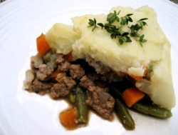
Fake 1:1 Relationship (Type A) 1.English can be directly translated but the meaning is inaccurate 2. Contextual meaning has no direct translation therefore explanation required
Shepherd’s Pie
양치기의 파이
???
고기에 그래비 소스를 섞고 매시트 감자를 위에 얹어 먹는 영국음식.

Slide 88
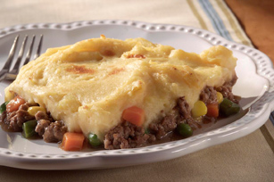
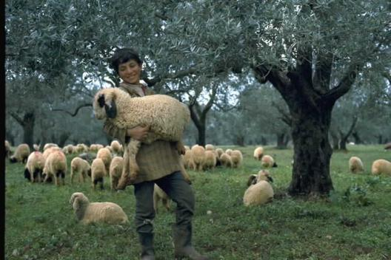
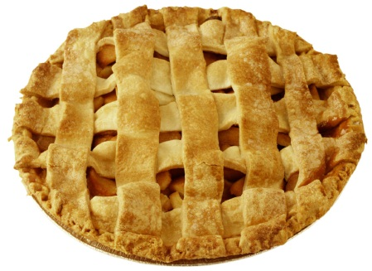
Fake 1:1 (Type A) Translation
English
Korean
Fake 1:1 (Type A) Translation
There is a representative in the Korean language, but meaning is different. The translation/explanation must reflect the meaning in the context.
shepherd’s pie
양치기의 파이
Language
Meaning

Slide 89
Let’s Try
I love you~

Slide 90
Fake 1:1 Relationship (Type B) English word has a very close direct translation however slight meaning difference may exist.
사랑해
사랑해
I love you
사랑해
가족이나 친구들 사이에서 ‘I love you’를 습관적으로 쓰인다. 한국어로 무겁고 깊이가 있는 ‘사랑해’란 표현 비해 영어는 더 쉽게 자주 사용된다.

Slide 91
Fake 1:1 (Type B)Translation
English
Korean
Fake 1:1 (Type B) Translation
On a language level, it seems to be a perfect match, however, languages hold different usage and meaning. In such cases, you have to give explanation to provide a full picture of the word/expression used.
I love you
난 너를 사랑해
Language
Meaning

Slide 92
Let’s Try
Xiaoming ate a poutine for lunch.

Slide 93
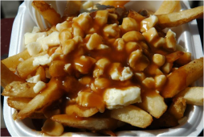
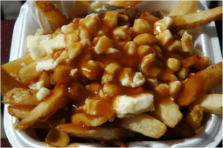
1:0 direct translation is not possible (no word or phrase match)
사랑해
사랑해
감자튀김에 그레이비 소스랑 치즈를 버무린 음식.
poutine
???

Slide 94
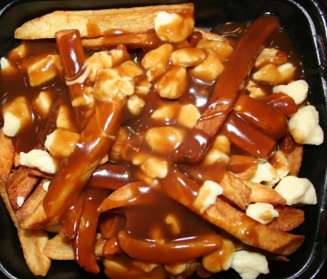
1:0 Translation
English
Korean
1:0 Translation
There is no direct match in Korean for the English word/phrase. In such case, you have to provide explanation to understand what it means and how it is used.
poutine
Language
Meaning

Slide 95
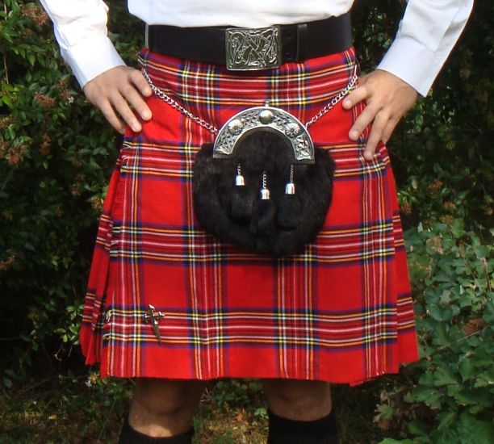
Thinking Time
The test was a piece of cake!
Shut Up! I can’t believe you won!!
The bag is heavy.
I saw a snail on the road. The car was driving so slow!
An old man sees a young boy (they have never met).. He says, “Come here son!”.
Hi pumpkin! How was your day?
I bought a kilt when I went to Scotland

Slide 96
Extra Practice
The coffee shop was crowded.
My friend launched his new clothing line last week.
She was paranoid about her parents finding out.
He injured his leg in the game.
She got cold feet before the wedding.
He was very masculine.

Slide 97
Steps to Effective L1
DO NOT translate word to word simply from memory or from an English to Korean dictionary! (GTM style) this can lead to inaccurate translation!
Find the English meaning of the word or phrase in the context you are teaching.
DO NOT teach multiple definitions. The context will give you the correct meaning to teach.
This is your starting point to effective translation.

Slide 98
Implications of the Model

Slide 99
Practice
Application time

Slide 100
Practice
Identify words from the text that would need to be taught to students before reading.
Identify their meaning in English.
Decide what kind of relationship the word has to its synonym in Korean.
Choose how you would use L1 to present the meaning (direct translation, explanation)

Slide 101
Practice

Slide 102
Practice
Flies are very sensitive to the smell of meat. Many female flies like to lay their eggs on meat to provide food for their babies. During past wars when many people were wounded, it could take several days for all the injured soldiers to be found and taken to a doctor. Since the soldiers were lying outside, sometimes the doctors found maggots inside the wounds. After some time, the doctors noticed that the soldiers who had maggots in their wounds recovered faster than the soldiers who did not. They studied what was happening and discovered that the maggots only ate the dead flesh. Not only that, but the maggots produced a chemical called allantoin, which helped the wounds heal faster. Look at the ingredient lists of hand lotions and deodorants, toothpastes, and soaps. Do you have any allantoin in your house?

Slide 103
Checking Understanding of Meaning
Concept Checking Questions

Slide 104
Concept Checking Questions
Purpose: to check if students have understood key concepts in vocabulary/ grammar / instructions.

Slide 105
CCQs
Questions
Concept checking questions are specialized questions that elicit responses related to the meaning of the words they were taught.
Eliciting
CCQs

Slide 106
Which of these questions are good to check students understanding?
Do you understand?
Got it?
OK?
알았어?
이해했지?

Slide 107
CCQs and ICQs
The checking of concepts usually occurs in vocabulary and grammar teaching. ( iceberg below the surface)
The checking of instructions usually comes after a teacher gives instructions and wants to check if students have understood what to do.
REMEMBER: ICQs are under the umbrella of CCQs but are specifically focusing on instructions

Slide 108
Concept Checking Vocabulary
www.dictionary.com
Identify the key concept/ meaning of the word in context (only teach the meaning that they will encounter in the lesson).
Create questions that focus on the key concept/meaning.
REMEMBER: You can use gestures and visual aids to support your concept checking!
Make sure the questions are NOT more difficult than the point you are trying to check.

Slide 109
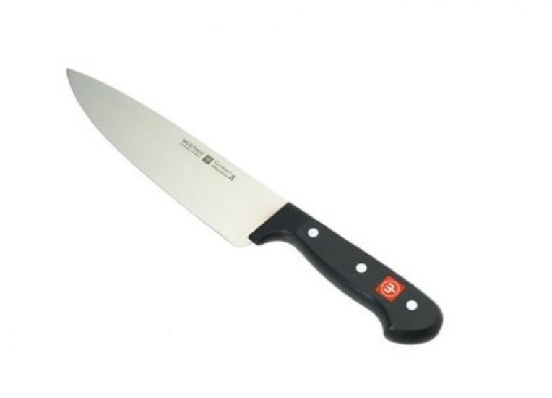
Example CCQs for Vocabulary
sharp (adj.)
The knife is sharp!
Is a spoon sharp?
Is a pen sharp?
Is a knife sharp?
Tell me some things that are sharp.
BEGINNER RECIPE:
1. NO
2. NO
3.YES
4. WHAT?

Slide 110
Time to practice
Look at the following examples.
Put a circle next to good CCQs and an X next to bad CCQs.
Bakery (N)
Is Baskin Robbins a bakery?
What can you buy in a bakery?
Does a baker work at a bakery?
Tell me some bakeries in Korea!
Do you like bakeries?
2.
Heavy (Adj)
Is an elephant heavy?
Are you heavy?
What is heavier… a chicken or a horse?
How do you say “heavy” in Korean?
What else is heavy?

Slide 111
MORE CCQ RECIPES
Is a noun + adjective? Ex. Is a knife sharp?
Can a noun + verb? Ex. Can a penguin fly?
Tell me things that are/can_______?
Give me an example!
How do you say ___ in Korean?
No, No, Yes, What?

Slide 112
More Practice
float (v)
rotate (v)
antique (adj.)
octagon (n)
outgoing (adj.)
relative (n)
simmer (v)
fun (adj.)
funny (adj.)
poke (v.)
slippery (adj.)
dangerous (adj.)
sneak (v)

Slide 113
Make your own CCQs
candle (n)
adore (v)
rotate (v)
fundamental (adj.)
acceptable (adj.)
suspect (n)
accomplish (v)
imagination (n)
scandal (n)
foolish (adj.)
vein (n)
controversial (adj.)
ashamed (adj.)
freezing (adj.)
regularly (adv.)
situation (n)
evidence(n)
pillar (n)
common (adj.)
seek (v)
billboard (n)
cautiously (adv.)
near (adj.)
serious(adj.)

Slide 114
Extra Practice

Slide 115
Putting it together
Choose 3 words that you made CCQs for.
Teach the meaning and CCQ each word one by one.
Choose the most appropriate methods to teach the meaning. (shortest and clearest way)

Slide 116
TIP
Don’t answer your own CCQs/ICQs
Break up your instructions with ICQs (do not give long instructions one shot and then try to ICQ all of them!)

Slide 117
Word Frequency
Wordcount.org

Slide 118
Appendices

Slide 119
The Six-Step Process to Effective Vocabulary Instruction
Provide a description, explanation, or example of the new term.
Ask students to restate the description, explanation, or example in their own words.
Ask students to construct a picture, pictograph, or symbolic representation of the term.
Engage students periodically in activities that help them add to their knowledge of the terms in their vocabulary notebooks.
Periodically ask students to discuss the terms with one another.
Involve students periodically in games that enable them to play with terms.

