Slide 1
Teaching Listening & Speaking
Introduction

Slide 2
Getting Started
Speaking
Listening
What are different aspects of speaking that come to your mind?
In order to speak English well what do learners need?
What are your personal speaking aims?
What are your speaking strengths and weaknesses?
If you were teaching a speaking class what would your aims be? Why?
In your opinion how do English speaking skills develop in L2 learners?
What are different aspects of listening that come to your mind?
In order to listen well what do learners need?
What are your personal listening aims?
What are your listening strengths and weaknesses?
If you were teaching a listening class what would your aims be? Why?
In your opinion how do English listening skills develop in L2 learners?

Slide 3
What do you think (T/F/D)
The more native-like a person’s pronunciation is the better.
Knowing a lot of idioms and slang is important to be a fluent speaker.
Knowing a lot of idioms and slang is important to be a fluent listener.
It is difficult to communicate if one’s grammar is poor.
Korean English words like ‘eye shopping’ should be avoided when speaking
Practicing speaking with non-native speakers hinders fluency.
A good goal for speaking is to be able to communicate with a native speaker of the language fluently.
A good goal for listening is to be able to understand native speakers fluently.
Confidence in learners own ability is one of the most important things to develop in regard to speaking.
Speaking and listening require constant and consistent input and output opportunities to develop.

Slide 4
Examining the Native Speaker model
The concept of the native speaker has been around for a long time and is often used as a reference point for teachers and learners of the language (Dewaele, 2017)

Slide 5
English Speaking Countries
When you think of English speaking countries which countries come to mind?

Slide 6
Opinion
In your opinion which one is the best? Why?

Slide 7
Models
Which standard model is followed in Korea?
Why?

Slide 8
Speaking & Listening
Experience

Slide 9
Task
Rate the following mystery guests speaking ability from 1 – 10 based on your subjective feeling listening to them.
Try to explain why you gave them the score you did (especially super low or super high)
Which speakers were easiest for you to understand? Why?

Slide 10
Mystery Guests

Slide 13
The Current Situation
Key points to consider when teaching or learning English

Slide 14
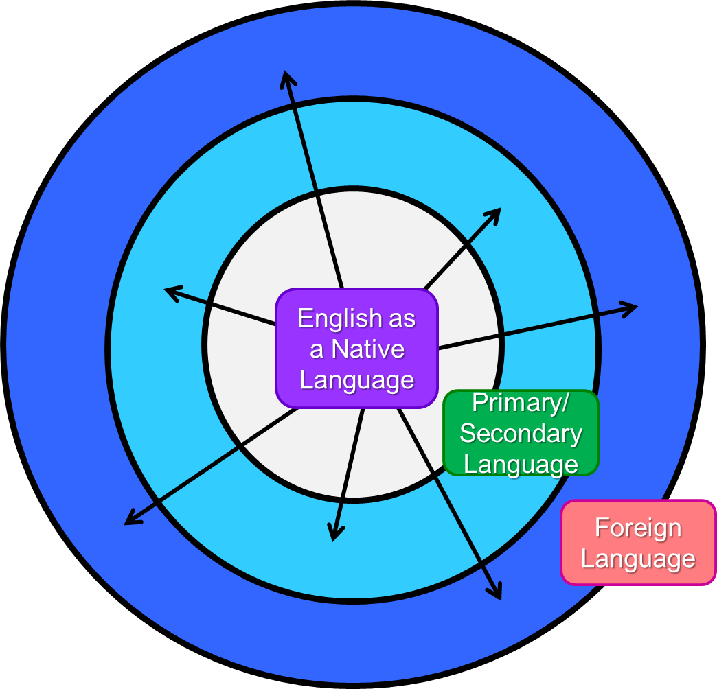
The Spread of English (3 circles)
Inner Circle
Outer Circle
Kachru, 2006
Expanding Circle

Slide 15
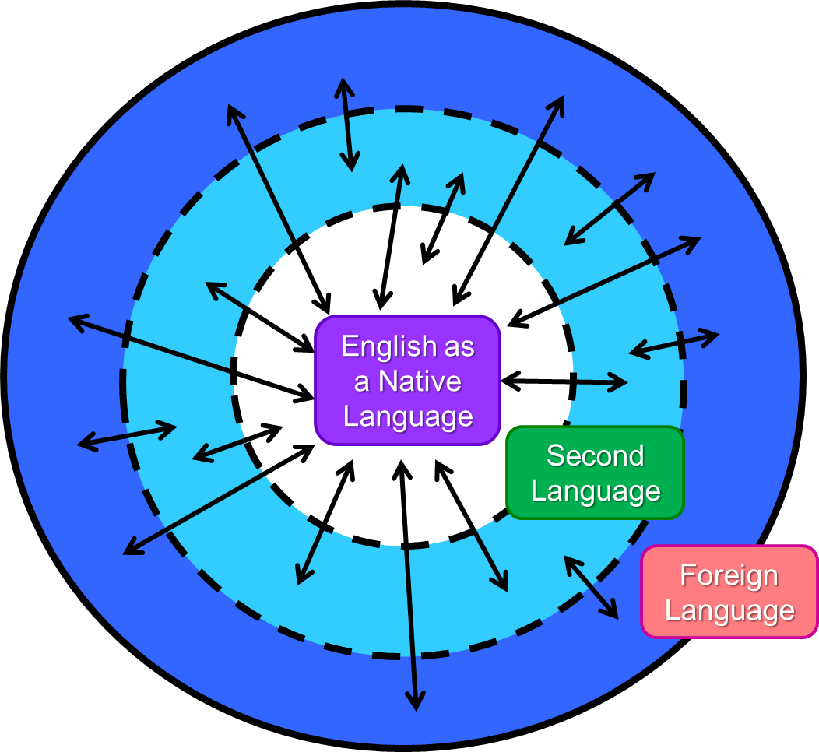
The Current Situation

Slide 16
Regional Varieties
English Ice Cream

Slide 17
Current facts
There are now many more non-native speakers of English than native speakers ( 5 to 1)
Five times more people are learning English in China than there are people in England
The English language is changing especially in international contexts
Both native and non-native speakers can be fluent in the language
Native can have great difficulty in non-native settings due to their nativeness

Slide 18
English in International Settings

Slide 19
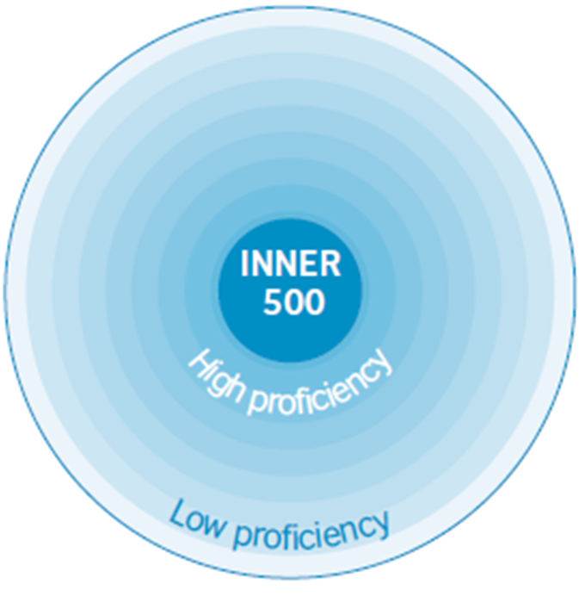
The New Circle
Inclusive
No-mention of Native/ Non-native

Slide 20
Key Points
There are many fluent English speakers, not all are native…
The most important thing is to be comprehensible
Be proud to be a Korean English speaker and having a Korean variety of the language
Native speakers can have troubles in international settings.
Native speakers should try to understand your English just as much as you try to understand theirs.

Slide 21
What does this mean?
With your group, discuss what you think this means for learners of English in regards to their speaking and listening skills.
Who are learners most likely to speak English with?
What is a good English speaker?
How can they develop those skills?
Who are learners most likely to listen to?
In the current situation what is a good English listener?
How can they develop those skills?

Slide 22
What do you think (T/F/D)
The more native-like a person’s pronunciation is the better.
Knowing a lot of idioms and slang is important to be a fluent speaker.
Knowing a lot of idioms and slang is important to be a fluent listener.
It is difficult to communicate if one’s grammar is poor.
Korean English words like ‘eye shopping’ should be avoided when speaking
Practicing speaking with non-native speakers hinders fluency.
A good goal for speaking is to be able to communicate with a native speaker of the language fluently.
A good goal for listening is to be able to understand native speakers fluently.
Confidence in learners own ability is one of the most important things to develop in regard to speaking.
Speaking and listening require constant and consistent input and output opportunities to develop.

Slide 23
Speaking & Listening Aims
As a teacher, what should be the goal(s) of listening and speaking? Why?

Slide 24
Key Points
Fostering comprehensible input (how?)
Fostering comprehensible output (how?)

Slide 25
Key Points
Fostering comprehensible ouput (how?)
Practice, practice, practice
Natural and creative use of language/ not memorized dialogues etc.
Focusing on problems in comprehensibility rather than native-like accuracy
Chunks, Phrases, Vocabulary ( and Word Choice: the more common the better)
Circumlocution
Fostering comprehensible input (how?)
Exposure
Awareness of different speakers of English (linguistically, culturally)
Chunks, Phrases, Vocabulary ( and Word Choice: the more common the better)

Slide 26
Approaching Young Learners

Slide 27
Considering young learners’ L2 development?
Is younger better? Why or why not?
At what age would you recommend young learners start listening to English?
At what age would you recommend young learners speaking English?

Slide 28
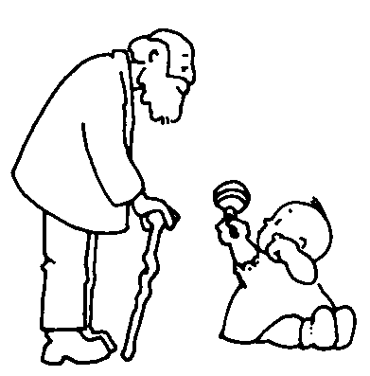
Is younger better?
Learners are never to young to be introduced and surrounded by English
Books/ Audiobooks
T.V.
Music
Games
English Toys
Learners can be too young to study it.
When it comes to speaking it depends on the situation…

Slide 29
Different Environments
Bilingual environment
Non-bilingual environment

Slide 30
Bilingual environment
Parents speak different languages to the child (Mom Korean/ Dad English)
Parents can both speak 2 languages but there are rules to where and when each language is used.
i.e. one language is used in the house and the other is used outside
Parents do not speak an L2 but they live in a place which the child is exposed to the L2 and interacts in the L2
안녕하세요

Slide 31
Parallel vs. Sequential
Parallel – both languages are developing at the same time
Sequential – One language follows after another
i.e. Korean focus until 3 years old → slowly add a focus on English until bilingual environment is established.

Slide 32
Non-bilingual environment
Children do not get constant and consistent interactive exposure to the L2 (at least 5 hours a week)
Parents code-switch without any rules or reason
There is one dominant language that the child uses and is exposed to
?
?
?

Slide 33
Bilingual Environment
Specific rules/ guidelines must be followed to create a true bilingual setting
Who speaks which languages (one parent – one language)
When specific languages are spoken (minority language at home)
Which languages the child is expected to use
http://bilingualkidsrock.com/how-to-raise-a-bilingual/
If a true bilingual setting is not provided, both languages can suffer.

Slide 34
Non-bilingual Environment
Children should not be forced to study English at a young age but rather be surrounded by it and enjoy it. (Pull Don’t Push!)
Children should first be able to produce the language in Korean before focused studying of English.
They should start when they show interest in starting.
If children are not getting enough input then then their may be little benefit of starting early. Starting in middle school, with the right environment can produce the same results! (Ellis, 2011; Lightbown & Spada, 2013; Nunan, 2013)
Minimum of 3 hours a week, spaced out evenly (Lightbown & Spada, 2013).

Slide 35
English Input
Focus on surrounding kids with and exposing them to enjoyable English input
Books
Audiobooks
Music
Games
This can be started from birth
Key point: Don’t quiz them on it. Don’t make it into lessons. Make it a natural part of their environment.

Slide 36
When starting English Output
Must create the need to use the L2
Support/ Coaching/ Modeling what they want to say
Natural correction (like parents to children in L1)
Repetition of situation
I would start this around 3 years old.
Any older and they may reject it completely.

Slide 37
References
Dewaele, J. M. (2017). Why the Dichotomy ‘L1 Versus LX User’is Better than ‘Native Versus Non-native Speaker. Applied Linguistics, amw055.
Kachru, B. B.(2006). The English language in the outer circle. World Englishes, 3, 241-255.

