Slide 1
Teaching Listening & Speaking
Flow & Activities

Slide 2
Key Points
I believe that listening and speaking go together and do not have to be taught as separate skills.
It is incorporating listening tasks into speaking activities that may be most authentic.

Slide 3
Past Lesson Flow Suggestions
In the past many programs separated classes by skill (Reading, Writing, Listening, Speaking)
Nowadays, most textbooks, and teacher take a more integrated approach.
Old blueprint for speaking: Present, practice, produce (PPP)
Old blueprint for listening: Task feedback cycle

Slide 4
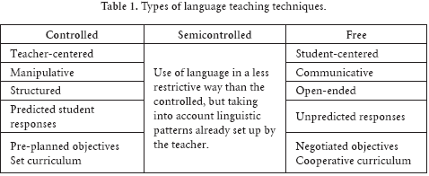
Speaking: PPP controlled, less-controlled, free
Present the context
Present the target language
Students drill the target language through repetition activities
Students do a less-controlled activity where they have a language guideline but may also use creatively use the language
Students do a free activity in which they must naturally use the new target language for a specific purpose (without needing to reference it).
Teacher gives feedback to learners highlighting any inaccuracies or issues

Slide 5
Critical Thinking
Are there any problems you notice with this approach?
What are some of the benefits and drawbacks of a PPP or controlled, less-controlled, free lesson?
Who would benefit most and least from this structure of lesson?

Slide 6
Listening: Task Feedback Cycle
Lead-in (Setting the context/ background information)
Pre-teach key vocabulary/ grammatical structures
1st Listen – focus on general understanding
2nd Listen – focus on details
Post-Listening discussion – Addressing problem/ questions
Productive Activity – Speaking or writing activity that connected to the key topic or aspects of what they listened to.

Slide 7
Listening Sources
Important to chunk (pause the audio) to give students time to comprehend. Lower level students will need more chunking
Video clips – between 1 – 3 mins max
Audio clips – between 1 – 3 mins max
Teacher
  Speaking
  Reading
Student
  Discussion
  presentation

Slide 8
Critical Thinking
Are there any problems you notice with this approach?
What are some of the benefits and drawbacks of a following a task-feedback cycle lesson?
Who would benefit most and least from this structure of lesson?

Slide 9
Speaking & Listening
activities

Slide 10

New Important Features

Slide 11
4 Strands
( Paul Nation)
Language focused learning
  Learning through deliberate attention to language items and language features
  Learning through attention to the sounds and spelling of the language, through direct vocabulary study, through grammar exercises and explanation, and through deliberate attention to discourse features.

Slide 12
4 Strands
( Paul Nation)
Meaning-focused input
  Learning through listening and reading where the learners’ attention is on the ideas and messages conveyed by the language.

Slide 13
4 Strands
( Paul Nation)
Meaning-focused output
Learning through speaking and writing where the learners’ attention is on conveying ideas and messages to another person

Slide 14
4 Strands
( Paul Nation)
Fluency development
Developing fluent use of known language items and features over the four skills of listening, speaking, reading and writing
Key point: becoming fluent with what is already known.

Slide 15
A Focus on Speaking

Slide 16
Accuracy → Fluency

Slide 17
Accuracy → Fluency
Form focused
1. Focus on the correct forms
2. Attention drawn to new language items and constructs
3. Repetition of correct patterns
4. Feedback
Meaning and message focused
1. Focus on the message
2. Activity must be very easy
  No new vocab
  No new grammar
  Language used should be 100% familiar
  Content should also be familiar
3. Needs to be pressure to go faster than normal.
  Pushed and challenged to go a little faster in their speaking
4. Quantity of practice

Slide 18
Bank: Types of Speaking Activities
Brainstorming
Surveying
Interviewing
Discussions
Role-play
Debate (?)
Dialogues
Information gap
Jigsaw activities
Explaining
Planning
Group Projects/ Teamwork
Presentations
Speeches
Describing
Group Task
Think about whether the following activities are more accuracy focused, fluency focused, or somewhere in the middle.
Think about why you have categorized them in that way.

Slide 19
Useful sites
http://iteslj.org/questions/
http://eslflow.com/speakingandcommunicativeicebreakeractivities.html
www.forvo.com
http://www.dialectsarchive.com/

Slide 20
A Focus on Listening

Slide 21
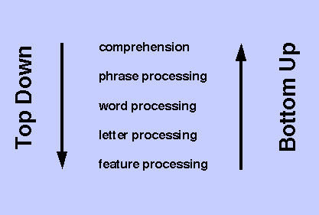
Top down → Bottom up Processing

Slide 22
Accuracy → Fluency

Slide 23
Accuracy → Fluency
Detail focus
1. Focus on the correct details
2. Attention drawn to new language items and constructs and their use
3.
Meaning and message focused
1. Focus on the message
2. Focus on developing awareness and familiarity with different accents and speech patterns.
3. Focus on general understanding and interpretation

Slide 24
Bank: Types of Listening Activities
Ordering
Gap-fill
Graphic organizers
Summarizing
Translating
Dictation
Find the mistake
Predict and check
Writing down questions they have when listening
Ticking items
Taking notes
True/ False
Comprehension questions
Listen & Draw
Follow the directions
Group Task
Think about whether the following activities are more accuracy focused, fluency focused, or somewhere in the middle.
Think about why you have categorized them in that way.

Slide 25
Graphic Organizers

Slide 26
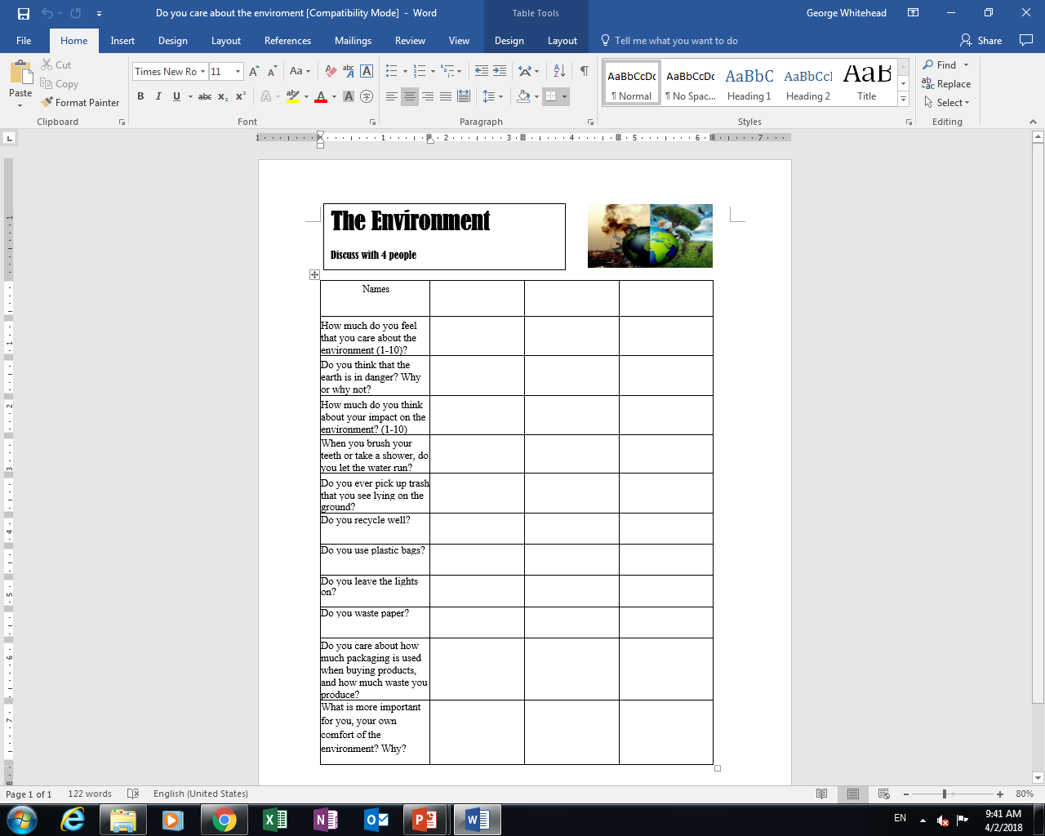

Slide 29
List of sites
www.youtube.com
  www.en.savefrom.net
  www.keepvid.net
  www.offliberty.com
https://lyricstraining.com/
https://www.eslvideo.com/
https://www.englishcentral.com/videos
http://esl-lab.com/
http://www.eslcommando.com/search/label/Listening

Slide 30
Key Points Listening & Speaking Lessons
As a teacher what are some of the things you must consider in listening and speaking lessons based on what we have discussed in this lesson?

Slide 31
Reflective Thinking
Think and apply

Slide 32
Critical Thinking
Write down the steps of the listening and speaking lesson you experienced regarding the environment
Analyze it in regards to how well it satisfies the 4 strands.

Slide 33
Applying PPP and Task Feedback Cycle
Without looking at last class’s notes
Create a PPP lesson outlilne describing what you would do in each stage
Do the same for a listening lesson with the task feedback cycle
50 minute class
Analyze it in relation to the 4 strands

Slide 34
Ur, P. (1981). Discussions that work: Task-centred fluency practice. Cambridge University Press.
Ur, P. (1984). Teaching listening comprehension. Cambridge University Press.

Slide 35
Lesson Flows
(General Flow)

Slide 36
Environment Lesson
Lead –in (activate background knowledge & personalize topic)
  Video
  Pictures
Survey(activate background knowledge & personalize topic)
  Survey Feedback Discussion
Group discussion ( biggest problems earth faces)
Watch Video of 9 boundaries
Teach new or unknown words from video
Teacher led explanation of 9 boundaries
Group project ( Greenpeace)
Rotation Fair

Slide 37
PPP
Lead-in (Setting the context/ background information, activate background knowledge, personalize content)
Present ( Target language, grammar patterns, etc.)
Practice ( Controlled practice, Less controlled practice)
Produce ( Free Speaking or Writing activity)

Slide 38
Task-feedback Cycle
Lead-in (Setting the context/ background information, activate background knowledge, personalize content)
Pre-teach key vocabulary/ grammatical structures
1st Listen – focus on general understanding
2nd Listen – focus on details
Post-Listening discussion – Addressing problem/ questions
Productive Activity – Speaking or writing activity that connected to the key topic or aspects of what they listened to.

