Slide 1
Teaching a receptive lesson
Approaching Listening & Reading

Slide 2
Thinking about The purpose & Focus

Slide 3
Purpose of listening or reading
Getting general information ( general comprehension)
Getting specific information ( accuracy)
For pleasure or interest (extensive)
(see Nation 2010)

Slide 4
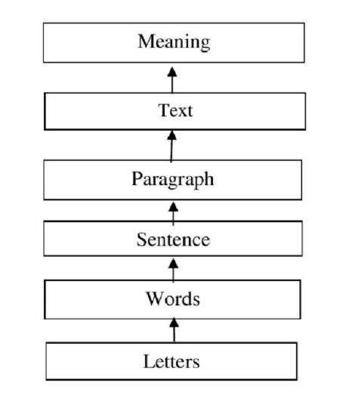
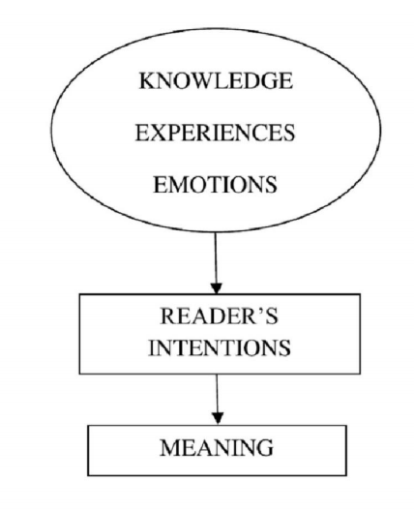
Top down → Bottom up
A bottom up view of reading occurs as decoding letters leads to words and words into sentences, and through the process the reader obtains and understands the meaning of the text
A top down view is seen as a process in which the readers’ prior knowledge of the text structure and text content guides them toward meaning.

Slide 5
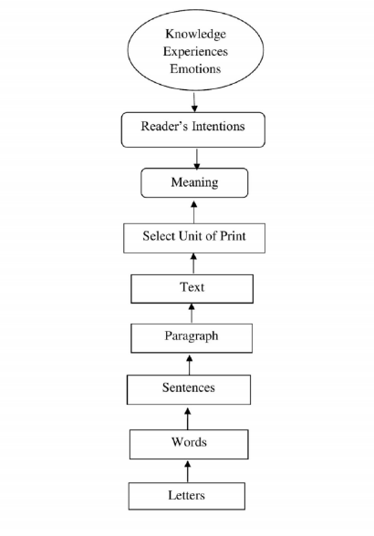
Interactive model
Contemporary second language reading specialists favour the interactive model of reading for the reason that second language readers actively construct meaning of a text by simultaneously utilizing their background knowledge and the information in the text.

Slide 6
Accuracy → Fluency
Detail focus
1. Focus on the correct details
2. Attention drawn to new language items and constructs and their use
Meaning and message focused
1. Focus on the message
2. Focus on general understanding and interpretation

Slide 7
Receptive lesson: task feedback cycle
Lead-in (Setting the context/ background information)
Pre-teach key vocabulary/ grammatical structures
1st – focus on general understanding
2nd – focus on details
Post-task discussion – Addressing problem/ questions
Productive Activity – Speaking or writing activity that connected to the key topic or aspects of what they read or listened to.

Slide 8
Sample lesson flow
Teacher introduces the topic being presented in the class listening of reading through a class discussion, pictures, video etc.
Teacher then tells Ss that before they listen/read they are going to learn some of the Key words.
Teacher teaches the vocabulary ( in the way we have covered in class: FUMP – application- check)
Teacher gives students their first reading/listening task ( i.e. a graphic organizer)
Teacher checks to see if at least 80% of the students could successfully complete 80% of the task correctly.
If yes, move on to the next activity… if no, have the students redo the task.
Once 80% of Ss have completed 80% of the task correctly – go over the answers and discuss in more detail clarifying anything that students are still confused about.
Move on to a productive activity where students apply what they have listened or read about to a real word task.
Review key words
Wrap-up class

Slide 9
Bank: Types of Receptive Activities
Ordering
Gap-fill/ Cloze activity
Graphic organizers
Summarizing in L1
Summarizing in L2
Translating
Dictation
Find the mistake
Predict and check
Writing down questions they have when reading/ listening
Ticking items on a list
Taking notes
Comprehension questions
  Multiple choice
  True/ false
  Open ended
Listen/ Read & Draw
Explain to a friend
Group Task
Think about whether the following activities are more accuracy focused, fluency focused, or somewhere in the middle.
Think about why you have categorized them in that way.

Slide 10
Bank: productive activities
Write something
  Self-reflection
  Summary
  What happens next
  Rewrite the story
    Make it scary, funny, sad etc.
Make something
  A menu
  Poster
  Schedule
  Plan
  Brochure
Discussions
Role-play
Debate
Dialogues
Explaining
Planning
Group Projects
Presentations
Make a video

Slide 11
Graphic Organizers

Slide 22
Reflective Thinking
Think and apply

Slide 23
Applying the Task Feedback Cycle
Without looking at last class’s notes
Create a listening/ reading lesson following the general flow of the task feedback cycle
50 minute class

Slide 24
Ur, P. (1981). Discussions that work: Task-centred fluency practice. Cambridge University Press.
Ur, P. (1984). Teaching listening comprehension. Cambridge University Press.

