Slide 1
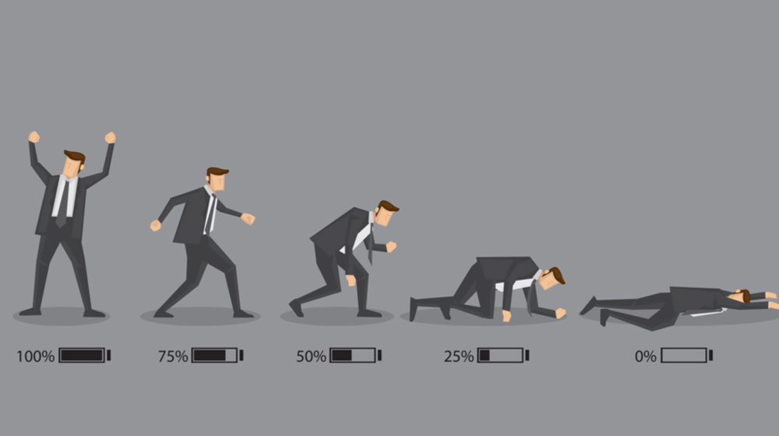
Teacher burnout
What is it and how can we avoid it?

Slide 2
What is teacher burnout?
Teacher burnout is a psychological condition that leads to exhaustion, depersonalization, and decreased teacher achievement and self-worth (Raines, 2011).
Burnout is a reaction to chronic stress.

Slide 3
Teacher Burnout
Burn out occurs when a teacher, who was once passionate and excited about the field, experiences feelings of chronic exhaustion and hopelessness about the job.
It is “a state of chronic stress that leads to physical and emotional exhaustion, cynicism, detachment, and feelings of ineffectiveness and lack of accomplishment.“
-Psychology Today

Slide 4
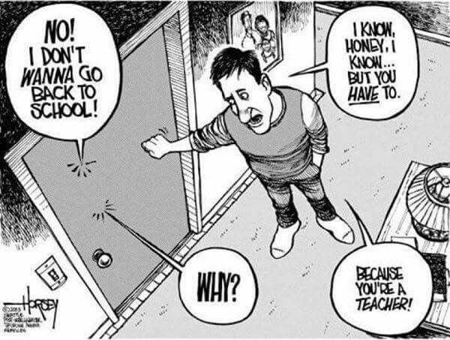
What causes teacher burnout?

Slide 5
Teacher Burnout
Teaching requires a lot of mental and physical energy.
A lot of energy goes into preparing lessons, teaching, managing students ( inside and outside of class), marking/grading, providing feedback, counseling, administrative work, paperwork, school events etc.
Quite often teachers overwork, and also fail to take care of their own mental and physical health needs.

Slide 6
Causes of burnout
Too much work – intense workload and/or working hours/ work outside of working hours
Student misbehaviour
Meeting parental demands
Stressful working environment
Lack of resources to teach
Receiving poor feedback from students, parents, administrators
Poor colleagues ( unsupportive, complainers, problem-makers, gossipers etc.)
Administrative issues
Feeling you are not getting paid enough for the work you do
Feeling underappreciated
+ others

Slide 7
The Facts
The first year is often the most challenging.
Teachers often endure a type or ‘reality shock’ (Veenman, 1984) during their first year of teaching due to the sudden transition from the ideals of teacher education programs to coping with the actual demands of the job and new working context (Farrell, 2006; Freeman & Johnson, 1998; Richards & Pennington, 1998).
A great deal of teacher leave the profession within the first 5 years.
It has been widely documented that teachers endure a type or ‘reality shock’ (Veenman, 1984) during their first year of teaching due to the sudden transition from the ideals of teacher education programs to coping with the demands of the job and new working context (Farrell, 2006; Freeman & Johnson, 1998; Richards & Pennington, 1998).

Slide 8
Dealing with burnout
Knowing how to deal with the stresses of the job and knowing how to take care of yourself when you are stressed are really important to succeed in this profession.

Slide 9
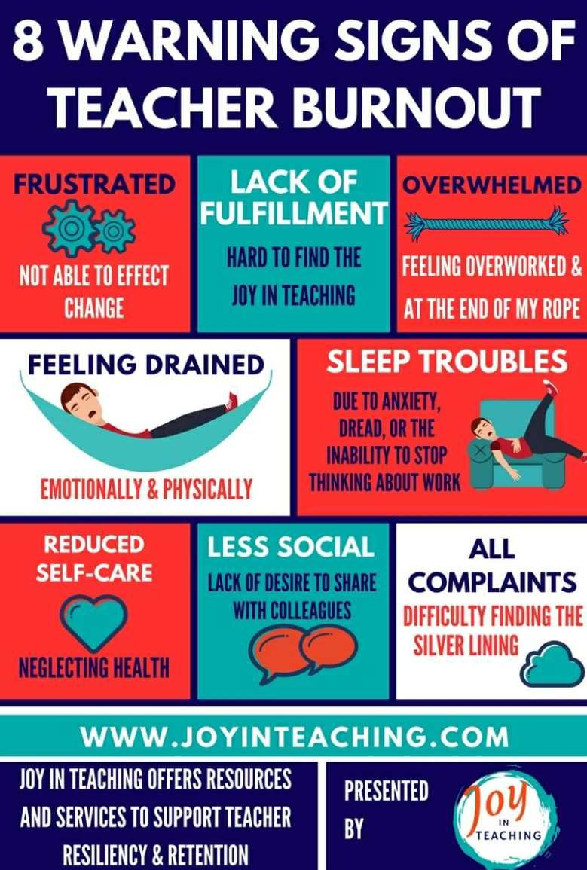
The warning signs

Slide 10
10 ways to avoid teacher burnout
Make your own happiness a priority
Stay healthy
Indulge in personal time
Be part of a support group ( colleagues, professional groups and associations)
Look for the positive in every day
Prepare ahead of schedule
Schedule your time daily, weekly, etc.
Take things seriously, just not too seriously
Switch things up in the classroom: decorations, seating, lesson activities etc.
Step back and let the students do more

Slide 11
Time | Monday | Tuesday | Wednesday | Thursday | Friday
6:30-9:00 am | Breakfast/ Get ready/ Walk dog/ Take kids to school | Breakfast/ Get ready/ Walk dog/ Take kids to school | Breakfast/ Get ready/ Walk dog/ Take kids to school | Breakfast/ Get ready/ Walk dog/ Take kids to school | Breakfast/ Get ready/ Walk dog/ Take kids to school
9:30- 11:00 | Kickboxing | PhD study | Kickboxing | Kickboxing | PhD study
11:00-12:00 | PhD study |  | PhD study | PhD study
12:00-1:00 | Lunch | Lunch | Lunch | Lunch | Lunch
1:00-1:30 | Free time | Free time | Free time | Free time | Free time
1:30-6:00 | Study/ Lesson prep/ Research time/ Consult | Study/ Lesson prep/ Research time/ Consult *Pick up kids | Study/ Lesson prep/ Research time/ Consult | Classes | Study/ Lesson prep/ Research time/ Consult *Pick up kids
6:00- 7:30 | Classes | Jiu jitsu | Classes | Classes | Jiu jitsu
7:30-9:40 |  | Kids: Reading & ready for bed |  |  | Kids: Reading & ready for bed
10:00-12:00 | Free time | Free time | Free time | Free time | Free time

Slide 12
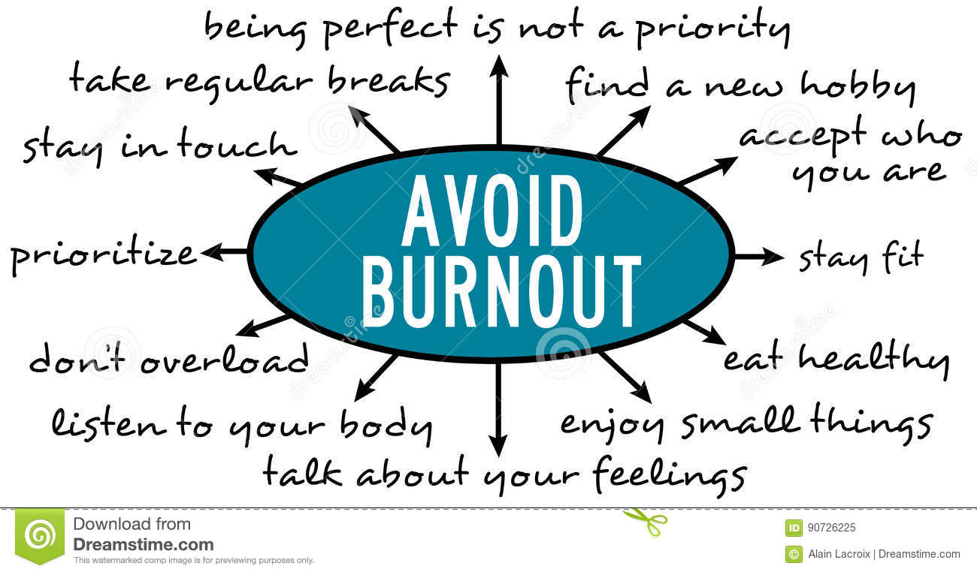
`

Slide 13
happiness
How can we be happy and stay happy?​
​

Slide 14
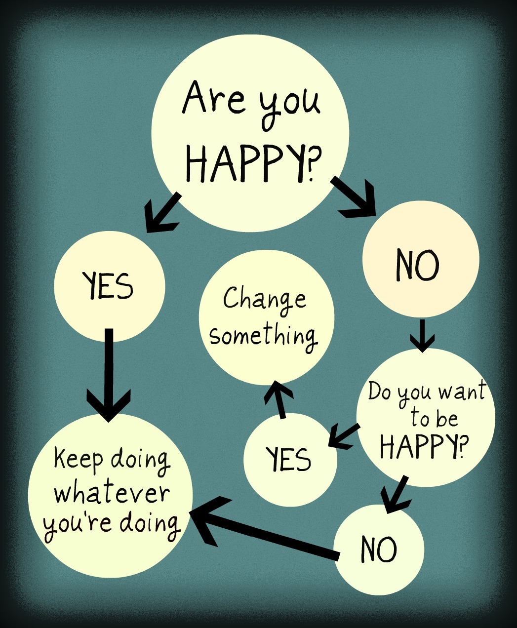
How happy are you?

Slide 16
What makes you happy?

Slide 17
What makes you Unhappy?

Slide 18
The Daily Happiness Checklist

Slide 19
Daily happiness checklist
1. kickboxing/ jiu jitsu
2. weekend trip
3. meeting friends
4. buy new clothes
5. go to the mart and buy good food
6. chicken and beer
7. take a nap
8. Starbucks
9. planning something to look forward to
10. sauna
11. play PS4
12. watch a comedy
13. do something fun with my kids
14. go out just me and my wife
15. podcasts
16. reading a good book (non-academic)
17. Audiobooks (Audible)

Slide 20
Make your happiness checklist

Slide 21
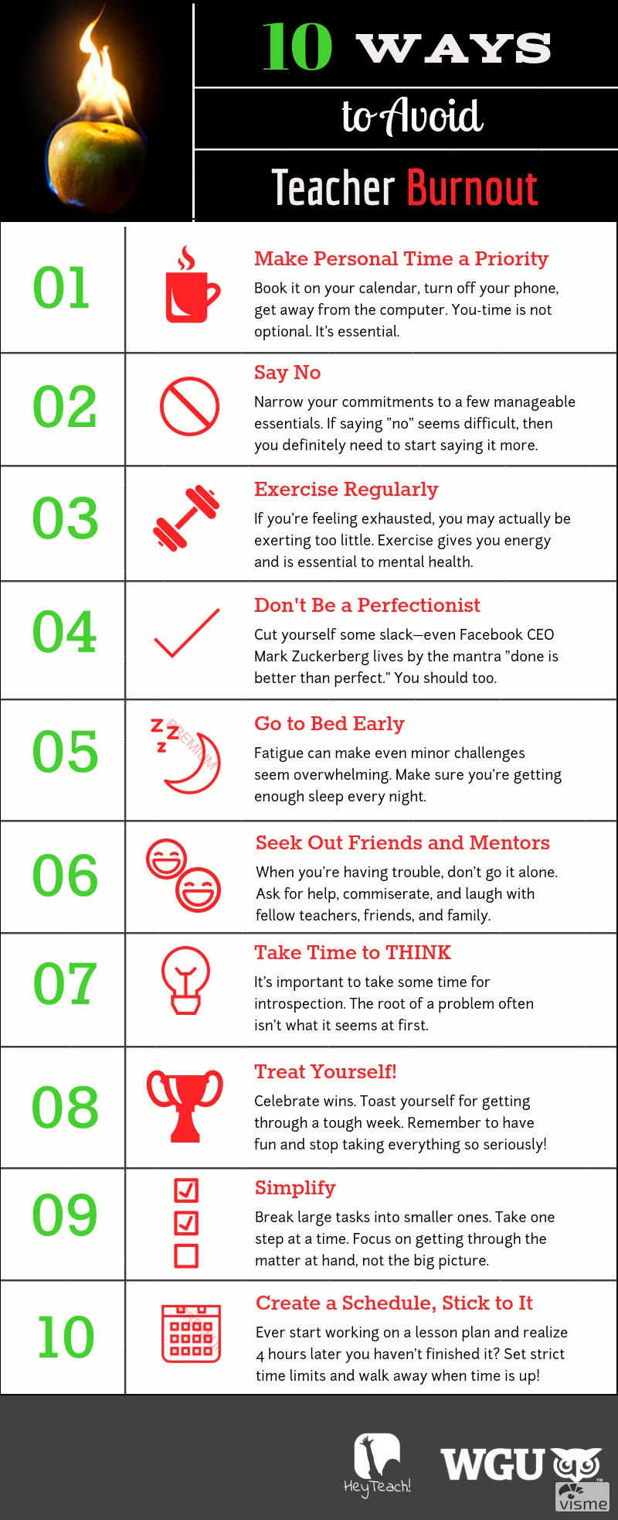
Wellbeing tips
Personal time daily (3 hours)
Happiness checklist
Health – mind & body
Notes:
https://www.wgu.edu/heyteach/article/10-ways-avoid-teacher-burnout-infographic1612.html

Slide 22
Jesse Itzler
I make sure that I take a couple hours during the day for myself. I call it the three hour rule. Throughout the course of the day I allocate three hours where I can do things that I like or want to do. That could be go for a run or sit on the couch and do nothing.

Slide 23
Scholars to check out on the topic
Christina Gkonou
Sarah Mercer
Elizabeth Miller

Slide 24
remember
Your outlook on things, and your reaction to them greatly impacts your happiness.
You are central in your own happiness.

Slide 25
School Happiness Essay

Slide 26
Photo Essay Project
Think about 5 everyday things that make you happy at or around your school (little things)
Take a picture or find a picture on the internet
Explain your pictures to 3 people

Slide 27
Final Task
If a new teacher asked you for advice on how to be happy what would you tell them?
What do you think are 4 secrets to being happy? Explain.
What are 4 ways that you can increase your everyday happiness? Explain

