Slide 1
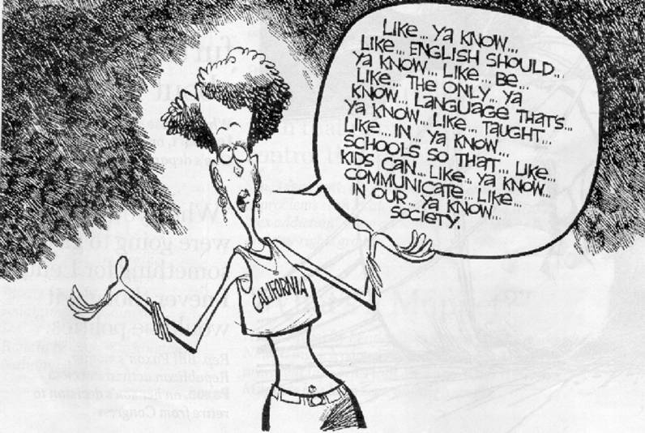
Teacher Talk:
Teaching English in English (T.E.E.)

Slide 2

Teaching English In English
The revised 7th National Curriculum (2008) emphasizes TEE.
“Korean teachers will be required to teach English by using only the foreign language by 2012.”
~Lee Myung Bak Administration, 2009

Slide 3
How practical is T.E.E.?
If everything was perfect (a utopia), what percent of a teacher’s classroom language do you think should be in English? 0-100%
How much English do you think teachers actually use in their classrooms? (Elementary, Middle school, High-school English teachers)
What are some reasons that teachers have difficulty using English in the classroom?

Slide 4
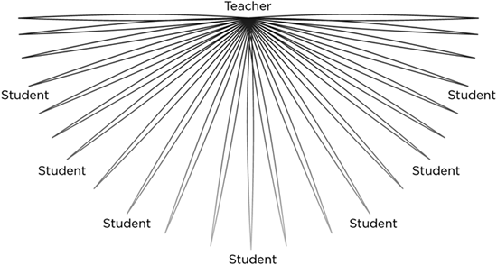
What is English Teacher Talk for us?
How to use English effectively in the classroom.
Effective means comprehensible!! (Krashen’s Input Hypothesis i+1)

Slide 5

Demonstration Time

Slide 6
Misunderstandings of Good Teacher Talk
People often think that being fluent in the target language makes you a better “teacher talker”.
Teachers think that they have to talk a lot.
Teachers think that their language has to be perfectly accurate.

Slide 7
Teacher Talk Mistakes
Teachers talk too much.
Running Commentary ( I am now going to…)
Teachers talk when they don’t have students’ attention
Teachers talk too much without pausing!
Teachers do not demonstrate /show
Teachers speak then translate immediately
Teachers use language that is far above the level of their students.
Teachers check if students have understood by asking “do you understand? Got it? Etc..

Slide 8
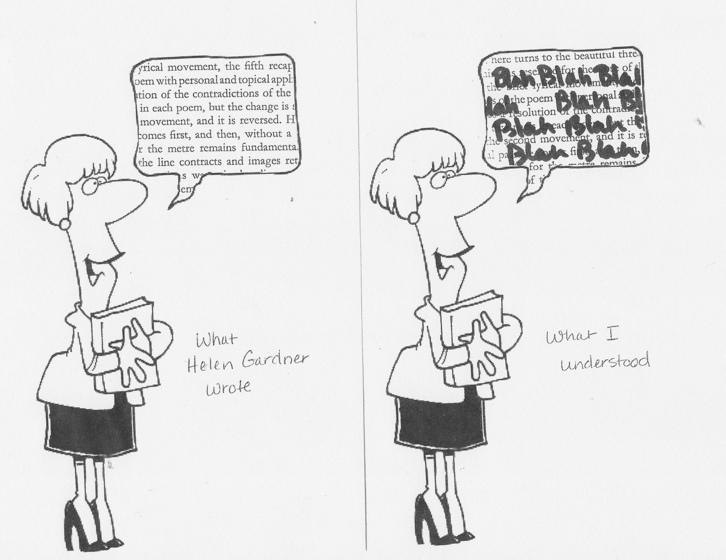
Making Teacher Talk Comprehensible

Slide 9



Two sides of teacher talk

Slide 10
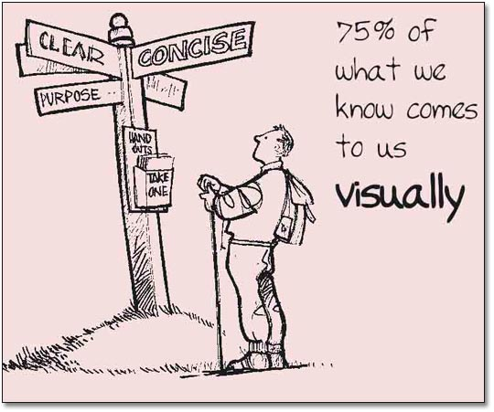
Visual Clues

Slide 11
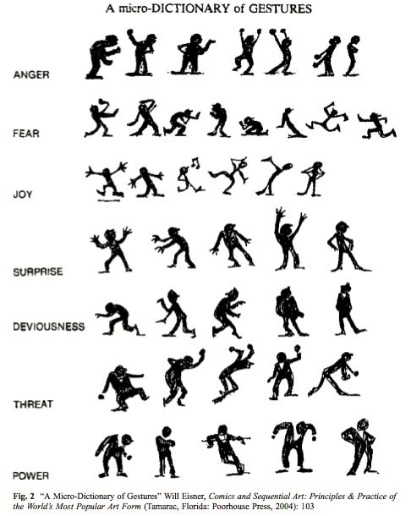



Providing Visual Clues
Body language
  Gestures
  Facial expressions
Visual Aids
  Pictures
  Drawings
  Videos
  Charts
  Realia

Slide 12

Application
Show students don’t just tell students!!
Demonstrate what you want students to do!
Support your speech with simple gestures when needed
“Watch me.. Do this… Look at him… Do that!! Etc.”
Stop talking and try to provide visual support
Instead of saying “ Let me tell you” or “Let me explain” say “LET ME SHOW YOU!!”

Slide 13
Practice Time!
With a partner take turns acting out and guessing the following words with facial expression and /or gesture.
exciting enormous terrible
strange exhausting
tiny itchy relax
smelly
boring long

Slide 14
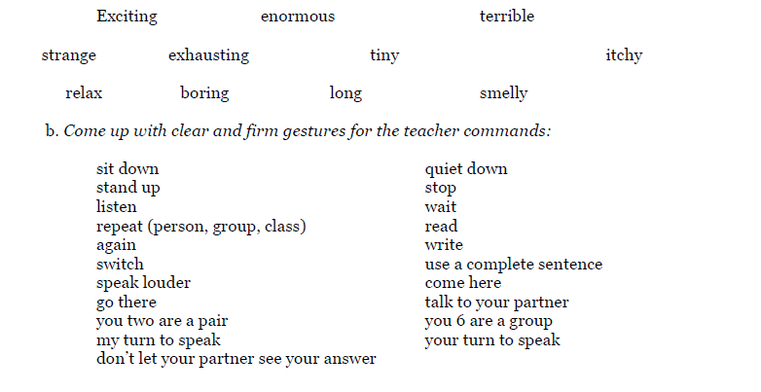

Slide 15


Slide 16


Using Speech
Keep It Short and Simple
I+1 (Krashen “Comprehensible Input”)
Modify your language to the level of your students
(like a parent and child) Baby Talk Hypothesis ☺
Find the simplest and most direct way to say it!

Slide 17

About Speed
How fast should we speak?
Don’t slow down your speaking too much, instead, pause and chunk a lot!
  Tip:Break it into steps

Slide 18

Recipe for Increasing English
Try in English…
Repeat, Rephrase .. Recycle words students know
Get students to explain to other students.
If they still can’t understand use Korean
IF STUDENTS DON’T UNDERSTAND..
IF STUDENTS DON’T UNDERSTAND..
IF STUDENTS DON’T UNDERSTAND..

Slide 19


Summary
It is essential that students are provided with as
much comprehensible L2 input as possible.
English
Korean (Ss)
Korean (T)
repeat, recycle, rephrase

Slide 20

Summary of Goals for Successful English Teacher Talk
Don’t talk…. SHOW.. DEMO DEMO DEMO
Keep your teacher talk (I)
Be clear and concise
K.I.S.S.
Less is more
Chunk your language

Slide 21
ENGLISH-MEDIUM EDUCATION IS ONE CAUSE OF EDUCATIONAL FAILURE
Children do not learn English simply by being taught through English.
A hasty shift to English medium without appropriate teaching of the language causes educational failure.
Sustained education in, and development of, the mother tongue remains important. (Graddol, 2010)

Slide 22
Paul Nation (2011)
“One thing I think probably does not get much attention in Korea is the opportunity to become really good at using what you already know,”

