Slide 1
Supplementary Materials
Worksheets

Slide 2
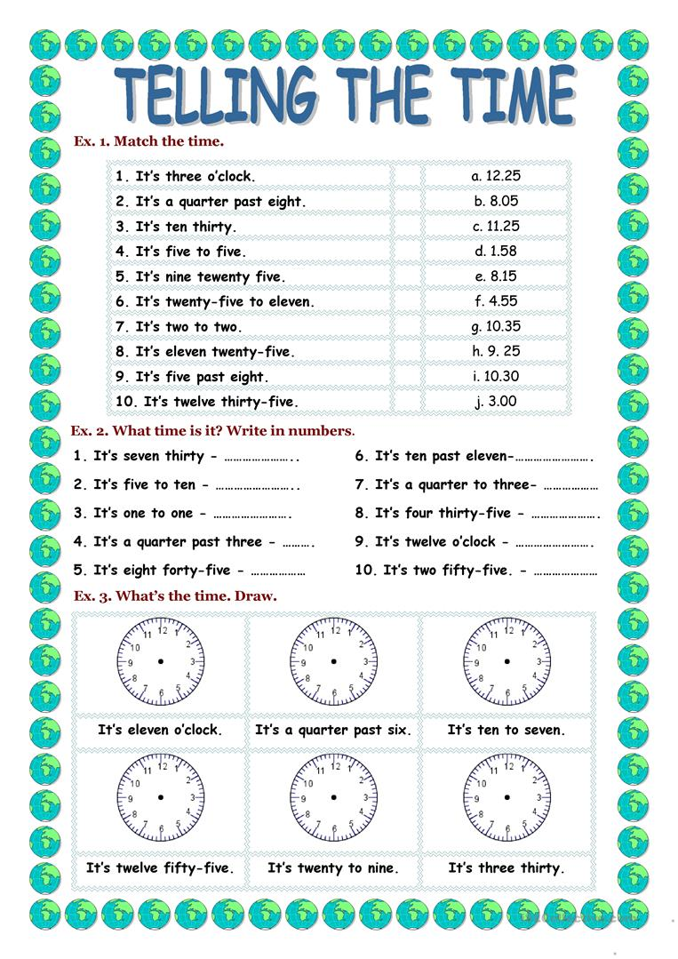
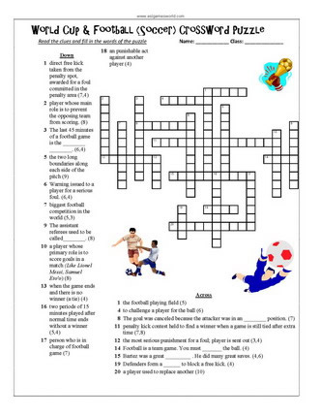
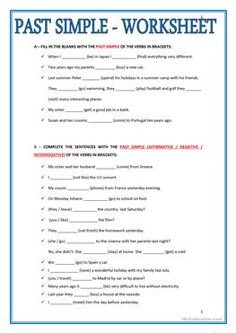
Why use worksheets?

Slide 3
Why use worksheets?
they can make good fillers and warm-ups
useful for revision, practice and test preparation
they can reinforce instruction
some worksheets can be done in pairs or small groups, helping develop communication and teamwork skills
in large classes, when stronger learners have finished you can have some worksheets handy to keep them happy
worksheets can help stimulate independent learning
they can provide a good deal of repetition, often vital for internalizing concepts
they are useful for assessment of learning and/or progress (especially targeted to specific areas)
they are flexible and can supplement a text book very well
they let students keep their work as reference material if they so wish

Slide 4
Different things to consider…
Aims/ Target Language
Worksheet type
  Fill in the blank
  Matching
  Multiple choice
  Puzzle (www.puzzlemaker.com)
  Sorting
  Labelling
  Graphic organizer
  Writing
  Etc.
Organization/ Format
Content
  Visuals
  Font

Slide 5
Key things to focus on
Useful/ purposeful
Clear instructions
Visually appealing and not cluttered
Not intimidating
Age/ Level appropriate

Slide 6
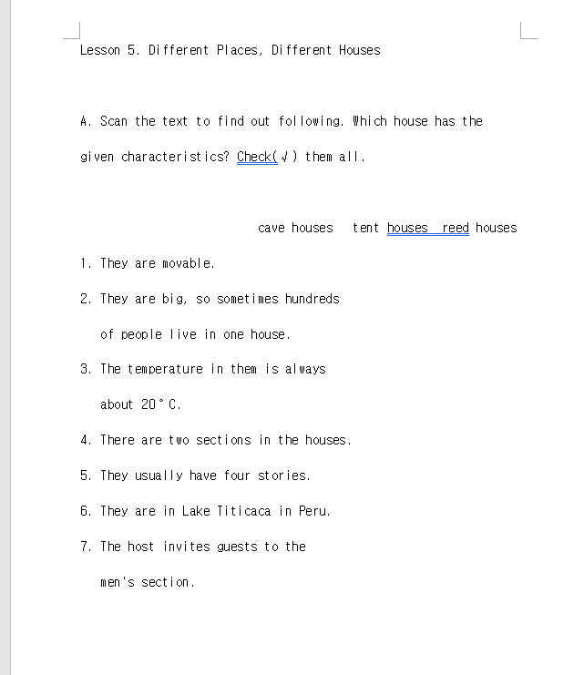

Slide 7
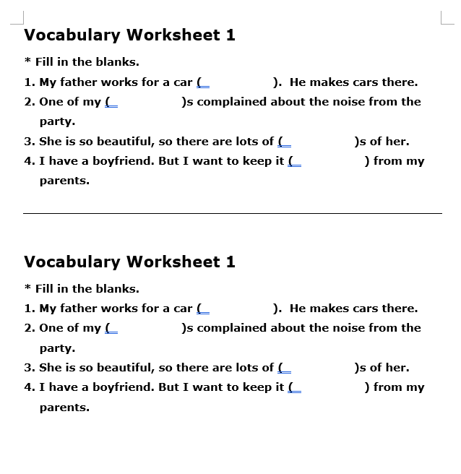

Slide 8
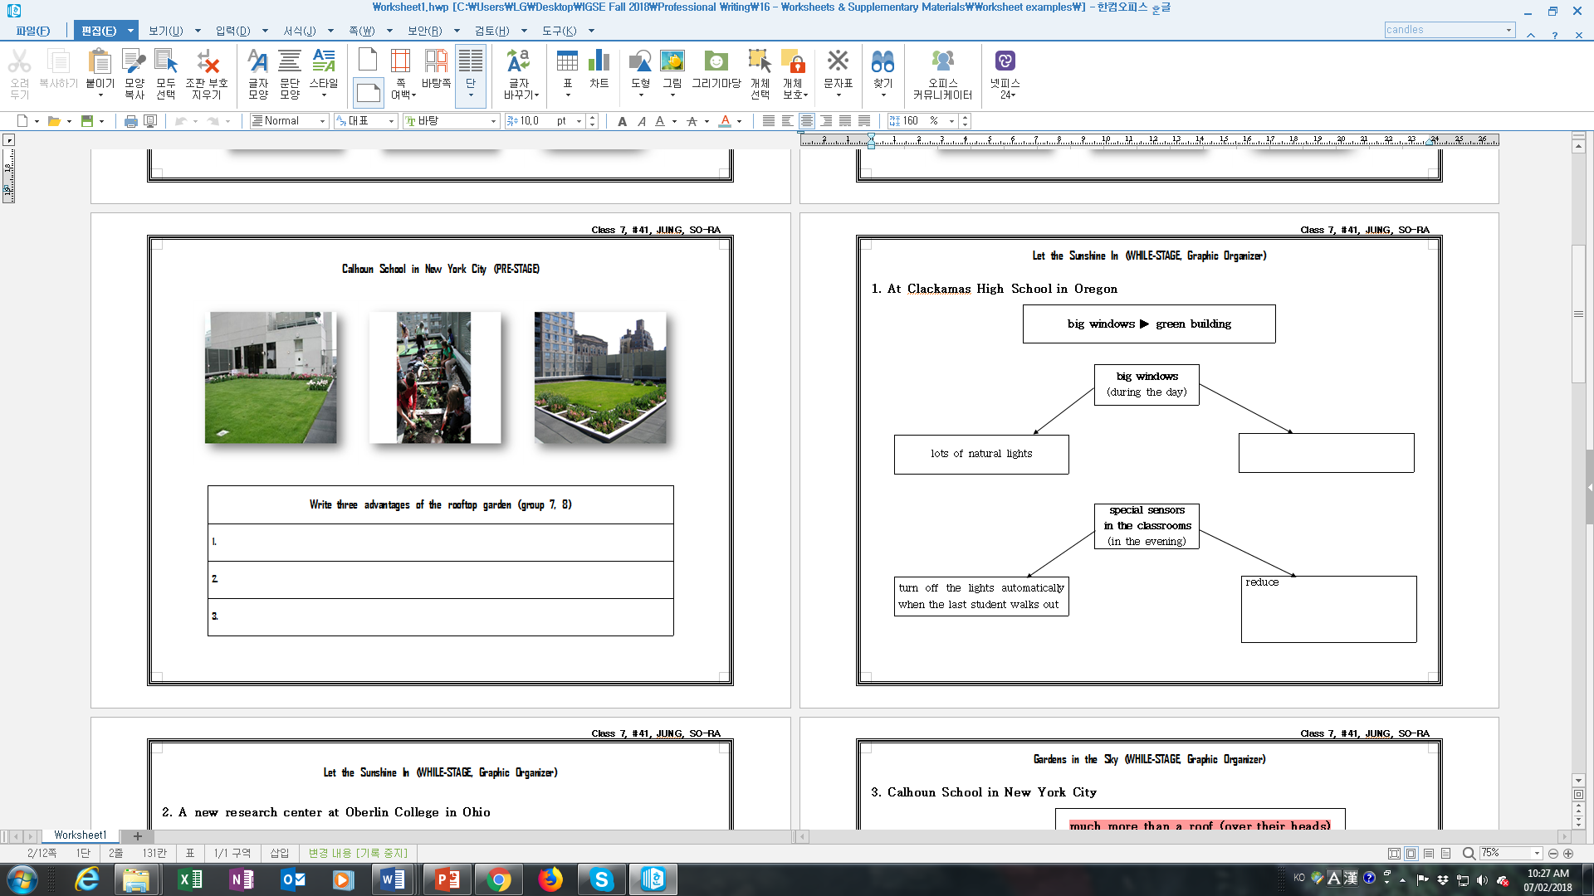

Slide 9
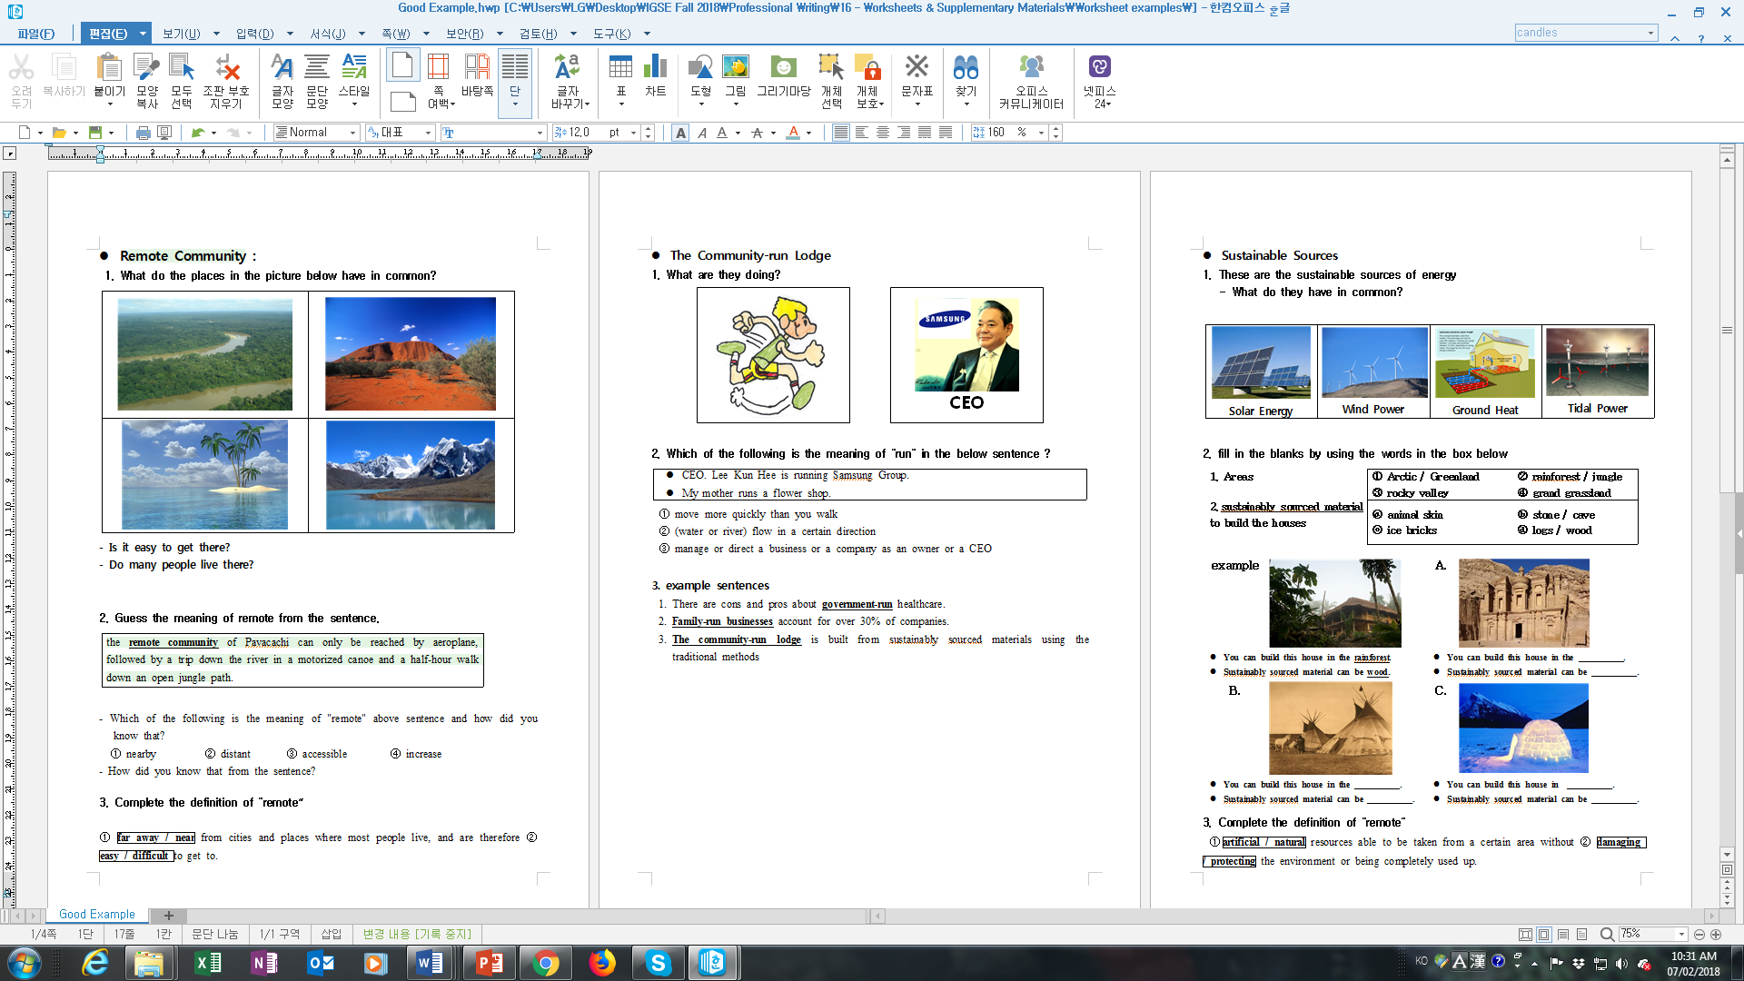

Slide 10
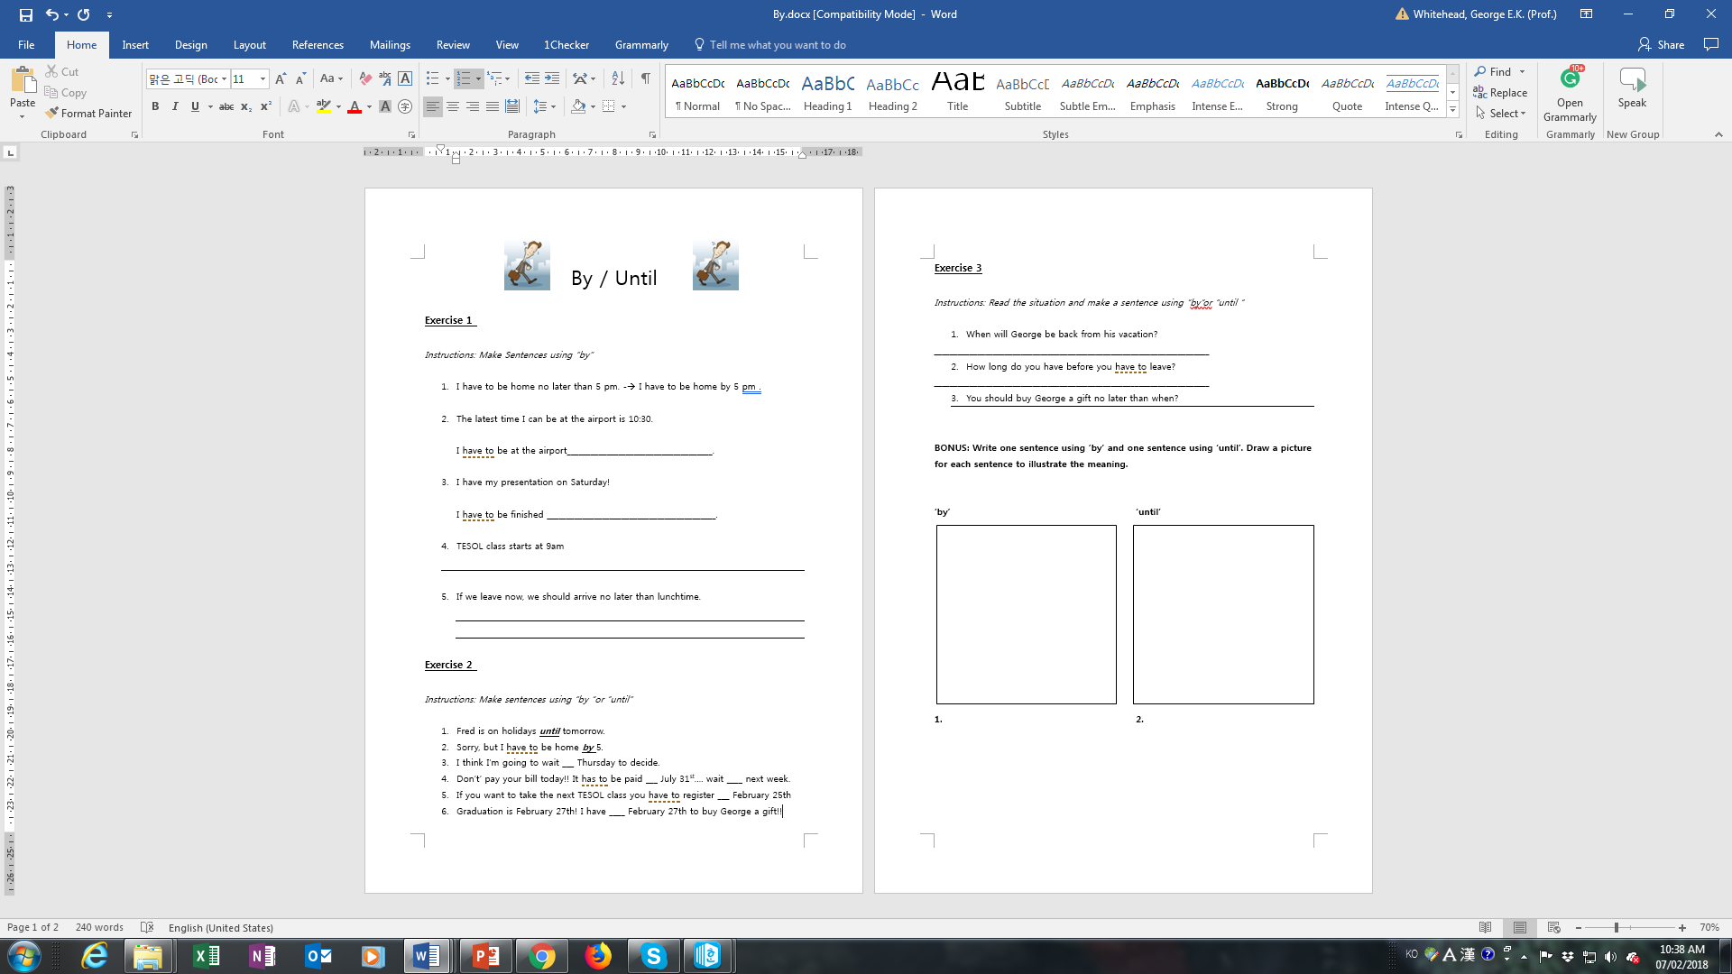

Slide 11
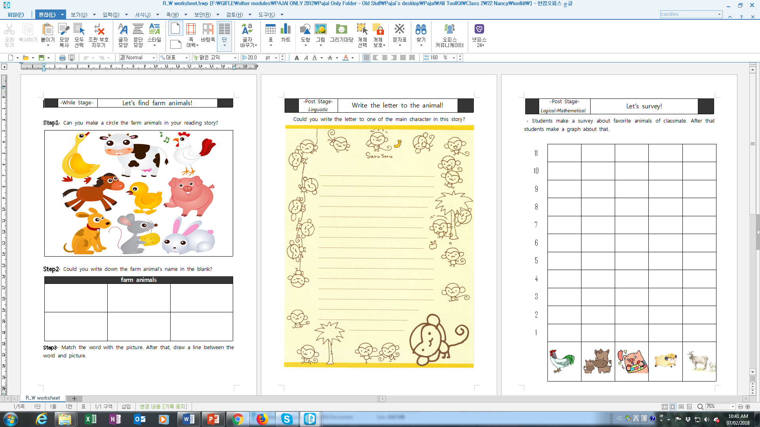

Slide 12
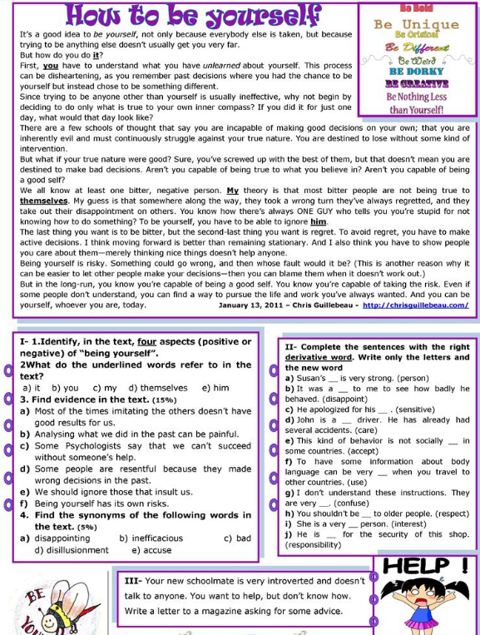

Slide 13
Create your own worksheets online
http://www.eslhq.com/worksheets/
www.puzzlemaker.com
http://www.toolsforeducators.com/
https://www.tefl.net/worksheet-generator/

Slide 14
Graphic Organizers

Slide 25
Task
Create 2 supplementary worksheets for a textbook unit lesson of your choice.
IF you do not have a textbook I will give you a .pdf file.
You can choose the focus of the lesson and this will guide you in choosing an appropriate worksheet design.

Slide 26
Key things to focus on
Useful/ purposeful
Clear instructions
Visually appealing and not cluttered
Not intimidating
Age/ Level appropriate

Slide 27
Features of Effective Worksheets
is clear & attractive
clearly labels questions/tasks with numbers or letters (so they can easily be referred to orally during feedback or answers)
is appropriate to the age, level and ability of the students can be created (and stored) on a computer and is thus easy to edit and print repeatedly
Is not intimidating (visuals, text, difficulty, length etc.)
has a font that is easy to read and of large enough size
uses images for a specific purpose only, and without cluttering up the worksheet
does not have irrelevant graphics and borders
has a descriptive title at the top and a space for the student to write their name
gives students sufficient space to write their answers
has clear, unambiguous instructions
uses bold OR italics OR underline for emphasis
is no longer than one or two pages (that is, front and back of a single sheet)
should be accessible to the learner (at that level) and answerable in a relatively short period, say 5 to 15 minutes (worksheets are not exam papers)
should have the easier tasks first - success is motivational

Slide 28
References
https://www.tefl.net/esl-worksheets/guide.htm

