Slide 1
Supplementary Materials
Worksheets

Slide 2
Features of Effective Worksheets
is clear & attractive
clearly labels questions/tasks with numbers or letters (so they can easily be referred to orally during feedback or answers)
is appropriate to the age, level and ability of the students can be created (and stored) on a computer and is thus easy to edit and print repeatedly
Is not intimidating (visuals, text, difficulty, length etc.)
has a font that is easy to read and of large enough size
uses images for a specific purpose only, and without cluttering up the worksheet
has a descriptive title at the top and a space for the student to write their name
gives students sufficient space to write their answers
has clear, unambiguous instructions
uses bold OR italics OR underline for emphasis
is no longer than one or two pages (that is, front and back of a single sheet)
Can be completed in 5 to 15 minutes (worksheets are not exam papers)
should have the easier tasks first - success is motivational

Slide 3
Key things to focus on
Useful/ purposeful ( *connected to learning objectives rather than time filling)
Clear instructions
Visually appealing and not cluttered
Not intimidating
Age/ Level appropriate

Slide 4
Examples of worksheets
Any issues you notice?

Slide 5
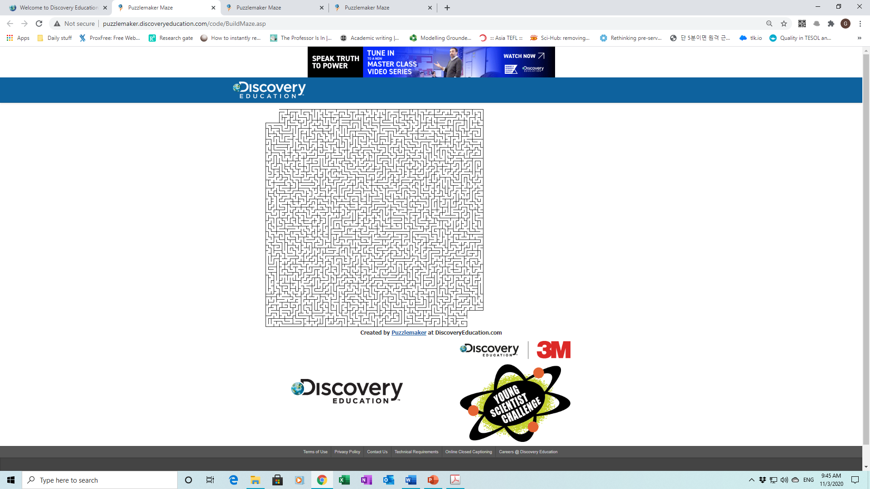
MaZes Runnner
Start at the blue dot.
Find the exit.

Slide 6
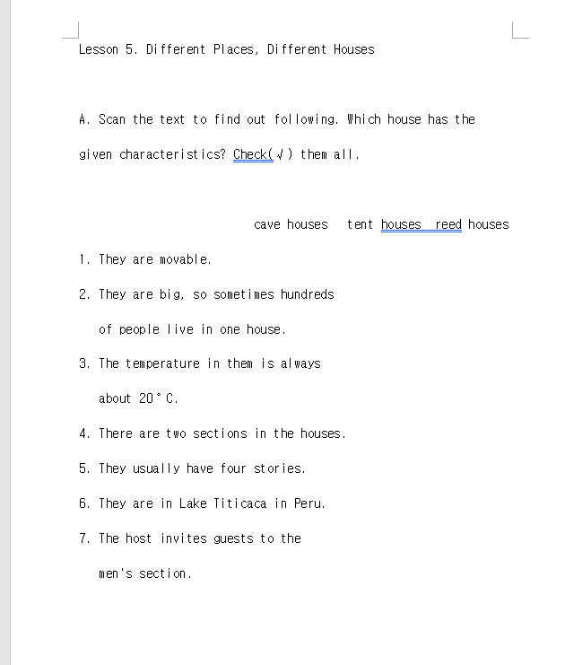

Slide 7
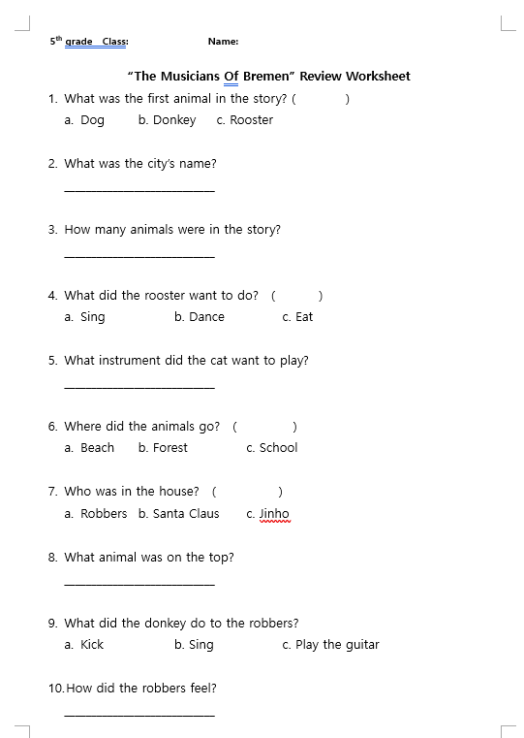

Slide 8
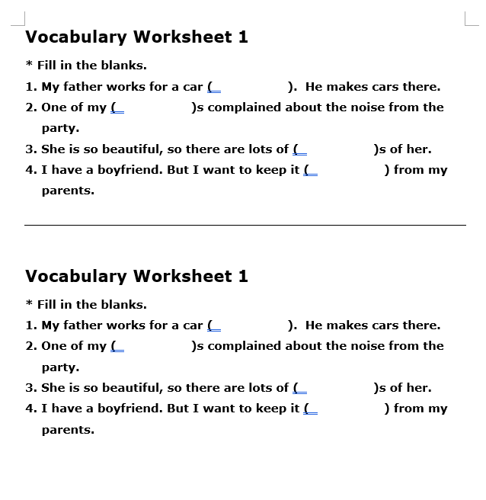

Slide 9
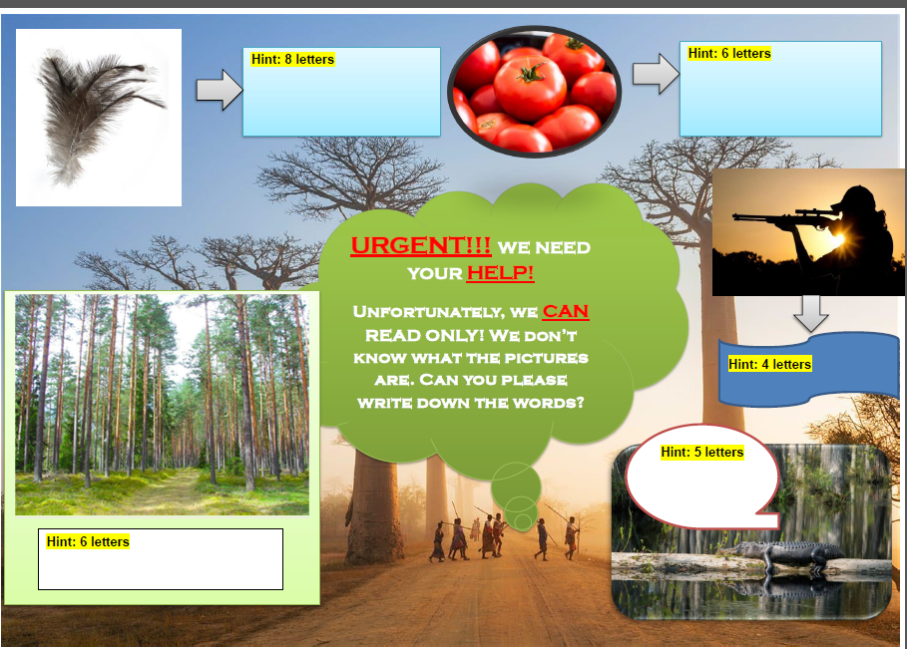

Slide 10
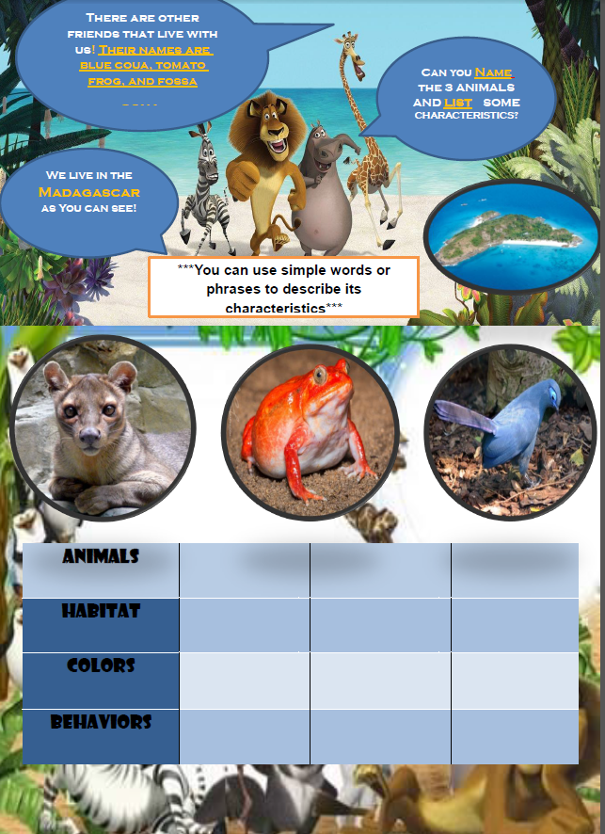

Slide 11
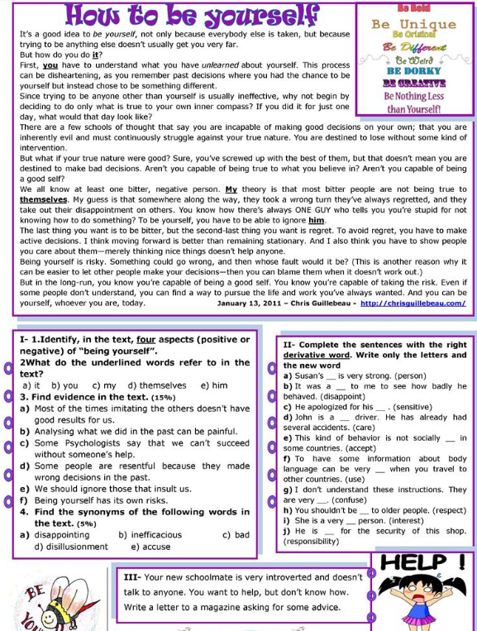

Slide 12
Examples of worksheets
Good examples

Slide 13
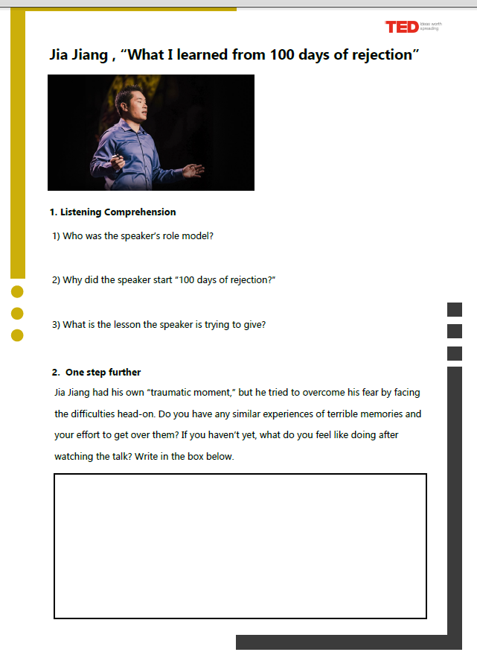

Slide 14
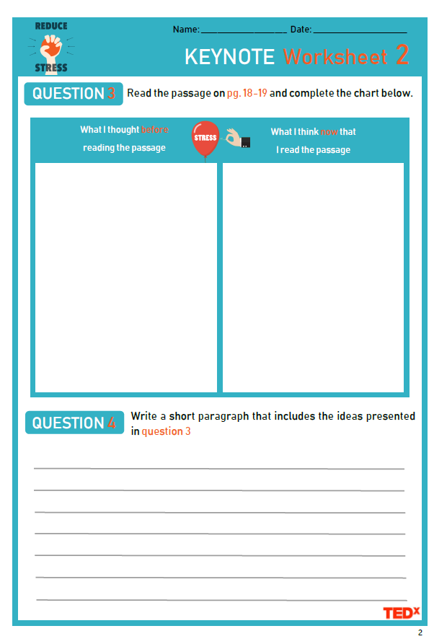

Slide 15
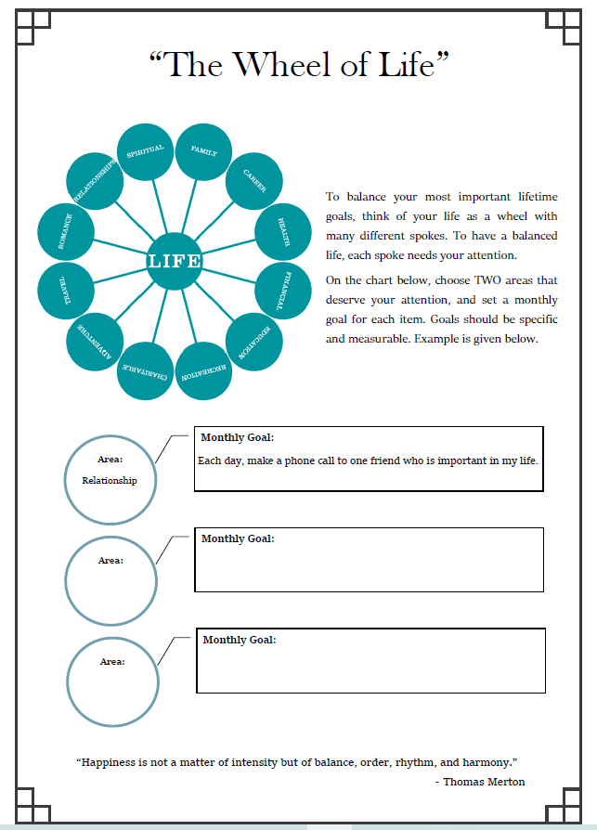

Slide 16
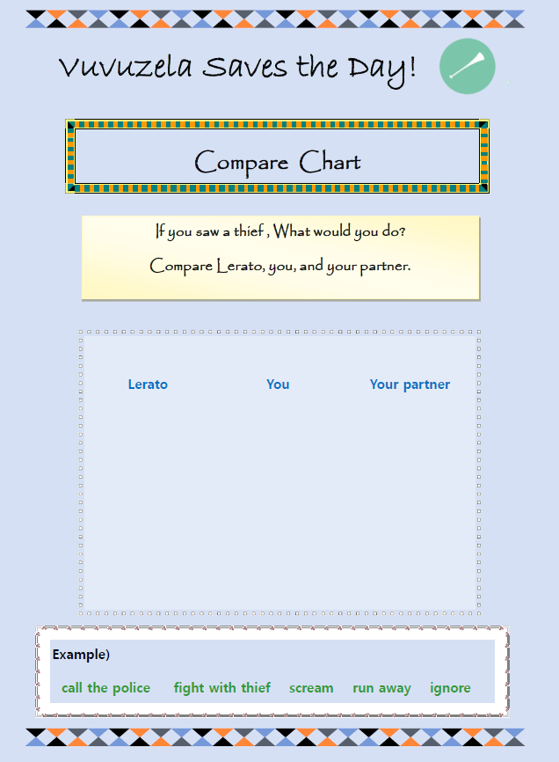

Slide 17
Graphic Organizers
Ideas

Slide 28
Features of Effective Worksheets
is clear & attractive
clearly labels questions/tasks with numbers or letters (so they can easily be referred to orally during feedback or answers)
is appropriate to the age, level and ability of the students can be created (and stored) on a computer and is thus easy to edit and print repeatedly
Is not intimidating (visuals, text, difficulty, length etc.)
has a font that is easy to read and of large enough size
uses images for a specific purpose only, and without cluttering up the worksheet
does not have irrelevant graphics and borders
has a descriptive title at the top and a space for the student to write their name
gives students sufficient space to write their answers
has clear, unambiguous instructions
uses bold OR italics OR underline for emphasis
is no longer than one or two pages (that is, front and back of a single sheet)
should be accessible to the learner (at that level) and answerable in a relatively short period, say 5 to 15 minutes (worksheets are not exam papers)
should have the easier tasks first - success is motivational

Slide 29
Key things to focus on
Useful/ purposeful
Clear instructions
Visually appealing and not cluttered
Not intimidating
Age/ Level appropriate

Slide 30
Programs and Websites
MS Publisher
OpenOffice Draw
Canva (canva.com)
Designhill (designhill.com)

Slide 31
Task
Create 2 supplementary worksheets for a textbook unit lesson of your choice.
IF you do not have a textbook I will give you a .pdf file.
You can choose the focus of the lesson and this will guide you in choosing an appropriate worksheet design.

Slide 32
References
https://www.tefl.net/esl-worksheets/guide.htm

Slide 33
Additional Resources
http://www.eslhq.com/worksheets/
www.puzzlemaker.com
http://www.toolsforeducators.com/
https://www.tefl.net/worksheet-generator/

