Slide 1
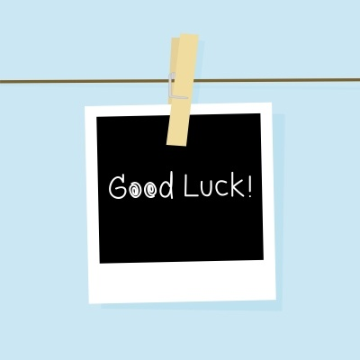
Superstitions
Strange things we believe and do!

Slide 2
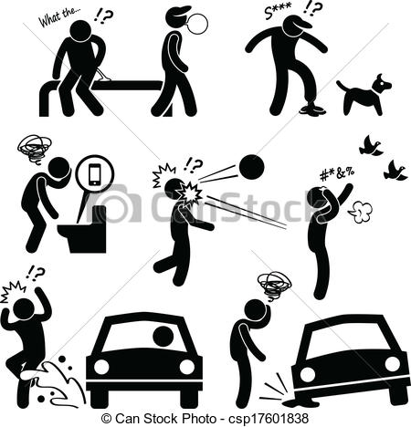
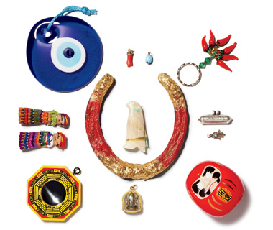
What is a superstition?
a belief that certain events or things will bring good or bad events

Slide 4
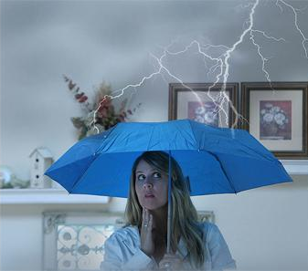
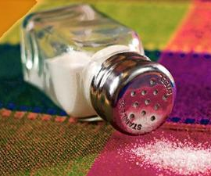
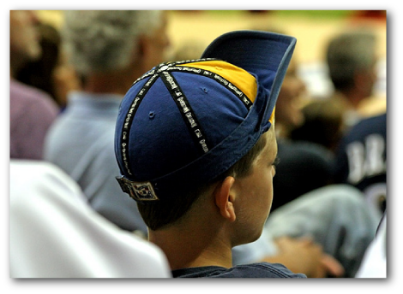
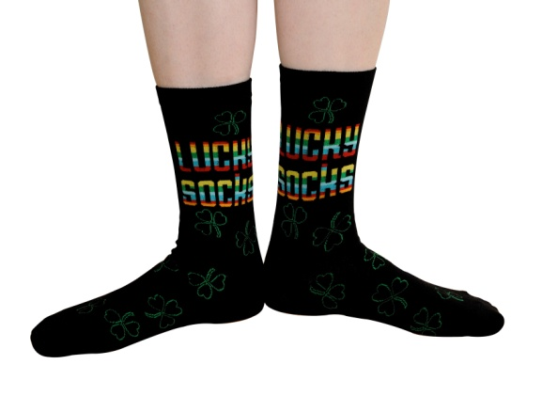
Two Categories of Superstitions
Cultural
Personal

Slide 5
Cultural Superstitions

Slide 6
What did you see?
What superstitions did you see in the video?

Slide 7
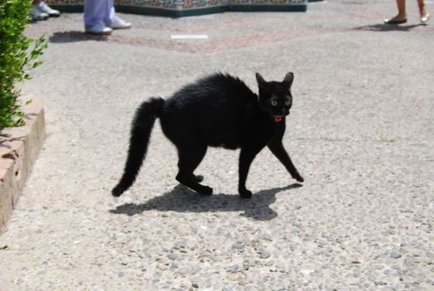
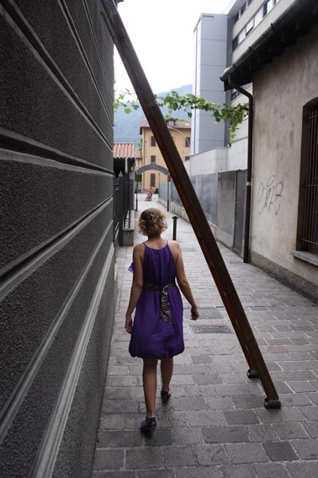
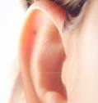
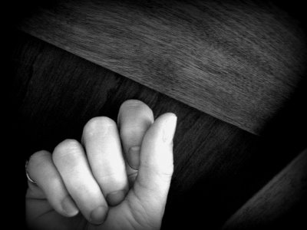
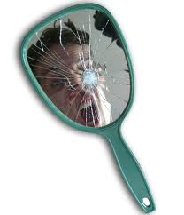
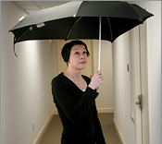
Common Canadian Superstitions

Slide 8
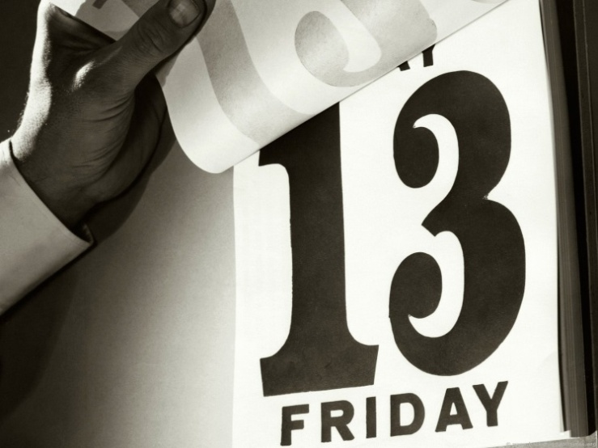
Friday the 13th & #13
Friday the 13th is considered an unlucky day
The number 13 has been considered unlucky for a long time
12 is considered to be the perfect number i.e. 12 months, 12 hours on a clock, etc.

Slide 9
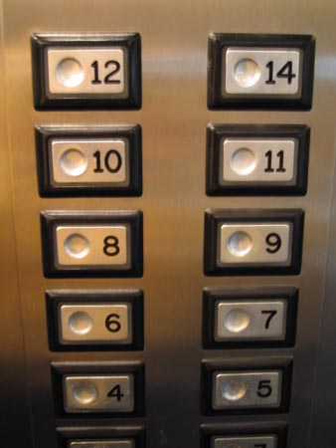
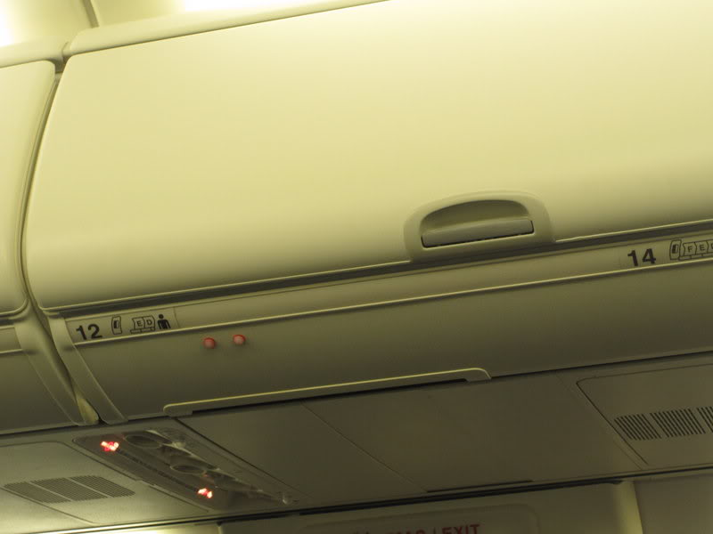
More than 80 percent of high-rises lack a 13th floor.
Many airplanes don’t have a 13th aisle.

Slide 10
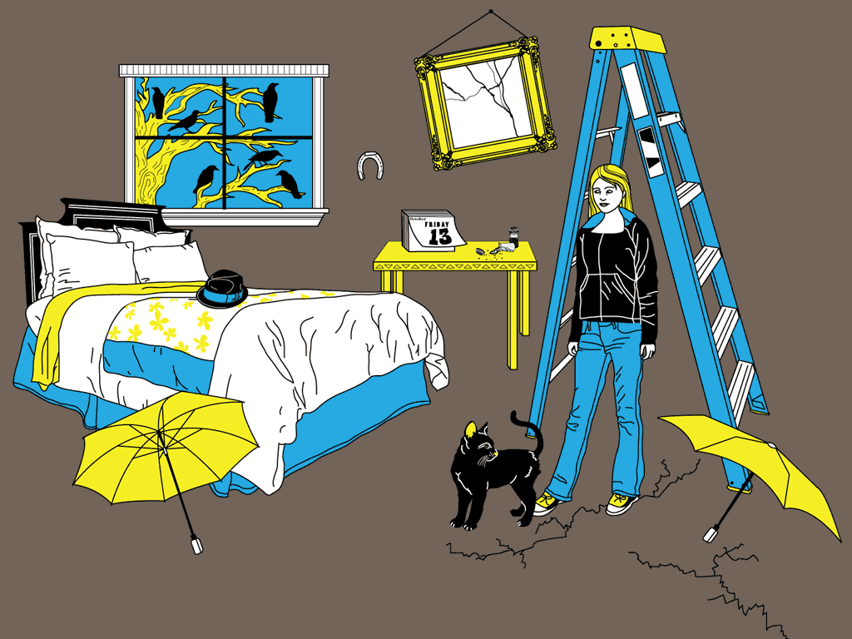
Discussion
With your group, talk about some cultural superstitions in your country.
*Try to think of at least 3*
Do you believe them? Why, why not?

Slide 11
Superstition Fair
Choose a country
Find 2 superstitions each and the reason for the superstition

Slide 12
Fortune Telling
Cards
Dice
Face
Palm
Other?

