Slide 1
Superstitions
Strange things we believe and do!

Slide 2
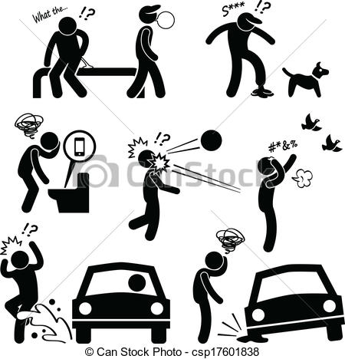
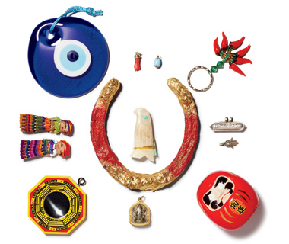
What is a superstition?
a belief that certain events or things will bring good or bad events

Slide 3
Are you superstitious?

Slide 4
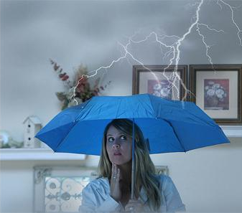
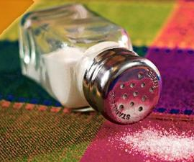
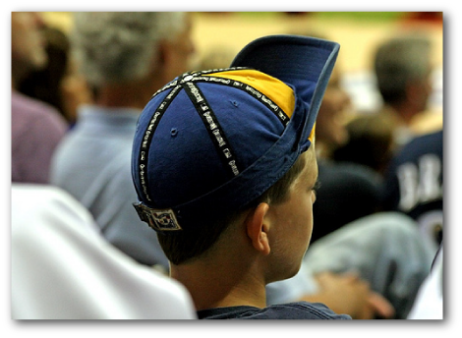
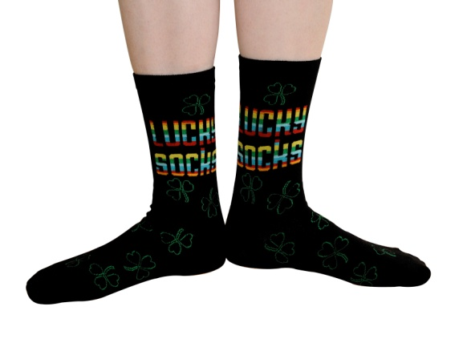
Superstitions
Cultural
Personal

Slide 5
Cultural Superstitions

Slide 6
What did you see?
What superstitions did you see in the video?

Slide 7
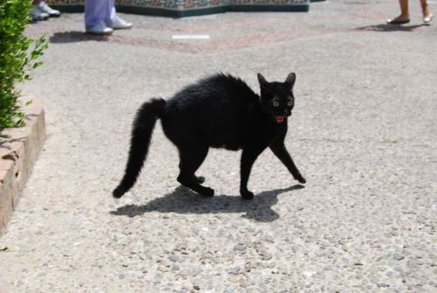
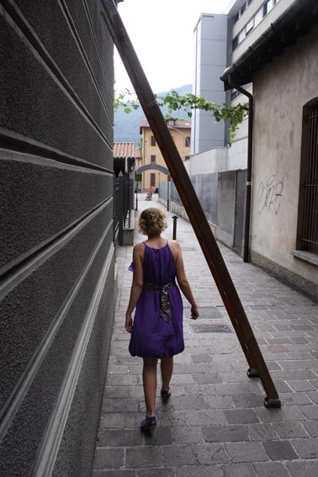
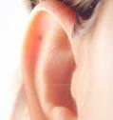
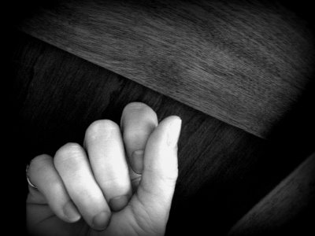
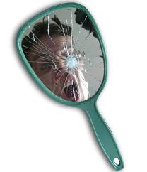
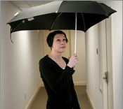
Common Canadian Superstitions

Slide 8
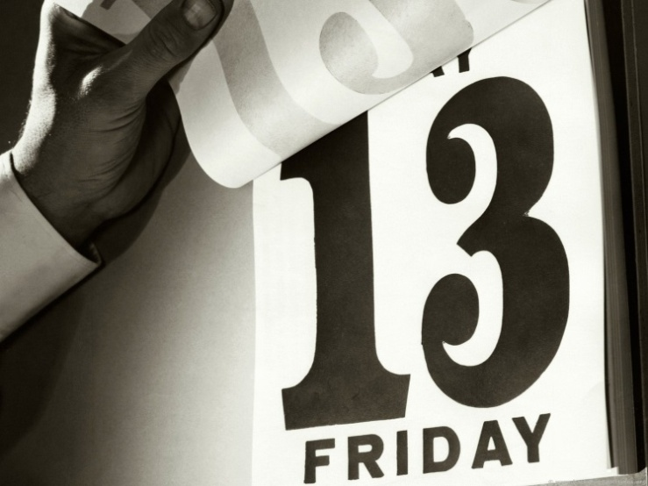
Friday the 13th & #13
Friday the 13th is considered an unlucky day
The number 13 has been considered unlucky for a long time

Slide 9
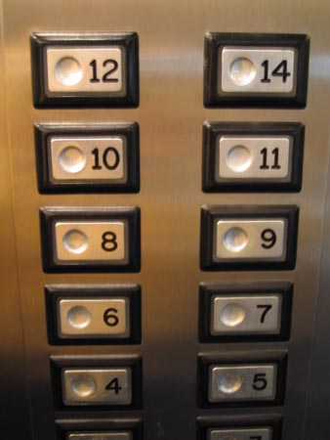
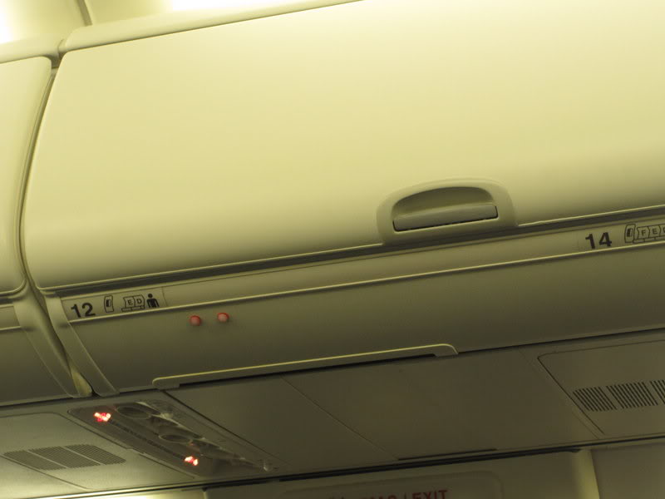
More than 80 percent of high-rises lack a 13th floor.
Many airplanes don’t have a 13th aisle.

Slide 10
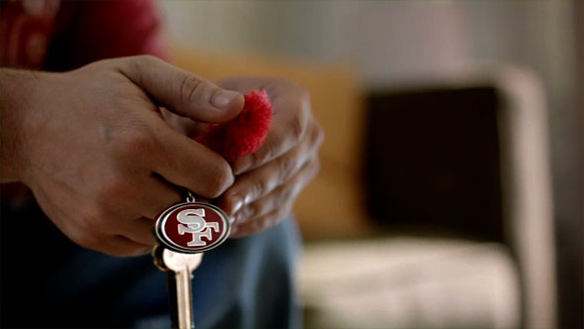
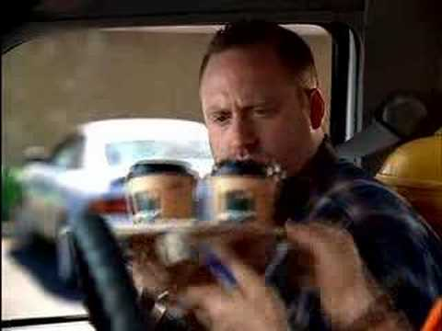
Personal Superstitions

Slide 11
Personal Superstitions
Do you have any personal superstitions?
Before a test
For good luck
About your dreams
Relationship
Sports
Numbers
Share your superstitions with your group

Slide 12
Korean Superstitions
What are some of the most common superstitions that Korean people believe?
With your group try to write down at least 5 and rank them in order of most common to least common.

Slide 13
Fan Death
Key Words

Slide 14
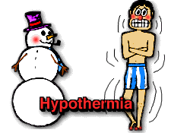
hypothermia (n)
She was in the cold for a long time so she developed hypothermia.

Slide 15
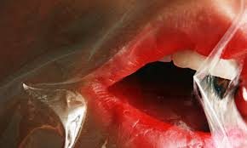
asphyxiation (n)
There was not enough oxygen left in her tank and she died from asphyxiation.

Slide 16
perpetuate (v)
It’s sometimes easier to perpetuate a lie than to convince people the lie is false.
To make (something, typically an undesirable situation or an unfounded belief) continue.

Slide 17
propaganda (n)
North Korea uses a lot of propaganda to create strong, negative feelings towards the USA.
information, especially of a biased or misleading nature, used to promote or publicize a particular political cause or point of view.

Slide 18
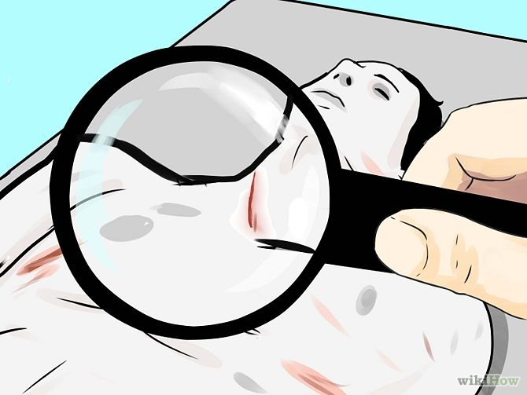
autopsy (n)
They conducted an autopsy to identify the cause of death.

Slide 19
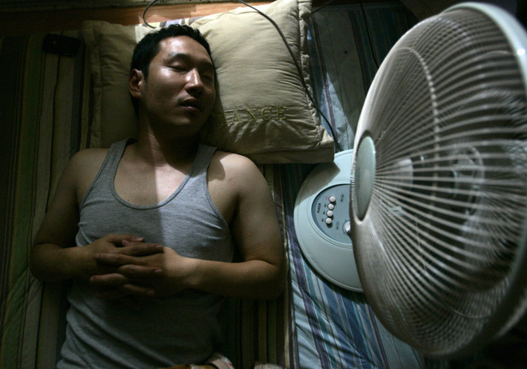
FAN DEATH

Slide 20
Superstition Fair
Choose a country
Find 2 superstitions each and try to provide the origin of the superstition

Slide 21
Fortune Telling
Cards
Dice
Face
Palm
Other?

Slide 22
Appendices

Slide 23
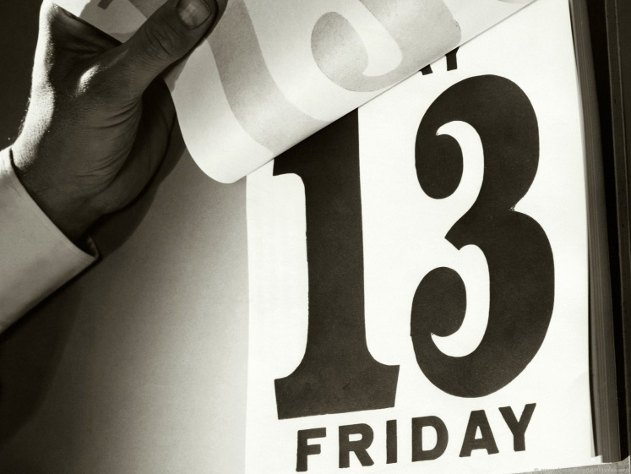
FRIDAY THE 13TH
FRIDAY THE 13TH IS CONSIDERED AN UNLUCKY DAY (ACCORDING TO CHRISTIAN TRADITION, JESUS DIED ON A FRIDAY)
THE NUMBER “13” HAS BEEN CONSIDERED UNLUCKY FOR A LONG TIME SINCE “12” IS CONSIDERED TO BE THE PERFECT NUMBER (12 MONTHS / 12 HOURS ON THE CLOCK / 12 APOSTLES / ETC.)

Slide 24
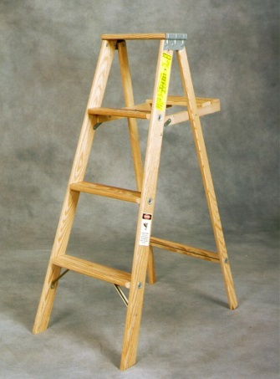
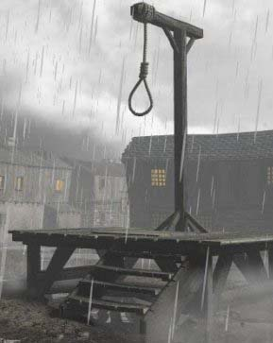
WALKING UNDER A Ladder
WALKING UNDER A LADDER IS CONSIDERED BAD LUCK
THE REASON IT IS CONSIDERED BAD LUCK IS BECAUSE LADDERS ARE ASSOCIATED WITH GALLOWS AND EXECUTIONS
ANOTHER POPULAR BELIEF IS BECAUSE A LADDER CAN CREATE A TRIANGLE SHAPE. THIS TRIANGLE SHAPE CAN BE INTERPRETED AS THE HOLY TRINITY (FATHER, SON AND THE HOLY GHOST). WALKING THROUGH THE LADDER WOULD BREAK THE TRIANGLE AND BE BLASPHEMOUS

Slide 25
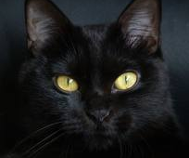
Black cats CROSSING YOUR PATH
BLACK CATS CROSSING YOUR PATH IS CONSIDERED BAD LUCK
MOST LIKELY, THE SUPERSTITIONS COMES FROM THE OLD BELIEF THAT WITCHES HAVE BLACK CATS
IT WASN’T UNTIL THE MIDDLE-AGES IN EUROPE WHEN THE CAT BECAME ASSOCIATED WITH WITCHES.
THE BELIEF WAS THAT WITCHES WOULD TRANSFORM THEMSELVES INTO BLACK CATS TO WALK AROUND THE STREETS AND LOOK FOR PEOPLE TO HEX
THE COLOR BLACK IS ALSO ASSOCIATED WITH EVIL

Slide 26
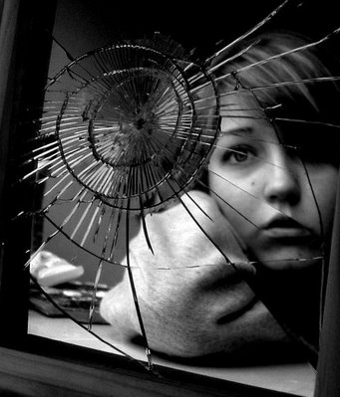
BREAKING A MIRROR
BREAKING A MIRROR GIVES YOU BAD LUCK FOR SEVEN YEARS!
THE SUPERSTITIONS COMES FROM THE BELIEF THAT MIRRORS DON’T JUST REFLECT YOUR IMAGE, THEY ALSO HOLD PIECES OF YOUR SOUL. IF YOU BROKE A MIRROR, YOUR SOUL WAS TRAPPED IN THE PIECES OF THE MIRROR
ESSENTIALLY, A BROKEN MIRROR CREATED A BROKEN SOUL

Slide 27
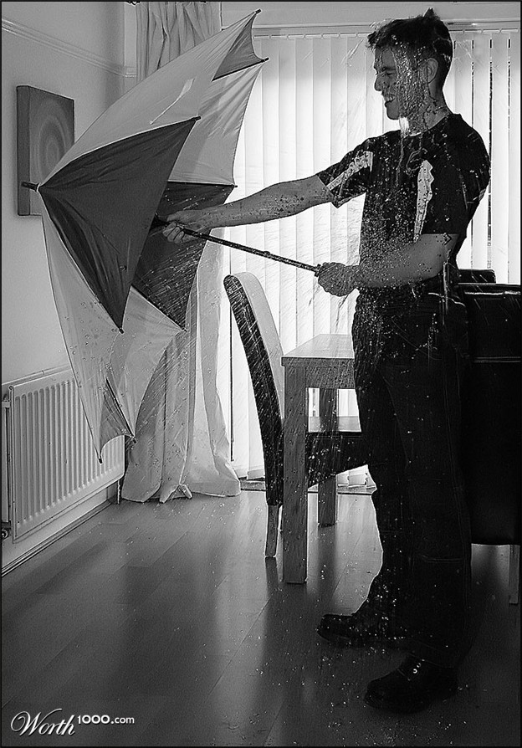
OPENING AN UMBRELLA INSIDE
OPENING AN UMBRELLA INSIDE BRINGS YOU BAD LUCK
LEGEND SAYS THAT A ROMAN WOMAN OPENED HER UMBRELLA INSIDE HER HOUSE AND MOMENTS LATER, HER HOUSE COLLAPSED
ANOTHER STORY IS ABOUT A BRITISH PRINCE WHO RECEIVED TWO UMBRELLAS FROM A VISITING KING AND HE DIED TWO MONTHS LATER

Slide 28
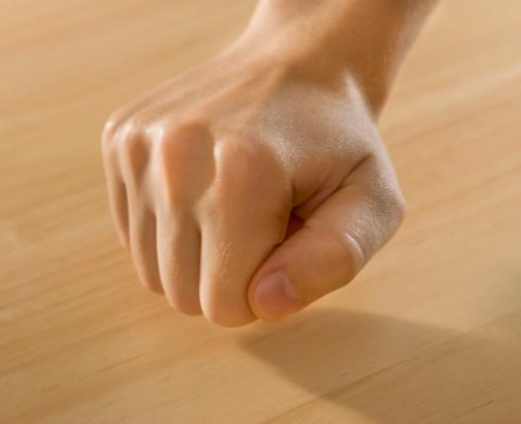
KNOCKING ON WOOD
KNOCKING ON WOOD WARDS OFF BAD LUCK
THE FIXATION ON WOOD MAY COME FROM OLD MYTHS ABOUT GOOD SPIRITS LIVING IN TREES
IN ENGLISH FOLKLORE, PEOPLE WOULD KNOCK ON WOOD WHILE TELLING SECRETS TO HIDE THEIR COMMUNICATION FROM EVIL SPIRITS AND TALK MORE IN PRIVATE
IT CAN ALSO BE ASSOCIATED WITH THE CHRISTIAN CROSS WHICH WAS MADE OF WOOD

Slide 29
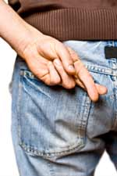
CROSSING YOUR FINGERS
PEOPLE WISHING FOR GOOD LUCK WILL OFTEN CROSS THEIR FINGERS
THE REASON, AS THE STORY GOES, IS THAT TWO PEOPLE USED TO CROSS INDEX FINGERS WHEN MAKING A WISH, A SYMBOL OF SUPPORT FROM A FRIEND
THE TRADITION BECAME SOMETHING PEOPLE COULD DO BY THEMSELVES AND NOWADAYS, JUST SAYING “FINGERS CROSSED” IS ENOUGH
CROSSING YOUR FINGERS CAN ALSO BE ASSOCIATED WITH THE CHRISTIAN CROSS

