Slide 1
Success

Slide 2
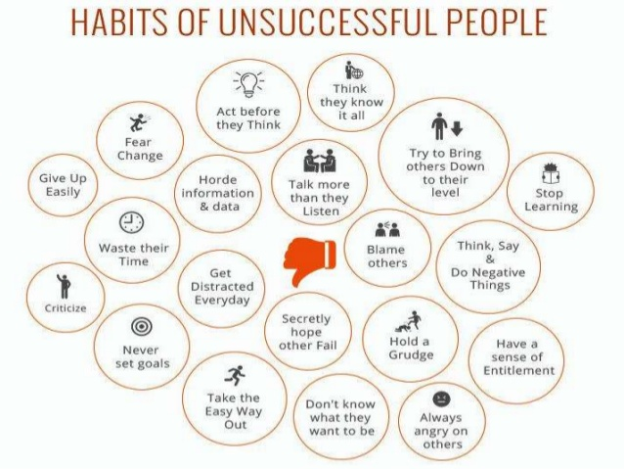

Slide 3
Success

Slide 4
Situations

