Slide 1
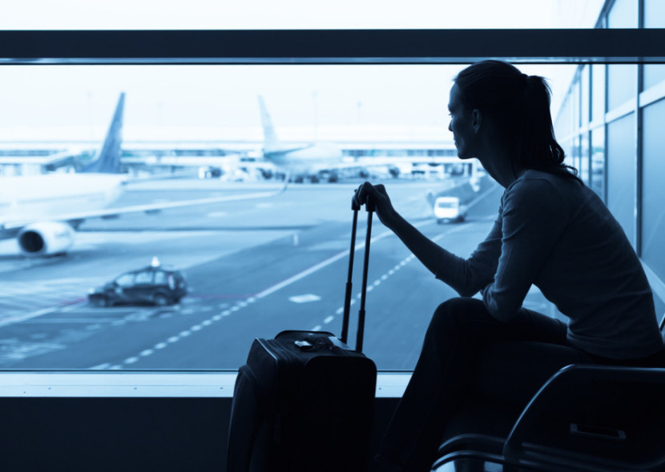
Stuck Flying Standby

Slide 2
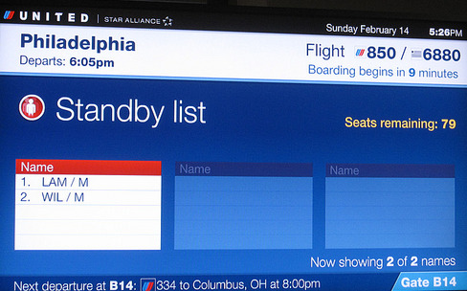
Have you ever flown standby?
What are some of the reasons that people would fly standby?

Slide 3
Discussion Questions
Have you ever missed your flight or almost missed your flight? Explain.
Has your flight ever been cancelled? Why? What did you do ?
Has your luggage ever been lost or delayed?
Have you ever been stuck at an airport or train station because your departure time was delayed?
If you were stuck waiting at an airport or train station for many hours how would you kill the time?

Slide 4
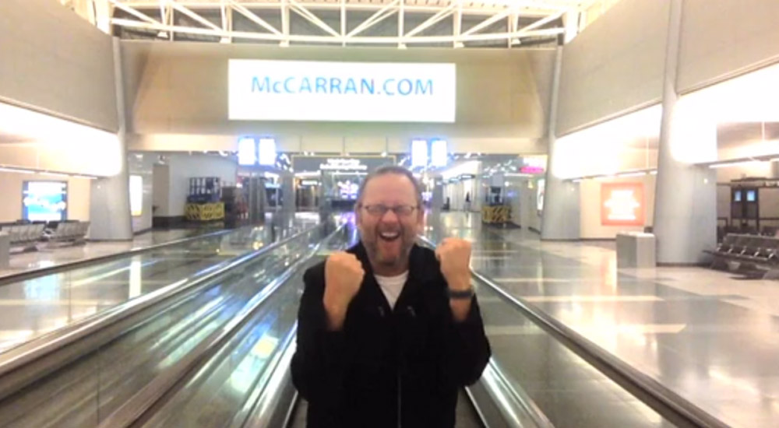
What do you think this guy did?

Slide 5
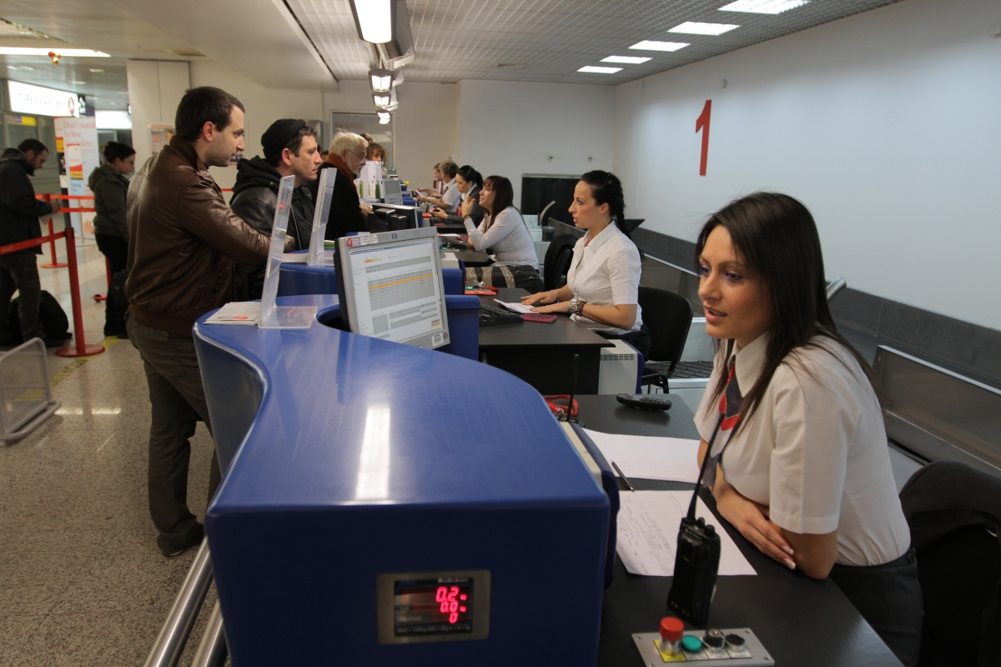
Role Play

Slide 6
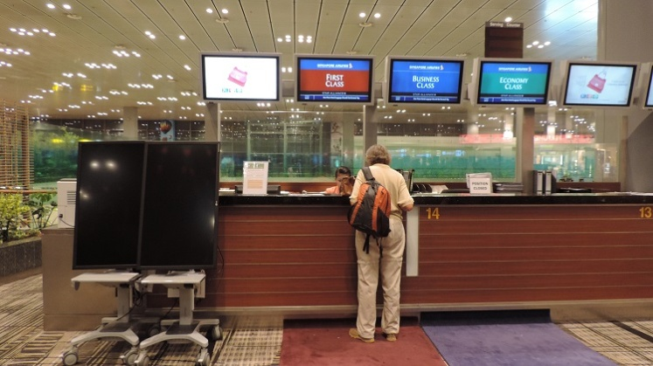
Role-play
You missed your flight and you need a ticket right away!
Your luggage was already checked in
You are at the airline desk explaining your situation
The staff member helps to put you on standby for the next available flight

Slide 7
Can I help you?
How can I be of service?
Will my luggage be checked through to my final destination?
I have missed my flight…
I will check for availability…
I would like the route that will get me there the fastest.
Can I see your ticket and passport please
Can I see your ticket and passport please
I’m sorry the flight is full…

Slide 8
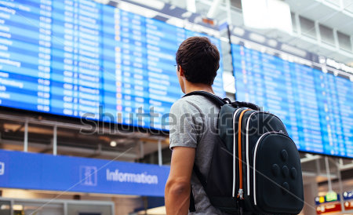
What advice would you give this guy?
I have missed 5 flights in my life. I arrive at least 1 hour before my flight but there are always so many people waiting to check-in and then I have to go through immigration which also has a long line. By the time I get to the boarding gate (which I have to take a shuttle to usually), the boarding has finished and I see the plane departing the gate. I am getting so frustrated!!

