Slide 2
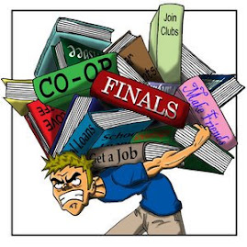
What stresses you out?
With your group make a list of things that stress you out. Then try to order then from the most stressful to the least stressful.

Slide 3
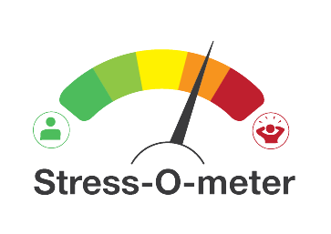
How stressed out are you?

Slide 4
What are some strategies to reduce stress?

Slide 5
Giving advice
Write down a description of why you or someone you know may be stressed out.
You will give your problem to another person who will give you advice on how to reduce your stress.

Slide 6
Giving advice face-to-face
Stand up
Meet someone
Describe your stress problem that you wrote down
Get advice from them
Switch roles
Switch papers
Repeat

