Slide 1
Stereotypes

Slide 2
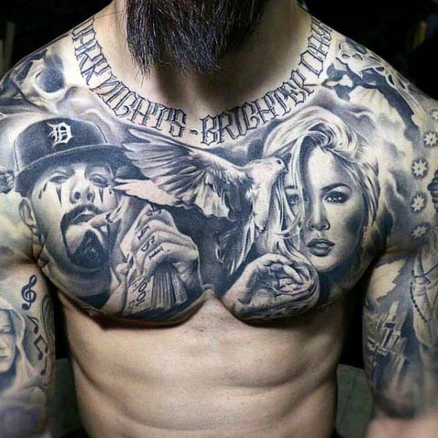
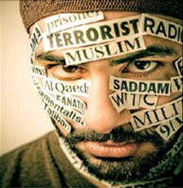
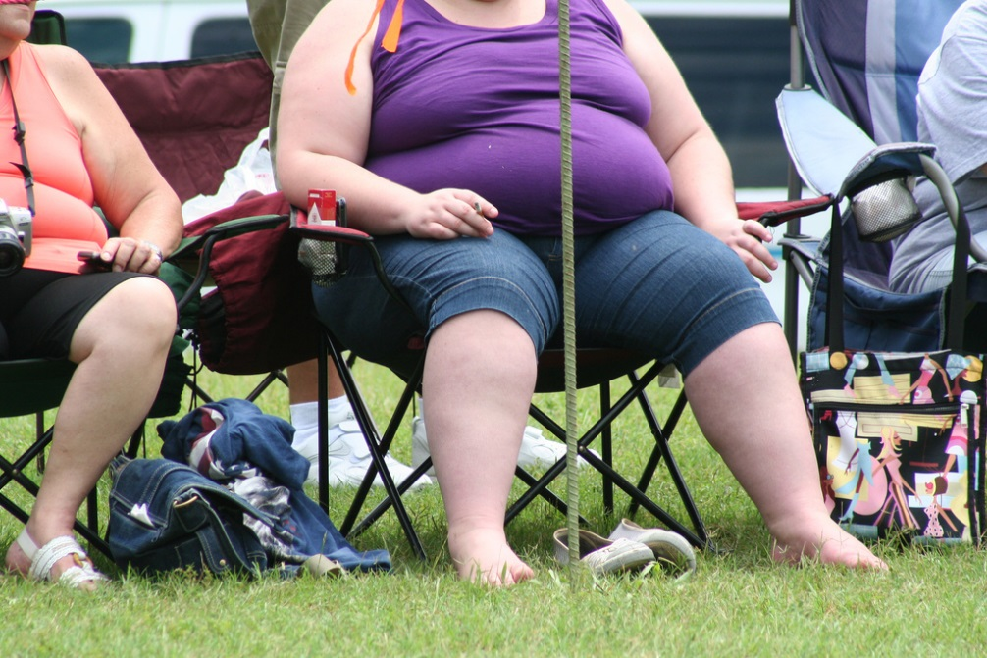
Discussion
What is a stereotype?
Why do you think people stereotype?

Slide 4
STEREOTYPES IN KOREA
About countries
About certain types of people
Gender
Race
Religion
Job

Slide 5
GENDER STEREOTYPES

Slide 6
STEREOTYPING PEOPLE
Japanese
Chinese
American
Korean

Slide 7
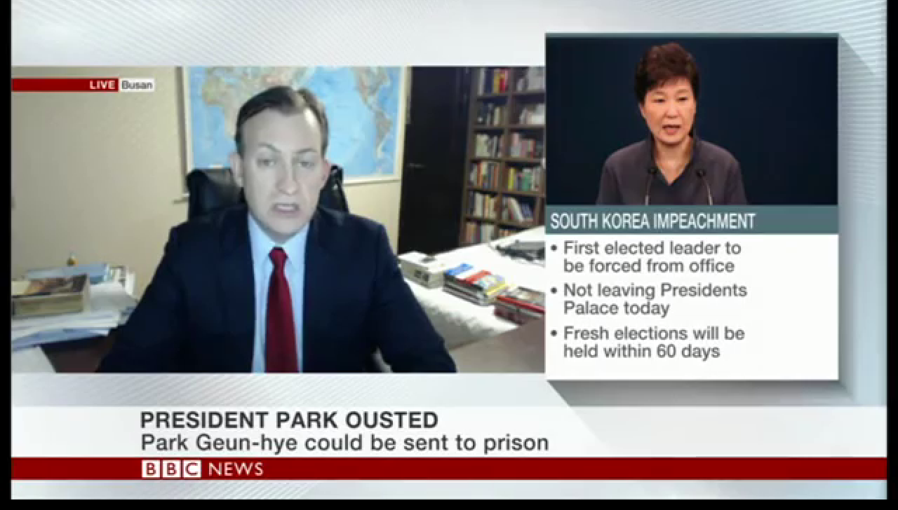

Slide 9
What are some stereotypes you have?

Slide 10
Thinking
How can stereotypes be damaging?
How can being stereotyped hurt your job opportunities?
Tattoos
The way you dress
Hairstyle
University you graduate

Slide 11
I am Video Project
Create a video that teaches others about the dangers of stereotyping
Focus on common stereotypes
Shifting people’s paradigms
I am ______, but I’m not ________.
But I don’t_____________.
But I can_____________.
But I can’t ___________.

