Slide 1
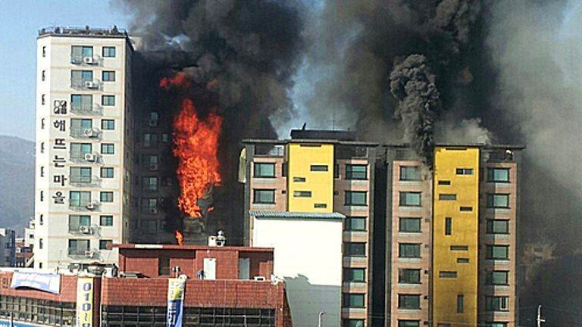
Someone Call 911 Now

Slide 2
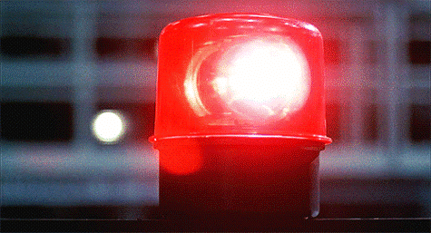
Warm-up
What are some reasons you may have to call 911?

Slide 3
Heart attack
Fire
Poison
Choke
Bleed
Unconscious
Burn
Car accident
ambulance

Slide 4
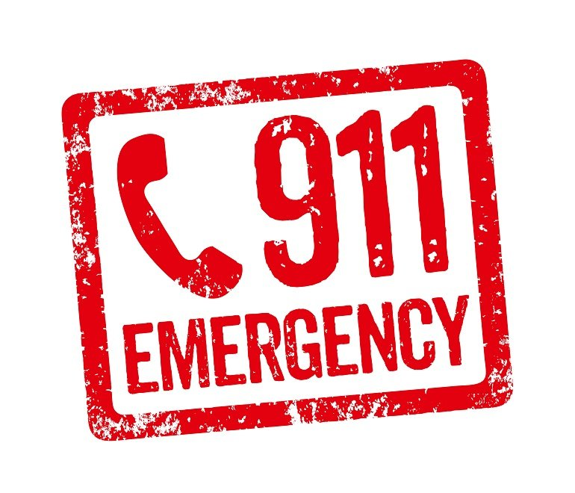
Dumb 911 Stories

Slide 5
911/119
Hello 911, what is your emergency?
What is your location?
Has anyone been injured?
Please remain calm.
I’ll dispatch a ____ immediately.
The police are on their way.
An ambulance is on its way.
Please stay on the line until _____ arrive.

Slide 6
Role Play
You are reporting an emergency to a 911 operator. The operator helps you to stay calm while emergency crews are dispatched!

