Slide 1
Skills & Activities
Choices

Slide 2
Skills + Grammar
Listening
Speaking
Reading
Writing
Grammar
Receptive Skills | Productive Skills
Listening | Speaking
Reading | Writing

Slide 3
Past Lesson Flow Suggestions
In the past many programs separated classes by skill (Reading, Writing, Listening, Speaking)
Nowadays, most textbooks, and teacher take a more integrated approach.

Slide 4
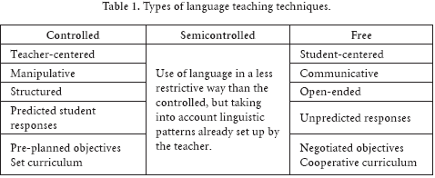
Productive Skills & Grammar: PPP controlled, less-controlled, free
Present/ set the context (situation)
Present the target language
Students drill the target language through repetition activities
Students do a less-controlled activity where they have a language guideline but may also use creatively use the language
Students do a free activity in which they must naturally use the new target language for a specific purpose (without needing to reference it).
Teacher gives feedback to learners highlighting any inaccuracies or issues

Slide 5
Receptive: Pre-While-Post (Task Feedback Cycle)
Lead-in (Setting the context/ background information)
Pre-teach key vocabulary/ grammatical structures
1st Listen/ Read – focus on general understanding
2nd Listen/ Read – focus on details
Post-Listening discussion – Addressing problems/ questions
Productive Activity – Speaking or writing activity that connected to the key topic or aspects of what they listened to.

Slide 6
Well balanced courses
The 4 Strands

Slide 7

New Important Features

Slide 8
Language focused learning
  Learning through deliberate attention to language items and language features
  Learning through attention to the sounds and spelling of the language, through direct vocabulary study, through grammar exercises and explanation, and through deliberate attention to discourse features.

Slide 9
Meaning-focused input
  Learning through listening and reading where the learners’ attention is on the ideas and messages conveyed by the language.

Slide 10
Meaning-focused output
Learning through speaking and writing where the learners’ attention is on conveying ideas and messages to another person

Slide 11
Fluency development
Developing fluent use of known language items and features over the four skills of listening, speaking, reading and writing
Key point: becoming fluent with what is already known.

Slide 12
Applying the 4 strands
Critical Thinking and Application

Slide 13
Productive Skills & Grammar: PPP controlled, less-controlled, free
Present/ set the context (situation)
Present the target language
Students drill the target language through repetition activities
Students do a less-controlled activity where they have a language guideline but may also use creatively use the language
Students do a free activity in which they must naturally use the new target language for a specific purpose (without needing to reference it).
Teacher gives feedback to learners highlighting any inaccuracies or issues

Slide 14
Receptive: Pre-While-Post (Task Feedback Cycle)
Lead-in (Setting the context/ background information)
Pre-teach key vocabulary/ grammatical structures
1st Listen/ Read – focus on general understanding
2nd Listen/ Read – focus on details
Post-Listening discussion – Addressing problems/ questions
Productive Activity – Speaking or writing activity that connected to the key topic or aspects of what they listened to.

Slide 15
Key Points
When creating materials/ textbooks it is important to consider the learners aims and distribute the focus on the 4 strands to meet their aims.
For general development in general English classes the strands should be relatively balanced over the course of a week.
There is currently a lack of focus on MFO and FD and an over focus on LFL and MFI
  This has led/ and continues to lead to a lack of productive skill proficiency

Slide 16
Reading, Listening, Speaking, Writing
Activities

Slide 17
Listening & Reading
Receptive

Slide 18
Selecting a suitable text

Slide 19
Levels of Difficulty
Independent - Easy
  Should be able to read alone and comprehend 90% without any help
Instructional - Challenging
  The learner understands most of the content but feels the needs help with new words they do not know and comprehension.
  They should be able to comprehend at least 75%.
  The material should be challenging but not too difficult.
Frustration – Too difficult
  This level should be avoided
  Word recognition presents such difficulty that adequate comprehension is impossible.
  Can comprehend 50% or less
Warning signs: looks of confusion, anger, heavy breathing, crying

Slide 20
Assessing Student level

Slide 21
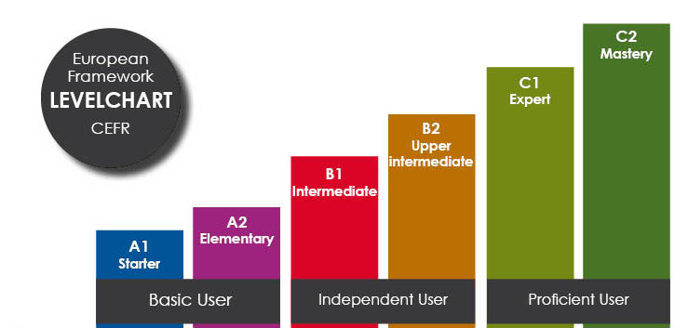

Slide 22
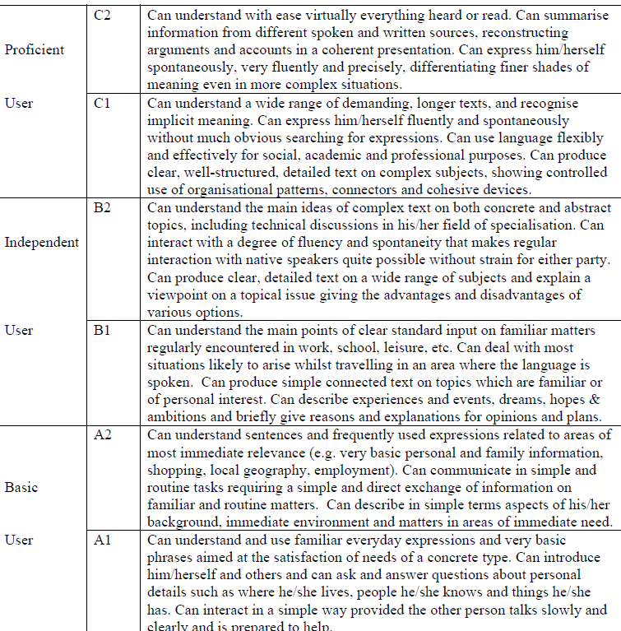
The Framework
Basic
  A1
  A2
Independent
  B1
  B2
Proficient
  C1
  C2

Slide 23
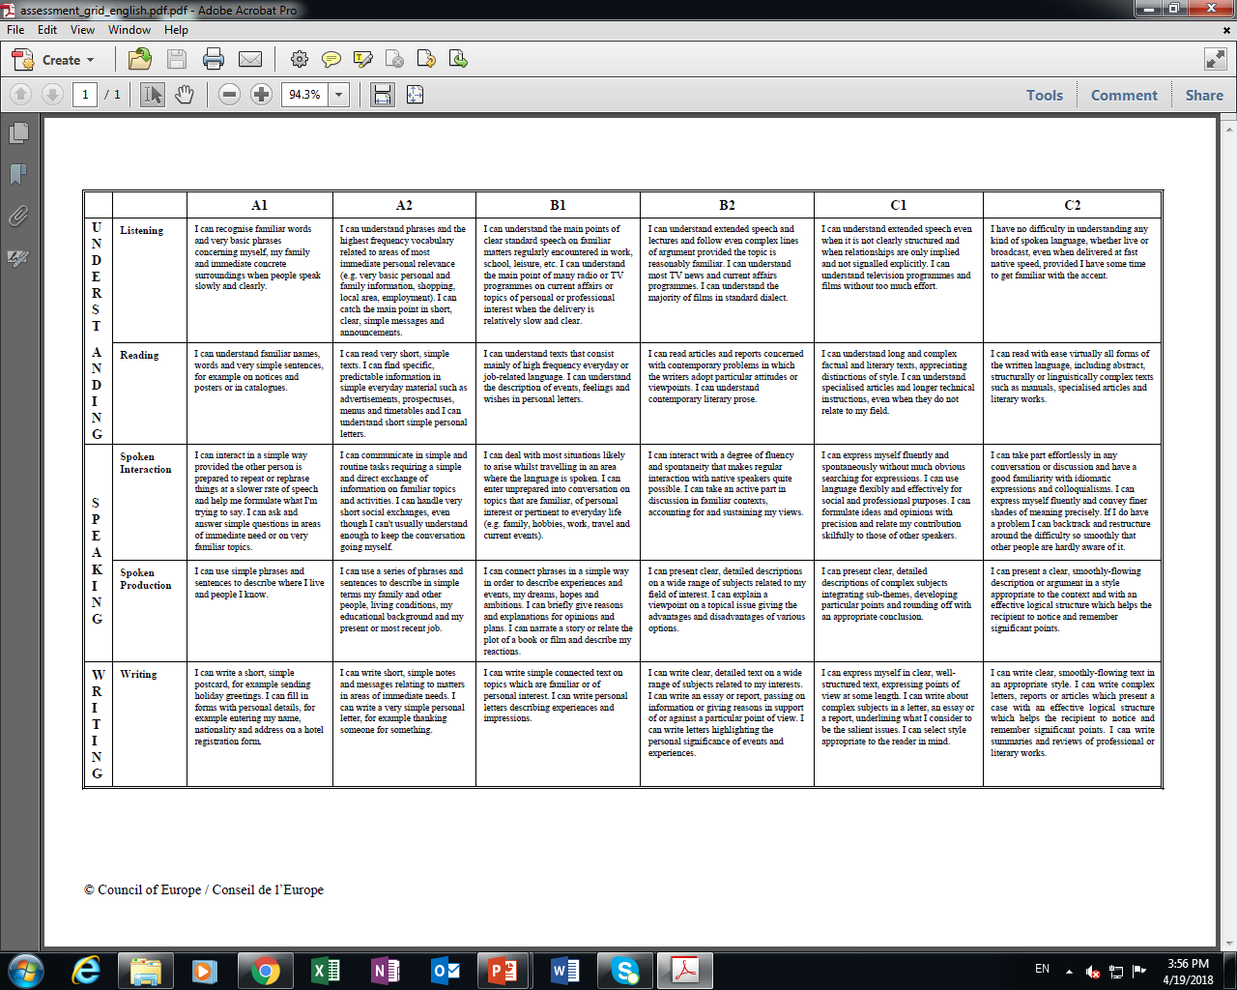
Self-assessment

Slide 24
Assessing content level

Slide 25
Sample content
Matthew and Jimin saw a strange art show down the street. They were curious. They went inside. The hall had several rooms. They went into the first room. They saw colorful cushions on the benches. The cushions looked beautiful. They were made of plastic bags. Matthew and Jimin went to the next room. There were many pretty lamps. In the center of the room, an artist was explaining her artworks. She was surrounded by many people. Matthew and Jimin went to her.
Students are likely to be more motivated when they have a high expectancy of success in completing the task and when they value the outcome. This principle basically means that students are more likely to do what they expect to accomplish successfully and avoid tasks that they feel they may not be able to do successfully. But this alone is not enough. They also take the value of the tasks into consideration. Thus, students’ expectancy of success and the intrinsic value of the task influence students’ decision to do or avoid the tasks.

Slide 26
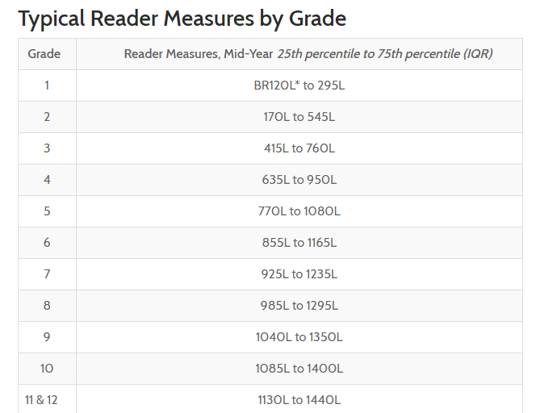
Assessing Reading Content Level
Paid Original
https://www.lexile.com/
Free Alternative
https://www.cathoven.com/en/free-lexile-analyzer/
4 5 6 7 8 9 10 11 12 Uni +

Slide 27
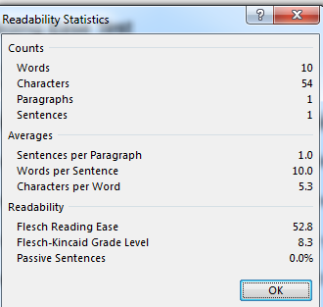
Flesch-Kincaid (MS Word)
Highlight text – Hit F7
Based on contexts with predominantly fluent speakers of English
Reading Ease Higher score = easier (Max 120)
  Lower score = more difficult
  100 – 90 can be easily understood by an average 11-year-old student.
  60 – 70 can be easily understood by 13 – 15-year-old students.
  30 – 0 is best understood by university graduates.
Grade Level
  The score indicates the grade level for which the text is appropriate
  The score also means the number of years of education required to understand the text.
  A score of 8.3 indicates that the text can be understood by a typical 8th grader, or someone with 8 years of education.

Slide 28
CAUTION: Readability Tests
Readability tests cannot tell you anything about several important factors which affect readability. For example:
Is the material well organized?
Does it make sense?
How technical is the vocabulary?
How complex are the ideas?
Is the vocabulary appropriate for the readers?
Is the layout open and easy to read?
Readability formulas are based on measuring words and sentences. They do not take the characteristics of the reader into consideration. For example:
What does the reader already know about the subject?
How well does he or she read?
For what purpose is he or she reading the text?
Does the reader speak a different first language?

Slide 29
Reading & Listening
Activities

Slide 30
Bank: Reading & Listening Activities
Ordering (Pictures, paragraphs, words etc.)
Gap-fill
Graphic organizers
Summarizing
Translating
Find the mistake
Predict and check
Writing down questions they have when reading/ listening
Ticking items
Taking notes
Comprehension activities
  Questions
  T/F
  Multiple Choice
  Class Discussion
  Dictation (listening/ writing)
Listen/ Read & Draw
Follow the directions

Slide 31
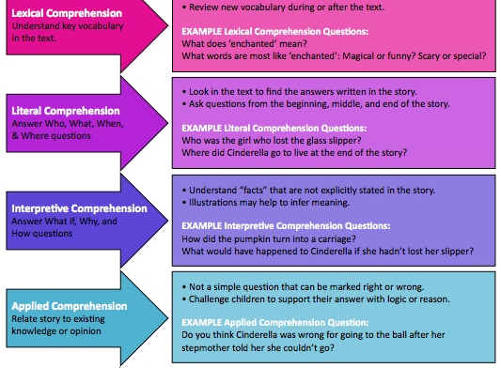
Types of Comprehension Questions

Slide 32
List of sites for listening
www.youtube.com
  www.en.savefrom.net
  www.keepvid.net
  www.offliberty.com
  http://www.listentoyoutube.com/
https://lyricstraining.com/
https://www.eslvideo.com/
https://www.englishcentral.com/videos
http://esl-lab.com/
http://www.eslcommando.com/search/label/Listening

Slide 33
Reading Sources/ Listening Sources
  Books
  Storybooks
  Internet sites
  News
  Text messages
  Emails
  Written letters
  Posters
  Schedules
  Menus
  Signs
  Brochures
  Magazines
  Advertisements
  Others?
  Audiobooks
  Storybooks (Storytelling)
  Internet sites
  News
  T.V.
  Movies
  YouTube
  Teacher
  Students
  Radio
  Podcast

Slide 34
List of sites for Reading
https://breakingnewsenglish.com/
https://www.rong-chang.com/
http://web2.uvcs.uvic.ca/elc/studyzone/
www.storybird.com
http://www.storylineonline.net/

Slide 35
Speaking
Productive

Slide 36
Bank: Types of Speaking Activities
Brainstorming
Surveying
Interviewing
Discussions
Role-play
Debate (?)
Dialogues
Information gap
Jigsaw activities
Explaining
Planning
Group Projects
Presentations
Speeches
Describing
Teamwork activities
Make a video
Record their own answers to something using their phone

Slide 37
writing
Productive

Slide 38
Bank: Writing activities
Fill-in the blank
Copy
Translate
Write something
  Sentences
  Paragraphs
  Email
  Story
  Finish a story
  Rewrite a story
  Text message
Make something
  A menu
  Poster
  Schedule
  Plan
  Survey
Correct a text (Rewrite)
Rolling paper
Writing prompts
Descriptive writing
Taking notes
Picture prompts

Slide 39
Grammar
Grammar

Slide 40
Bank: Grammar activities
Fill in the blank
Find the mistake
Correct mistakes
Sentence scramble
Write/ Speak using the target grammar
  Sentences
  Paragraph
  Dialogue
  Other previously mentioned activities
Draw a picture
  i.e. prepositions
Translate sentences

Slide 41
References
Azar, B. S. (1999). Understanding and using English grammar (3rd Ed.). White Plains, NY: Pearson Education.
Bouchard, M. (2005). Comprehension Strategies for English Language Learners. New York, NY: Scholastic.
Scrivener, J. (2017). Learning teaching: The essential guide to English language teaching. London: Macmillan Education.
Ur, P. (1981). Discussions that work: Task-centred fluency practice. Cambridge University Press.
Ur, P. (1984). Teaching listening comprehension. Cambridge University Press.

