Slide 1
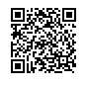
Setting the groundwork for student motivation
The role of the teacher
George E.K. Whitehead

Slide 2
Motivating Students
Do you ever have demotivated learners in your class?
Have you ever been demotivated in class as a learner?

Slide 3
Getting started
What do you think are the biggest reasons for student demotivation in English class?
With your group make a list.

Slide 4
Is student motivation a student or a teacher problem?
What do you think?

Slide 5
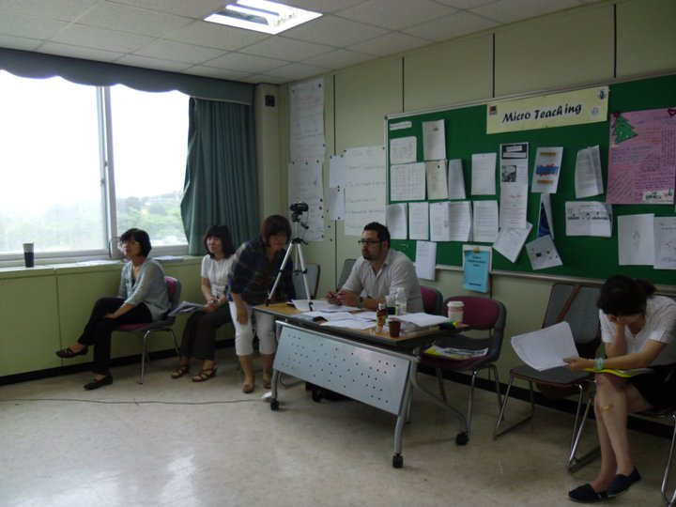
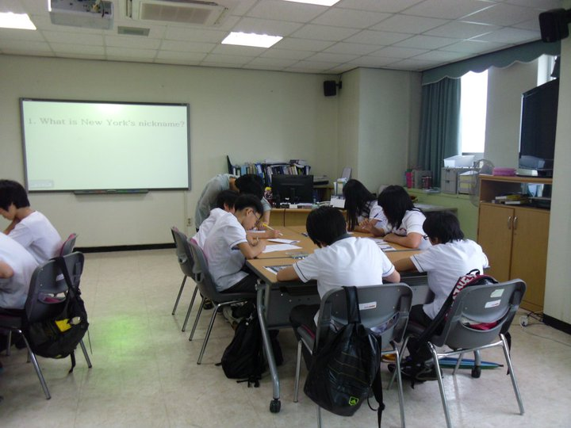
Background
Teacher-educator for over 15 years
Observation of over 3000 teachers in action in both private and public contexts

Slide 6
Theoretical Background
Whose responsibility is it to ensure that students’ motivation and levels of engagement remain high during the learning process?
Fixed
Dynamic
Seeing students as either motivated or unmotivated.
Believing that motivation can change depending on the learning situation in the classroom or school.
( Renandya, 2014)

Slide 7
Fixed
We see motivation to learn as being essentially a ‘student problem’ (Johnson, 2008).
The students are responsible for their own motivation and there is not much we can do to change it.
( Renandya, 2014)

Slide 8
Dynamic
Motivation viewed more as a ‘teacher problem’ (Johnson, 2008).
We acknowledge that there are many classroom-specific factors that the teacher can exploit in order to foster student motivation.
This however is not to say that students have little or no responsibility to work on their motivation levels. They do, because ultimately motivation is the responsibility of the individual students.
( Renandya, 2014)

Slide 9
Getting started
What kind of things do you do to motivate them?

Slide 10
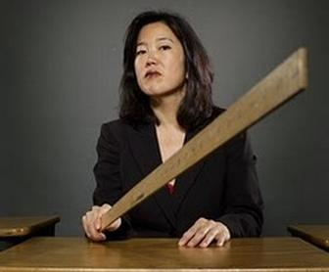
Poll
I mostly motivate my students through rewards.
I mostly motivate my students through fear.
I use both usually
I don’t motivate my students through reward nor fear.

Slide 11
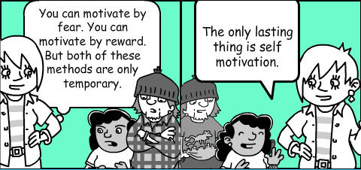

Slide 12
Punishment and reward proceed from basically the same psychological model, one that conceives of motivation as nothing more than the manipulation of behavior.
( Kohn, 1994)

Slide 13
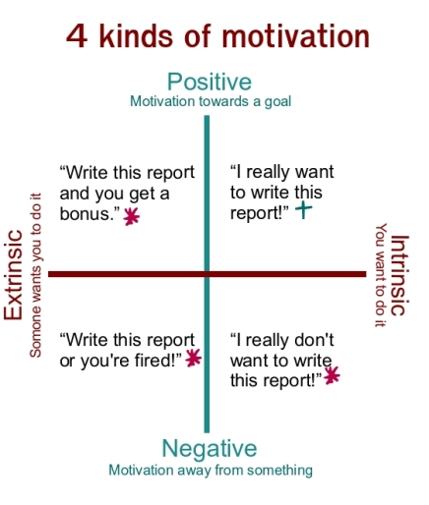
Do this and you will get a reward (ex candy, points)
I’m doing this because I really want to! I enjoy doing it!
If you don’t do this you will be punished!
(ex. extra homework, call your mother )
I really don’t want to do this!

Slide 14
Intrinsic Motivation
Inside-out

Slide 15
Sparking Intrinsic Motivation
Rapport
Likeability
Role Model
“Motivating students is lighting their fire within, and keeping that fire lit!”

Slide 16
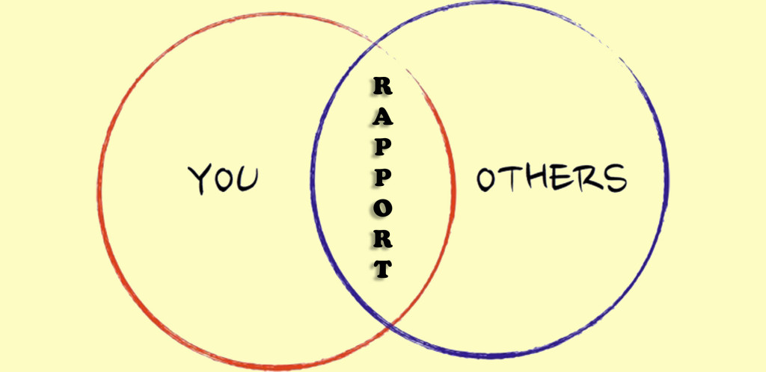
Rapport
You
Students
“People are more receptive to people like themselves.”
Try to relate to students in as many ways as possible.

Slide 17
Rapport & Mutual Respect
Rapport building starts the first second you meet.
Try to find things in common.
Reduce the gaps
Age
Teacher-Student relationship
Other?
Talk about things they like.

Slide 18
Signs of good rapport
Students don’t feel nervous around the teacher
Students are interactive with the teacher
Students seem to care about the teacher

Slide 19
Reflection
How much do you try to relate to your students?
Age
Experiences
Interests
How much time do you spend talking to them about things they like and care about?
How much do you try to make them feel comfortable with you?

Slide 20
Likeability
“Kids don’t learn from people they don’t like!”
~Rita Pierson

Slide 21
Likeability Factors
Honesty/ Fairness
Being humble
Empathy
Sense of humor
Positivity
Politeness
Control of hostility
?
https://www.hrtoolbox.nl/xquestion/pid/14329
( Greenier & Whitehead, 2016; Sanders,2005)

Slide 22
Likeable teachers
Knowledgeable about what they teach
Adapt to the context of where they are teaching
Methods
Language
Culture
Create a positive/ likeable learning environment
Interesting/ engaging atmosphere
Low-risk environment
Compelling lessons
Interactive
Easy to understand
Consider students’ needs and opinions (individual differences)
Sympathetic towards students’ L2 learning problems and needs
Push students a little (to their potential)
Likeable
Positive role model
( Renandya, 2014, Whitehead & Greenier, 2019)

Slide 23
Reflection
Are you creating a likeable environment for your learners?
Do you feel like your students genuinely like you?
Do your students genuinely like you?

Slide 24
Role Model
Teacher

Slide 25
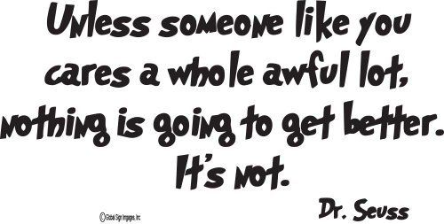

Slide 26
Being a Role Model
Your class is a mirror of yourself!
Be the person you want your students to be.
Teacher’s mask
It’s all about attitude:
Fake it, until you make it!
Energy
Motivation
Positivity
Passion
Enjoyment
“If you hate teaching it,
your students won’t like learning it!”
-George E.K. Whitehead

Slide 27
Reflection
Do you come to class looking motivated to teach?
During your lesson do you continue to appear positive and motivated?
Does it appear like you really enjoy what you are doing?

Slide 29
Extrinsic Motivation
Outside-in

Slide 30
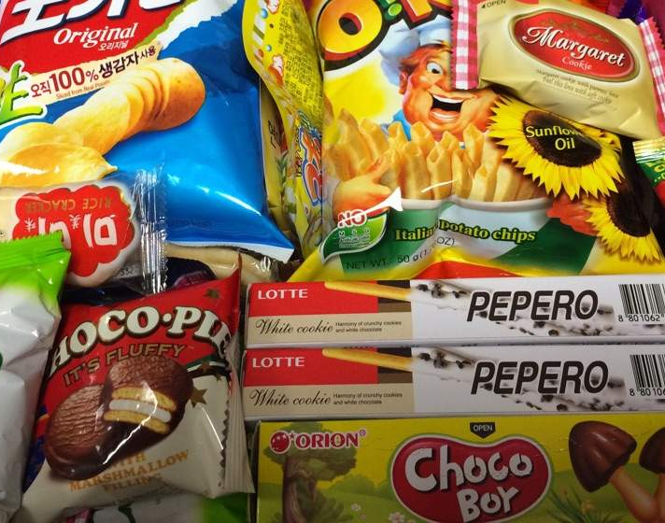
Reward Systems

Slide 31
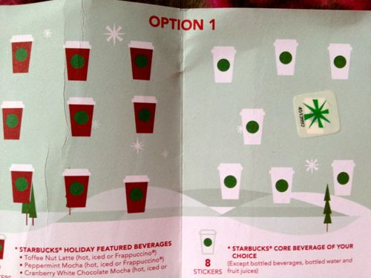
Reward Systems
The more often the reward, the worse.
It is important to create a long term goal system.

Slide 32
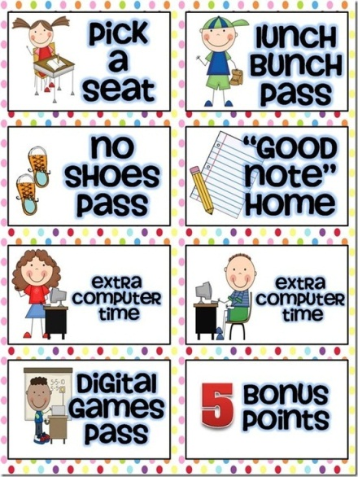
Types of Rewards
Candy
Extra points
Time
Coupons
Bomb Jar

Slide 33
Better than Rewards…
Enjoying the process.
Feeling rewarded from the process itself.
A sense of accomplishment.

Slide 34
In short, good values have to be grown from the inside out. Attempts to short-circuit this process by dangling rewards in front of children are at best ineffective, and at worst counterproductive.

Slide 35
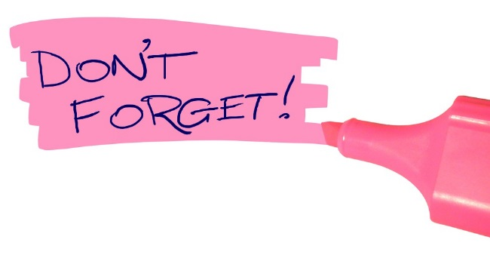
Keys to Motivating Language Learners
You don’t have to scare your students into being motivated!
Guide them through positivity!

Slide 36
Reflection
Based on what we discussed today and last class what are some of the things you need to keep in mind in order to motivate students?
What do you think you are already good at? What do you think you need to work on?

Slide 37
References
Greenier, V. & Whitehead, G. (2016). Towards a Model of Teacher Leadership in ELT: Authentic Leadership in Classroom Practice. RELC Journal, 1-17. DOI: 10.1177/0033688216631203.
Johnson, L.S. (2008). Relationship of instructional methods to student engagement in two public high schools. American Secondary Education, 36(2), 69-87.
Kohn, A. (1994). The risks of rewards. Urbana: ERIC Clearinghouse on Elementary and Early Childhood Education, University of Illinois.
Renandya, W. (2014). Effective strategies for motivating L2 learners. Paper presented at KAPEE International conference Chuncheon National Univeristy of Education, Chuncheon, South Korea.
Sanders, T. (2005). The likeability factor: How to boost your L-factor & achieve your life's dreams. New York: Crown.
Whitehead, G., & Greenier, V. (2019). Beyond good teaching practices: Exploring learners' views of teacher leadership in English language classrooms. TESOL Quarterly. doi: https://doi.org/10.1002/tesq.526

Slide 38
Extrinsic Motivation
Rewards
Compelling Input
Interesting materials and/or examples!
Task/Activity Motivation
Give students a job and a reason to do it!
Interesting Activities
Competition
Set goal for activity
Time
Amount
Quality

