Slide 1
Scattegories

Slide 2
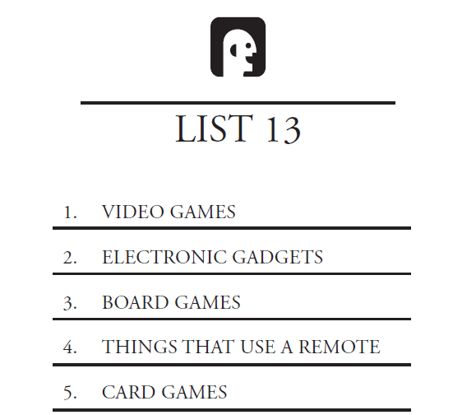
RULES
T
You will get a letter.
Try to write down a word
for each number.
One point for an answer
Two points for a unique
answer

Slide 3
PRACTICE
B
Something round
Something red
A hobby

Slide 4
Game 1
B
The first name of a famous person
Animal
A city in Korea
Things in a classroom
Something that can fly
A city not in Korea
A sports team (city or name)

Slide 5
Game 2
T
Weather
Things in a bathroom
A country
A drink
A brand of clothing
Something that you see at the beach
Something you wear

Slide 6
Game 3
C
Something you take on a trip
Something that has wheels
Things you sit on
A spicy food
Something at a bakery
A vegetable
A job

Slide 7
Game 4
G
Something you drink
A color
Something at a party
A wild animal
Something in your home
An internet website
A musical instrument

Slide 8
Game 5
S
A chocolate bar
Something sweet
Something salty
Something sour
Something expensive
Something you can buy at a stationary store
Something dangerous

Slide 9
Game 6
H
Something you eat
Something at a zoo
A girl’s name
Something you can buy at a supermarket
A flower
Something you can see at an amusement park
Something you can see in the sky

Slide 10
Game 7
M
A body part
A restaurant
Something at a bank
An animal
Ice cream flavor
A place to go on the weekend
Something in the park

Slide 11
Game 8
B
Transportation
A sport
Name of a beer
Something in your bedroom
A color
A car
Something in this room

Slide 12
Game 9
P
A country
Something delicious
Something in a movie theatre
Something you see at a wedding
A place where many people go
A fruit
A language

Slide 13
Game 10
F
A number
Something that is hot
Something in your home
Something you see outside
Something you buy at CU mart
Something you see in the summer
A movie

