Slide 1
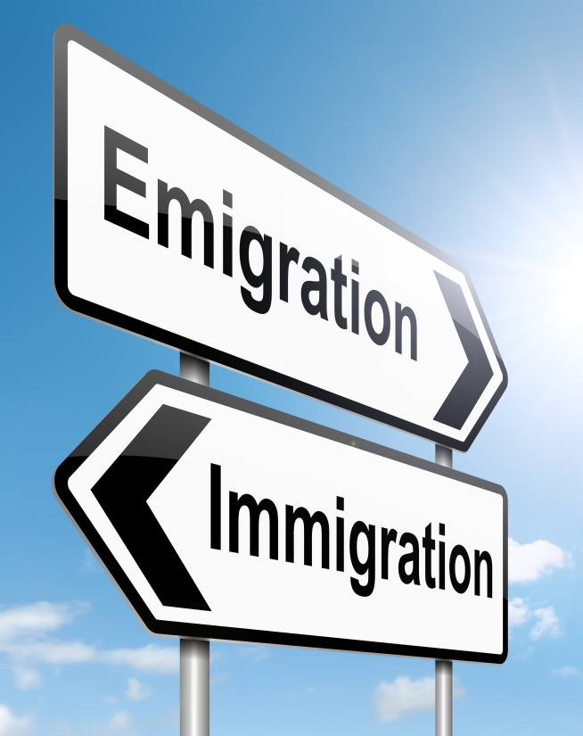
Save Our Country!

Slide 2
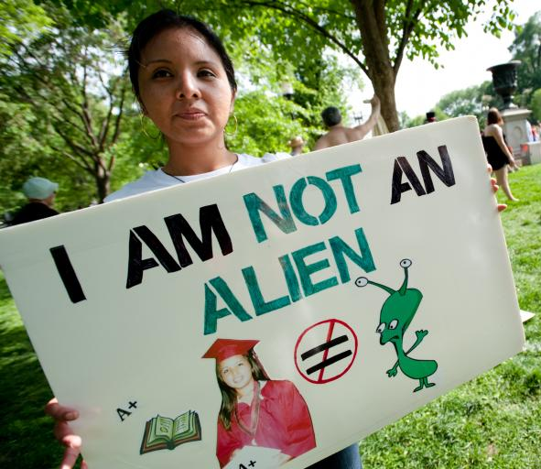
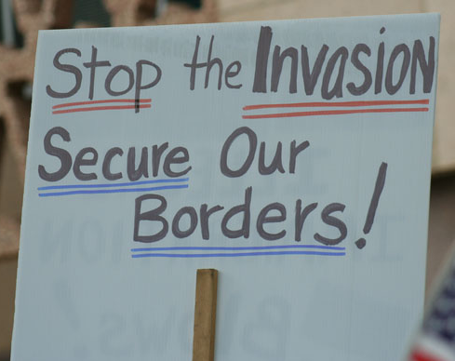
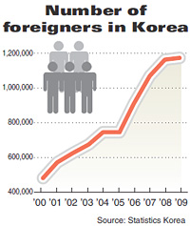
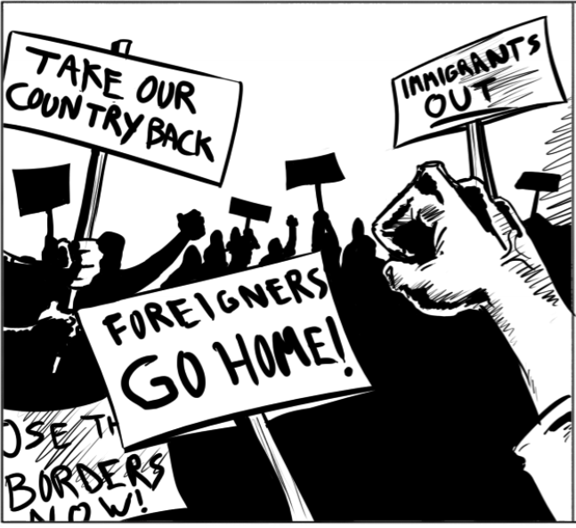

Slide 3
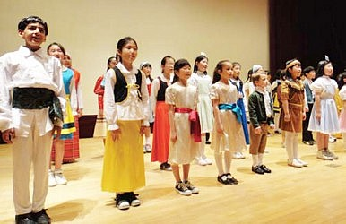
What countries do most of the people who have immigrated to Korea come from?
TASK: With your group discuss and write down a list of your thoughts on the top 5 countries.

Slide 4
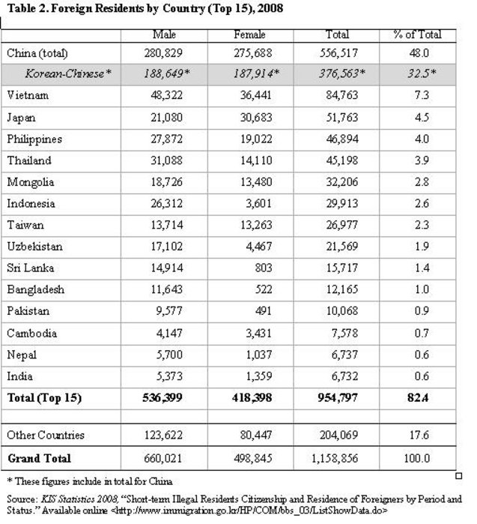

Slide 5
How do you feel about this?
Do you feel comfortable around people from other countries?
How would you feel living next to a person from another country?
How do you feel when you see mixed couples?
What are some of the good points and bad points about foreigners in Korea?

Slide 6
Save our Beloved Nation Shingistan
Listen to the article
Think about
Mr. Ware’s opinions (does he support immigration?)
How does he feel about immigrants?
What are his reasons?

Slide 7
Check Your Understanding
How are the Kushtos different from the people of Shingistan?
What kind of work do the Kushtos do in Shingistan?
According to B.A. Ware, why do they do this work?
Why does Mr. Ware think the Kushtos are dangerous to his country?
What does Mr. Ware want to do to save his country?

Slide 8
Discuss and Present
Each group represents a political party.
Does your party support immigration? Why or Why not?
Discuss with your group and present your stance on the issue.

Slide 9
Would you let them immigrate?
Rotate around the groups and put your opinion on the paper after reading about the candidates.

